Slide 1
You take your students to the cemetery don’t you
Maggie Jackson
Teesside University

Slide 2
“Human experience cannot be understood separately from the environments in which they occur” (Leavy 2009 p.226).

Slide 3
“it set the scene for starting to think about the role of culture and tradition in death”.

Slide 4
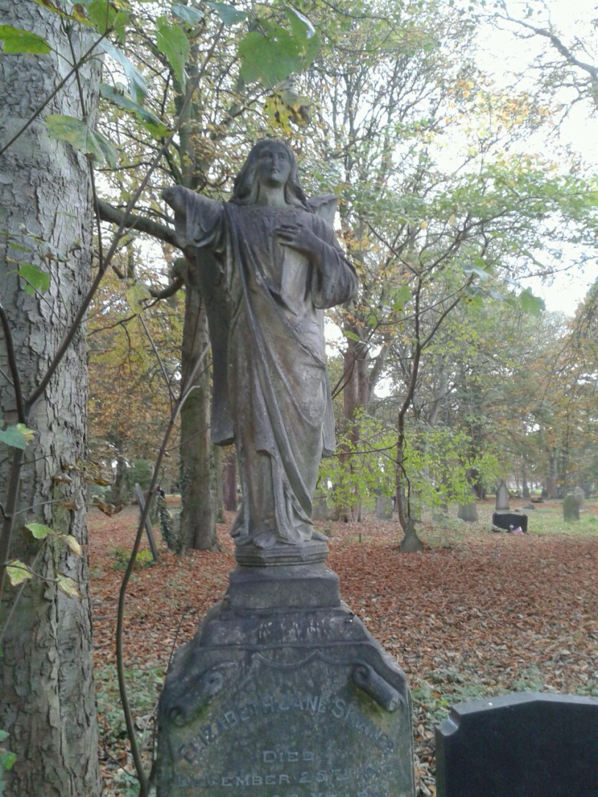

Slide 5
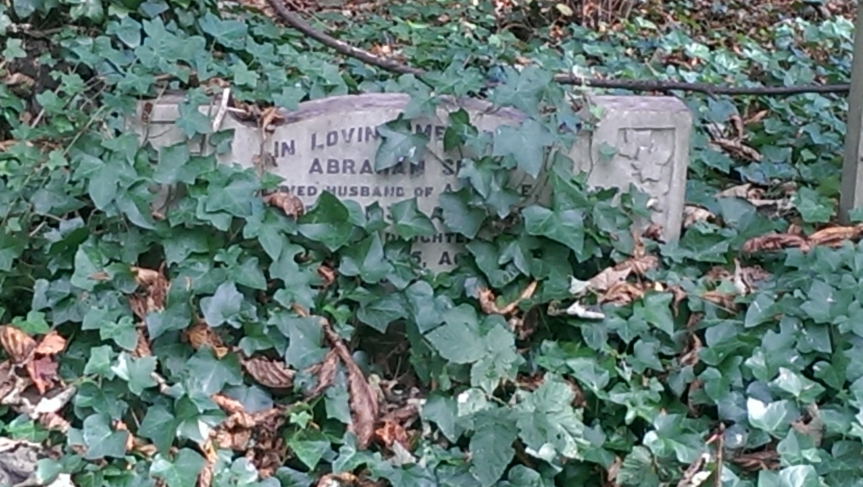

Slide 6
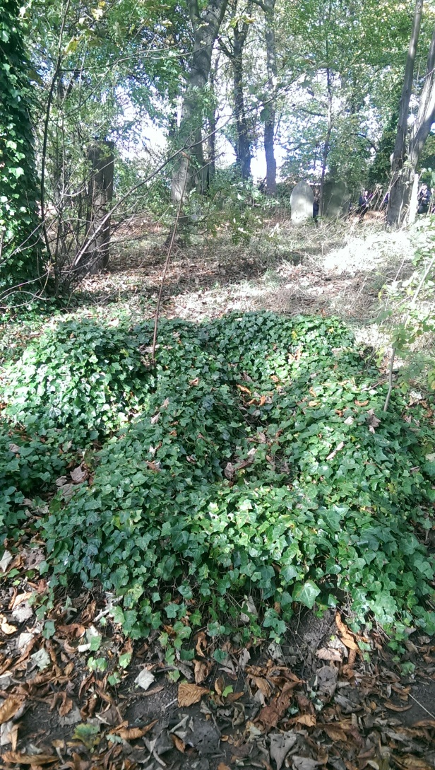

Slide 7
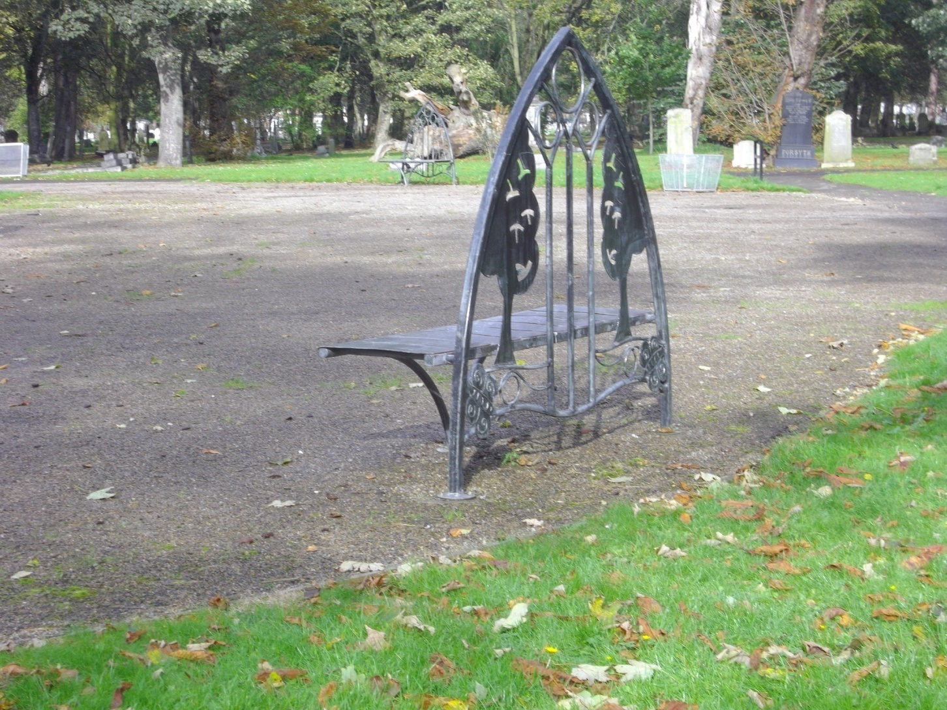

Slide 8
“I didn’t like the more recent graves –the stones were crammed together –I felt more awkward here taking photographs because a lot of people will have loved ones buried here. I felt I had to take care not to offend.”

Slide 9
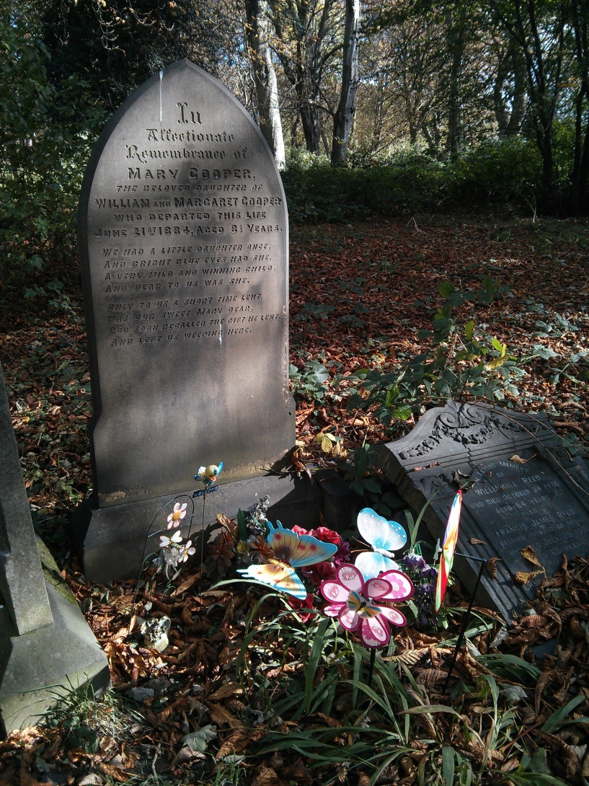

Slide 10
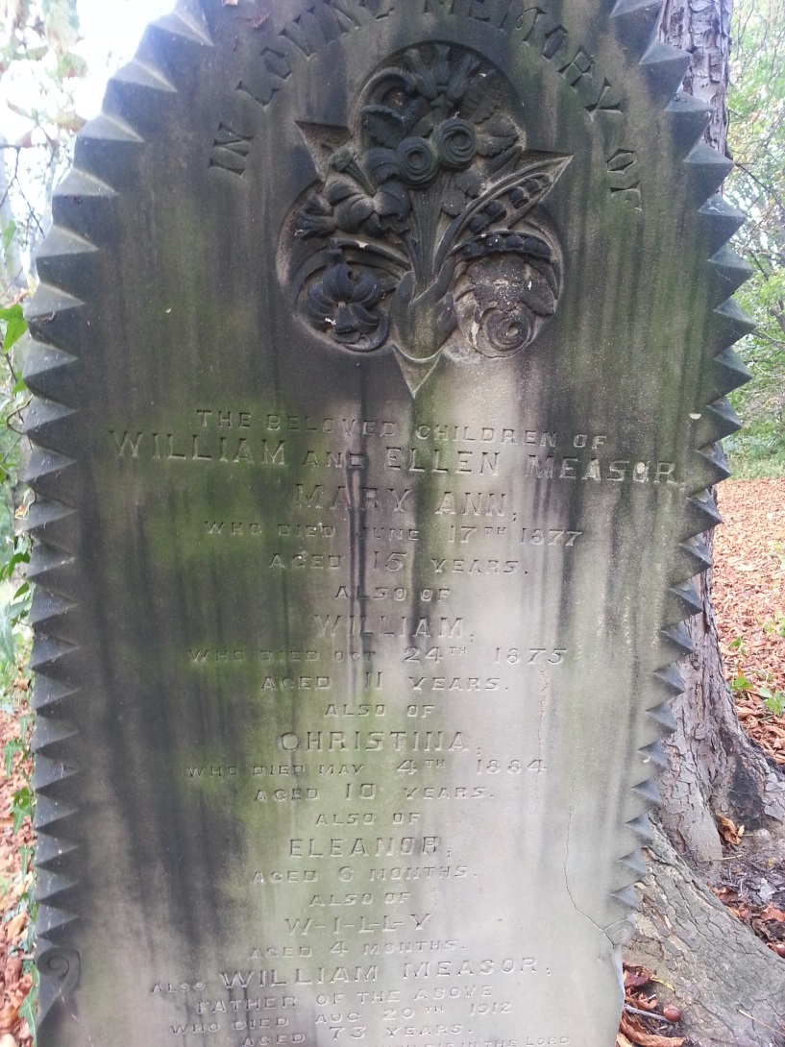

Slide 11
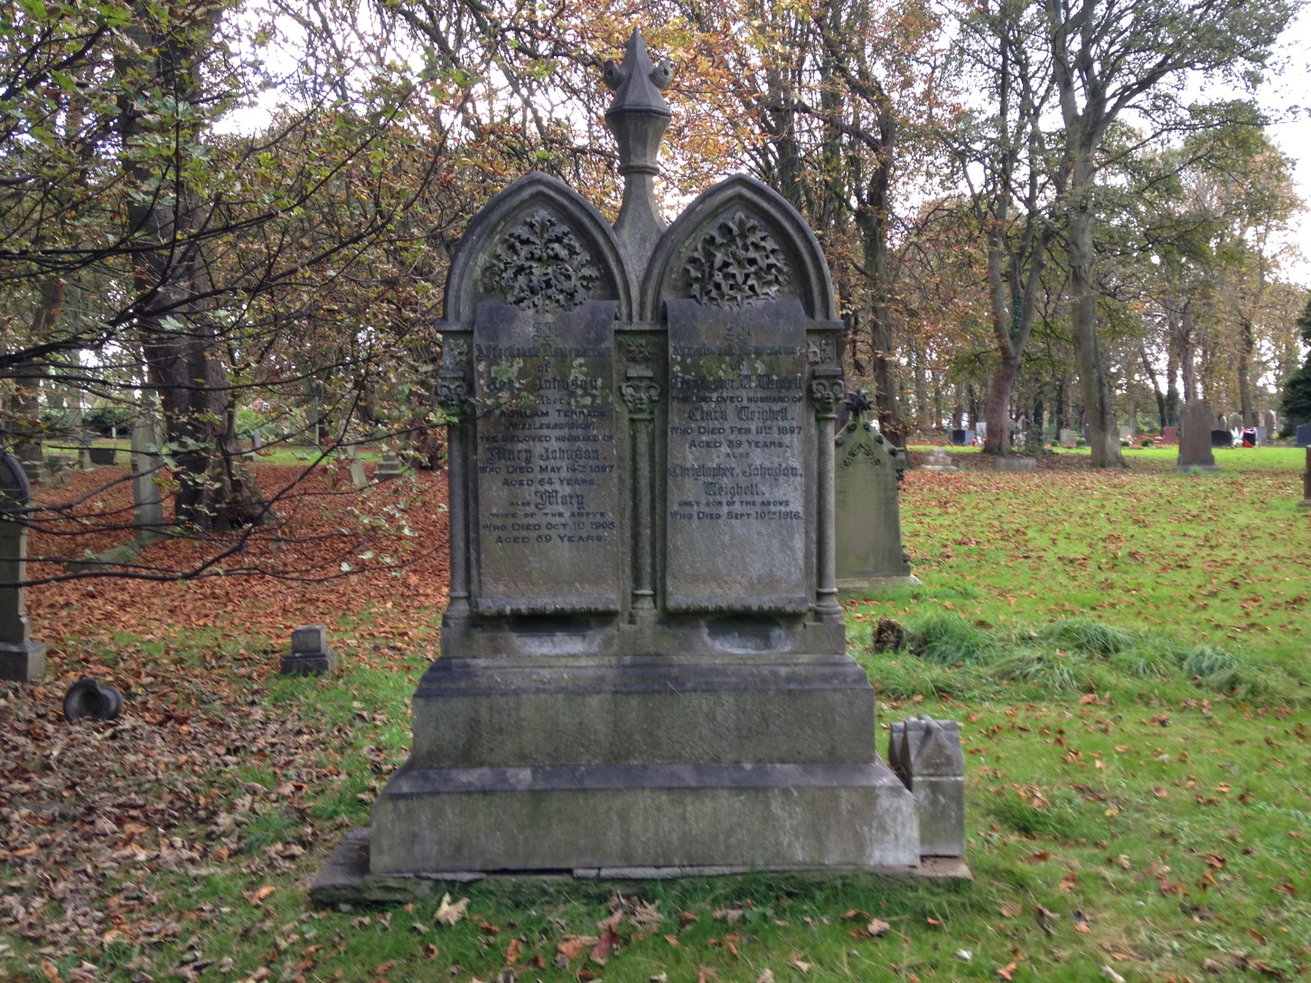

Slide 12
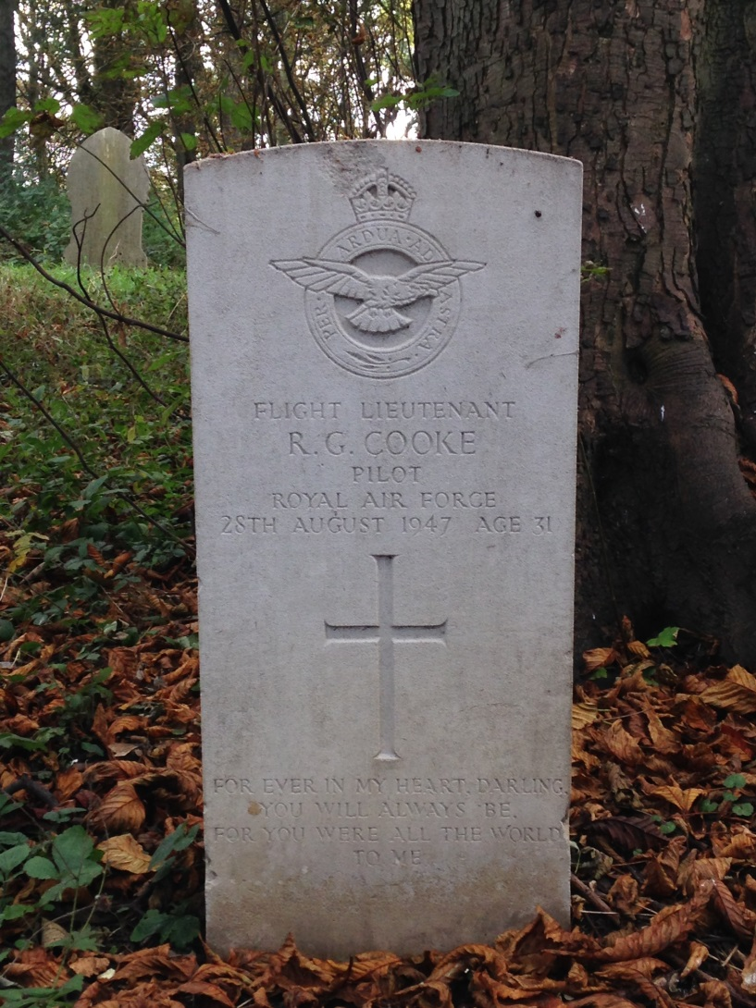

Slide 13
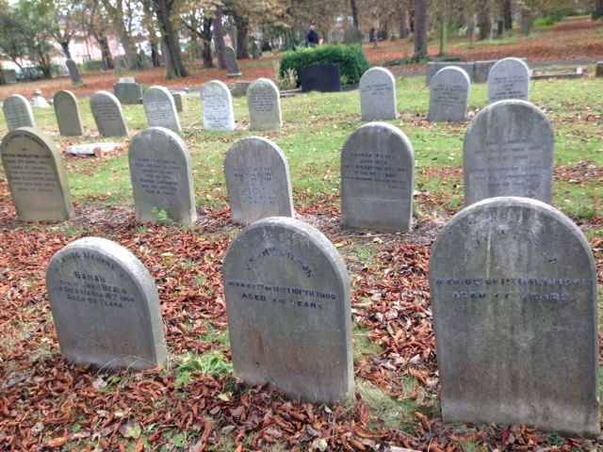

Slide 14
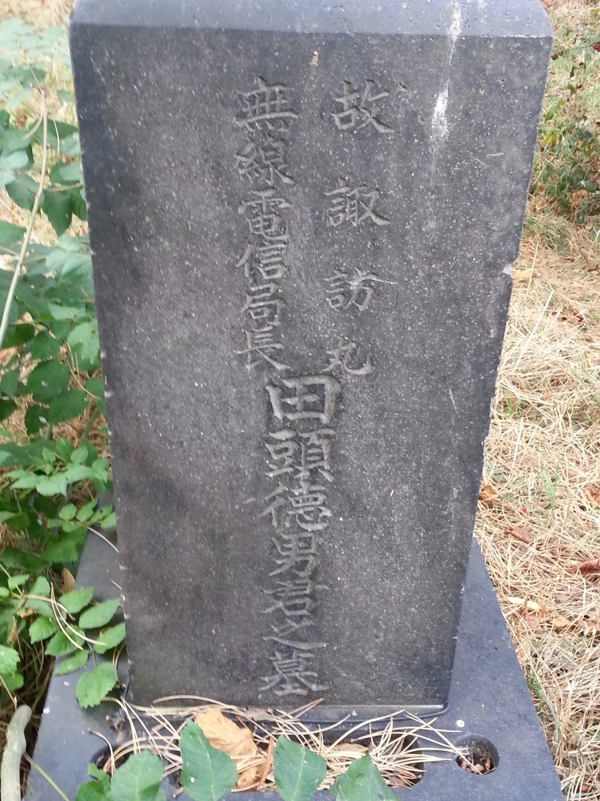

Slide 15
“It was the first time I had seen a Jewish gravestone”

Slide 16
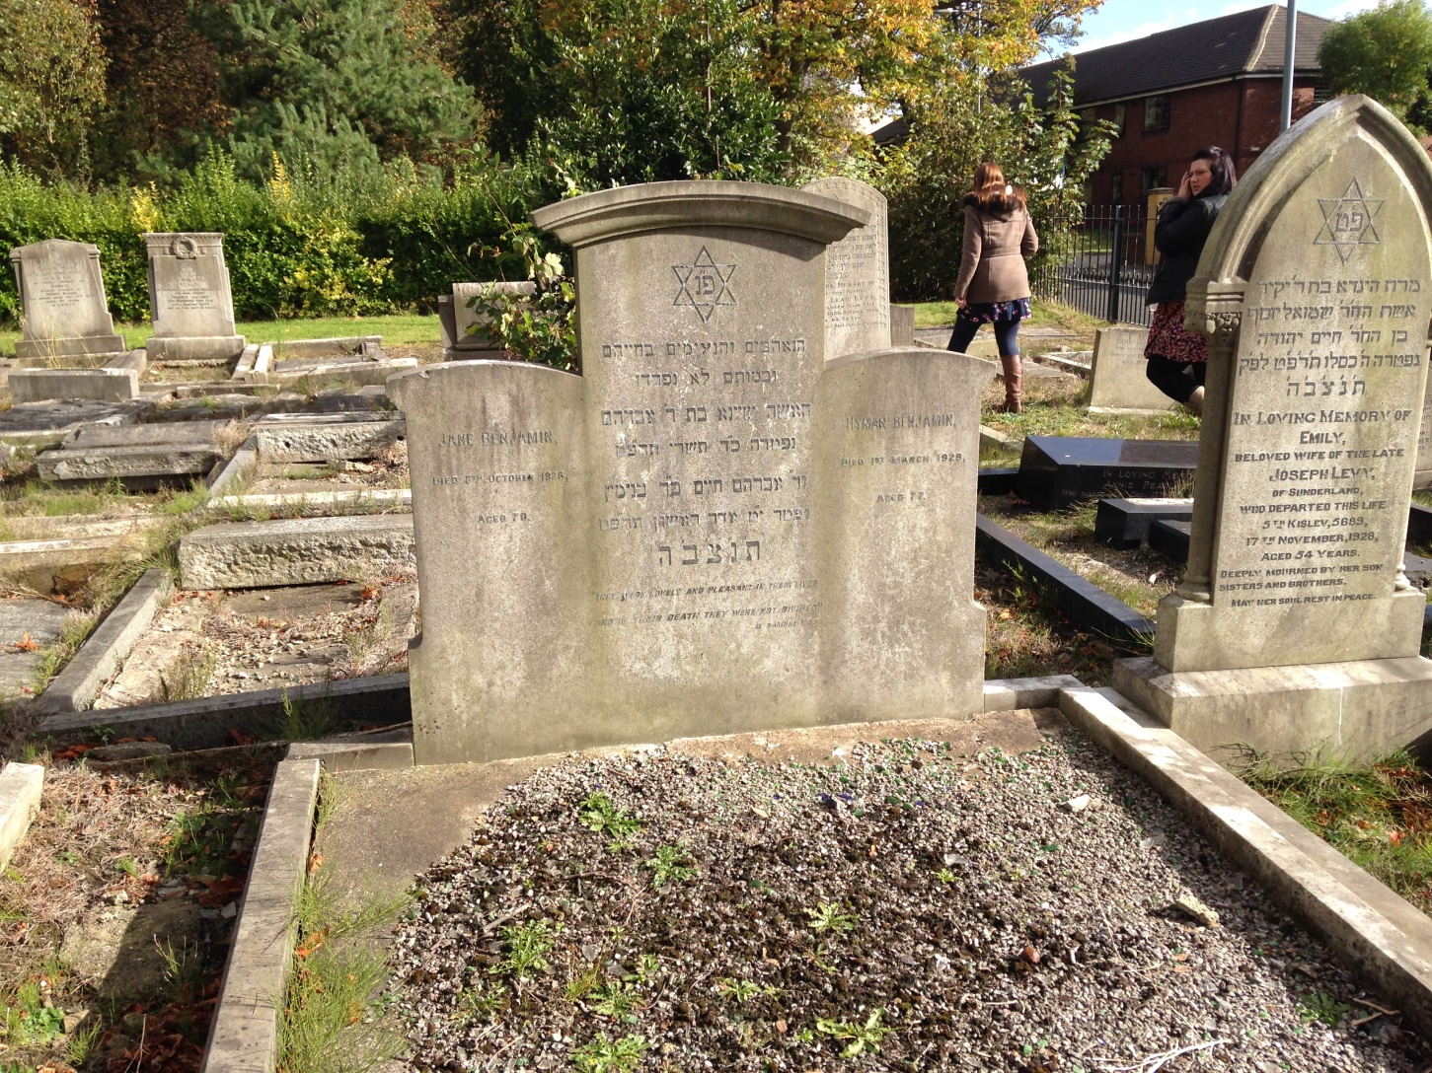

Slide 17
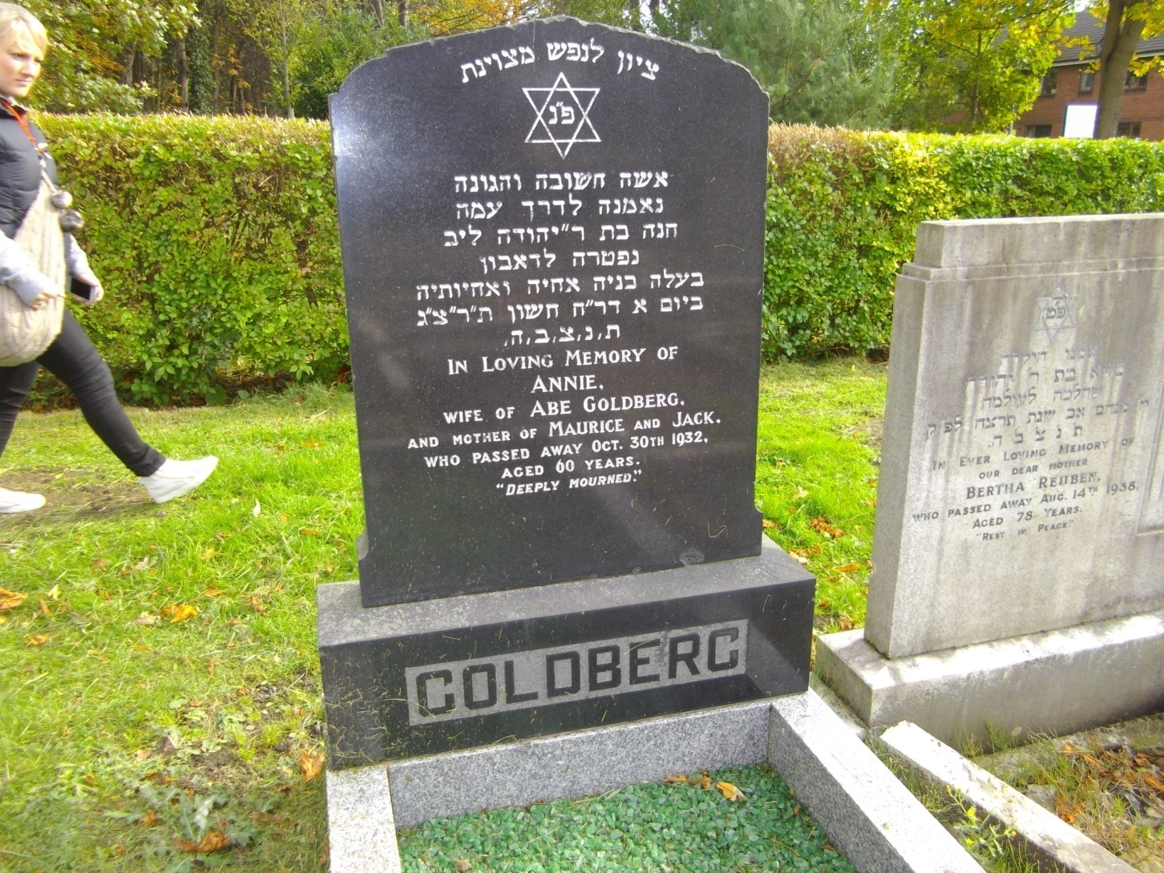

Slide 18
Although many graves were “traditional” the style of remembrance altered

Slide 19
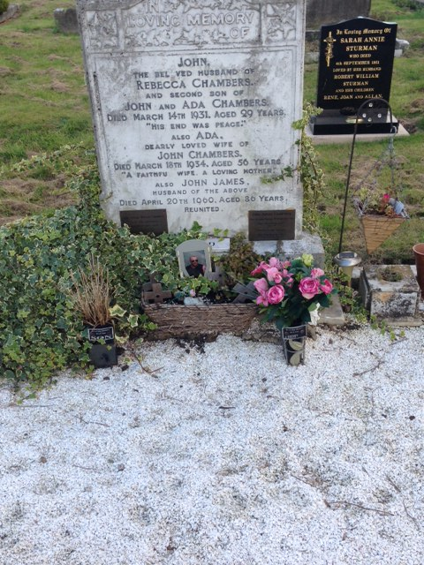

Slide 20
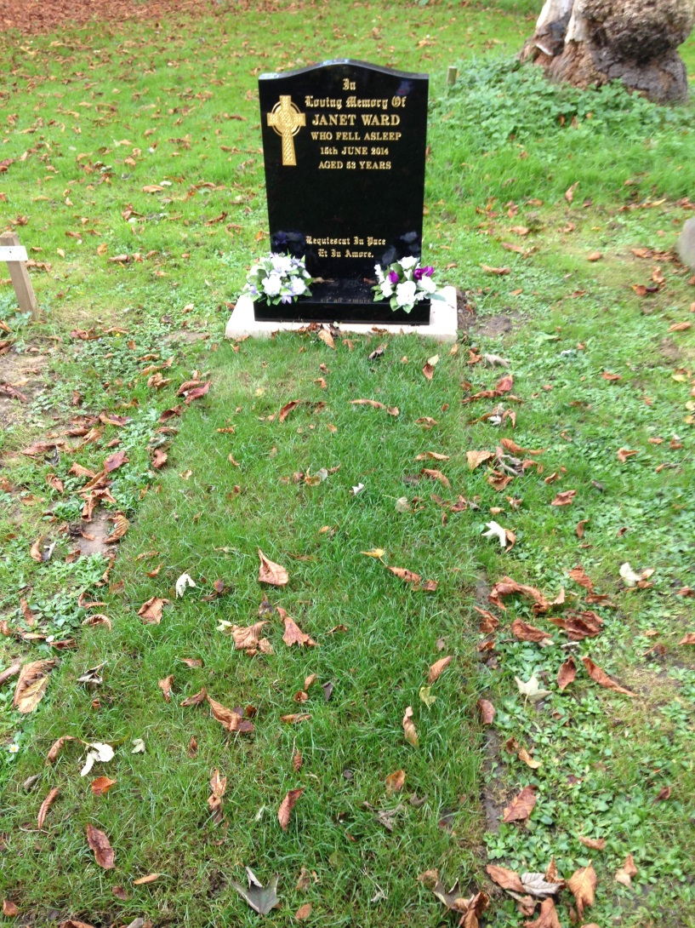

Slide 21
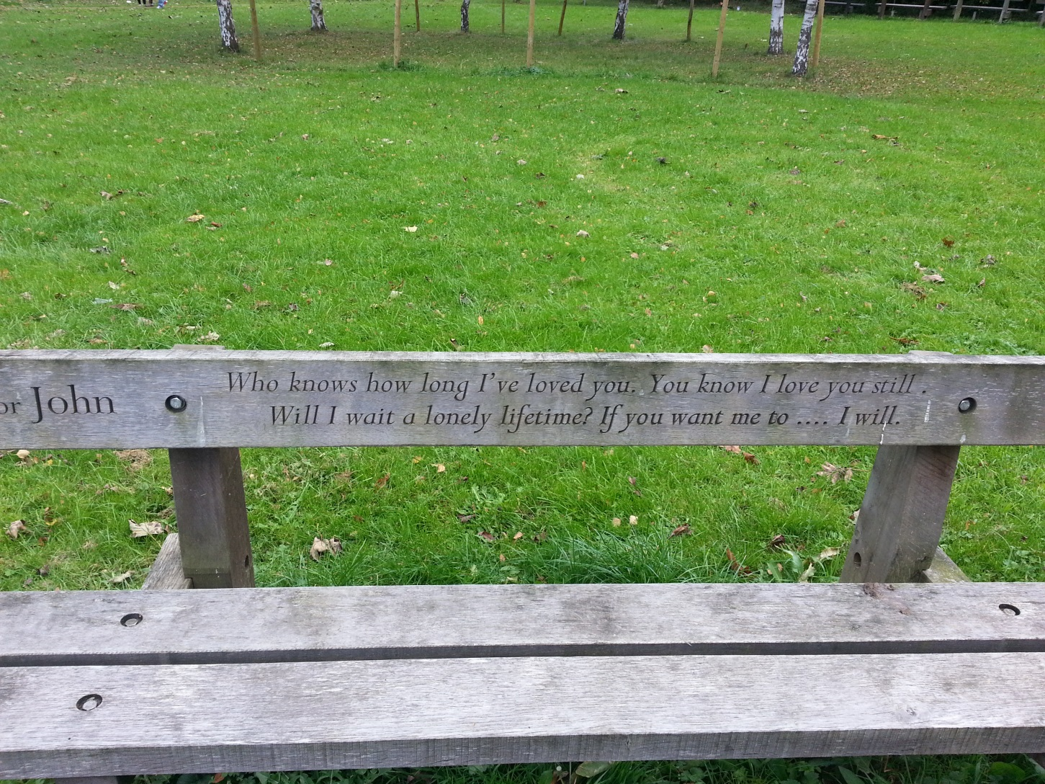

Slide 22
“it was open and had no eerie feeling to it”.

Slide 23
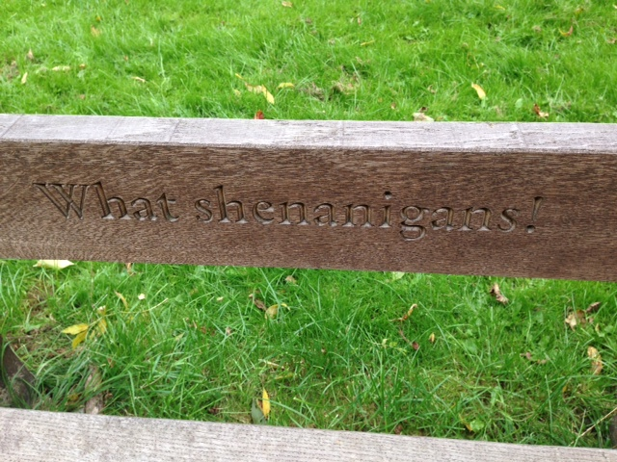

Slide 24
“it had a statement on it – something to do with wine, anyway I liked it”.

Slide 25
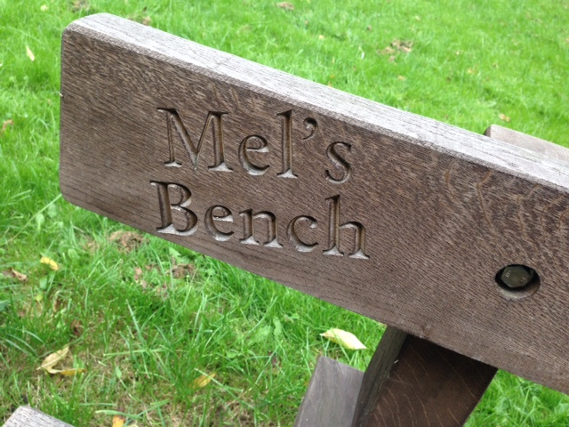

Slide 26
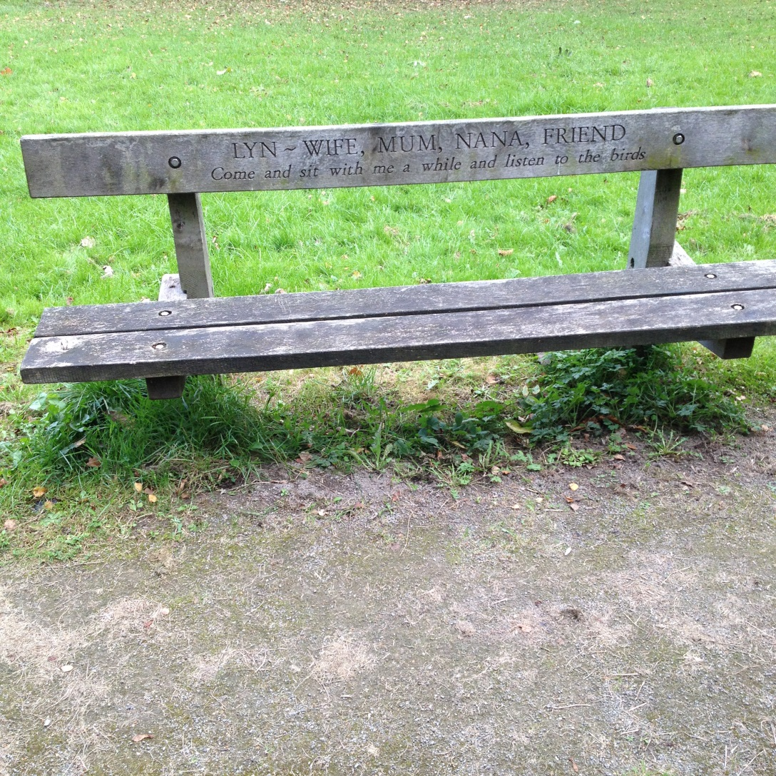

Slide 27
“I liked the simplicity but it made me wonder about the person who couldn’t afford a proper grave”
You might want to look at the date on this memorial

Slide 28
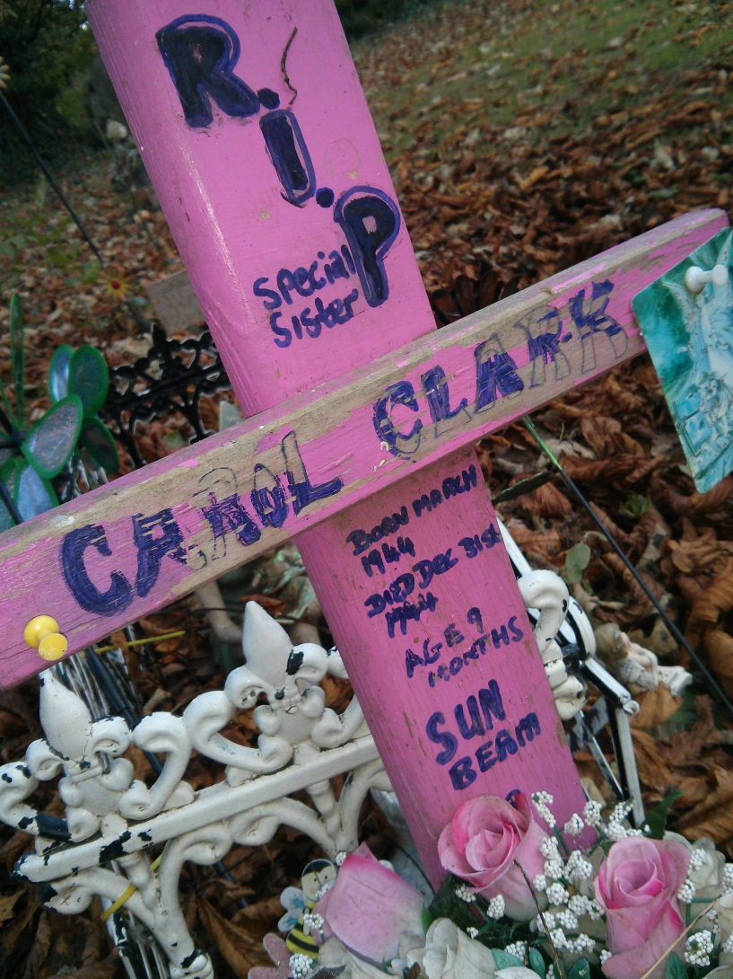

Slide 29
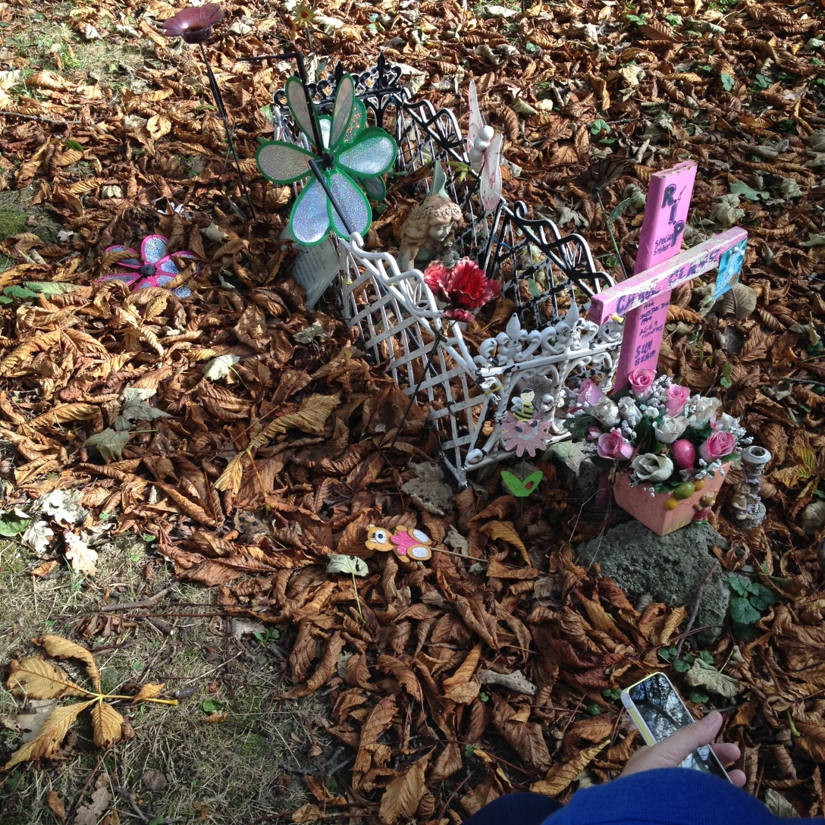

Slide 30
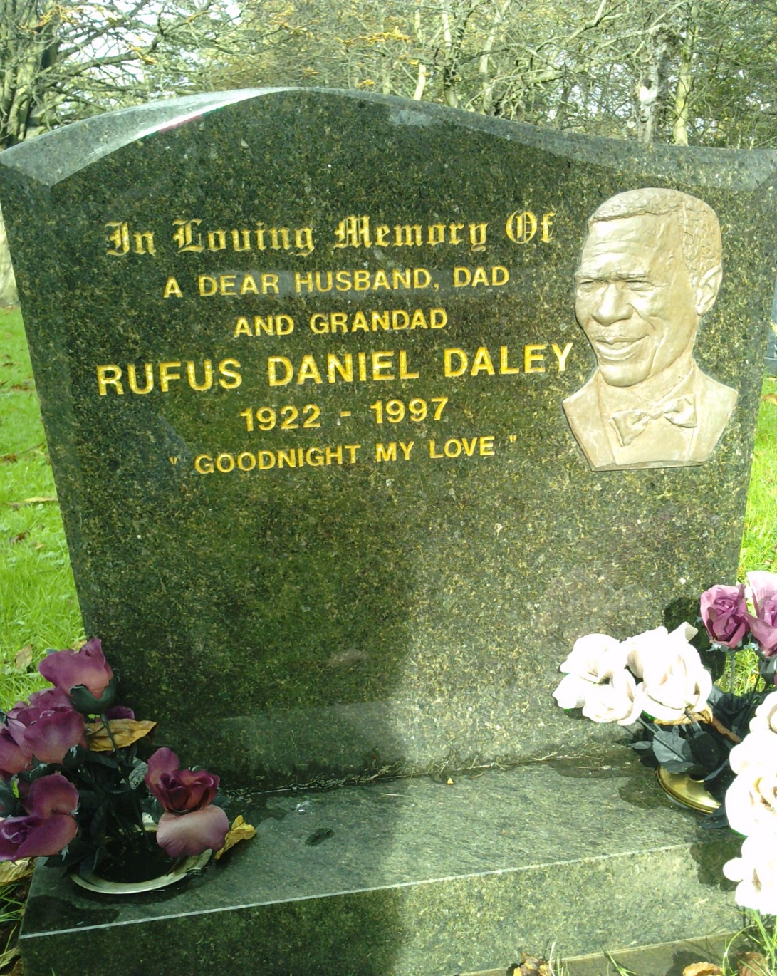

Slide 31
“the picture made me feel as if this was a real person, I think he looked like a nice man – it was the bow tie that did it”

Slide 32
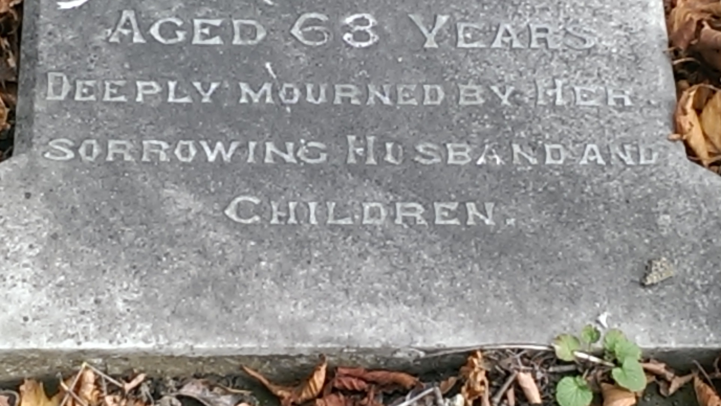

Slide 33
Children

Slide 34
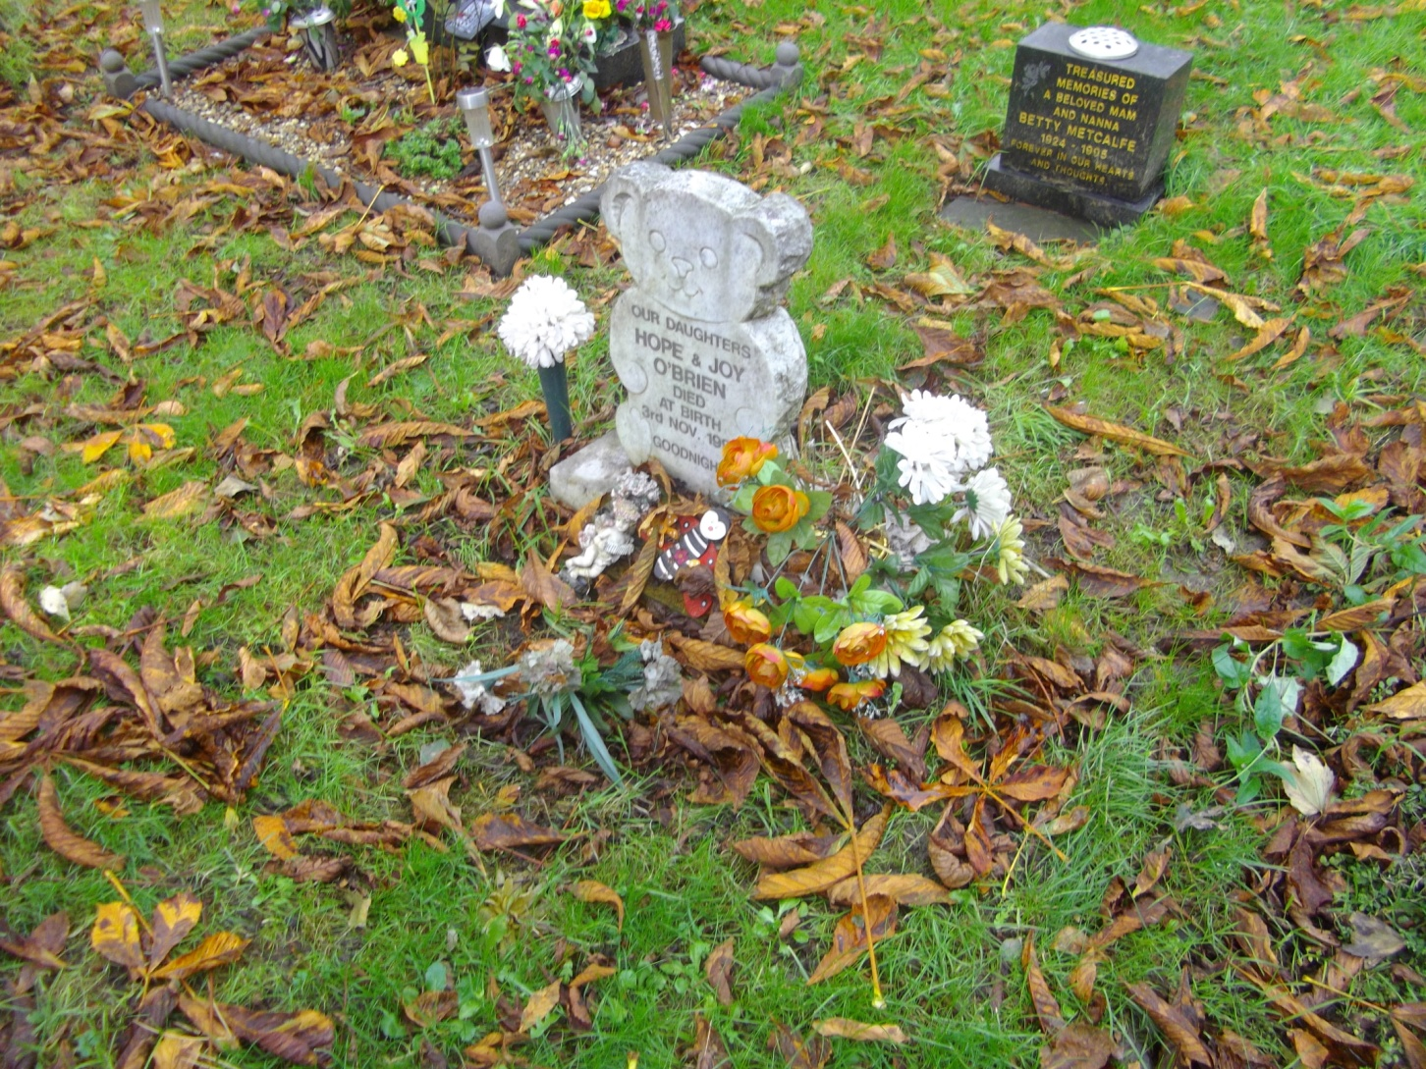

Slide 35
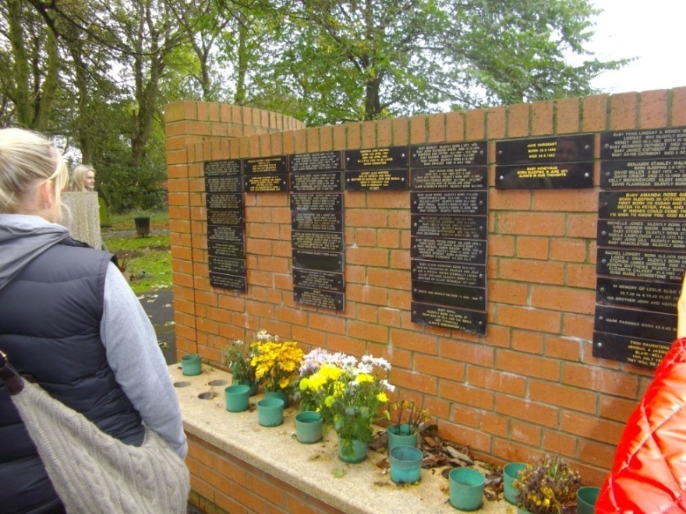

Slide 36
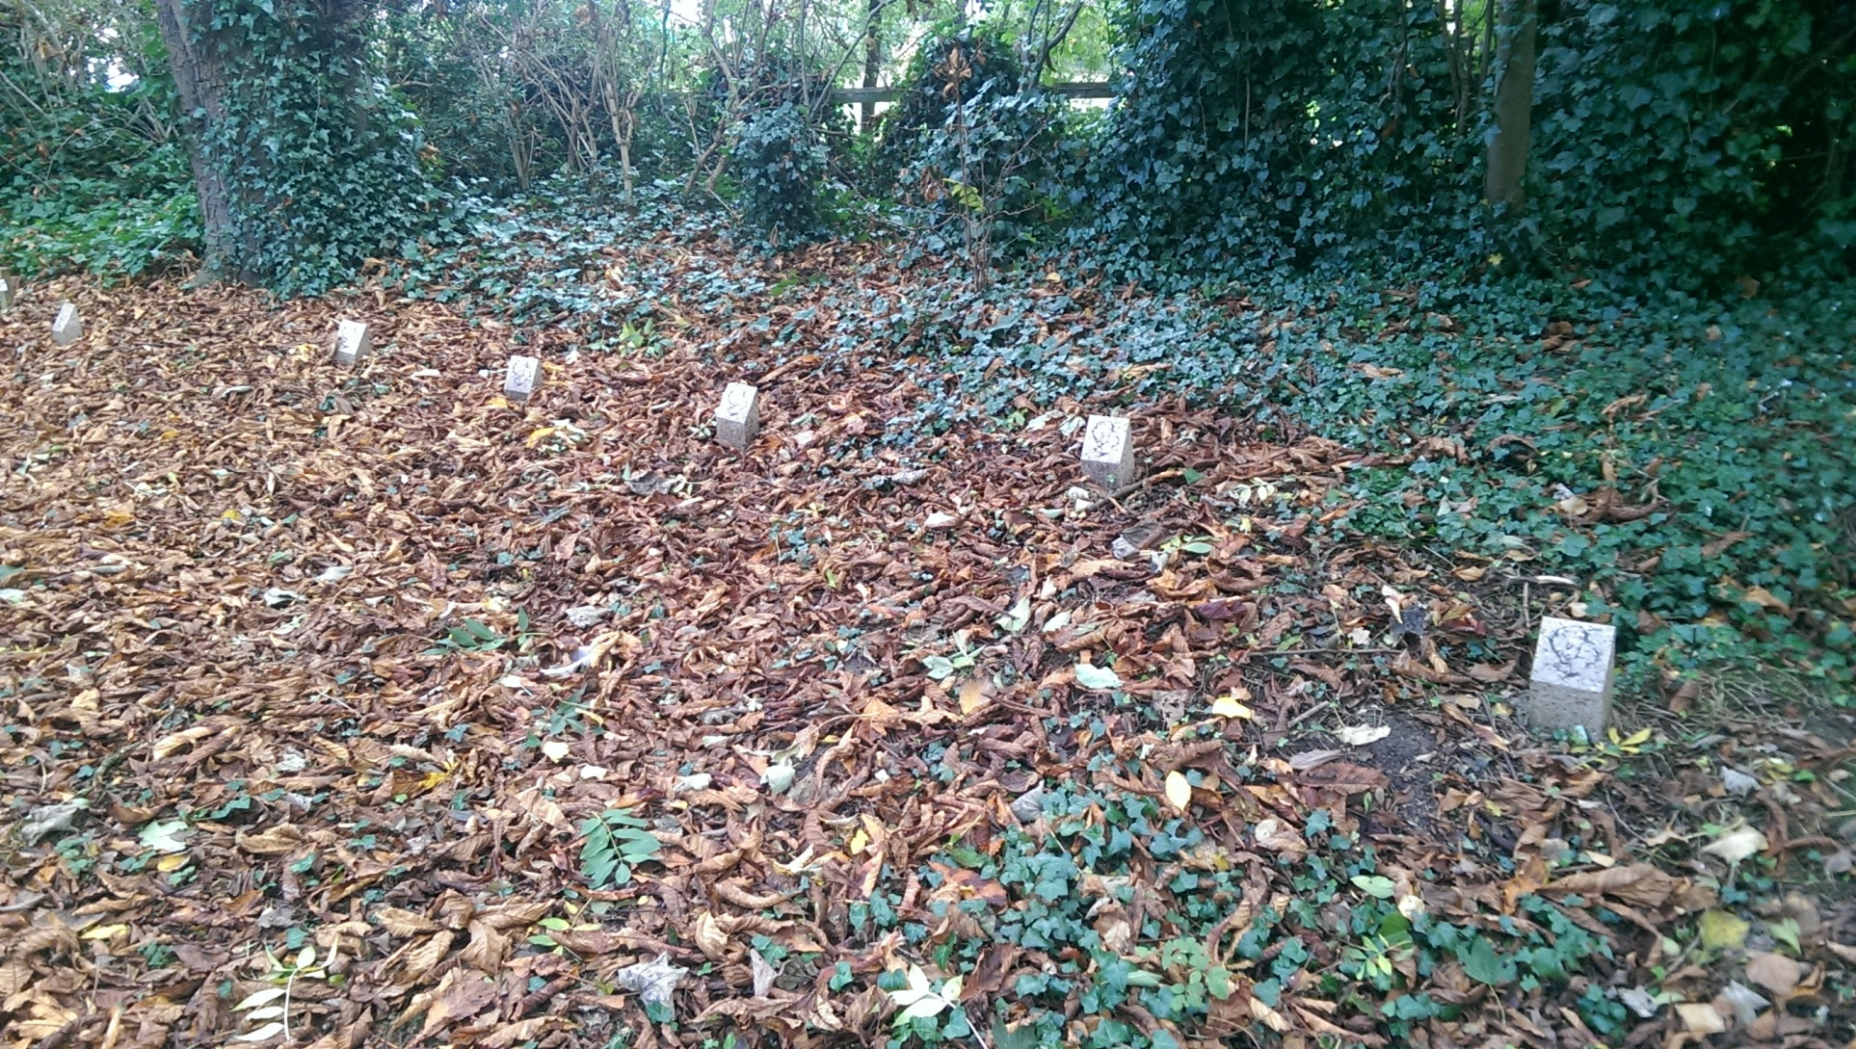

Slide 37
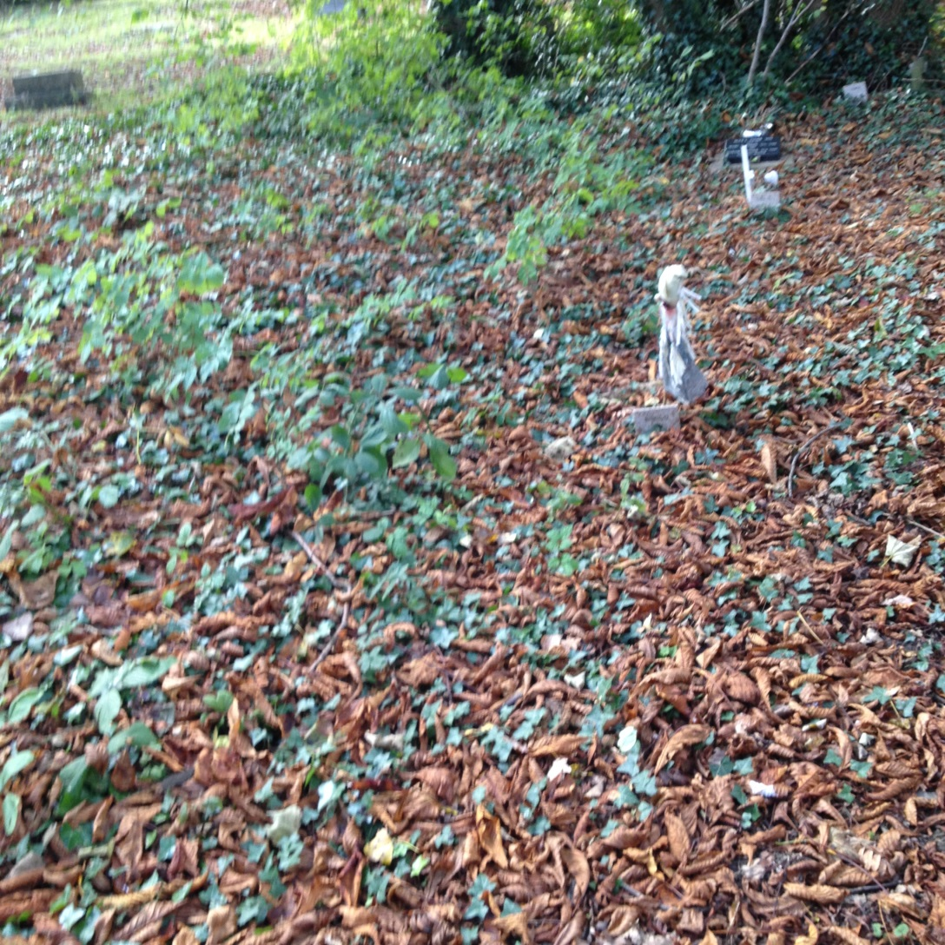

Slide 38
-“I was able to establish some meaning to the topic - by physically being in the graveyard gave me a deeper sense of understanding”.

