Slide 1
Bereavement in China
From the perspective of the Lost-Only-Child (Shidu) families
Chao Fang (cf493@bath.ac.uk )
2nd Year PhD
Centre for Death and Society
University of Bath

Slide 2
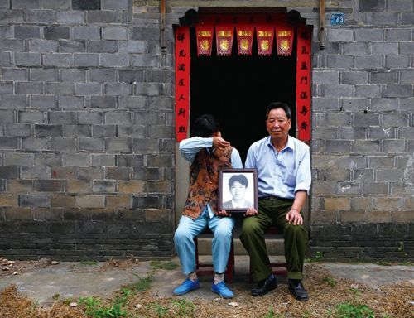
Shidu parents in China
What is “Shidu” (失独)?
  Loss of the only child in mainland China.
Who are “Shidu” parents?
  Couples who are subject to the One Child Policy
  and have lost their only child.

Slide 3
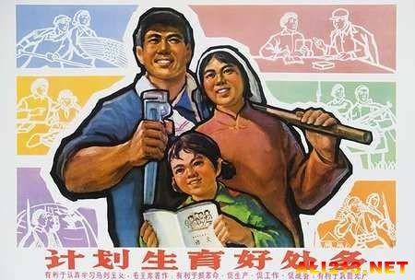
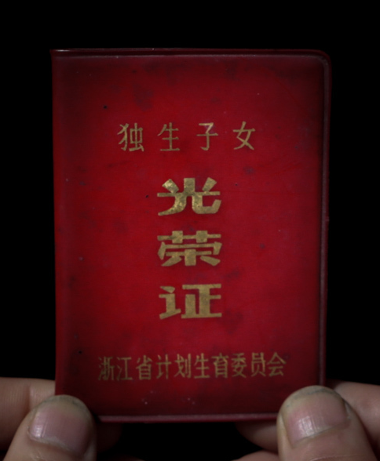
The One Child Policy (Family Planning Policy)
  A population control policy implemented in the early 1980s until 2015.
  Introduced to tackle the sharply increasing population and limited social/natural resources.
  Estimated number of the “One Child” in 2010 is approximately 145 million.

Slide 4
Loss of the “One Child”
Estimated number of deaths of the “One Child” is 1 million by 2010 (Wang 2013).
Accordingly, there are at least 1 million households, which are known as “Shidu Families”;
The number of “Shidu Families” increases by 76,000 households annually (China National Committee on Aging, 2013). Aging (2013)

Slide 5
Being “Shidu parents” in China
Provide a preliminary look at how Shidu parents deal with their bereavement and how they try to access to support in contemporary China.

Slide 6
Data sources
Shidu parents:
  One primary interview
  A survey including conversational interviews conducted by a Family Planning official (Han 2015)
British parents:
  An interview with a bereaved couple from a large dataset of interviews with people bereaved from drug and/or alcohol related deaths (Valentine, 2013).
Japanese parents:
  An interview with a bereaved father from interviews with people bereaved from a range of deaths (Valentine 2007-2008).

Slide 7
Data Analysis Themes
Four broad themes appeared during the analysis, which capture the dynamics and complexity of bereavement:
      Making sense of child death
      Making sense of self
      Making sense of life
      Finding support

Slide 8
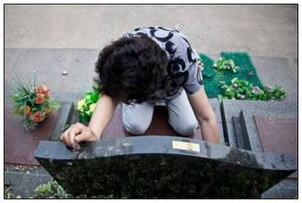
Being Shidu in China 1
Making sense of child death
  The nature of child death
  Impact of child death
  Meaning-making for child death

Slide 9
The nature of child death
“Un-natural”, “untimely” and therefore a “bad” death
“Bad death” for the child
    He was in his 30s. He had only been married for two years … no one expected what just happened…
      (Guoping, a Shidu father)
    …the thought of losing a child, it’s so different from losing a parent, completely the other way round, that the sense of wrongness, the natural order of things.
    (The British couple)
    … in old age people die but you never imagine that that will happen to a child.
    (UI, the Japanese father)
“Badness” for Shidu parents and family: Childlessness as un-filial action to ancestors
    … there are no more distressing things ever you can experience. Especially, we have thousands of years traditions emphasizing the continuity of family line. Losing the only child makes us feel too shamed to face our ancestors, and to meet other families and friends.
(Gudu, a Shidu father)

Slide 10
Being Shidu in China 1
Making sense of child death
  The nature of child death
  Impact of child death
  Meaning-making for child death

Slide 11
Impacts of death
Mainly emotional, mental and physical impacts
    Yes. Several days later, I collapsed. I rested at home for one month before returning to my work. .
    (Guoping, a Shidu father)
    There’s a whole lot of business about trying to make sense out of it because there is no… there’s no sense.
      (The British couple)
    I kind of felt numb when my son passed away…
    (UI, the Japanese father)
Financial impacts
    My son is still not buried yet! … … As I said, because of the financial difficulty.
      (Guoping, a Shidu father)
    We have been working hard for 8 years to pay the debt (for his son’s treatment). We are too old to work now, but the debt is not finished yet…
    (Qing, a Shidu mother)
These impacts could devastate Shidu parents
    … After I lost my only daughter, I lost all of my happiness. Since then, I have been living like a living dead.
    (Gudu, a Shidu father)

Slide 12
Being Shidu in China 1
Making sense of child death
  The nature of child death
  Impact of child death
  Meaning-making for child death

Slide 13
Meaning-making for child death
Reconstructing the dying process
Find “goodness” from death
    It was like he is sleeping as usual. He was who he was. At least he didn't suffer a lot.
      (Guoping, a Shidu father)
    I appreciate that we were not estranged from our child, he hadn’t been a long-term, you know a long-term drug user, his life hadn’t fallen to pieces …
    (The British couple)
    …this was kind of strange, a sort of coincidence that was a very meaningful one.
    (UI, the Japanese father)
Hard to find “goodness”
    Death of the only child brings unrecoverable damages to us. First, we lost the only child, so the family line is cut off forever, it is hard to be accepted in the culture; second, the only child, who is supposed to take care of us, is gone; third, the child loss collapses our health, it really worsens the situations.
(Chengqing, a Shidu father)

Slide 14
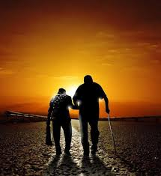
Being Shidu in China 2
Making sense of self
  Challenges for “self”
  Re-finding relationships with the deceased child
  Reconstructing continuing bonds
  Redefining self

Slide 15
Challenges for “self”
Overturning parenthood
    When we buried our son, we also buried ourselves. As the mother of my son, I died.
    (Diermama, a Shidu mother)
Denying the role of carrying on ancestral line
    My dear daughter! Others are commemorating their ancestors, we are commemorating our descendant.
      (Jingyi, a Shidu couple)
    We don’t only lost our only child, but also inheritance of life, family line, gens and culture.
    (Gudu, a Shidu father)
Collapsing structures of the core family
    The son is gone, the family doesn’t exist anymore…
    (Yangyang, a Shidu father)
Challenging the sense of a member of society (Self-stigmatization)
    Dear daughter, other people all have reunions and celebrations with families for the New Year, but I can only stay with you (in the cemetery). It is a festival for others, but a disaster for me.
    (Wangfei, a Shidu mother)
    I feel I am a little silly (comparing with others).
    (Mi, a Shidu father)
However, British and Japanese parents had no mentions of the challenges above.

Slide 16
Being Shidu in China 2
Making sense of self
  Challenges for “self”
  Re-finding relationships with the deceased child
  Reconstructing continuing bonds
  Redefining self

Slide 17
Re-finding relationships with the deceased child
Re-finding “goodness” and “kindness” of the child
    This is my son (in the phone). He is very handsome and 1m83 high.
      (Guoping, a Shidu father)
    He was and he is a dearly loved son and a very loving son…
    (The British couple)
    Not found in the Japanese interview
Re-finding positive relationships
    I am sure he would do… He would take over everything and would never let me walk out of the flat. I would be lying at home. He would also ask my daughter in law prepare meals for me…
(Guoping, a Shidu father)
    we were in very close contact.
(The British couple)
    … both parents (we) were taking care of the dying son until his death
(UI, the Japanese father)

Slide 18
Being Shidu in China 2
Making sense of self
  Challenges for “self”
  Re-finding relationships with the deceased child
  Reconstructing continuing bonds
  Redefining self

Slide 19
Reconstructing continuing bonds
Maintaining emotional or symbolic bonds
    My son, mother knows you haven’t gone far. You are staying close to me, protecting me. We can always feel each other. We know one day we will re-join again.
    (Yier, a Shidu mother)
    … his ashes are in an urn in our bedroom… … we don’t know anywhere that he’d really want to, I mean he didn’t say, he hadn’t said so, we just keep them with us and …
    (The British couple)
    I tried to make a connection with my son’s death - like I believe that my son went to a different world and so I needed to establish a connection with that world
    (UI, the Japanese father)
Interdependent bonds with the child

Slide 20
Being Shidu in China 2
Making sense of self
  Challenges for “self”
  Re-finding relationships with the deceased child
  Reconstructing continuing bonds
  Redefining self

Slide 21
Redefining self
Re-defining parenthood
    You are mum’s moon always hanging in the sky and lighting on my heart forever.
    (Fujian, a Shidu mother)
Relocating self into the family and the society
    (After trying the in vitro fertilisation for many times, Jishui, a Shidu father in his 50’s, talked to his paralysed father on the phone) What I am doing now is also for the whole family. As long as the new baby is born, I will go back to report the good news to you immediately.
      (Jishui, a Shidu father)
    … my daughter sacrificed for the country. I will follow her to contribute to the society.
    (Yanyan, a Shidu mother)
Redefining a more relational self for Shidu parents
    For me, you are my whole world.
    (Sichuan, a Shidu mother)
Redefining a more independent self in Britain
    I wanted to keep reminding myself of him. It’s not just remembering him as a person, but remembering my last contact with him.
    (The British couple)
Not found in the Japanese interview

Slide 22
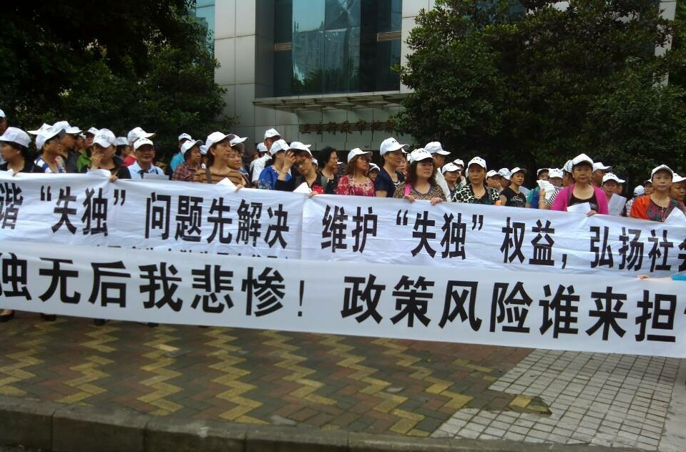
Being Shidu in China 3
Making sense of life
  Facing issues about present life
  Facing issues about future life
  Finding meanings for issues
  Making sense of life as a whole

Slide 23
Facing issues about present life
  Emotion issues:
    Do I feel alone? Yes, I do. (Guoping, a Shidu father)
    … there’s no point living, the pain, the grief was just so, extraordinary. (The British couple)
    I shed tears and felt really sad. (UI, the Japanese father)
  Financial issues:
    (A couple living on less than £100 per month said) No one knows when it will the end of such a life…
    (Shaoke, a Shidu father)
  Isolations:
    I am so isolated and helpless when I am feeling heart-breaking.
    (Wuzhu, a Shidu father)
    I was told they (the temple) only accept people under 60…
    (Pan, a Shidu mother)
  Health issues:
    I got more than 10 kinds of diseases since my son died. (Geng, a Shidu father)

Slide 24
Being Shidu in China 3
Making sense of life
  Facing issues about present life
  Facing issues about future life
  Finding meanings for issues
  Making sense of life as a whole

Slide 25
Facing issues about future life
  End of life care:
    If tomorrow I would not be able to walk anymore, how can I do? If I would not be able to cook and do laundry, how can I do…
    (Suixin, a Shidu mother)
    If we die, we even haven’t got anyone to bury us.
    (Geng, a Shidu father)
  Hopelessness:
    My company will be loneliness, what I am waiting for is hopelessness.
    (Suixin, a Shidu mother)
    I realise more and more, you know this is going to be with us for the rest of our lives [crying] can’t cope with this, can’t be this sad.
(The British couple)

Slide 26
Being Shidu in China 3
Making sense of life
  Facing issues about present life
  Facing issues about future life
  Finding meanings for issues
  Making sense of life as a whole

Slide 27
Finding meanings for issues
For present issues
  Financial issues:
    Negotiation for financial compensation
    Self-support
    I borrowed ¥300,000 (about £30,000). I do not only need to repay the debt, but also earn enough money for my end of life care. I haven’t relied on anyone in my life so far, and now I have to rely on my self more from now.
    (Mei, a Shidu and single mother)
  Isolations: fighting but suffering
    … now he is gone, I feel lonely indeed. So how can I do when I am missing him? If so, I will try to endure.
    (Guoping, a Shidu father)
  Health issues: fighting but suffering
    I spend one quarter of the whole year in hospitals. The most of my pension is used on medications.
    (Geng, a Shidu father)
For future issues
  End of life care
    Self support
    … have to reply on self anyway if you are childless. No other way. (Guoping, a Shidu father)
    Family support
    My brothers and my nieces have promised (to take care of me). (Guoping, a Shidu father)
    Lack of social support
    We even can’t go to retired homes as we don’t have guareentors. (Tiantang, a Shidu mother)
  Hopelessness: self support
    As Shidu parents, we need to love and respect ourselves and don’t lose our hopes… …
  (Yaoguang,a Shidu father)

Slide 28
Being Shidu in China 3
Making sense of life
  Facing issues about present life
  Facing issues about future life
  Finding meanings for issues
  Making sense of life as a whole

Slide 29
Making sense of life as a whole
Making sense of the present
  You need to keep yourself healthy as you still have quite a long time to live. Although the kid died, you can't follow him to die as well… … I have to live my own life little by little.
  (Guoping, a Shidu father)
Planning future
  … thinking to travel a bit. I don't want to get stuck at home… … I want to have a look at the outside world. (Guoping, a Shidu father)
Integrating the past to both present and future life
  We can’t be living in the past. We need to take it to our present life. Let’s cheer up. The future is still beautiful.
  (Yaoguang, a Shidu father)
Struggling with finding meanings for life: many issues threatening different aspects of Shidu parents’ life
  Pain is their entire life, pain is the poison for their life. In order to often the pain, they try to use another pain to paralyze themselves.
  (Shengxue, a Family Planning Official and the author of the survey)
Living a more interdependent life
  what can I do at home? I was thinking to save money for the next generations, like for my grandson. But even my son is gone now, where can I get a grandson. So why should I save money? For whom?
  (Guoping, a Shidu father)

Slide 30
Being Shidu in China 4
Finding support
  Self support: main support and highly active
  Family support
    Support from extended families
    My daughter in law said, "dad, even if I get married, I will take you with me." It is good that she thinks so.
    (Guoping, a Shidu father)
    Contradictory to family values
    She even said, if she has to get married one day, she will take me with her to the new family…I definitely can’t go with her.
    (Guoping, a Shidu father)
    British parents: support from close family members
  Peer support
    Support from workplaces and colleagues
    They (workplace and colleagues) know it and understand my situation. (Guoping, a Shidu father)
    because of the people I work with, they understand what the issues are. (British father, a GP)
    Support from self-help groups
    We have to stay together to turn our sadness to power and to overcome difficulties. (Heping, a Shidu mother)
    I got in touch with Compassionate Friends. (British mother)

Slide 31
Being Shidu in China 4
Finding support
  Social support: lack of social support
    Little support to well-being
    Little support to end of life care
      All of us love the country. We respected the One Child Policy, but now we have to face life’s challenges and our end of life care by our selves.
      (Tiantang, a shidu mother)
    Highly active to negotiate for support (sometimes being political)
      All of us are over 50. The reason why we assembled here is to let the whole society hear our real voice.
      (Tiantang, a shidu mother)
      We chose five people to represent us. We took the metro to the petition office of the National Family Planning Committee to ask for a negotiation.
      (Haiqin, a Shidu mother)

Slide 32
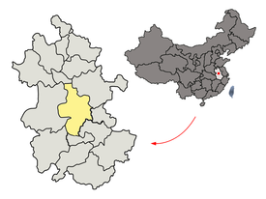
Finding support
  Social support: a sample
Minsheng Social Work Service Centre
  Service model
    Social worker + Government official + Volunteer + Professional service
  Purposes
    Release stress
    Rebuild purposes for life
    Identify personal needs of each family
    Change their inappropriate emotions and recognitions
  Methods
    Help Shidu parents rebuild social networks
    Develop self-help groups
    Integrate social work organisations and local communities
    Improve social engagements through various activities

Slide 33
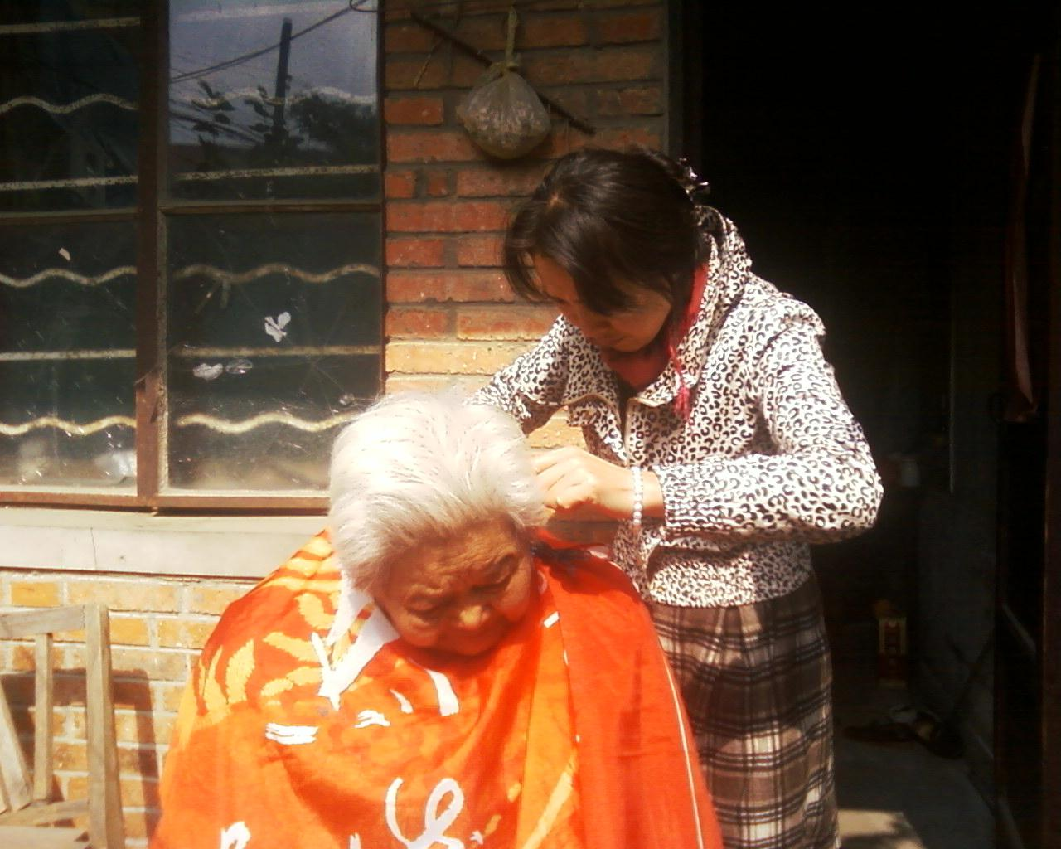
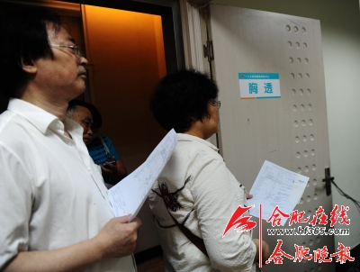
Services
Home visiting
Group consulting
Community activities
Social events
…

Slide 34
Summary
Shidu is considered as “bad” for the child, parents and family;
Shidu brings difficulties and impacts on different aspects of parents’ lives;
Shidu challenges the sense of self of being parents, family members and social members;
Issues of everyday life block parents in making sense of their lives;
Shidu parents tend to have a more relational self in an interdependent life;
Shidu parents tend to actively find support even if there is little social support;
It is necessary to further identify gaps between their needs and actual support.

Slide 35
Limitation and implications
Limitations:
  The interview data on the experiences of Shidu parents are incomplete;
  All three datasets were collected for purposes and using questions that were different to those related to the research on which this paper is based.
  No focus on other family members, such as grandparents.
Implications:
  Collect more primary interview data from Shidu parents as well as other family members in China from October, 2016.

Slide 36
Reference
China National Committee on Aging. (2013). The elderly lost their only child: who can provide old age support for us? C. N. C. o. Aging. Beijing.
Wang, G. (2013). "The estimated quantity of the Only Child in China and the its variation trend." Chinese Journal of Population Science 33(1): 57-65.

