Slide 1



Superfast Cooling
Shai Machnes
Tel-Aviv → Ulm University
Alex Retzker, Benni Reznik,
Andrew Steane, Martin Plenio

Slide 2
Outline
The goal
The Hamiltonian
The superfast cooling concept
Results
Technical issues (time allowing)

Slide 3
Outline
The goal
The Hamiltonian
The superfast cooling concept
Results
Lessons learned (time allowing)

Slide 4

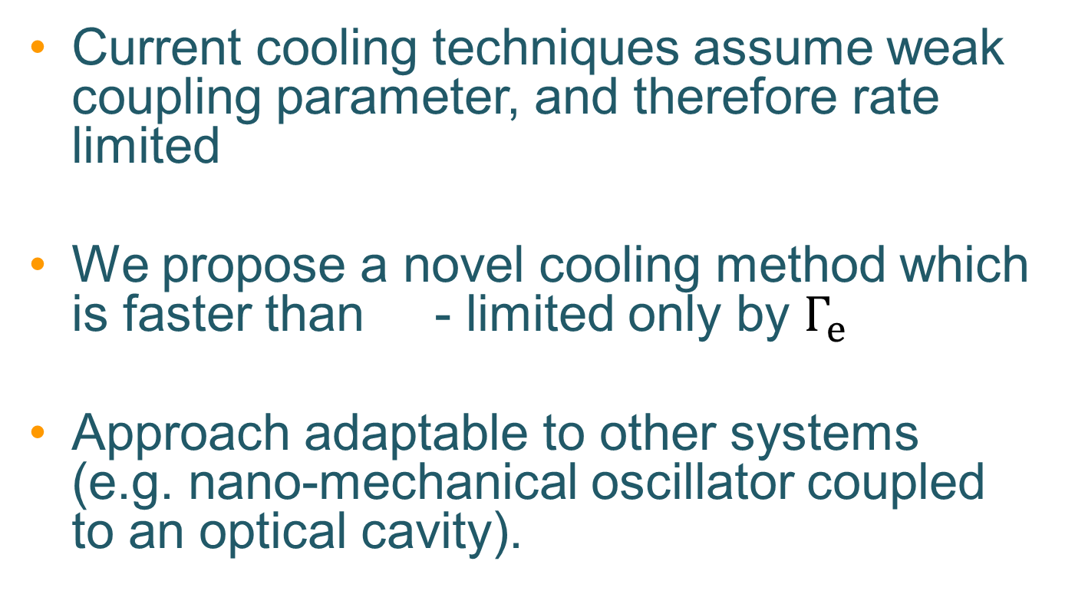
Goal
$$ν$$
Current cooling techniques assume weak coupling parameter, and therefore rate limited
We propose a novel cooling method which is faster than - limited only by $Γ_{e}$
Approach adaptable to other systems
(e.g. nano-mechanical oscillator coupled to an optical cavity).

Slide 5
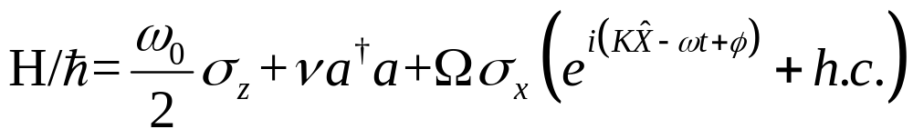
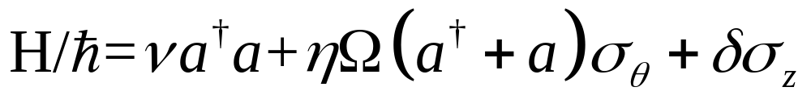
The Hamiltonian
Sidebands are resolved
Standing wave ^{(*)}
Lamb-Dicke regime ^{(**)}

Slide 6
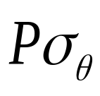
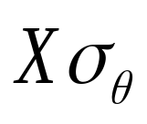
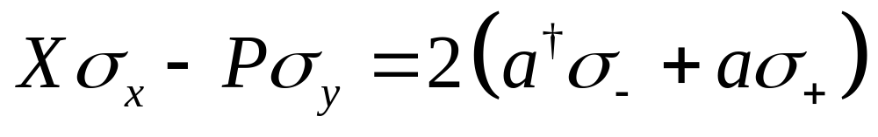
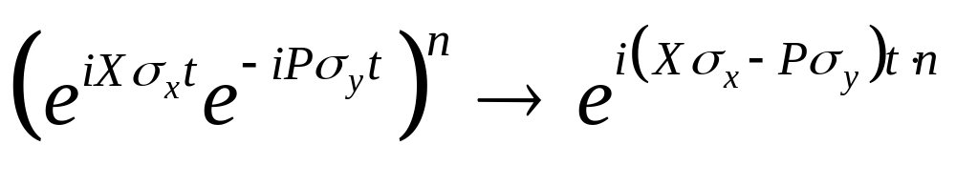
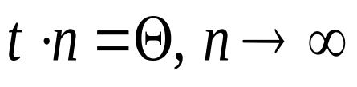
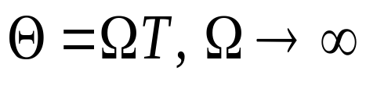
Cooling at the impulsive limit
Assume we can implement
both and pulses
We could implement the red-SB operator
and do so impulsively, using infinitely short
pulses, via the Suzuki-Trotter approx.
with
and taking

Slide 7

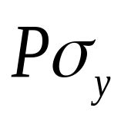
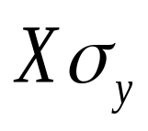
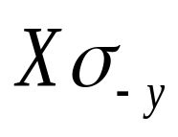

We have , we want
Solution: use a pulse sequence to emulate
  pulse
  Wait (free evolution)
  reverse-pulse
[Retzker, Cirac, Reznik, PRL 94, 050504 (2005)]
Intuition

Slide 8
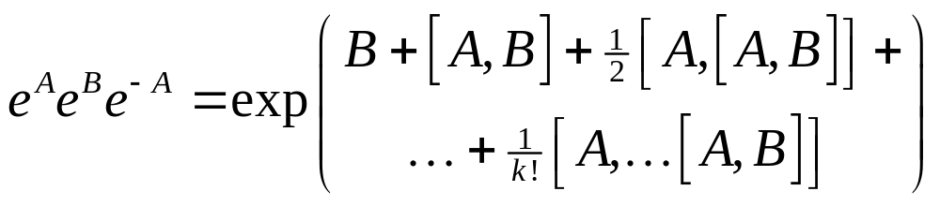
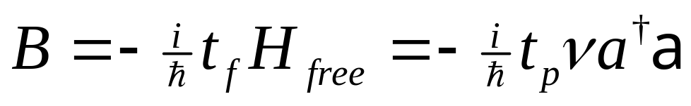
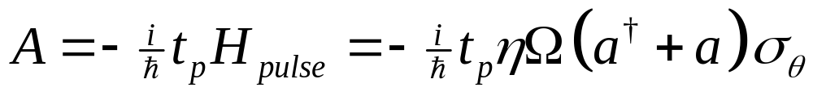
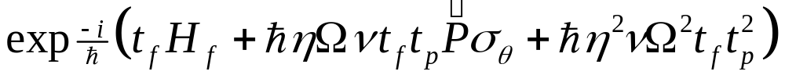

Slide 9
But …
The above argument isn’t realizable:
We cannot do infinite number of infinitely short pulses
Laser / coupling strength is finite → Cannot ignore free evolution while pulsing
→ Quantum optimal control

Slide 10
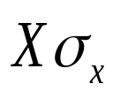
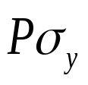
How we cool
Apply the pulse and
the pseudo-pulse
Repeat
Reinitialize the ion’s internal d.o.f.
Repeat
Sequence
Cycle

Slide 11
Numeric work done with
Qlib
A Matlab package for QI, QO, QOC calculations
http://qlib.info

Slide 12
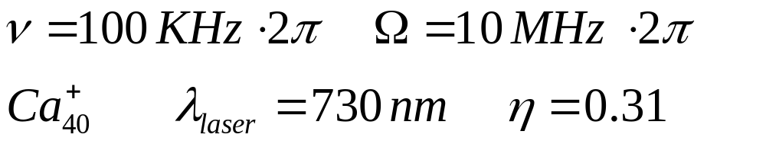

 | Cycle A | Cycle B | Cycle C
Initial phonon count | 3 | 5 | 7
Final phonon count | 0.4 | 1.27 | 1.95
after 100 cycles | 0.02 | 0.10 | 0.22
Cycle duration | 4.4 | 2.7 | 0.8
No. of X,P pulses | 6 | 3 | 3
No. of sequences | 10 | 10 | 10

Slide 13
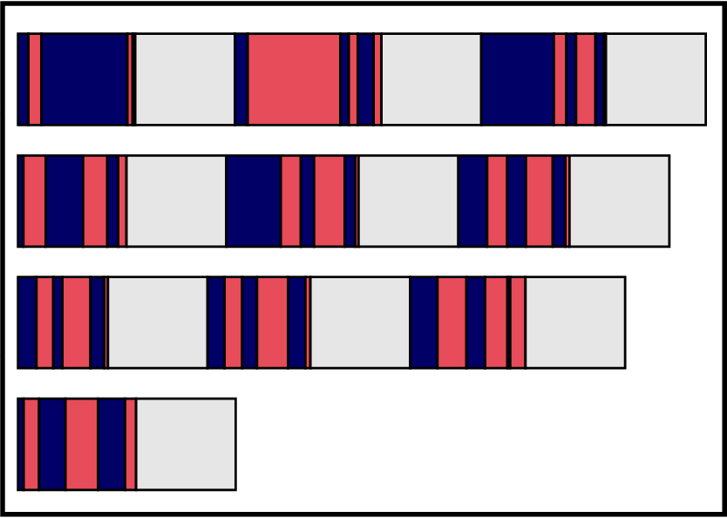
How does a cooling sequence look like?

Slide 14
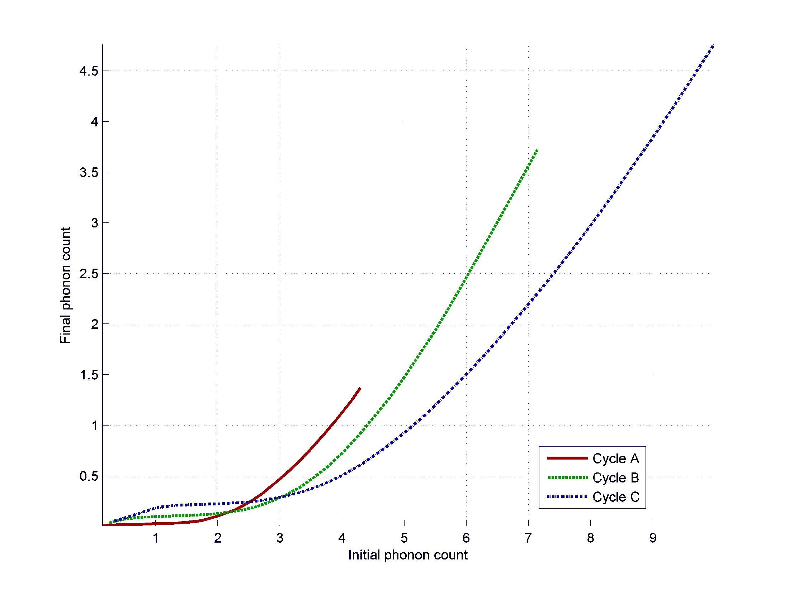
Dependence on initial phonon count
1 application of the cooling cycle

Slide 15
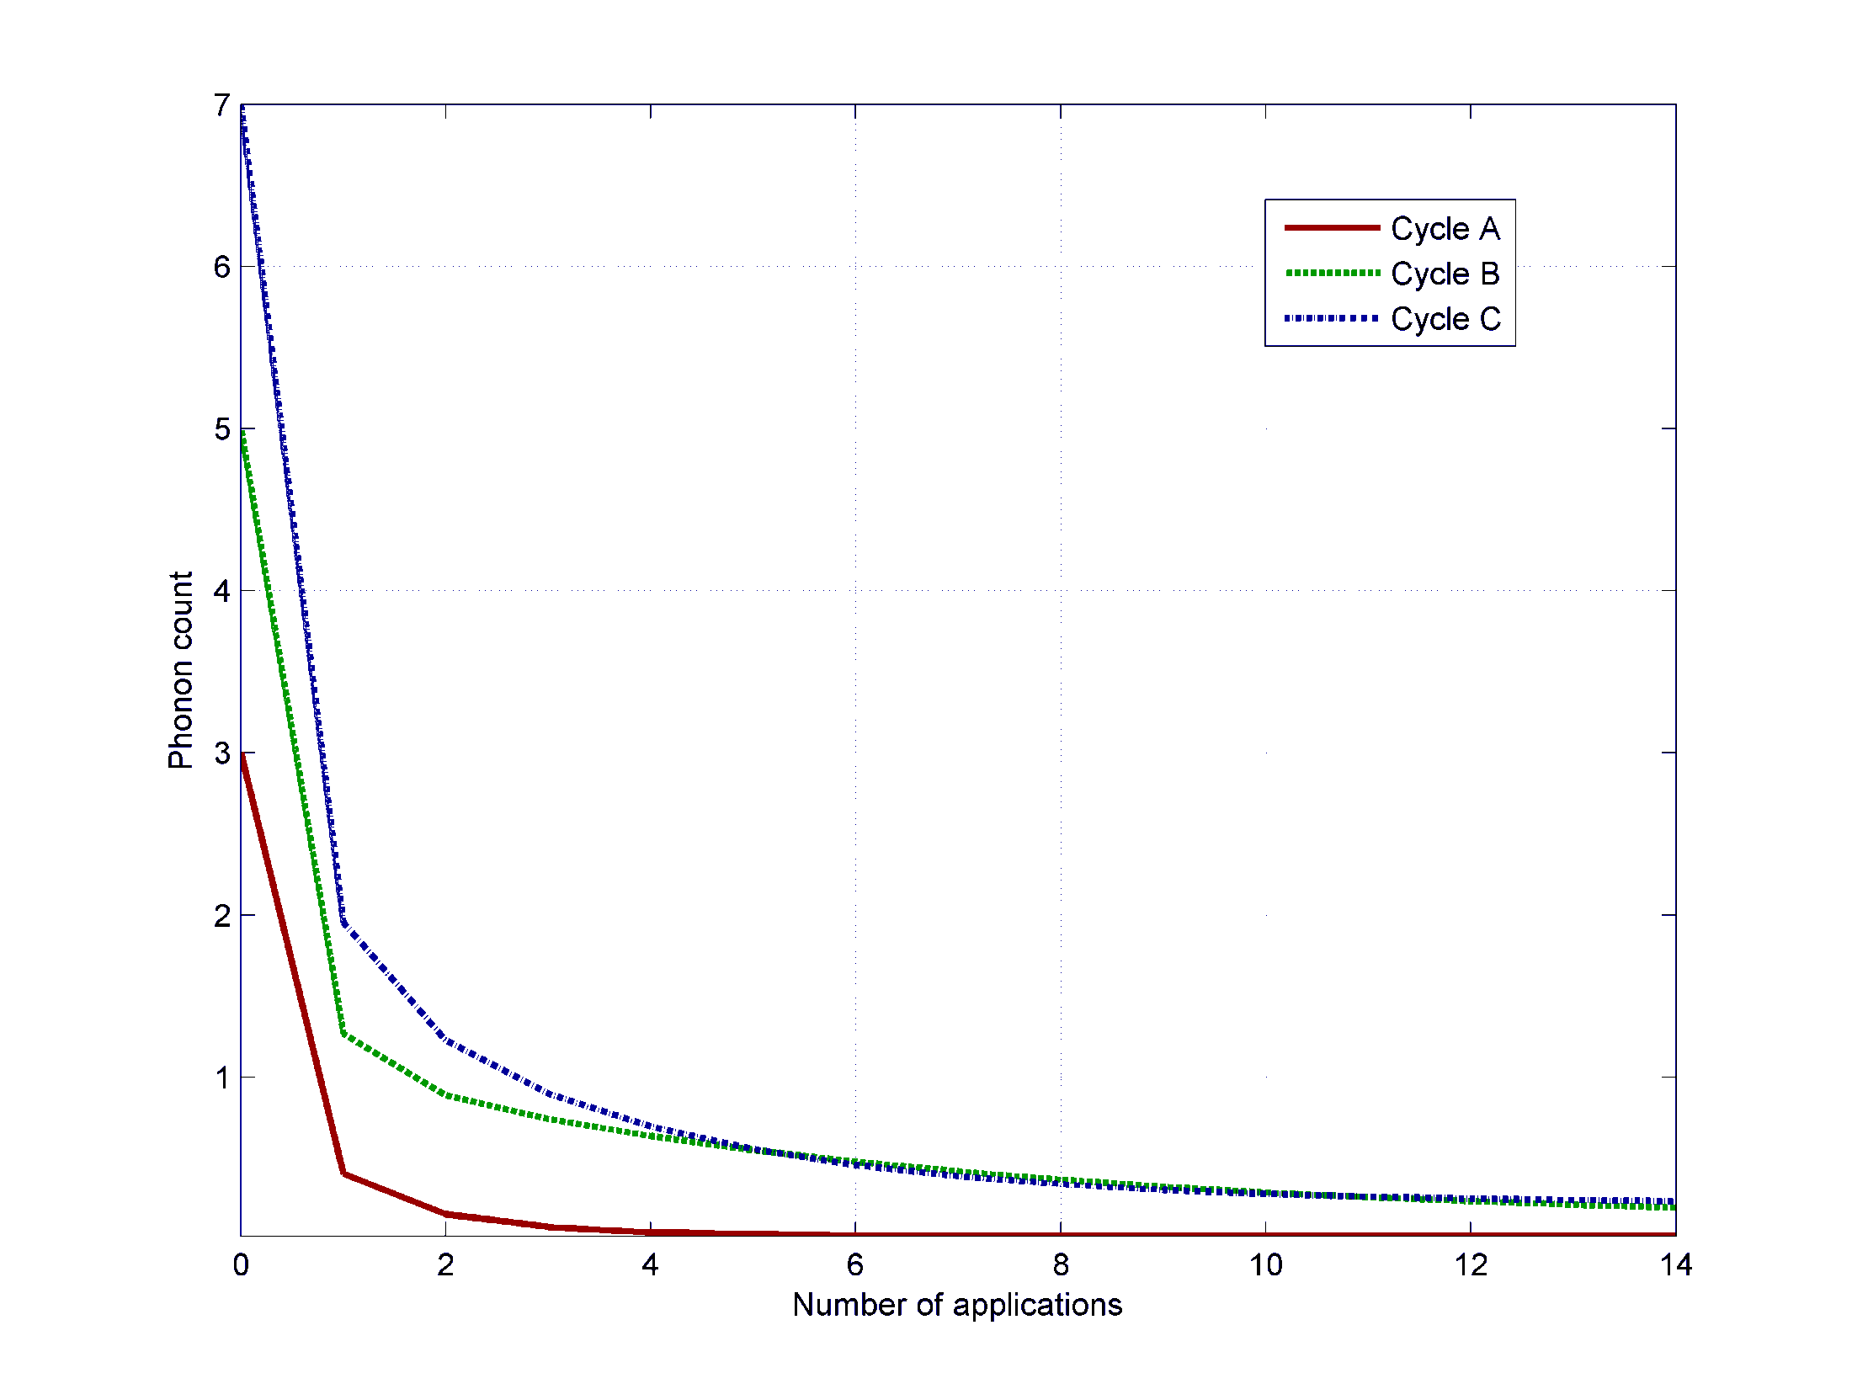
Effect of repeated applications
of the cooling cycles

Slide 16
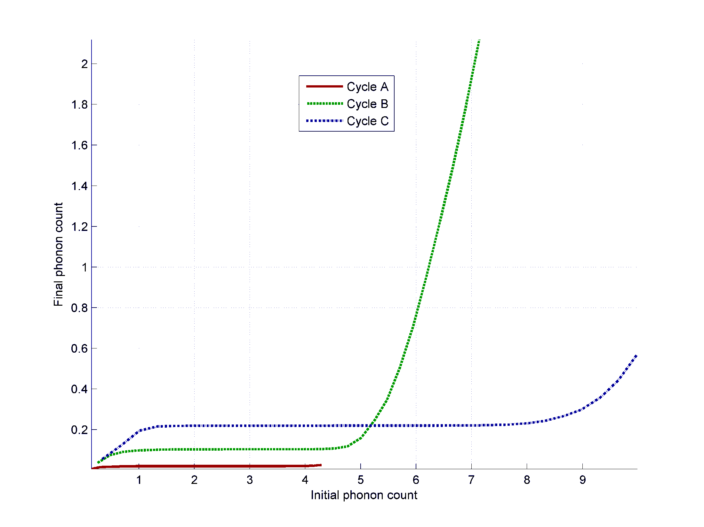
Dependence on initial phonon count
25 application of the cooling cycle

Slide 17
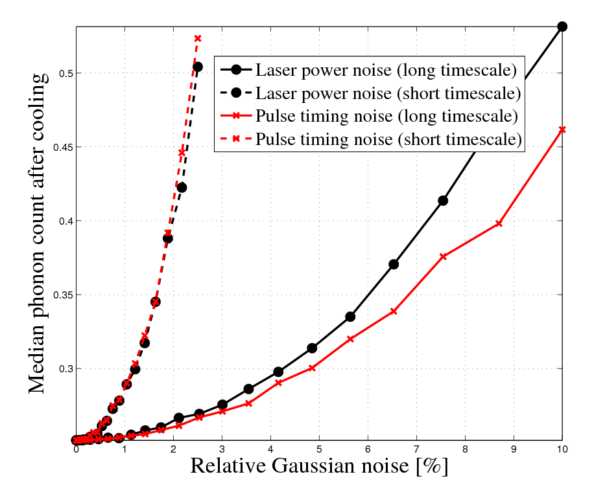
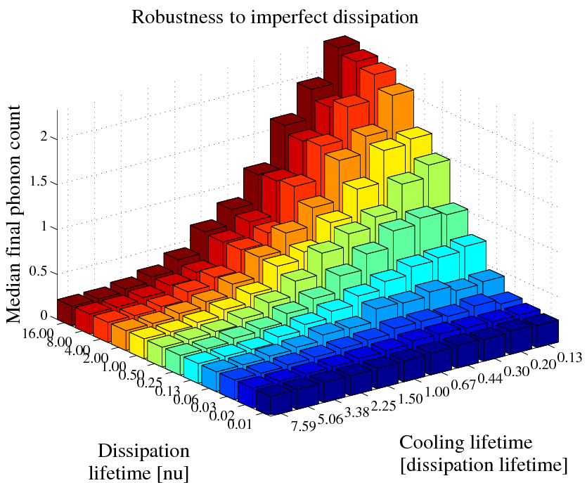
Robustness

Slide 18
We can do even better
Cycles used were optimized for the impulsive limit
Stronger coupling means
faster cooling

Slide 19
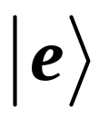

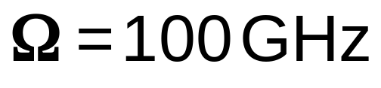
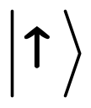
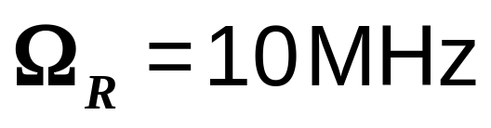
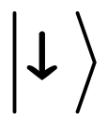
We can do even better

Slide 20
Lessons learned (1)
Exponentiating matrices is tricky
  For infinite matrices (HO), even more so
  Inaccuracies enough to break BCH relations for P-w-P
Analytically, BCH relations of multiple pulses become unmanageably long
Do as much as possible analytically
Use mechanized algebra
(e.g. Mathematica)

Slide 21
Lessons learned (2)
Sometimes it is easier to start with a science-fiction technique, and push it down to realizable domain than to push a low-end technique up
Optimal Control can change performance of quantum systems by orders of magnitude
See Qlib / Dynamo, to be published soon

Slide 22
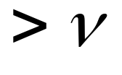
Superfast cooling
A novel way of cooling trapped particles
Upper limit on speed
Applicable to a wide variety of systems
We will help adapt superfast cooling to your system

Slide 23
Thank you !
PRL 104, 183001 (2010)
http://qlib.info

Slide 24
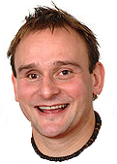
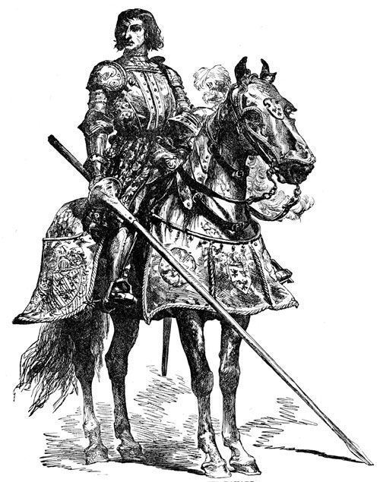


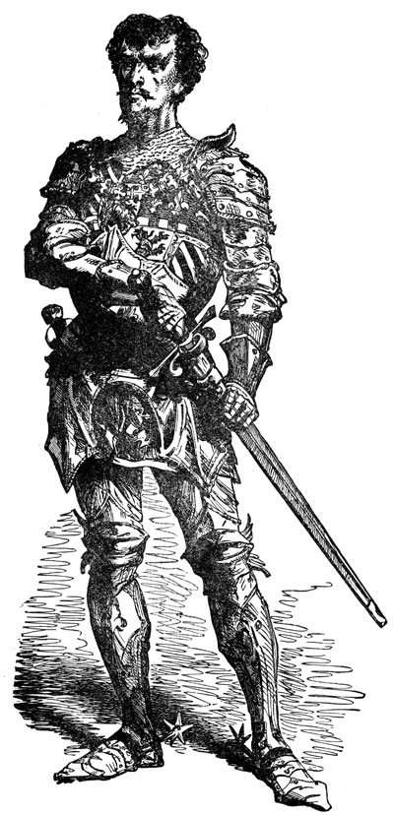
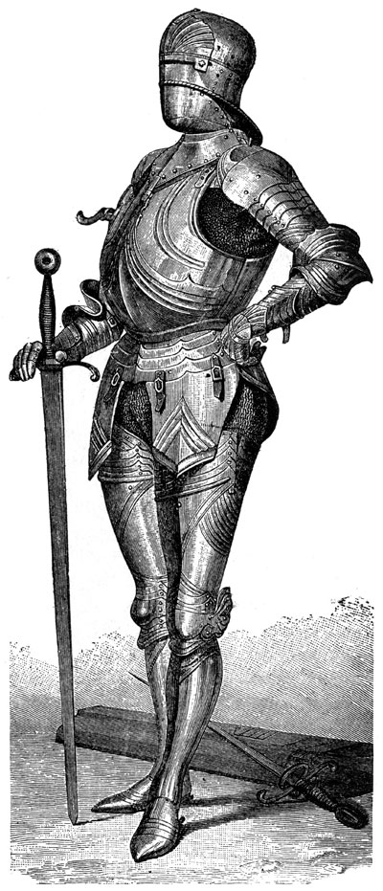
Sir
Segal
Sir
Hensinger
Sir
Thompson

Slide 25
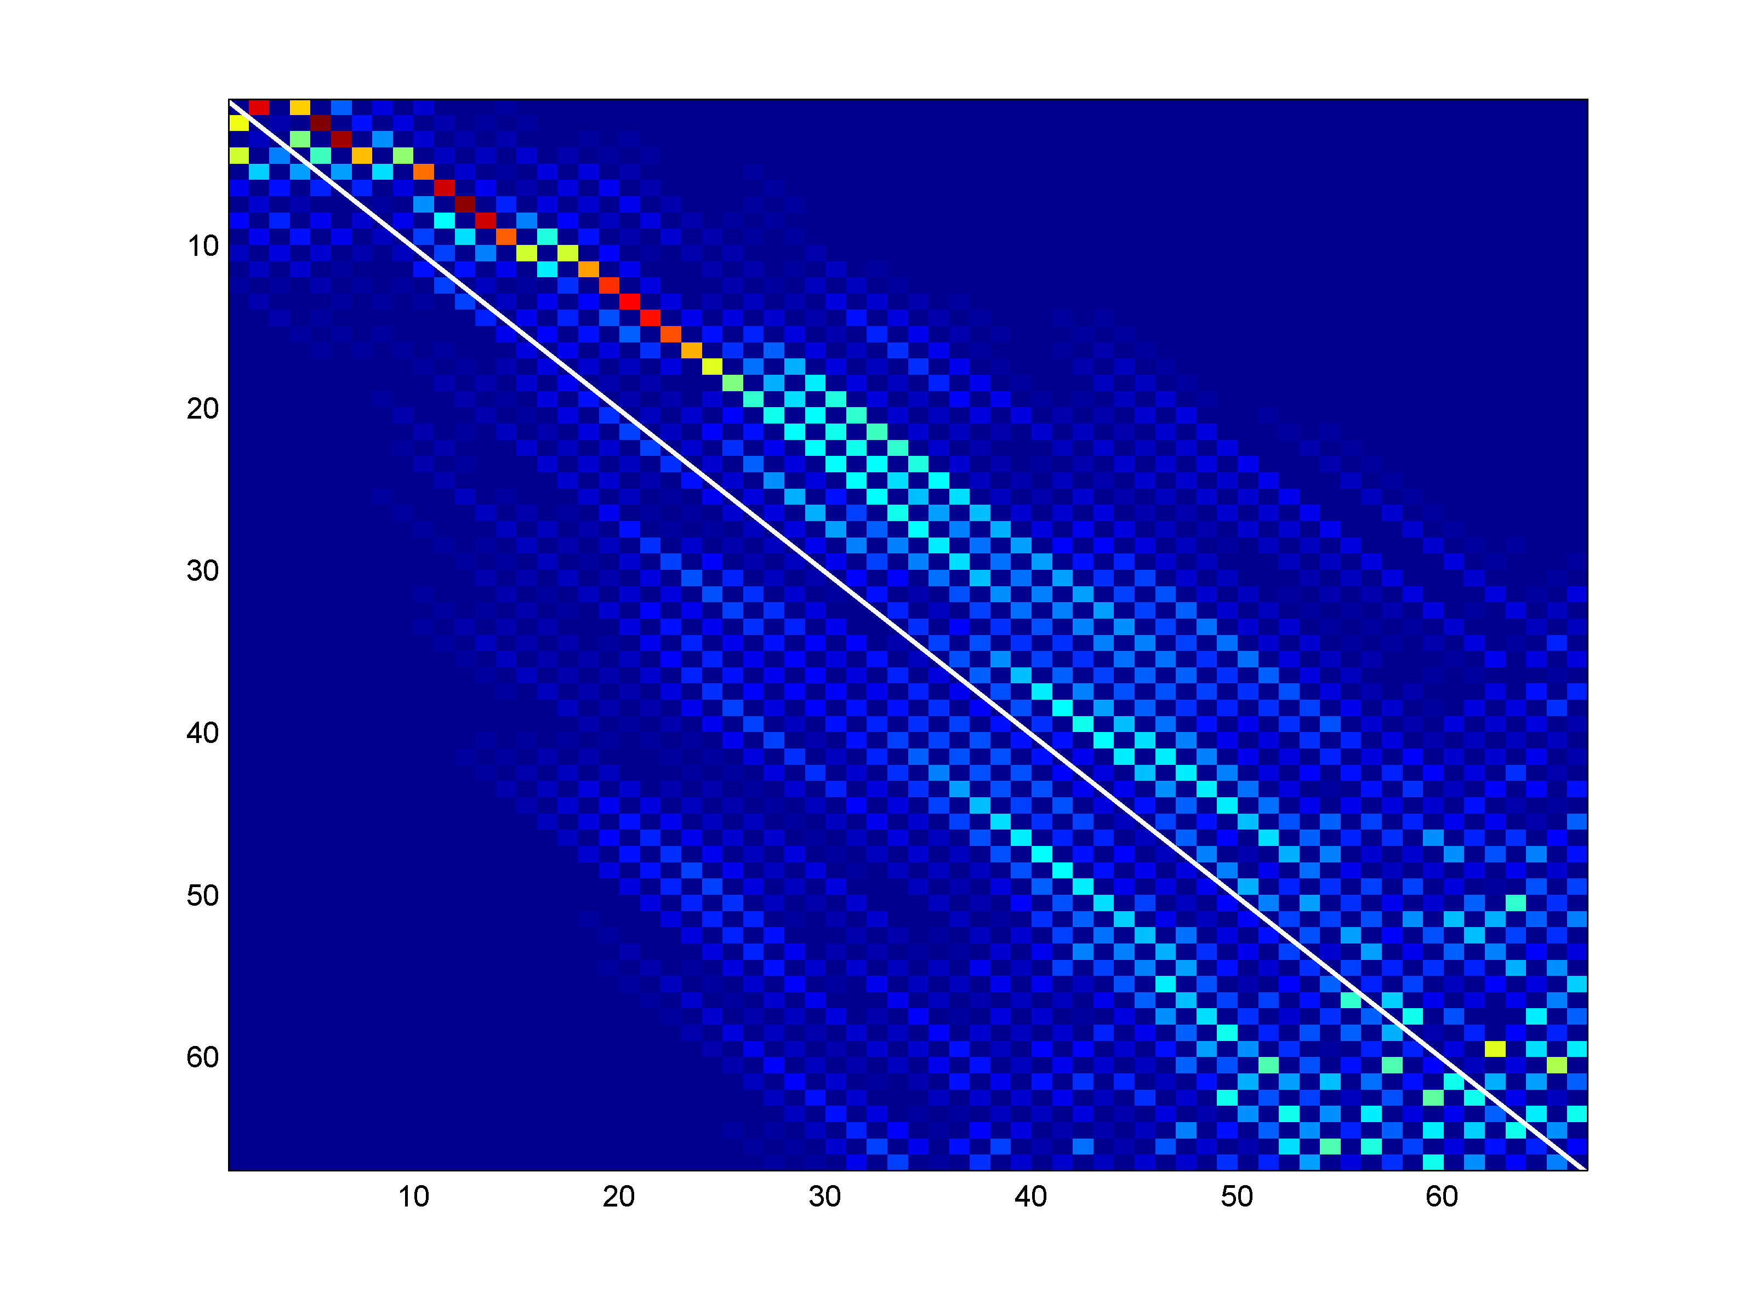
The unitary transformation

