Slide 1
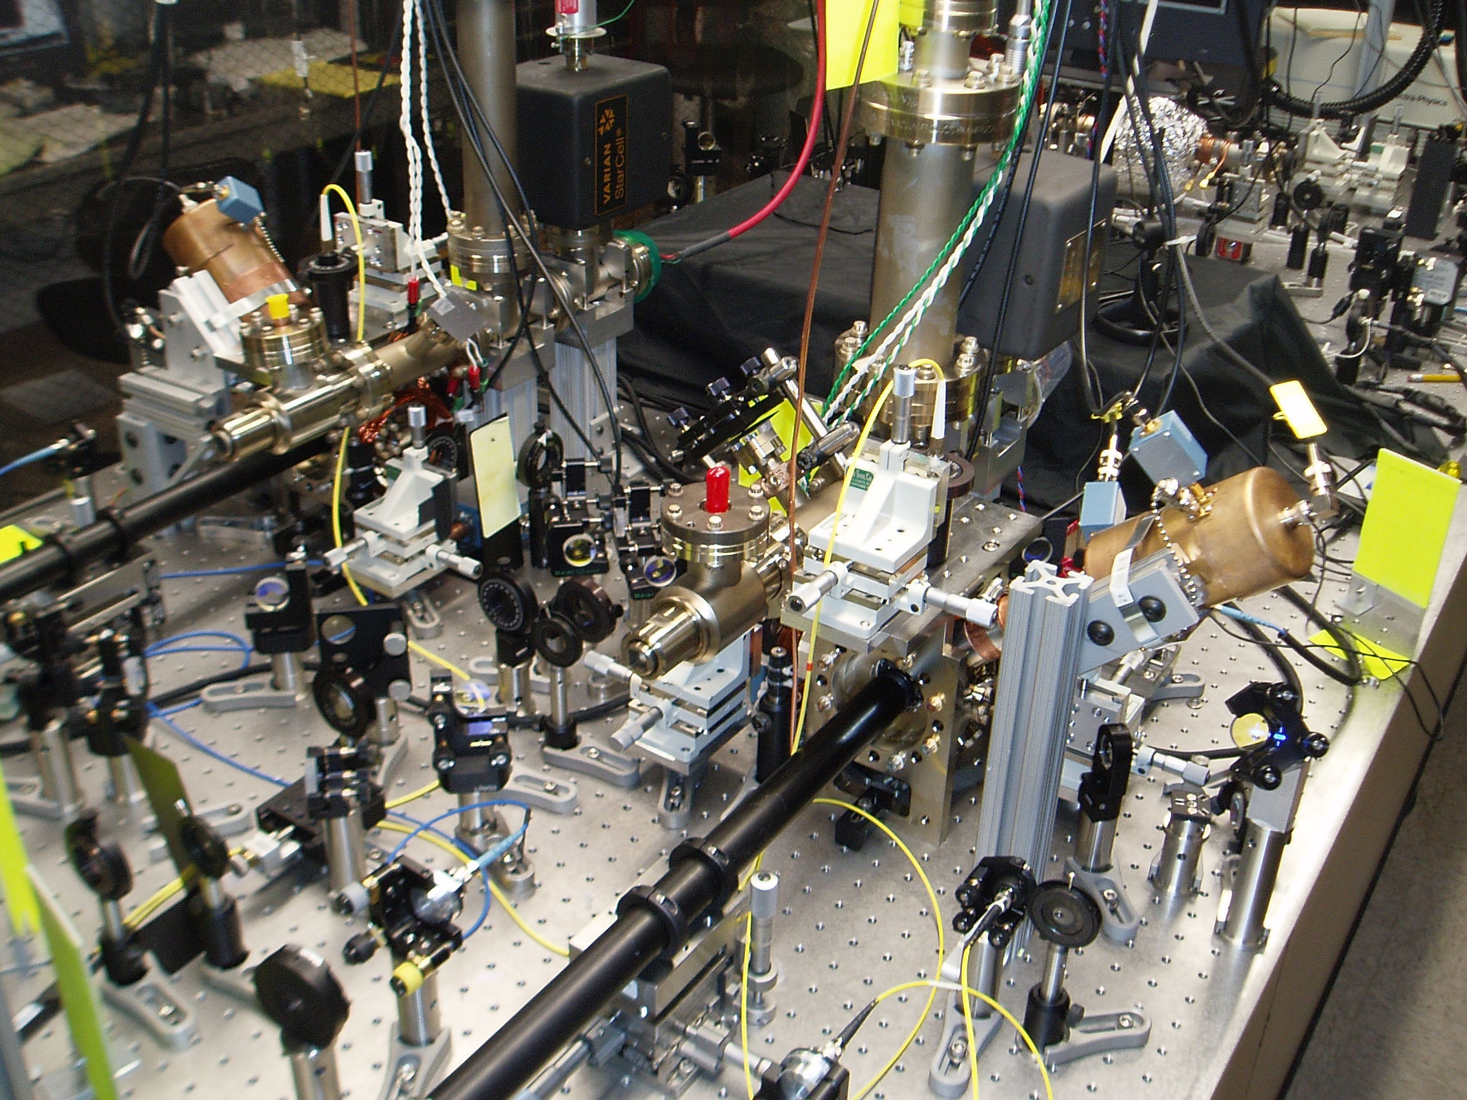








Ultrafast Pulsed Laser Gates for Atomic Qubits
JOINT
QUANTUM
INSTITUTE
ECTI Durham, UK
September 23, 2010
Wes Campbell
U. Maryland and NIST Joint Quantum Institute (USA)
with David Hayes, David Hucul, Le Luo, Andrew Manning,
Dzmitry Matsukevich, Peter Maunz, Jonathan Mizrahi,
Steven Olmschenk, Qudsia Quraishi, Crystal Senko, Jon Sterk
and Chris Monroe

Slide 2
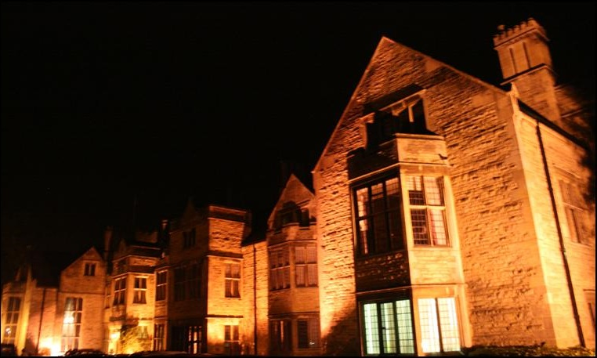
Things that are scary:
Ghosts!

Slide 3

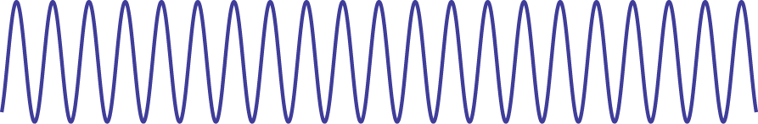

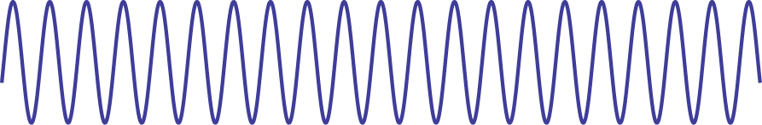
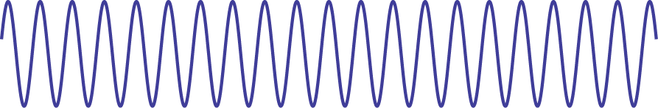
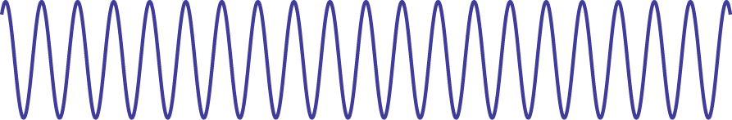
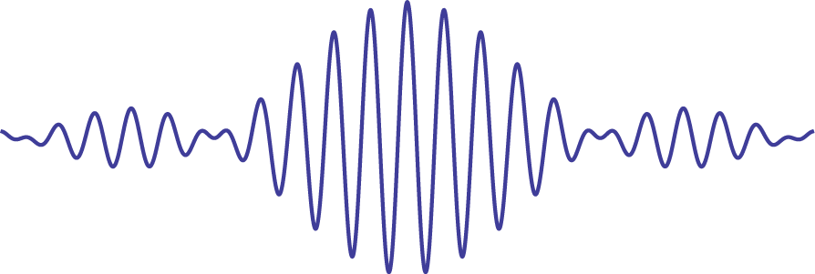
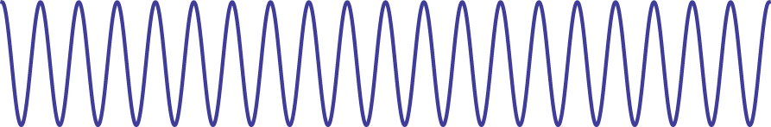
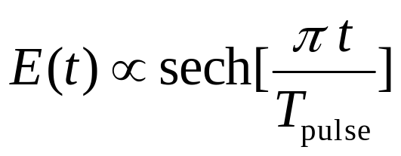
Mode-locked lasers: less scary (?)
FSR
PSD
ps – fs pulse durations
repeatable and clean
FSR = f_{rep}

Slide 4

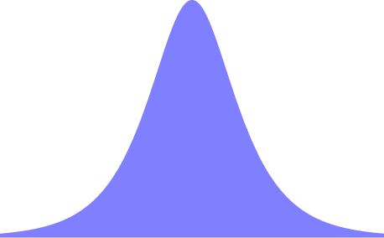
Mode-Locked Laser Gates
Resonant transitions: excite to the P state
photon frequency or polarization qubit
remote entanglement of two ions
Raman transitions: Strong excitation regime
fast single qubit operations
an approach for fast entanglement
Raman transitions: Weak excitation regime
your favorite cw tasks done with a comb
entanglement of two ions

Slide 5
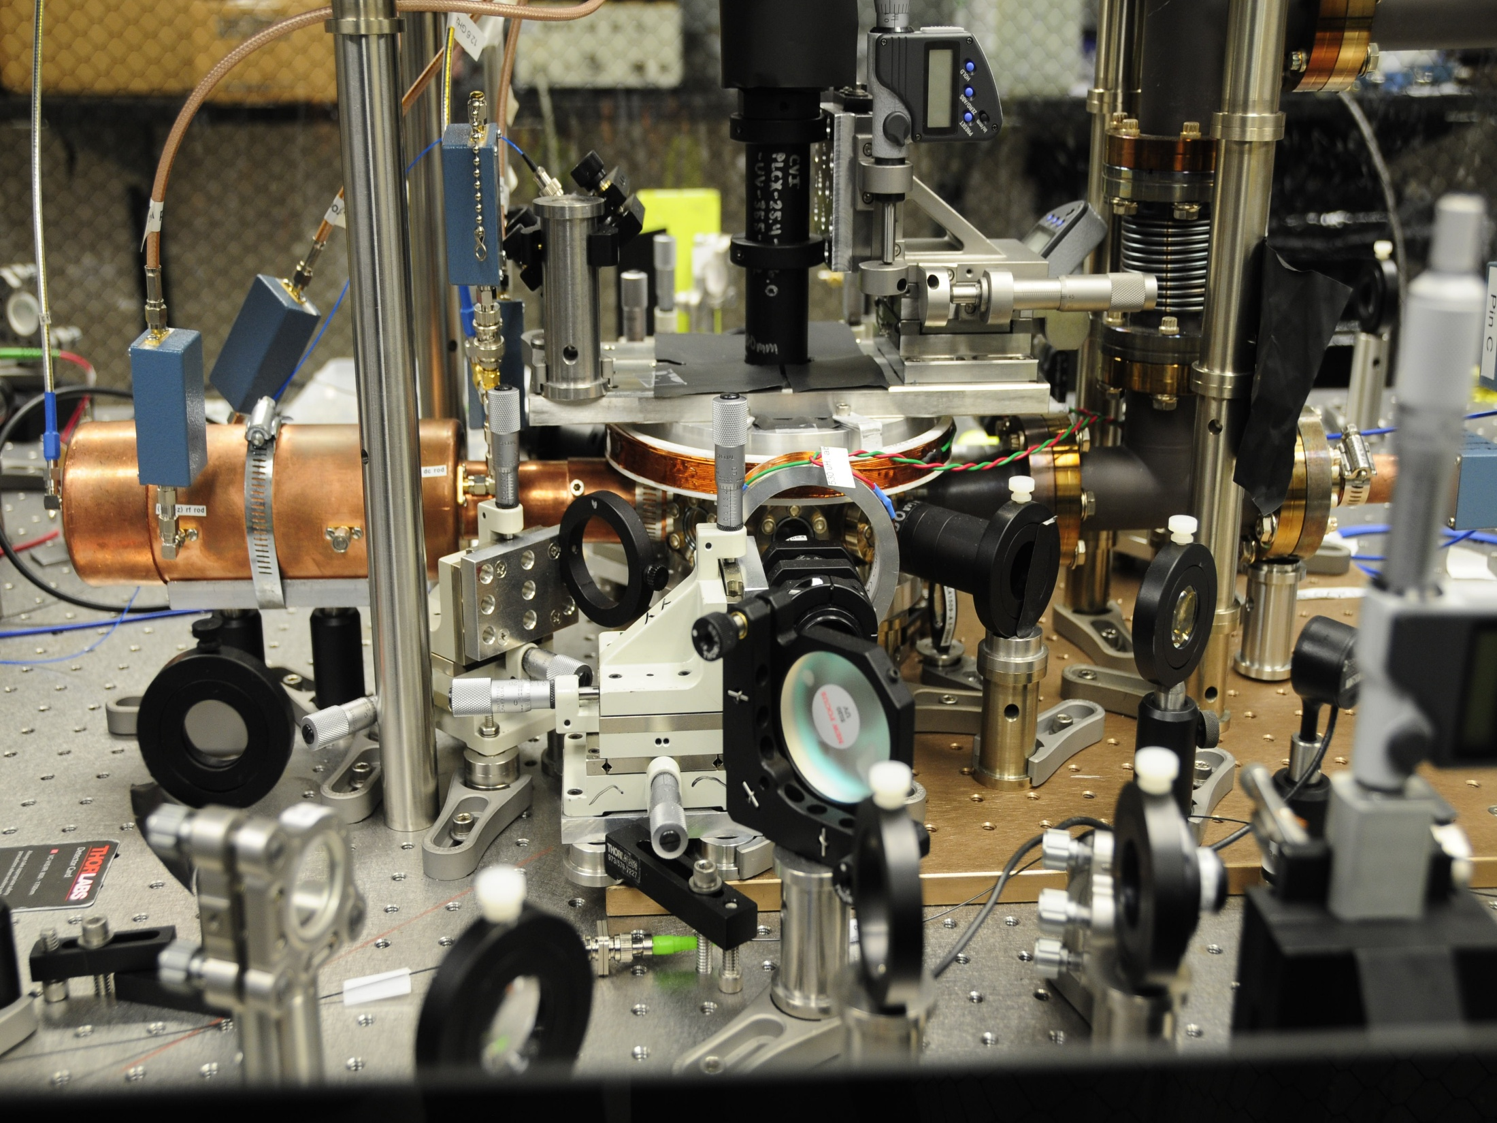


¹⁷¹Yb⁺ spin ½ nucleus
²P_{1/2}
370 nm
²S_{1/2}
12.6 GHz
hyperfine clock state qubit
S. Olmschenk et al., PRA 76, 052314 (2007)

Slide 6
¹⁷¹Yb⁺ spin ½ nucleus
²P_{1/2}
²S_{1/2}
12.6 GHz
state preparation:optical pumping
S. Olmschenk et al., PRA 76, 052314 (2007)

Slide 7
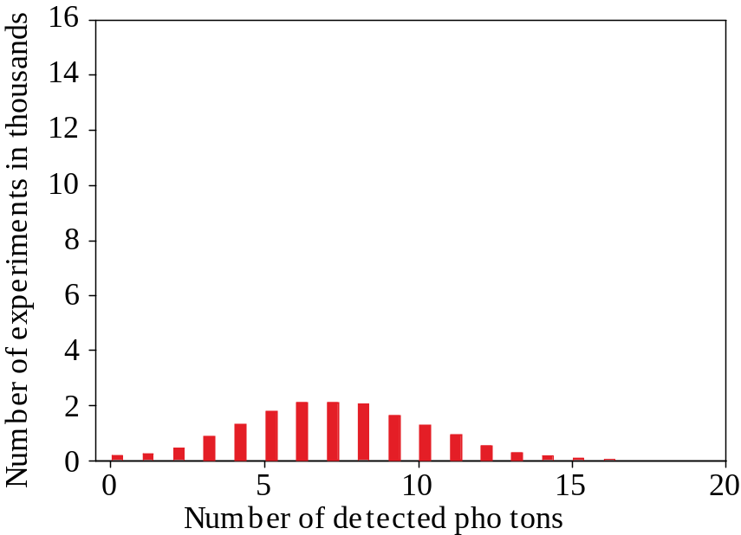
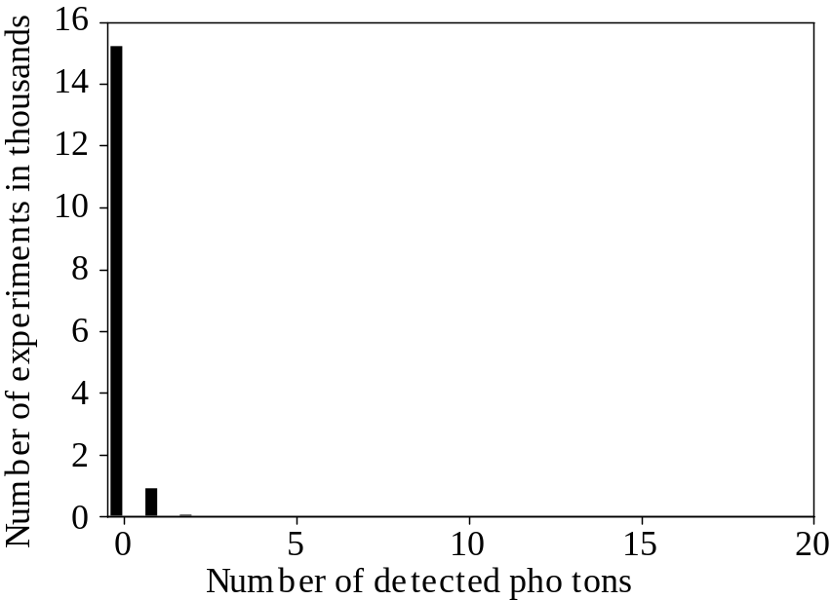
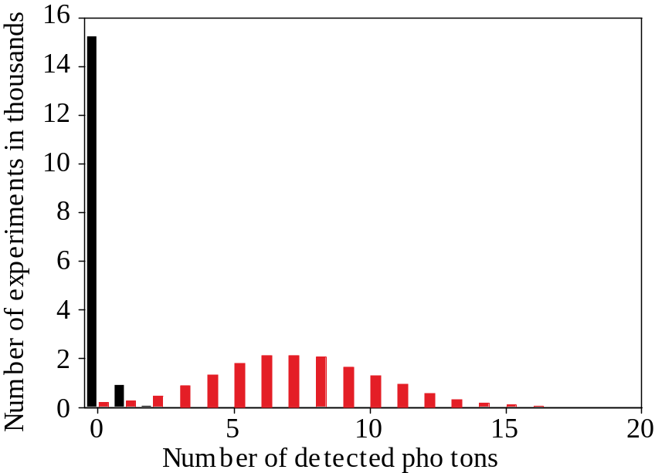
State detection with ¹⁷¹Yb⁺
²P_{1/2}
simple discriminator
detection fidelity 98.5%
²S_{1/2}
12.6 GHz
S. Olmschenk et al., PRA 76, 052314 (2007)

Slide 8


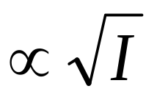
ion-photon entanglement
Ions for QI preparation, storage, and readout
Photons for QI transmission, communication
~
~
Pulse width considerations
Bandwidth must exceed qubit splitting(s)
Excitation probability
pico-second pulses
10 ps
70 GHz

Slide 9
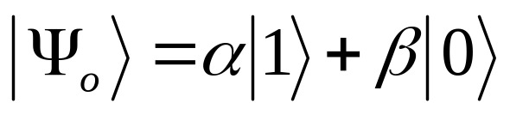
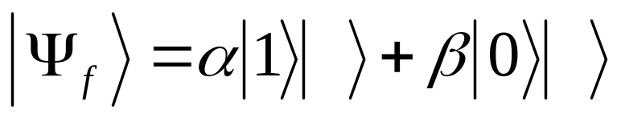
Ion-photon entanglement
Prepare ion in an arbitrary
state
²P_{1/2}
excite ion to P state with a
π-polarized picosecond pulse
collect π-polarized photon
²S_{1/2}
12.6 GHz
R
B
L.-M. Duan et al., PRA 73, 062324 (2006)

Slide 10
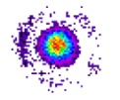

non-local QIP via
photon coincidence detection
Long Distance
atomic motion insensitivity
No optical interferometric stability necessary
Hybrid systems
Probabilistic but scalable
Simon and Irvine, PRL, 91, 110405 (2003)

Slide 11
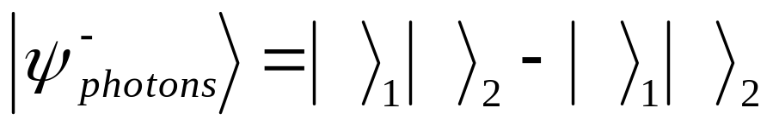

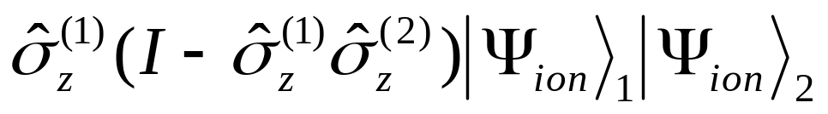
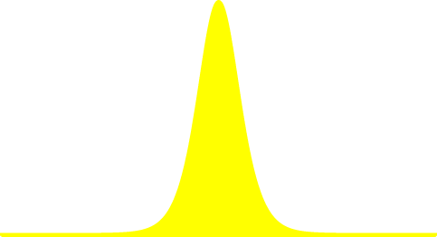
Ion-Ion entanglement
click!
click!
coincidence detection means
photons were in state
B
R
R
B
which heralds the ion-ion state
P. Maunz et al., PRL 102, 250502 (2009)

Slide 12
Photon-mediated entanglement of distant (~1 m) atomic qubits
Bell inequality test
D. N. Matsukevich et al., PRL 100, 150404 (2008)
Remote entangling gate
P. Maunz et al., PRL 102, 250502 (2009)
Quantum teleportation
S. Olmschenk et al., Science 323, 486 (2010)
Private random numbers
S. Pironio et al., Nature 464, 1021 (2010)
want better photon
collection efficiency

Slide 13

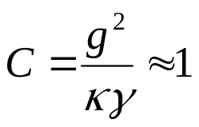
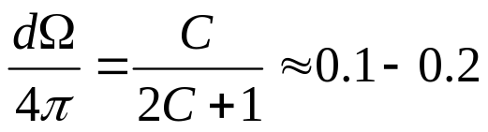

enhanced light collection
“Decent” cavities
G. Guthorlein, et al., Nature 414, 49 (2001)
A. Mundt, et al., Phys. Rev. Lett. 89, 103001 (2002)
W. Keller,et al., Nature 431, 1075 (2004)
Light collection: Innsbruck, NIST, Aarhus, Sussex, Saarbrucken, Sandia,
Singapore, Duke, GTRI, Erlangen, MIT, Griffith, Washington, JQI,…
Time-bin photonic qubit
late
early
early
photon
Insensitive to birefringence,
dispersion
late
photon
Fast
Fast
π
π
Cavity length free parameter
Time-bin resolving detectors
give other entangled states

Slide 14
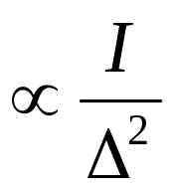
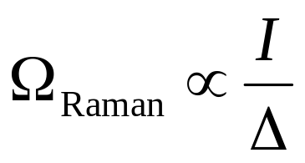

Stimulated Raman transitions
Single photon detuning Δ
Spontaneous emission
Diff. ac Stark shifts
Raman Rabi Freq.
Optical power = speed
and low laser-induced
decoherence

Slide 15
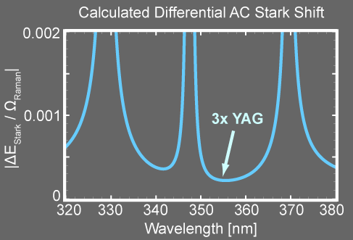
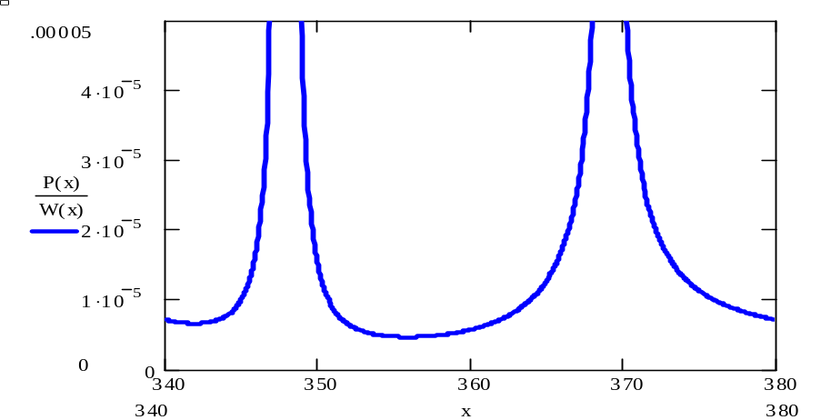

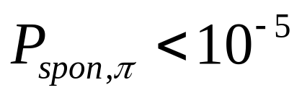


Raman Laser Wavelength
Δ = 33 THz
329 nm
²P_{3/2}
Spontaneous emission
5×10⁻⁵
4×10⁻⁵
3×10⁻⁵
2×10⁻⁵
1×10⁻⁵
0
²P_{1/2}
Δ
370 nm
340 350 360 370 380
Wavelength [nm]
²S_{1/2}
12.6 GHz

Slide 16
Pulsed laser Raman transitions
Short pulse = large bandwidth
10 ps pulse gives 70 GHz
Short pulse = easy UV
Single-pass SHG, THG, etc.
No need for HF / UV EOM
No need for buildup cavity

Slide 17
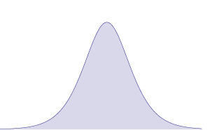
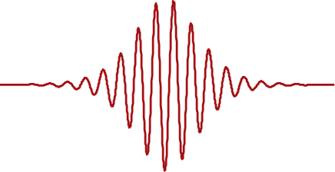
Pulsed Raman Transitions:
Strong Excitation Regime
Not very sensitive to
, temperature,
“bang-bang” dynamic decoupling, super-fast
cooling (see Machnes hot topic talk), photon
time bin qubit, rep rate limited experiments
Fast.

Slide 18
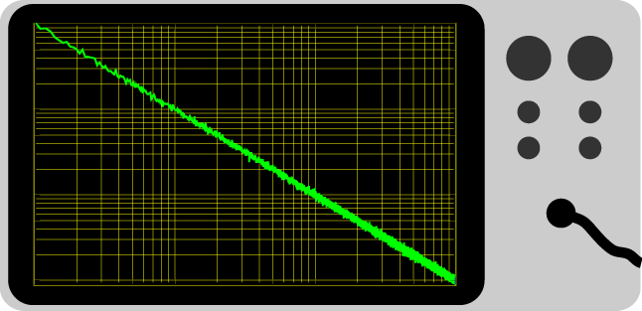


Speed for improved coherence
Slow QIP
Fast QIP
We want fast gates for both speed and fidelity

Slide 19
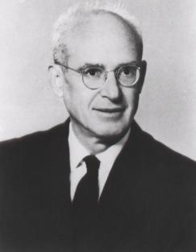
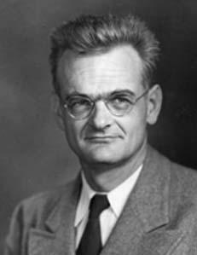
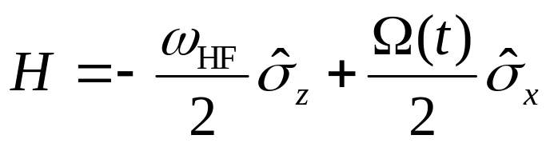
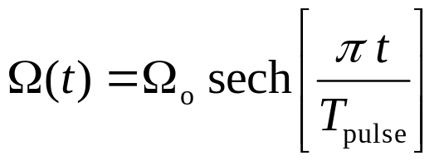
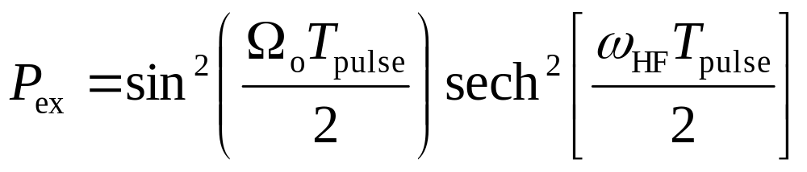
Strong Pulse Raman Transitions:
Rosen-Zener Solution
Nathan Rosen and Clarence Zener (PR 40, 502 (1932)):
Rabi flopping
contrast

Slide 20
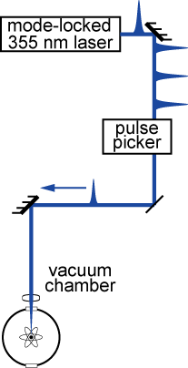
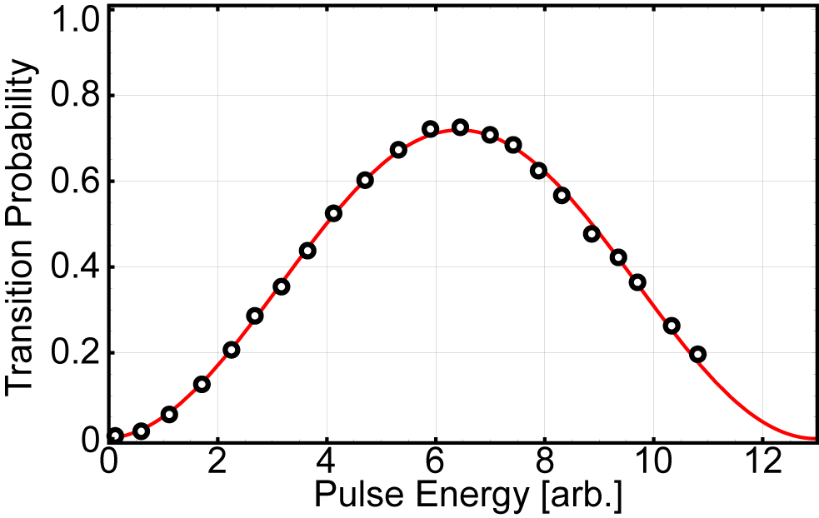
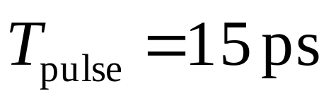
Strong Pulse Raman Transitions: pulse duration limited transfer
Single Pulse Rabi Flop
~70%

Slide 21
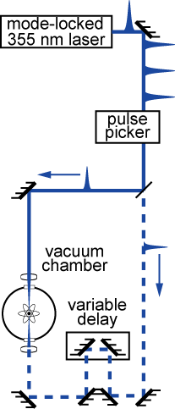

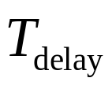
Strong Pulse Raman Transitions:
“pulse shaping”
pulse shape limits transfer
time
time

Slide 22
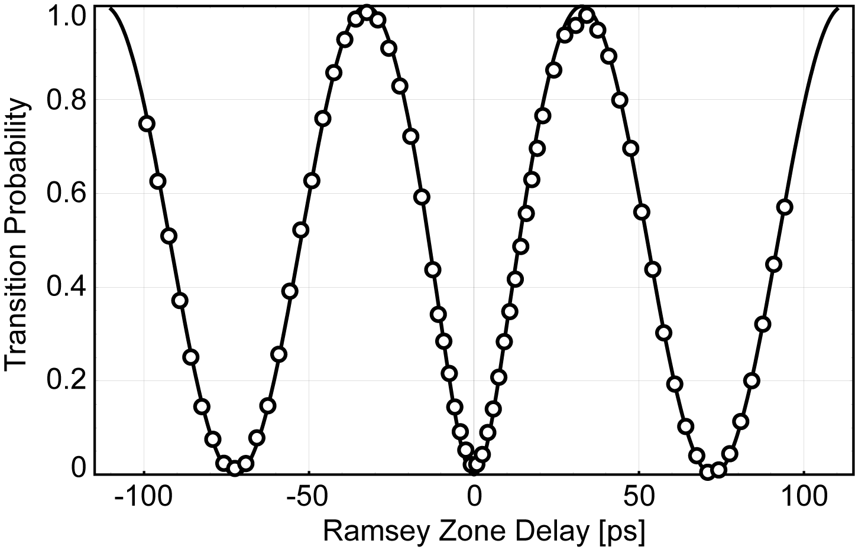
Strong Pulse Raman Transitions:
Ramsey Spectroscopy
σ+
σ-
time
40 ps
π-pulses

Slide 23
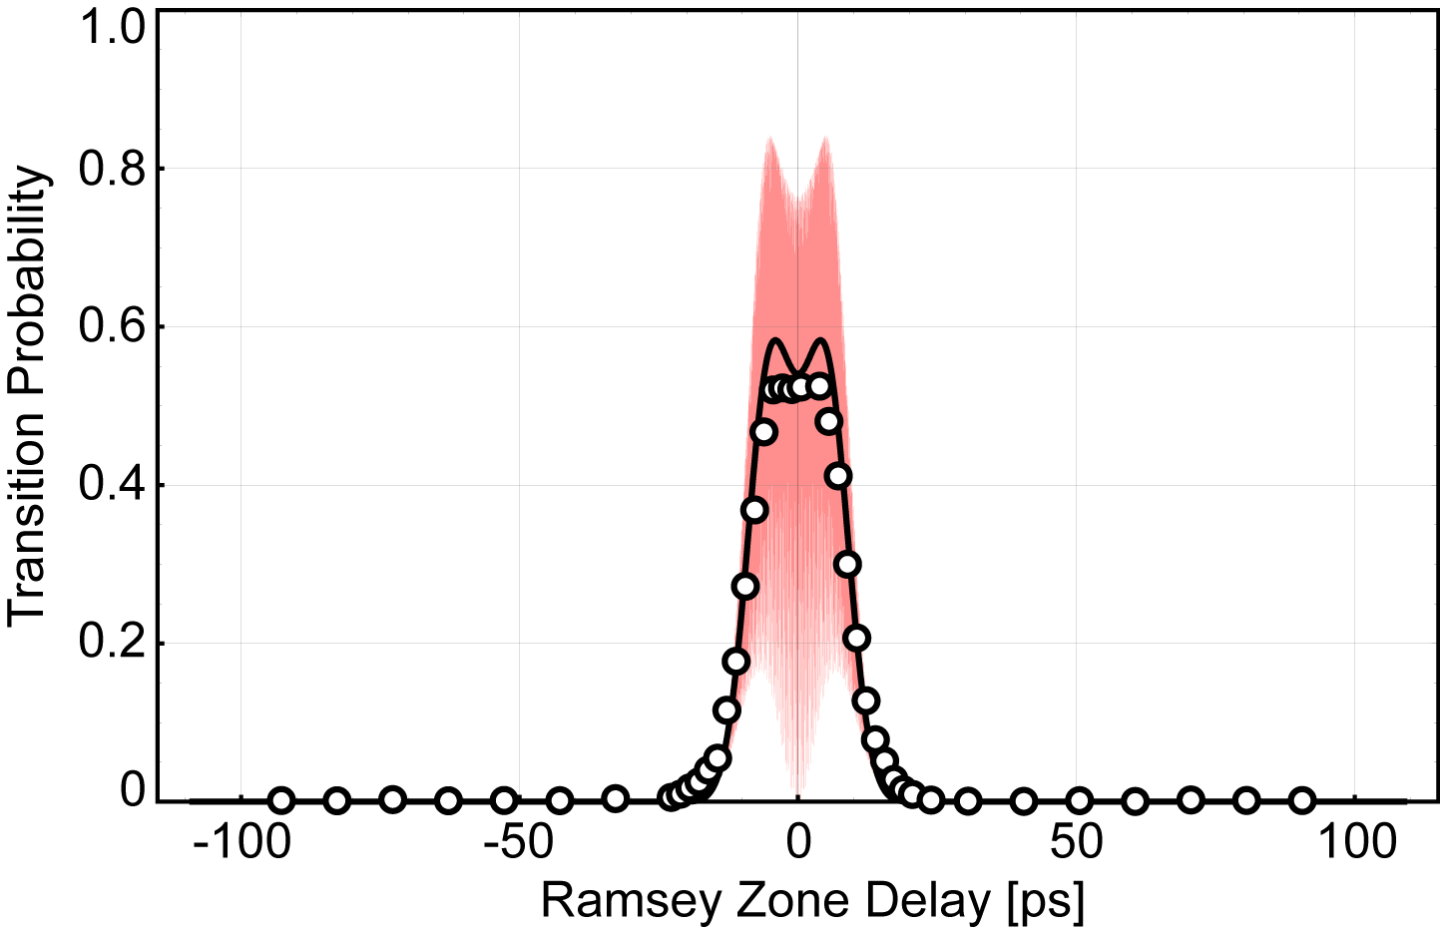
Strong Pulse Raman Transitions:
Ramsey Spectroscopy
Lin
Lin
time
Momentum
transfer

Slide 24
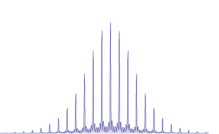
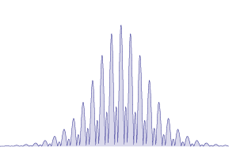
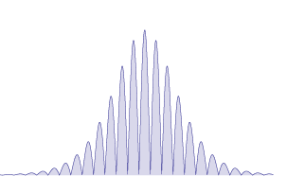
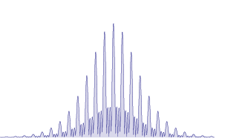

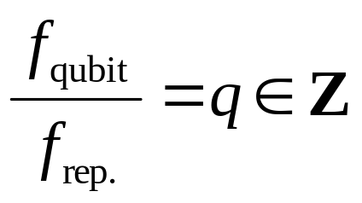
Pulsed Raman Transitions:
Weak Excitation Regime
X
Requirement:
Rep rate provides spectral sensitivity.

Slide 25
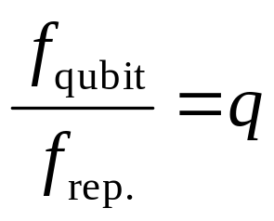
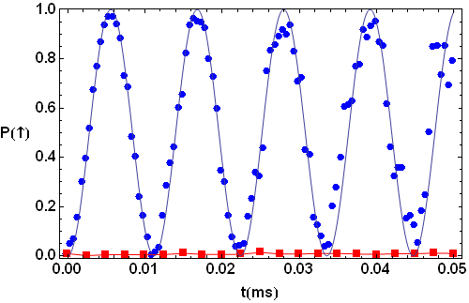




Pulsed Raman Transitions:
Weak Pulse Regime
Coherent accumulation of transition amplitude
Resonance Study for Rabi Flops
Pulse Train Duration [ms]
D. Hayes et al., PRL 104 140501 (2010)

Slide 26









Weak pulse Raman transitions: accessing motion
mode-locked
laser
AOM

Slide 27

Weak pulse Raman transitions: accessing motion
mode-locked
laser
AOM

Slide 28











standard trapped ion QIP tasks done with an optical frequency comb
Single qubit operations
Sideband cooling
0.6
0.7
Red Sideband
Blue Sideband
P( )
P( )
0.1
0.0
AOM Frequency (MHz)
Detuning from carrier transition (MHz)
Spin-motion entanglement
Mølmer-Sørensen gate
D. Hayes et al., PRL 104 140501 (2010)

Slide 29

Low-decoherence Raman transitions
²P_{3/2}
329 nm
²P_{1/2}
370 nm
²S_{1/2}
12.6 GHz
Low AC Stark shift (10⁻⁴Ω)
Low spon. emiss. (10⁻⁵)
High UV power (4-10 W)
(Emily Edwards hot topics talk Friday)

Slide 30
Mode-Locked Laser Gates
Resonant transitions: excite to the P state
entanglement of distant ions via photons
need increased light collection
Raman transitions: Strong excitation regime
fast single qubit operations
working toward fast entanglement
Raman transitions: Weak excitation regime
your favorite cw tasks done with a comb
low decoherence

Slide 31


JOINT
QUANTUM
INSTITUTE
P.I.
Chris Monroe
Postdocs
Kihwan Kim
Le Luo
Qudsia Quraishi
Emily Edwards
Susan Clark
Grad Students
David Hayes
David Hucul
Rajibul Islam
Simcha Korenblit
Andrew Manning
Jonathan Mizrahi
Crystal Senko
Jon Sterk
Shantanu Debnath
Alumni
Peter
Maunz
Steven
Olmschenk
Dzmitry
Matsukevich
Duke
NIST
Undergrads
Brian Fields
Kenny Lee
Aaron Lee
Singapore

