Slide 1
Biodiversity, Oil and Development in Ecuador
Carlos Larrea
Universidad Andina Simón Bolívar

Slide 2
Natural endowment in Ecuador
Biological diversity in Ecuador
    Ecuador has the largest amount of vertebrates per square Km in the word.
    When taking into account endemic species, Ecuador is the second most diverse country in the world.
    Ecuador ranks in the first ten most abundant countries in absolute number of amphibians, birds and butterflies.
    The equator, the Andean mountains and the Galapagos islands contribute to a rich and diverse environment.

Slide 3
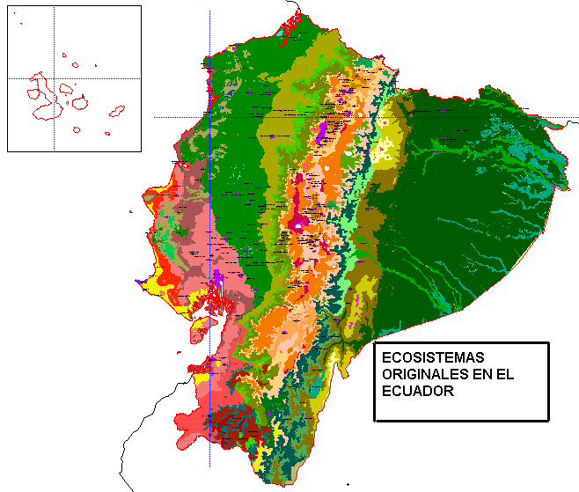
Original Ecosystems in Ecuador

Slide 4
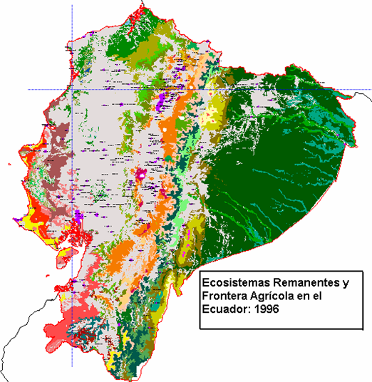
Remaining Natural Formations:
Ecological Footprint

Slide 5
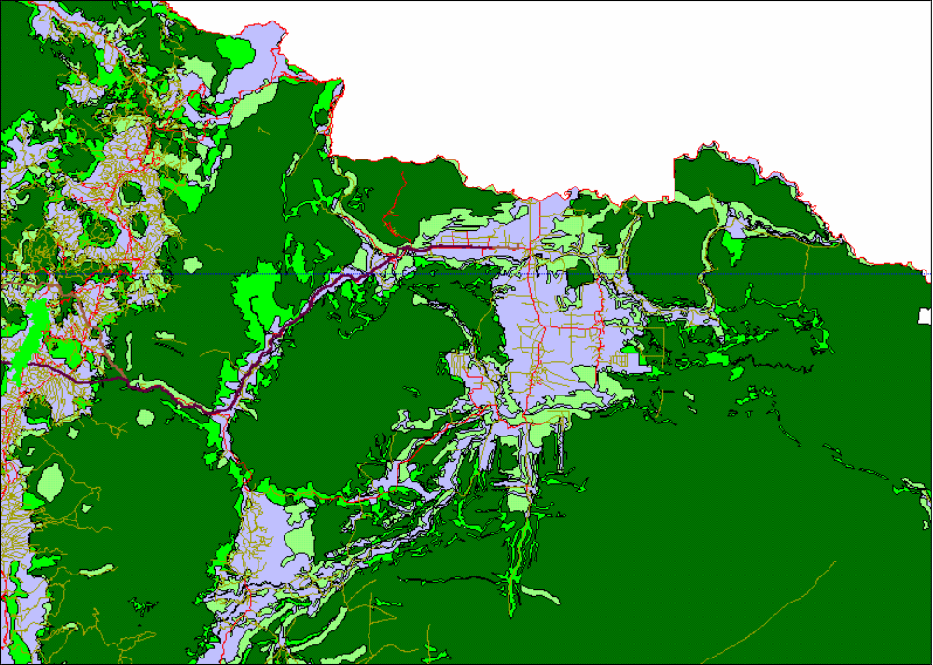
Oil and Deforestation in the Amazon

Slide 6
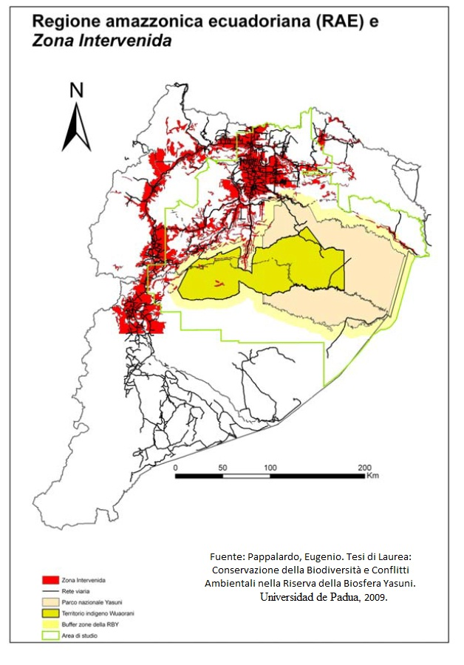
Amazon Deforestation and the Yasuni Park

Slide 7
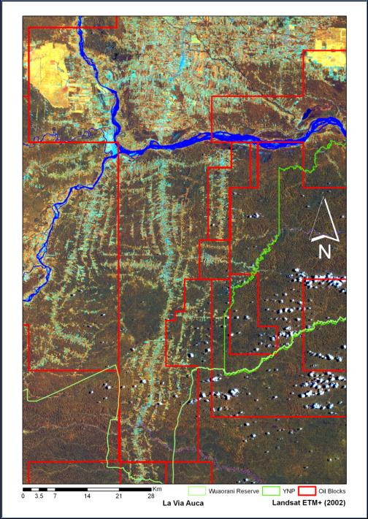
The Auca Road

Slide 8
The Yasuní National Park Endowment
The most diverse area in the world.
One hectare in the park contains as many tree species as the United States and Canada together.
150 species of amphibians, 121 of reptiles, 596 of birds, about 200 of mammals, 500 of fish and 4.000 plants have been identified in the Yasuni Park.
It was a biodiversity refuge during the Pleistocene period, when most of the Amazon rainforest became grasslands due to glaciations.
Home of two voluntarily isolated and not contacted indigenous cultures: the Tagaeri and the Taromenane.

Slide 9
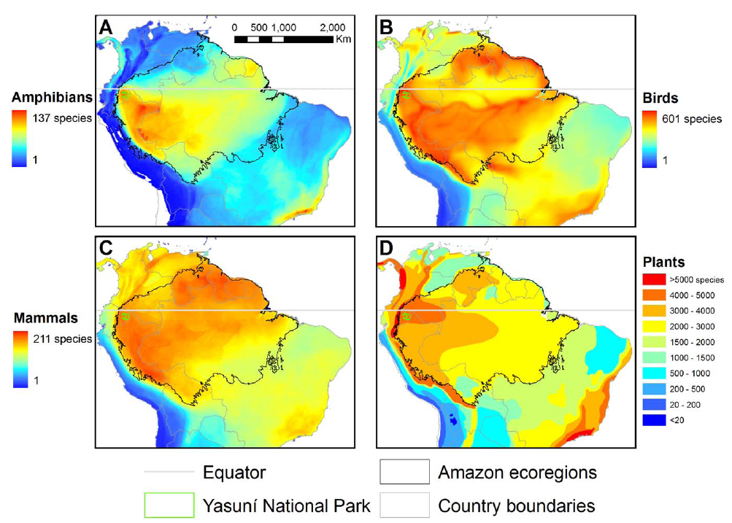
Biodiversity of Yasuni Park

Slide 10
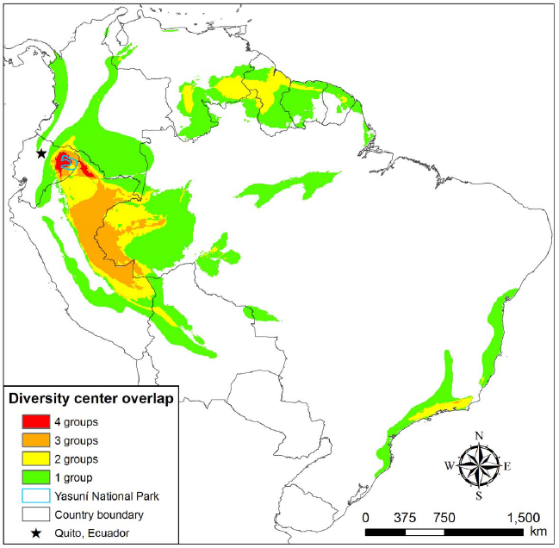
Yasuni biodiversity overlap map

Slide 11
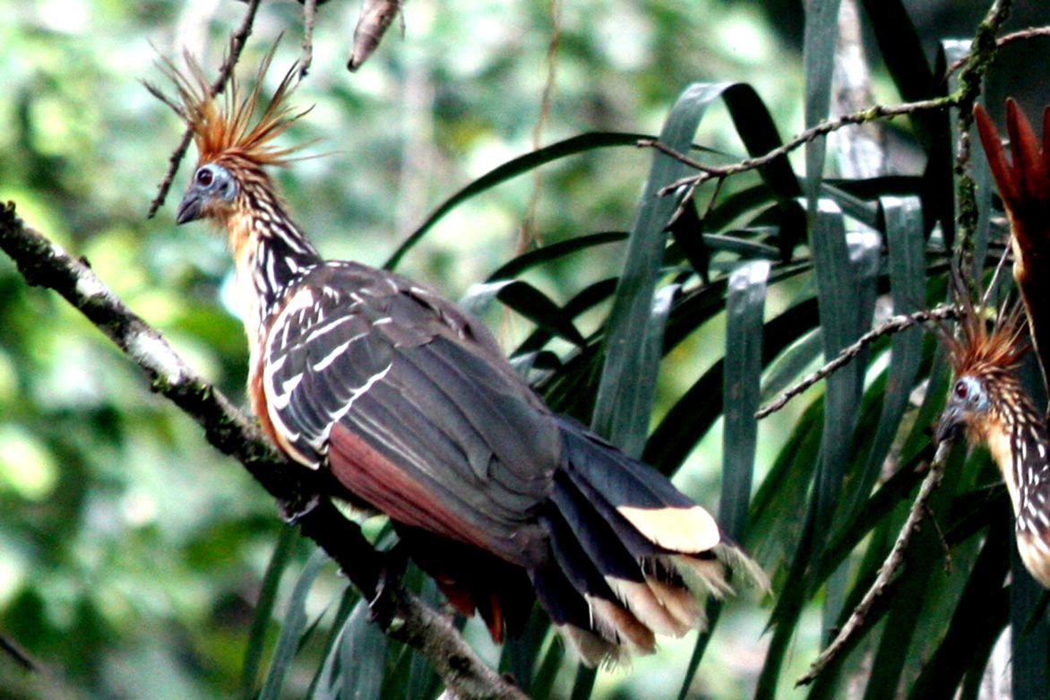
Opisthocomus Hoazin

Slide 12
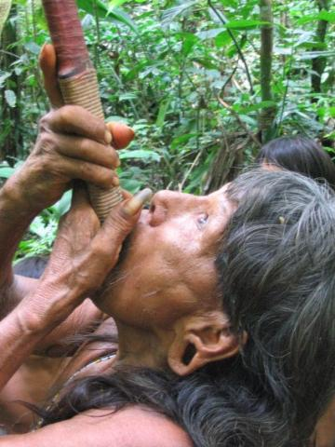

Slide 13
Oil, economy and society
Current situation:
  Record oil production: 529.000 b/d in 2006.
  High oil prices: $ 90/barrel (WTI)
  Poverty: 47 %, Urban underemployment: 47 %. Difficulties to reach MDGs.
  At least a million Ecuadorians have emigrated abroad since 1998.
  ¿Did we sow oil?
  Most comparative studies (Sachs, Thorp, Berry) point out serious development constraints in oil exporting economies.

Slide 14
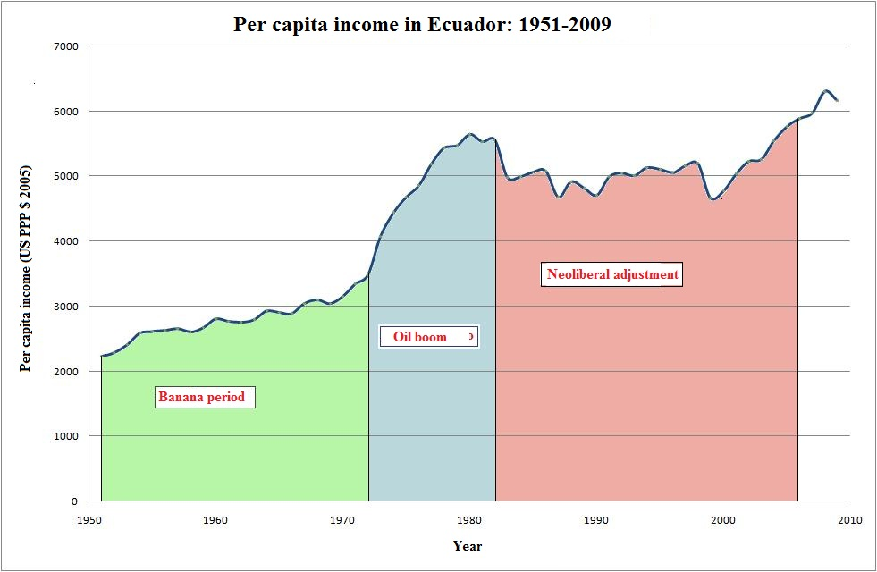
Per Capita Income in Ecuador: 1950-2009

Slide 15
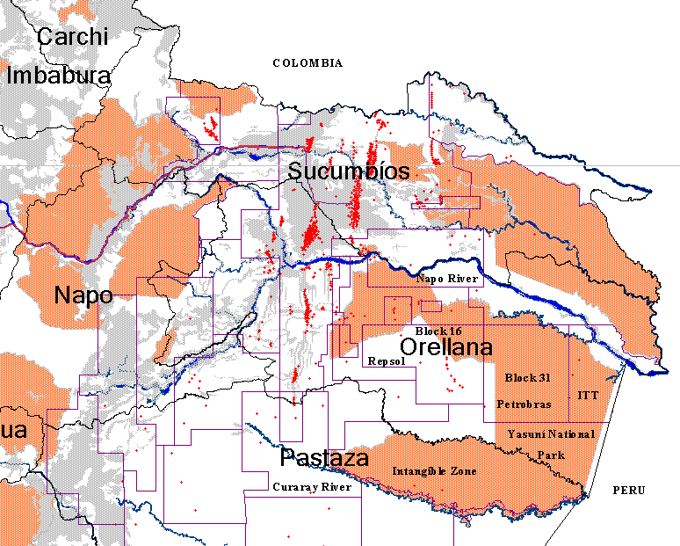
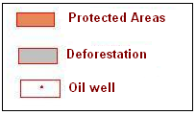
The ITT-Yasuní Dilemma

Slide 16
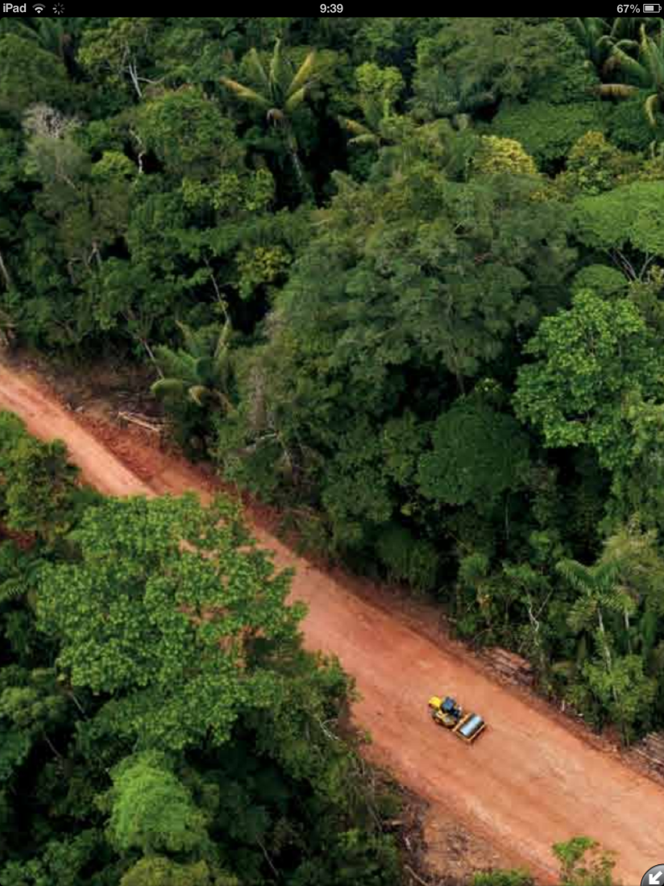
Block 31 Road inside Yasuni, Petroamazonas, 2013 (National Geographic Photo)

Slide 17
The Yasuni - ITT Initiative
Large reserves of heavy oil have recently been confirmed in the Yasuni National Park, the most biodiverse hot spots of biodiversity in the western hemisphere, and home of two still isolated indigenous cultures.
The Ecuadorian government decided, as a first option, to keep the oil underground, asking for an international contribution, equivalent to at least 50 % of the potential revenues of oil extraction.
The proposal was presented to the United Nations by President Correa on September 2007.

Slide 18
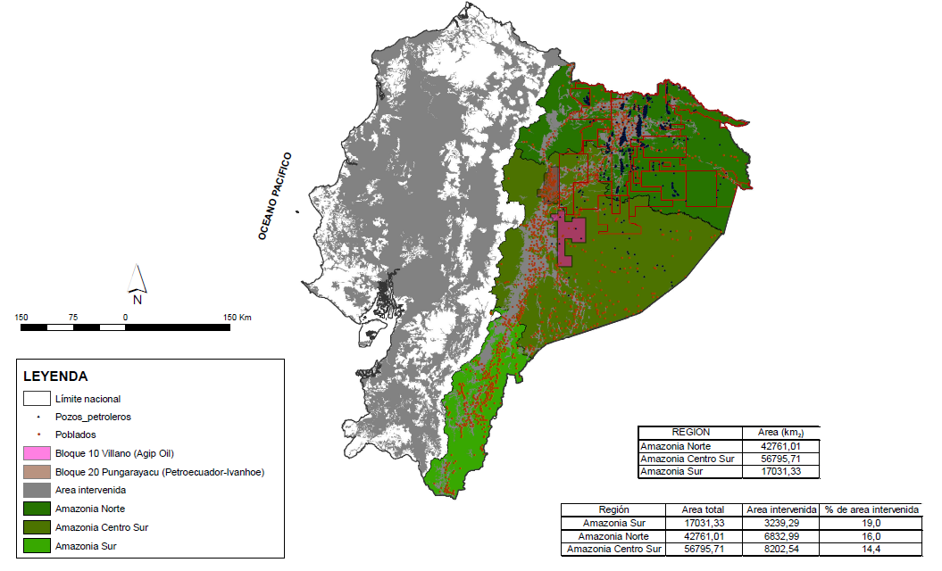

Amazonía Centro-Sur

Slide 19
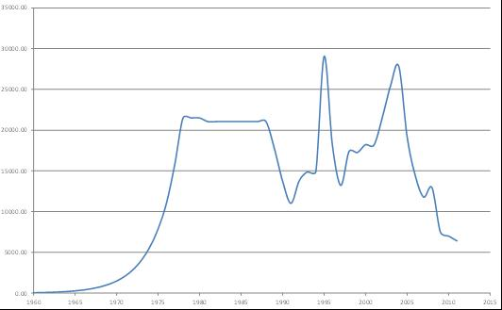
Deforestation in Brazil: 1960-2011
(Norway support: 1 billion dollars)

Slide 20
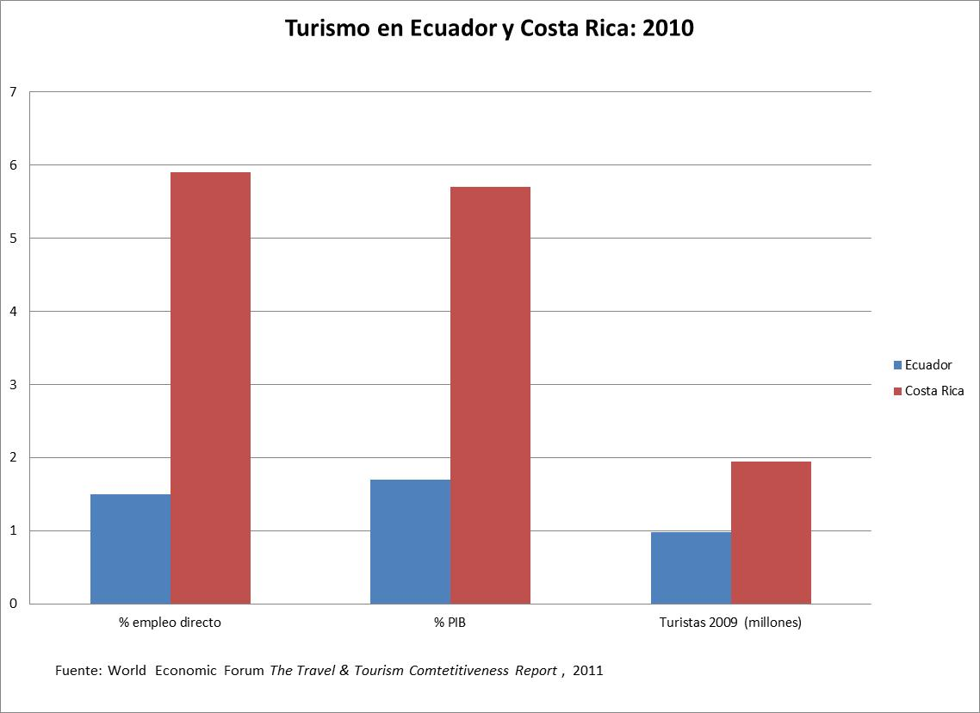
Ecuador and Costa Rica

