Slide 1
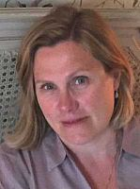
Video Call Support Groups for Doctoral Researchers
The webinar will start at 2Pm ON WEDNESDAY 28 OCTOBER 2020

Slide 2
Background
The benefits
Who should participate?
How to set a group up
How to run a group
Q Have any of you tried to set up anything like this before? How did it go?

Slide 3
Background
4 doctoral researchers in ESW
3 part-time and one full-time
Set the group up on Skype
‘Meet’ once a month
Over 3 years so far
Intention is to continue until we finish our PhDs
Could meet face-to-face if/when appropriate

Slide 4
"The thing is with PhDs, as I'm starting to see, is that it can be quite isolating....but if there was something that bound people together more strongly just intrinsically, then my feeling is that I think people would be less stressed about their position and feel like they're less imposters and stuff like that." (Doctoral Researcher, U-DOC Focus Group, Spring 2018)

Slide 5
Benefits
Prevention
Stay connected
Chance to reflect
Discuss ideas
Develops confidence
Make friends
Any Questions?

Slide 6
Who should participate?
Anyone, in any department
Possibly most suited to:
  Humanities
  Those who don’t spend much time on campus

Slide 7
Finding a group (1)
Think about what is a good match for you:
  Similar circumstances and interests:
    Full/part-time
    Area of study/discipline
    Year/stage of PhD
    Cross-discipline but with similar research interests (subject or method)
    Other, eg. International student

Slide 8
Finding a group (2)
Ask around (through contacts in your School/Department)
Speak to PhD Coordinators who can match you with 3 other appropriate people
Any problems, fill-in PGR Online Support Groups form and the Doctoral School will help you find people
Inform the Doctoral School (date of first meeting and names of participants)

Slide 9
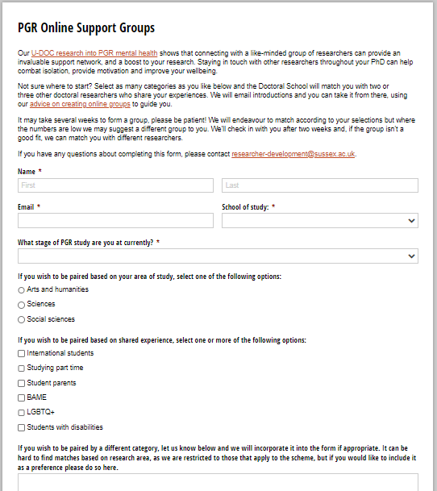

Slide 10
How to set up a group
Need an internet connection, speakers/headphones, microphone and webcam
Skype or Zoom?
Swap email addresses and set-up a date for first meeting
One member needs to set email addresses up on Skype, or send out an invitation on Zoom

Slide 11
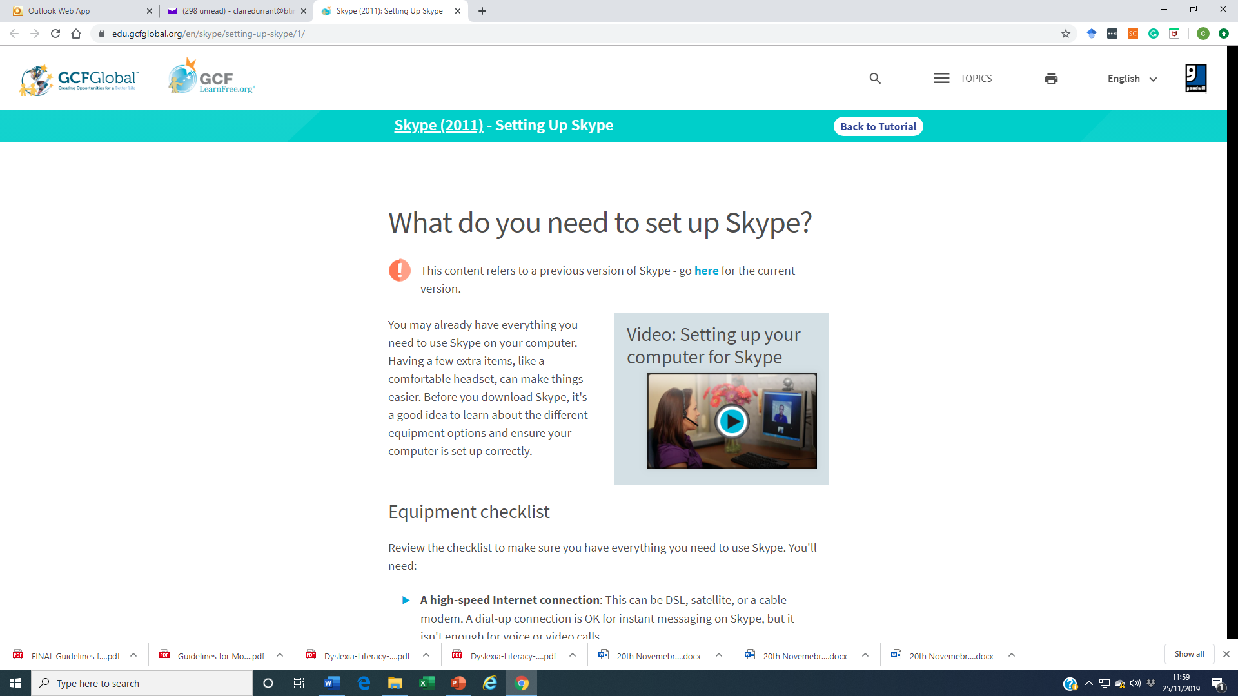
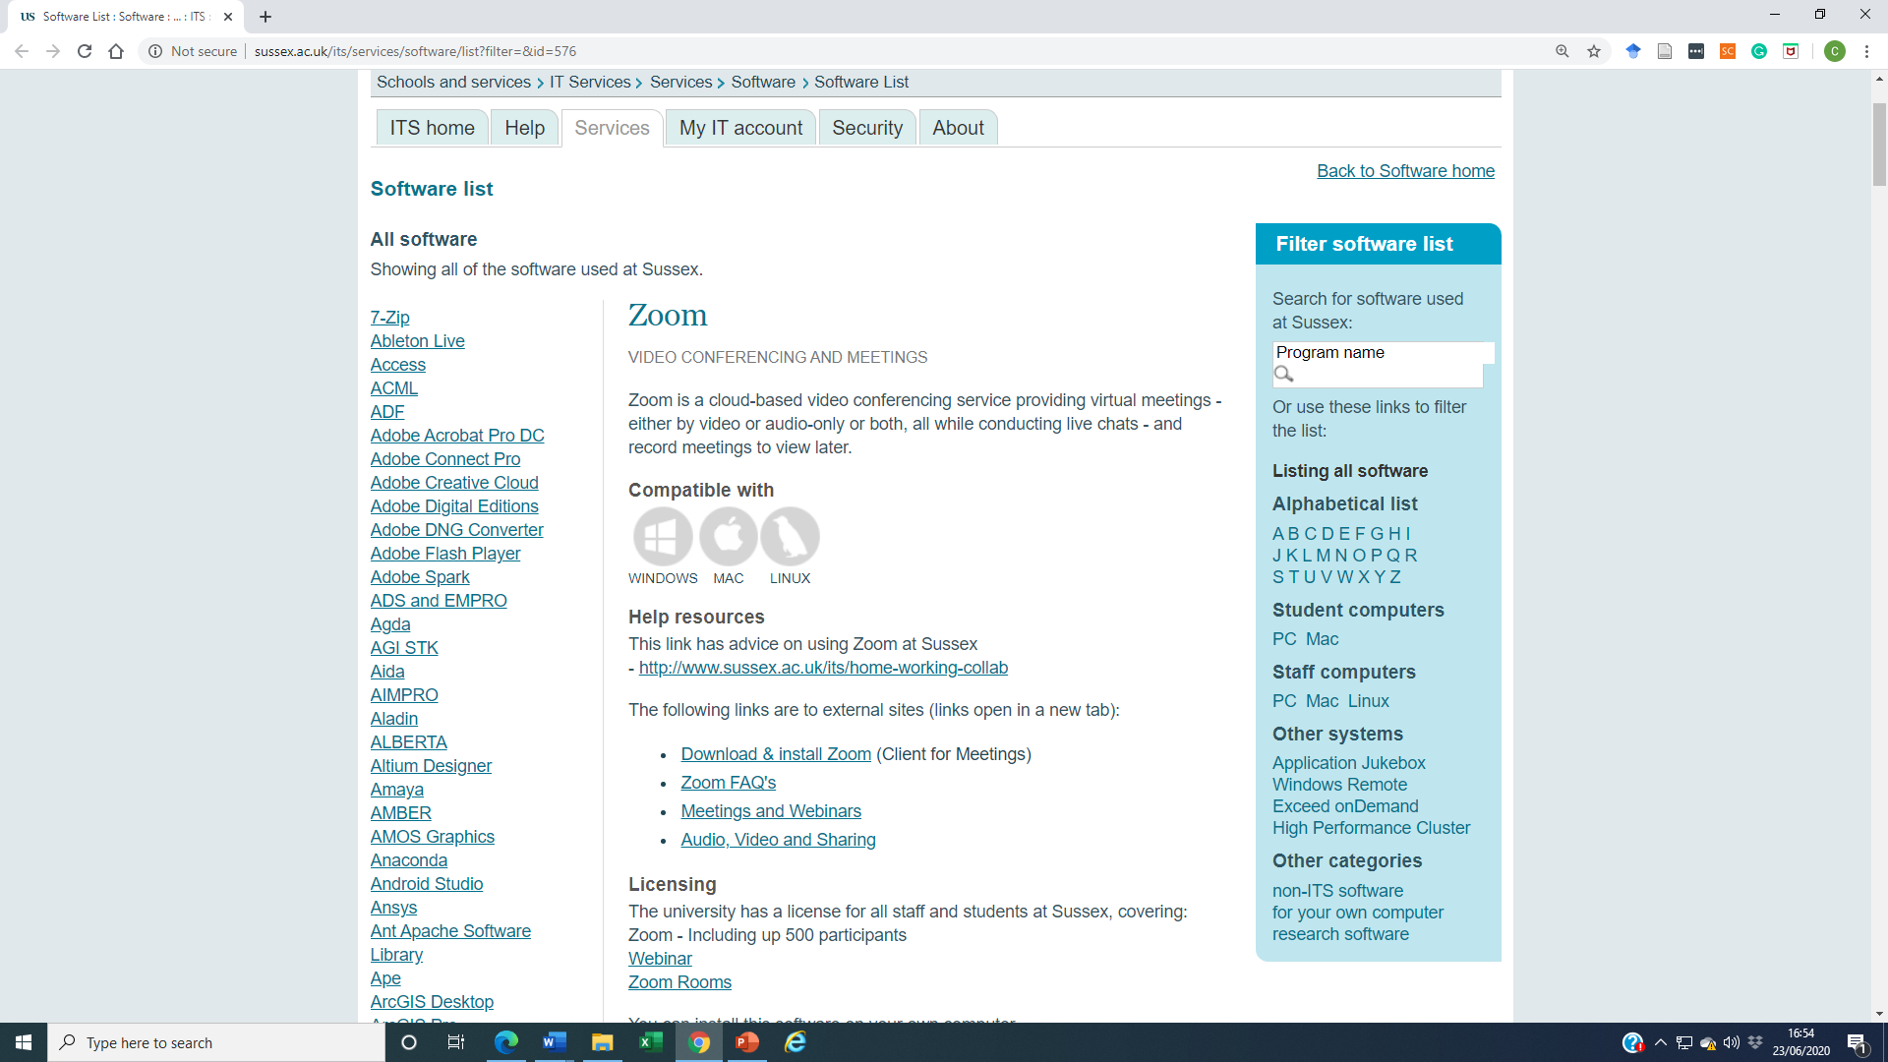
http://www.sussex.ac.uk/its/services/software/list?filter=&id=576
https://edu.gcfglobal.org/en/skype/setting-up-skype/1/

Slide 12
Format
‘Meet’ at least once a month for around an hour (or more while UoS closed)
WhatsApp??
At first meeting:
  Set boundaries
  Discuss confidentiality
  Decide how the group will be moderated (one person or rotate)
  Agree a structure
  Discuss how you will resolve any problems should they occur
Be respectful of views
Listen actively
Be supportive rather than judgemental
Enjoy it!

Slide 13
Structure
Discuss set readings
Opportunity to share what you have been doing on PhD (and other issues)
Talk about supervision
Agree a date for next meeting
After a couple of months discuss how you think the group is going
Any Questions?

Slide 14
Evaluation
Short questionnaire after 6 months
Administered by Doctoral School
Findings shared
Amendments will be made if necessary

Slide 15
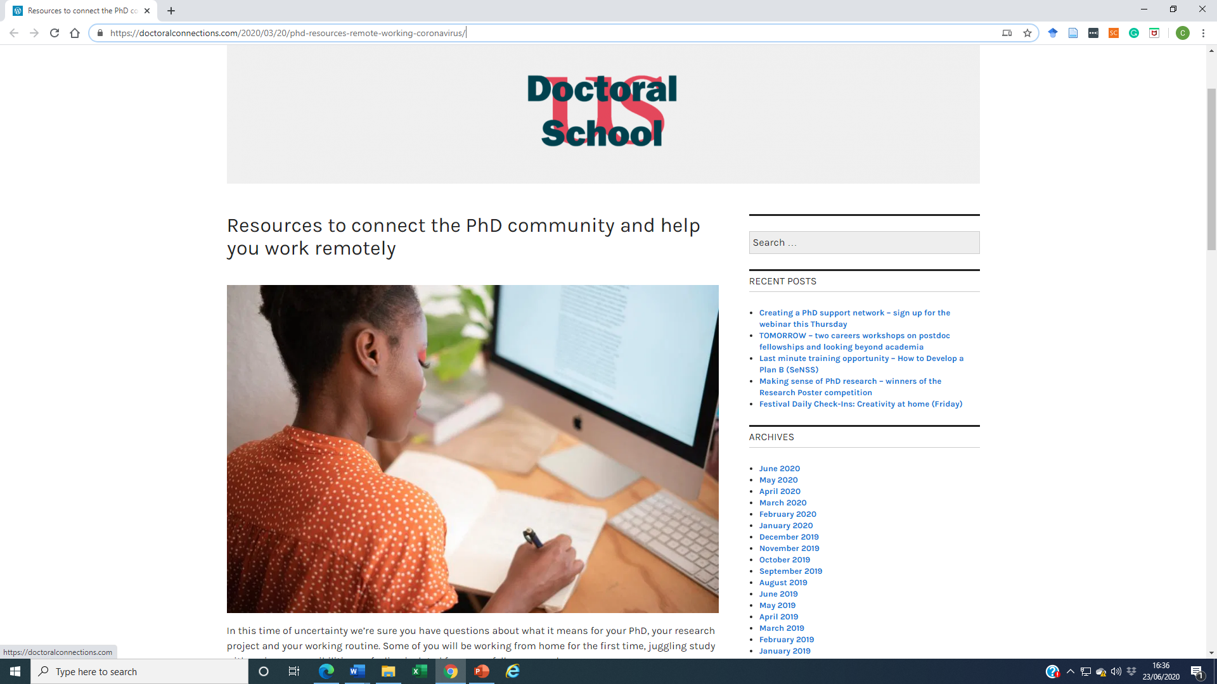
Other Resources
https://doctoralconnections.com/2020/03/20/phd-resources-remote-working-coronavirus/

Slide 16
Who to contact
Katy Stoddard (Doctoral School)
k.stoddard@sussex.ac.uk
or researcher-development@sussex.ac.uk

Slide 17

Q & A
Please write your question in the ‘Chat’ box or ‘Raise your hand’ and we will come to you

Slide 18
Thank you for your time
Please fill in the feedback form

