Slide 1
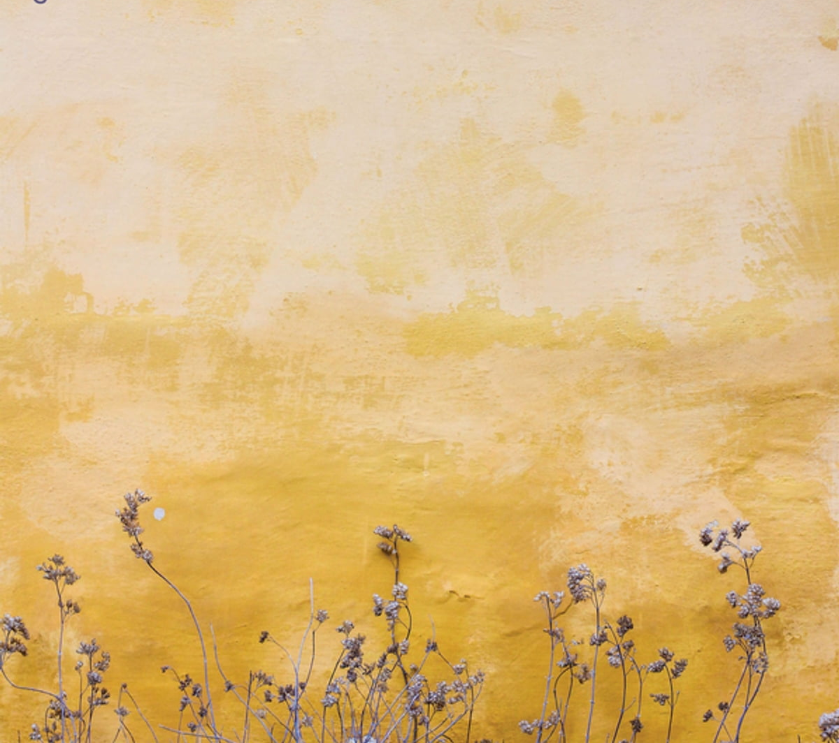
Colonialism and Modern Social Theory
Dr David Wearing
Email: d.wearing@sussex.ac.uk

Slide 2
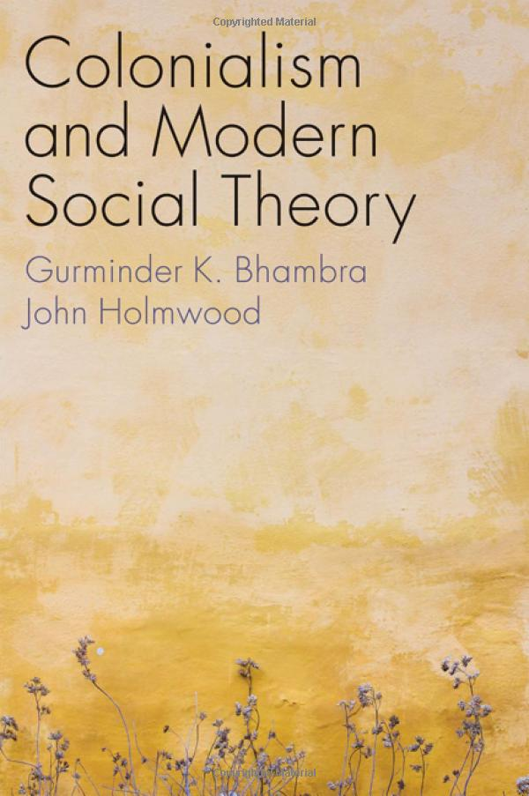
Introduction
I’m a Lecturer in International Relations, with an interest in colonial legacies, and in efforts to decolonise the curriculum in higher education. You can find out more about my work here.
This module is based on a new book co-authored by our colleague Gurminder K. Bhambra, Professor of Postcolonial and Decolonial Studies here in the Department of IR.
I’m happy to answer any questions you may have about the module. My email is d.wearing@sussex.ac.uk and my office hours are Fridays 2-4, in C348.

Slide 3
Module details
Some of our most important modern theories about how the social and political world works were originally formed in the colonial era.
In this module, we’ll explore how that colonial context shaped and influenced the ways in which those theories were developed.
We’ll place the key theorists firmly within their times and discuss their writing in terms of the histories they were living through.
We’ll also talk about the ways in which these historical contexts often come to be ‘missing’ in today’s discussions of these theories.
Our aim here is to ‘decolonise’ the concepts and categories that we use to understand the social and political world today.

Slide 4
Indicative content
Introduction: The Idea of Modern Society
Empires and European Colonialism
Private Property and Possession: Hobbes and Locke
Stadial Theory and the Idea of Progress
Tocqueville: From America to Algeria via Haiti
Marx: Colonialism, Capitalism, and Class
Weber: Religion, Nation, and Empire
Durkheim: Modernity and Community
Du Bois: Beyond the Colour Line
Decolonising Social Theory

Slide 5
Seminars and assessment
Weekly seminars, involving lecture and group discussion sections
One short essay, 1.5k words, due mid-term
One long essay, 3.5k words, on a question of your choice

Slide 6
Indicative readings
Aravamudan, Srinivas 2009. ‘Hobbes and America’ in Daniel Carey and Lynn Festa (eds) The Postcolonial Enlightenment.
Berry, Christopher J. 1997. Social Theory of the Scottish Enlightenment.
Du Bois, W. E. B. 1903. The Souls of Black Folk.
Fields, Karen E. 2012. ‘Individuality and the Intellectuals: An Imaginary Conversation between Emile Durkheim and W. E. B. Du Bois’
Marx and Engels 1848. The Communist Manifesto
Pitts, J. 2000. ‘Empire and Democracy: Tocqueville & the Algeria Question’
Shilliam, Robbie 2021. Decolonising Politics.
Tageldin, S. M. 2014. ‘The Place of Africa, in Theory: Pan-Africanism, Postcolonialism, Beyond,’ Journal of Historical Sociology
Zimmerman, Andrew 2006. ‘Decolonizing Weber,’ Postcolonial Studies

Slide 7
Learning Objectives
Demonstrate an understanding of the ways in which colonialism was central to the development of the traditions of modern social and political theory.
Evaluate the thought of the different thinkers addressed in the module in the context of their time.
Critically assess the strengths and limitations of modern social thought and its influence on contemporary constructions of relations among individuals, institutions, and wider society
Clarify and critically discuss the concepts developed by selected theorists and theories

Slide 8
Any questions?
Please email me at: d.wearing@sussex.ac.uk I look forward to hearing from you!
If you’d like to find out more about what a postcolonial social science might be, you can check out this podcast & interview.

