Slide 1
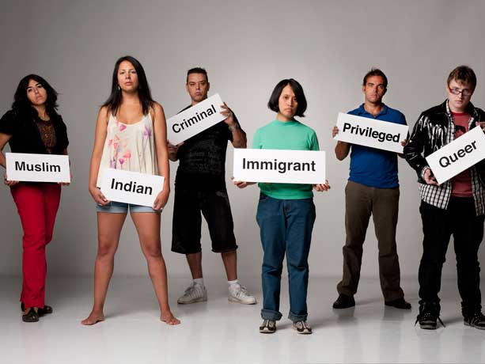
Race, Ethnicity and Identity
Dr. Pamela Kea
Department of Anthropology
Final year module
This Photo by Unknown Author is licensed under CC BY-SA-NC

Slide 2

What is race and racism?
How and when does race emerge as a concept, an object of study and a lived reality?
What is the relationship between race, ethnicity, gender, sexuality, nationality, class and culture?
How does the myth of a post-racial society relate to white privilege?
How has visual culture been used to reproduce and challenge racial hierarchies?
How do mixed race identities challenge racial hierarchies of belonging?
This Photo by Unknown Author is licensed under CC BY

Slide 3

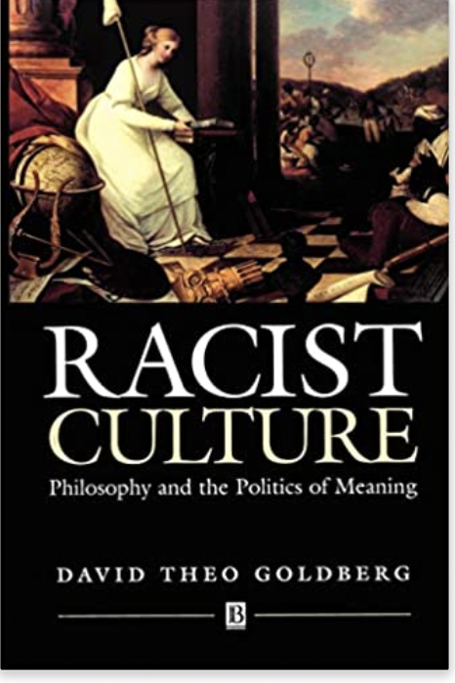
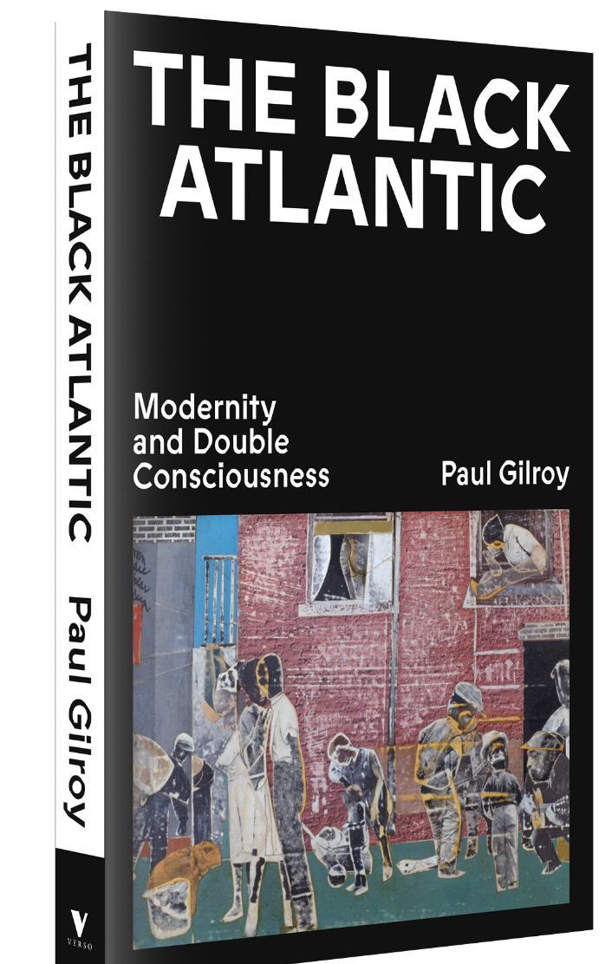
This module focuses on theories of race, ethnicity and identity. It applies diverse theoretical approaches to the terms in historical and contemporary contexts.

Slide 4

As well as examining the way in which racial and ethnic identities have been constructed across time and space, the course interrogates these constructions with specific reference to:

Slide 5
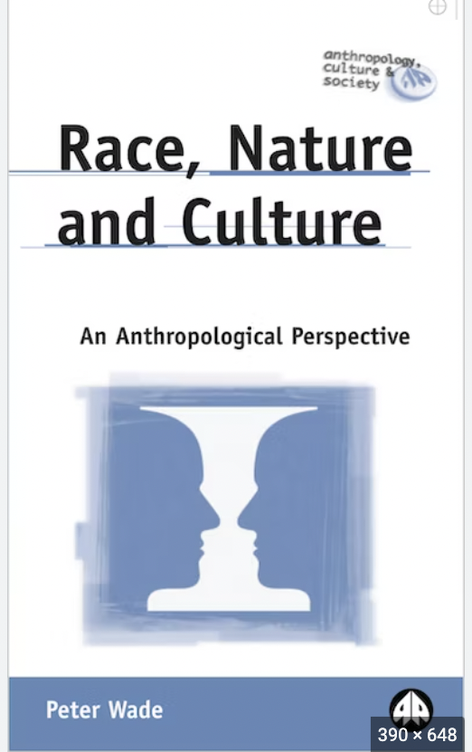
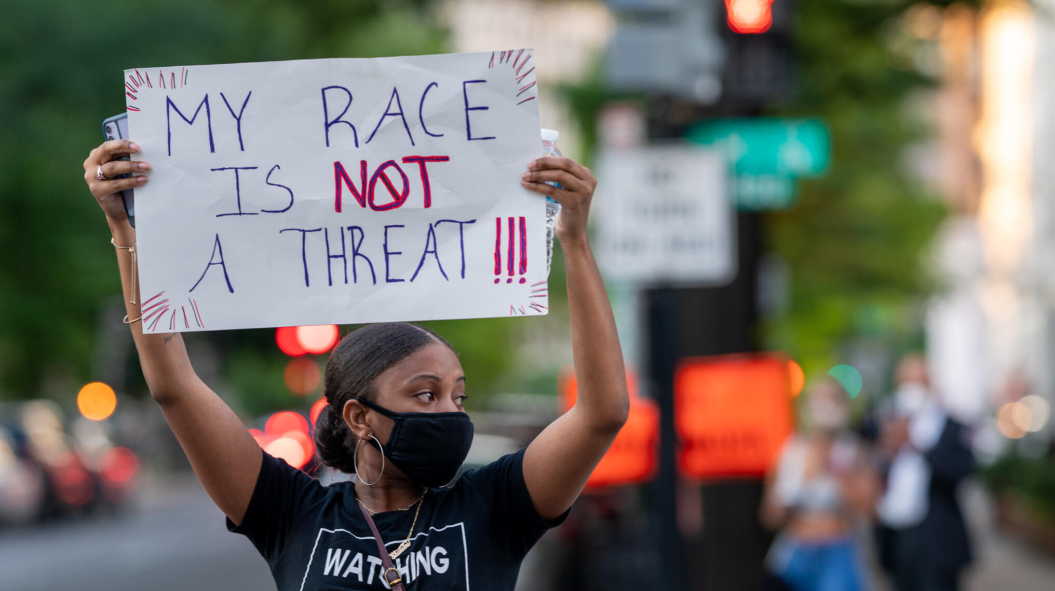
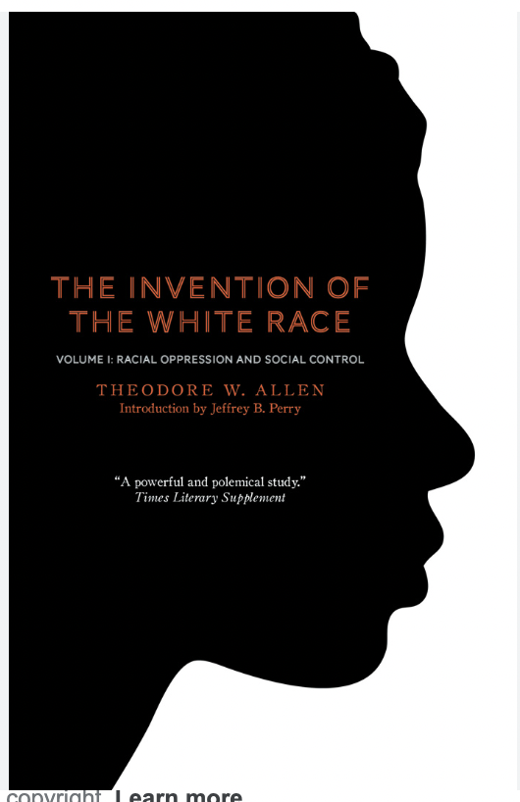
Week 1: Historical Reflections on Race: Slavery, Colonialism and the Science of Race
Week 2: Race, Visual Culture and the Gaze
Week 3: Racial Capitalism, Structural Violence and the State
Week 4: Feminism, Intersectionality and the Politics of Difference
Week 5: Whiteness studies and Critical Race Theory
Week 6: Migration and Decolonial perspectives
Week 7: Museum Collections and the Politics of Representation
Week 8: Mixed Race Identities
Week 9: Necropolitics and COVID-19
This Photo by Unknown Author is licensed under CC BY-NC-ND

Slide 6

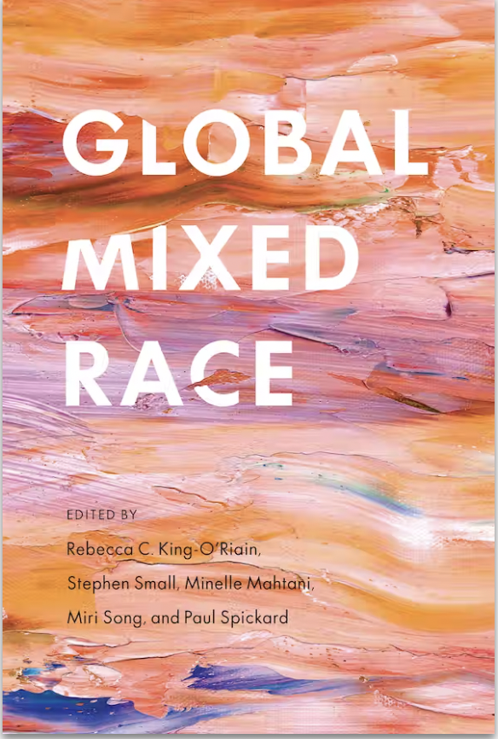


Slide 7
Teaching
Weekly 3 hour seminar with lecture and student led activities.
You will be exposed to a range of written, and visual resources - from academic texts to films.
Two individual tutorials, as well as a dissertation writing session.

Slide 8
Previous dissertation topics
Entangled Islands, Shifting Identities:
white supremacy, colonialism, and the Irish diaspora
Visibility and Invisibility of Native Indian Women in Contemporary Canada: An
Anthropological Perspective on Marginalization and Representation
Identity Politics as a Social Justice Technology
Brazil’s Racial Democracy: Boa Aparência (good appearance) and the ‘myth’ of harmonious
mixture

Slide 9
Previous dissertation topics
The American Nightmare: An analysis of slavery, institutional racism, and the birth
of the carceral state in the USA
Creative Disruption: Afrofuturism as a Methodology for Resisting Racial Mythologies
How has the outbreak of the COVID-19 Pandemic stimulated a resurgence of underlying racial attitudes by Western societies towards China?

Slide 10
Learning Outcomes
Have an understanding of the history and theories of race and ethnicity, and how they interact with others forms of identification such as gender, sexuality, nationality and class.
Display a knowledge of a range of situated historical, contemporary and ethnographic case studies that reveal the dynamics of race and ethnicity in relation to hierarchy, power, resistance, representation and techniques of governance.

Slide 11

Learning Outcomes
Apply theory/insights/literature to empirical contexts and specific themes related to the topic with an appropriate degree of critical awareness and with reference to the literature.
Conduct independent research on a related topic.

Slide 12

Assessment
Dissertation presentation (non-contributory)
7,000 word dissertation

Slide 13

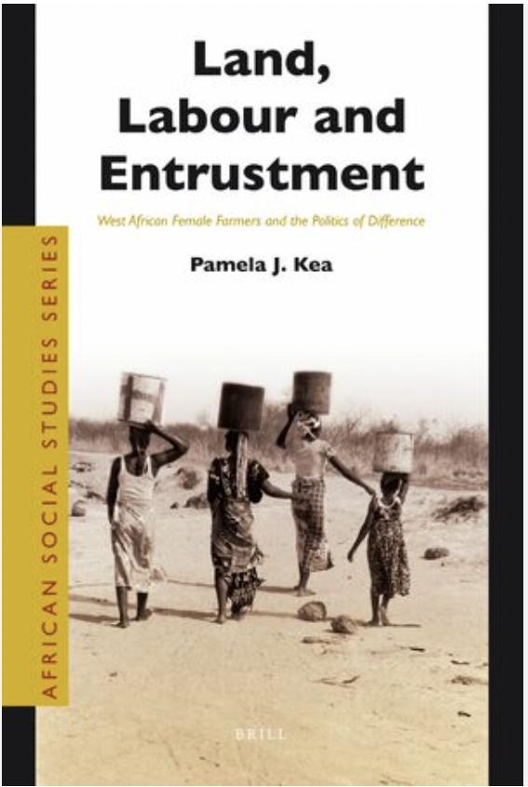
About the convenor
Pamela Kea, Reader in Anthropology
My research focuses on:
Asylum, displacement and migration governance in the UK and Europe
The West African diaspora in the UK, return to West Africa and transnational relations
Hidden and counter narratives of West African migration and return
Decolonizing the study of migration

