Slide 1
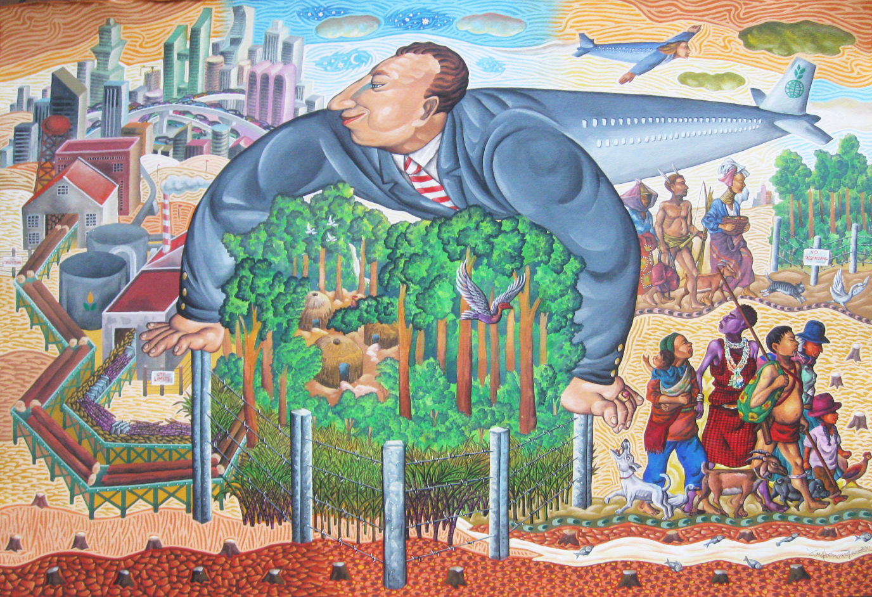
Environmental Anthropology 2022

Slide 2
Environmental Anthropology
Structure of the Course
Built around a number of current debates (and ‘turns’)
Week
Week 1 | Lecture: Introduction; Class: What is ‘the environment’ (earth, air, fire, water, music, words, virtual?)
Week 2 | Human Animal Relations & the turn to Multi-species ethnography
Week 3 | ‘Noble savage’, Indigeneity and the ontological and persepectivist turn.
Week 4 | NatureTM Inc. and the commodification of nature: Is nature ‘natural capital’?
Week 5 | Experiencing the environment: ‘reconnecting’, rewilding etc.
Week 6 | READING WEEK – 2000 word analytical essay, building your own topic due the next Monday
Week 7 | Anthropology of climate: Anthropology addresses Climate Change
Week 8 | Environmental Conservation: social justice or eco-centrist turns?
Week 9 | Transforming the planet: Anthropology, the Anthropocene and Geoengineering – Class: The temporal turn: Environmental futures: catastrophe in society, science and science fiction
Week 10 | One to one tutorials
Week 11 | Workshop presenting long essay ideas

Slide 3
Assessment is by 5000 word ‘essay’ ( short dissertation). Work Schedule:
The course delivers intensive content until week 9
Initial one-to-one meetings Thursday of week 1 (or by appointment)
In reading week you write an analytical essay of 1-2000 words to help build Long Essay ideas and analysis [this will be handed in at the beginning of week 7 and discussed in tutorials during week 9/10/11.
By week 10 you have developed an outline and in week 10, we present these dissertation outlines in a workshop
Thus you will have two 15-20 minute tutorials in Week 8 and Week 11
The tutorial in week 11 will provide feedback on dissertation outlines. I can read and comment on the introduction as well as on overall structure and argument.

Slide 4
Long Essay (‘Short Dissertations’)
My aim is to help you find topic that fascinates you and to write something original.
It does not have to relate directly to any element of the course so long as it addresses environmental questions (widely defined) and is approved by me.
They are a contribution to the discipline. Some are published.
It is evidence of what you can do, helpful to future study, to future employment and for job references etc. etc.
It should be fun

Slide 5
Some facts
30 Credits each
5,000 words (Spring)
This length INCLUDES footnotes, endnotes and quotations
5000 words DOES NOT INCLUDE abstract, bibliography or appendices
Referencing: Journal of Royal Anth. Inst.
E-Submission

Slide 6
2018 essay topics (2019 and 2020 to come….
Pollution in the Ganges
Climate change and evangelism in Fiji
Neoliberalism and Lyme disease in the UK
Discourses of self-regulation and the corporate world
Innate fear of snakes?
Virtual nature, google and biophilia
Half Earth for whom?
Grabbing the wind
Satoyama, landscapes and nationalism in Japan
Death or Digital endurance?
A garden wall… and the more than human
Gender and Lemur primatology in Madagascar
Extinction Rebellion: do crisis narratives work?
Algorithms and environment…

Slide 7
2017 topics:
Permaculture, Ontology and modern environmentalism
Queers in Nature: Queer navigation in rural environments
Green violence and African Wildlife Conservation
Anthropocentrism, and captive animals
‘Anthropomorphism’ and commodification in Western Conservation
Rewilding in a post colonial landscape
Diet and Climate Change
The Commodification of Conservation

Slide 8
Transhumanism and Food Packaging
Virtual worlds and refugee experience
Geoengineering policy
Green Washing and Nuclear Power
Warring for biodiversity
Minorities and climate change
Animals on social media platforms
Population offsetting
Ecovillages: Utopian or mainstream?
Horse drawn travellers
Media(tion) of nature in Conservation International
Animal love: multi-species romantic and sexual encounters
Wonky vegetables
Captive elephants
Moss in Japanese Temple Gardens
Reducing carbon emissions in Cambodia
Green burials and bereavement

Slide 9
Some previous topics
Green Wall of the Sahel
Walking in Centre Parks
Greek Gold mining
Public toilets in the UK
Bees, bee language and society
Anthropocene and aesthetics
Anthropology, Primatology and animal ‘culture’
Palm oil and Green Grabbing in Colombia
Dogs, Dog walking and Brighton society
Indian rivers and ‘pollution’
Small islands and climate change

Slide 10
Ecotourism
Flex crops and Oil Palm
Digital Battlefields in Wildlife Conservation
Agency in the ‘animal turn’: What of structure
Aboriginal Whaling
Swidden farming among the Karen (Myanmar)
Experiencing the city: underground and over-ground travel
Cranes, Human Dialogue and the Korean demilitarized zone
Snail Grazes and Charred Wooden Sculptures: Art, Imagination and Alternative Futures
Intimate Moments and the Digital Panopticon – snapchat
The human animal in Western Nature /Culture
National Parks and ‘Idyllic’ Landscapes – UK and Africa
Veganism as a social movement
Perfection narratives and food waste: aesthetics, desire and consumption
The real Westeros: film tourism and the experience of fictional landscapes
North Plan development: Ontological violence in Inuit Communities

Slide 11
Urban Cultivation
Intercultural universities and biodiversity
Finnish sauna
Bottled water
The ‘nature’ of belonging
The elemental destruction of the Tibet cosmological order
Have we lost sight of the moon?
Trip advisor: internet and environmental appreciation
Selling shamanism
Animal agency
Rethinking ‘The Whale’
Human Gull Relations
Wind Turbines

Slide 12
Past dissertation topics
Phenomenology of capitalism in Canary Wharf
Inhabiting virtual worlds
The ‘Environmental apocalypse’ in modern fiction
Experiencing the sea, fish and policy – Scottish Isles
Cemetry, space and nature in South London
Tourism and environment in Chernobyl
Classification of grass in Kew Gardens
Fox Hunting
Lithium mining in Bolivia
Environment & Palestinian politics
Bull fighting and environmental representation in Spain
Factory farming
Building in Italy
Community gardens and Ecocities
Biodiversity offsetting
Incommensurable ontologies
Informal waste pickers
‘Anthropomorphism’ and the whale

