Slide 1

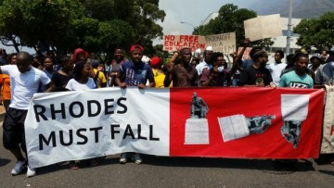


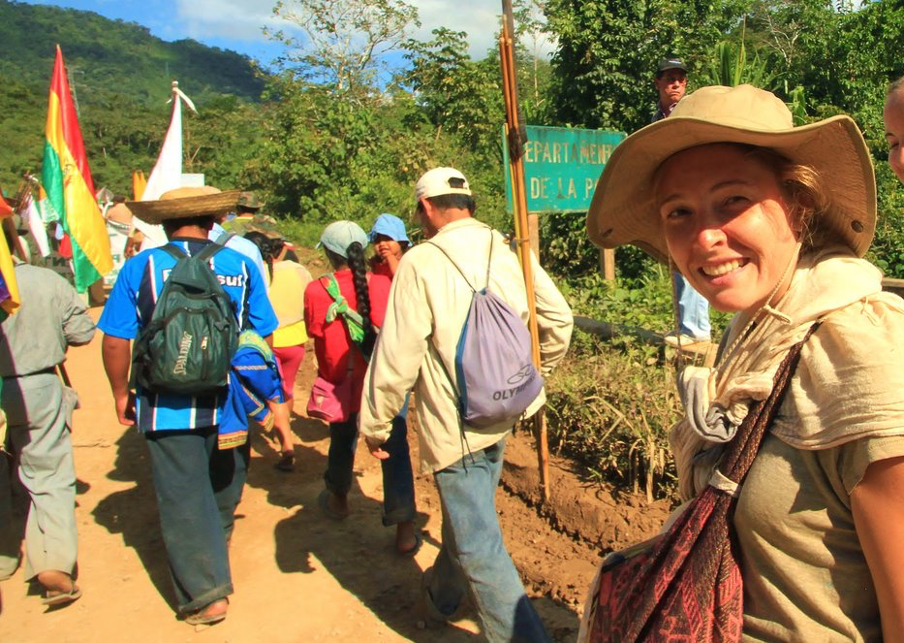
DECOLONIAL MOVEMENTS
Dr Anna Laing
Lecturer in International Development
(Geography)
Email: A.F.Laing@sussex.ac.uk
Office: Arts C, 208

Slide 2
Overview
PREMISE: Colonial forms of power, knowledge and social ordering exist despite a broader move towards post-colonial societies.
AIM: This module examines the historical and geographical context of colonialism and introduces de-colonial political projects and intellectual traditions. It will examine a number of emancipatory political struggles for decolonised futures – including indigenous, feminist, environmental and black movements – from the past and present.

Slide 3
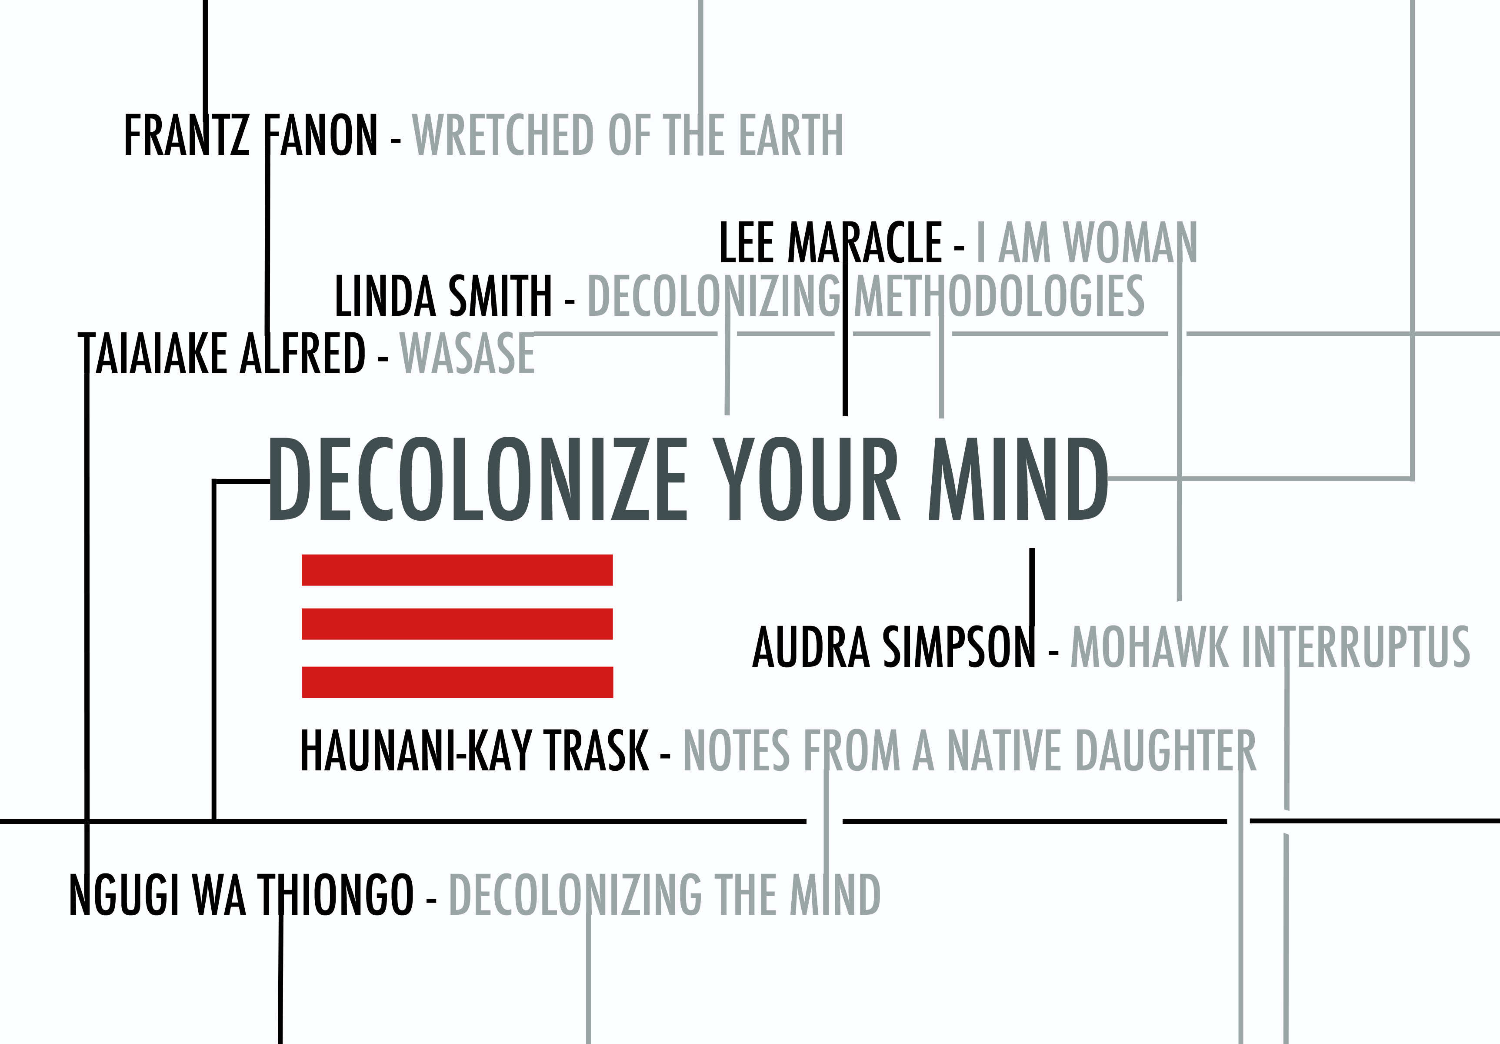
Who Should Take This Module?
This is an interdisciplinary module with no prerequisites.
It is open to International Development (single and joint) and Geography (single and joint) students.
The module would suit students with an interest in: decoloniality; postcolonial studies; social movements; grassroots development; and radical and emancipatory politics.

Slide 4
Weekly Topics
Section 1: Theoretical Perspectives
Week 1 Week 2 Week 3 Week 4 Week 5 | Introduction Postcolonial and Subaltern Studies Decolonial Theory and ‘Decoloniality’ Border Thinking and Indigenous Methodologies Decolonial Solidarities
Section 2: Decolonial Movements: Past and Present
Week 6 Week 7 Week 8 Week 9 Week 10 Week 11 | #RhodesMustFall Indigenous Autonomy Decolonising Nature Feminist Movements and Intersectionality Black Lives Matter One-to-one essay tutorials
Notes:
Subject to change on a yearly basis.

Slide 5
Teaching, Learning and Assessment
Assessment is split (20:80): a 1,500 word essay on the concept of ‘decoloniality’ due mid-term (20%), followed by a 3,500 word essay that bridges theoretical perspectives with case studies/examples of decolonial movements, title chosen by students with approval by course leader, due in assessment block 2 (80%).
Teaching is by 3-hour workshops comprising short lecture presentations, group discussion and analytical/practical exercises.
Learning materials will include academic research and publications, social movement literature, photos, art, poetry, documentaries and videos.

Slide 6
Learning Outcomes
Demonstrate a systematic knowledge and understanding of key theoretical perspectives from postcolonial theory, subaltern studies and decolonial thought;
Critically reflect on the ideas, theories and assumptions of dominant paradigms of power, knowledge and social ordering;
Critically analyse the historical and geographical contexts that shape subaltern resistance and decolonial movements;
Independently identify and explore appropriate empirical evidence and case studies of decolonial movements in the past and present;
Critically apply knowledge of key theoretical perspectives to analyse, evaluate and assess the implications of different movements and struggles on future decolonial political projects.

Slide 7


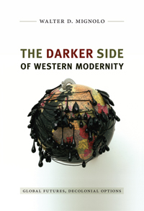

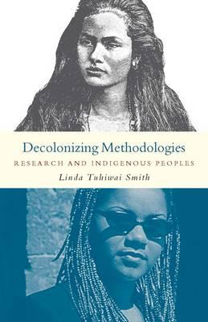

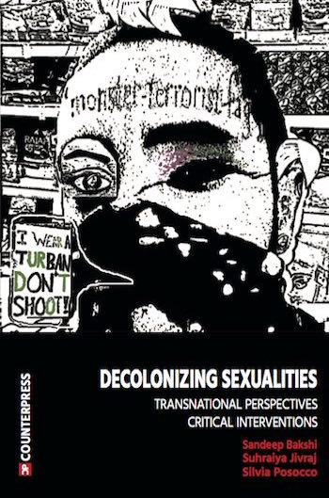


Some Readings
Notes:
Subject to change on a yearly basis.

