Slide 1

Anthropology in the World
Third Year Option

Slide 2
Overview
In this module we will explore how anthropological and ethnographic knowledge may be applied beyond the academy. However, we will also consider how anthropological engagements in the world open new conceptual questions. The path followed will be recursive, tracing theory, knowledge and practice back and forth.

Slide 3
Weekly Topics
Ethnographies of knowledge across contexts: institutional uses (and misuses) of anthropology; borderlands – Marilyn Strathern
Ethics of engaged/public anthropology: community-work and international development
Relations between social theory and experience: worlds as ontologically multiple in theory and practice (exploring multiple evidence cultures in global health and international development)
Queering Anthropological Knowledge

Slide 4
Weekly Topics
Death Worlds - Grief, Ghosts and Necropolitics: anthropology in worlds that are not worlds
Viral Ethnography: conceiving COVID 19, HIV, and non-human life-worlds
Anthropology with and without ‘textuality’: anthropology in action and abstraction
‘Worlding’: senses, affect, action – advanced perspectives; Heidegger and anthropology
Techniques and tensions of transition: from anthropology student to anthropologist in the world

Slide 5
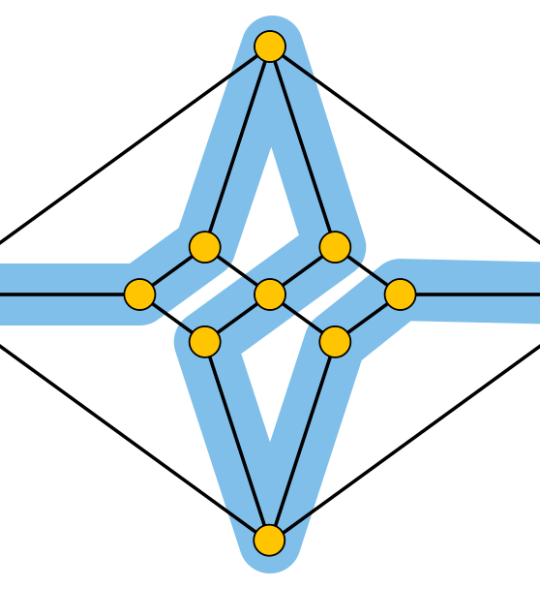
We will explore connections between anthropological knowledge and everyday life-worlds

Slide 6
Learning Outcomes
After taking this module students will be able to:
Demonstrate critical understanding of practices, methodologies and ethics of applied and engaged anthropology
Better understanding the relation between anthropological application and the generation of new theoretical perspectives
Apply critical knowledge of anthropological theory and practice in interdisciplinary contexts

Slide 7
Learning Outcomes
Utilise anthropological knowledge in respect of a range of ‘real world’ applications
Engage creatively with anthropological theory and practice

Slide 8
Format
The module will include weekly three hour workshops – involving lectures and student presentations
Creative exercises in engaging with anthropological texts and knowledge
Practical exercises in the application of anthropology and ethnography – in the world

Slide 9
Assessment
Students will take one of three 4000 word assessent options:
Essay – in the form of theoretical discussion and analysis
A report on an engaged project – including theoretical application and analysis
A reflexive piece of writing that explores the relation between anthropological theory and experience

Slide 10


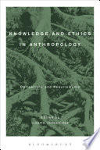
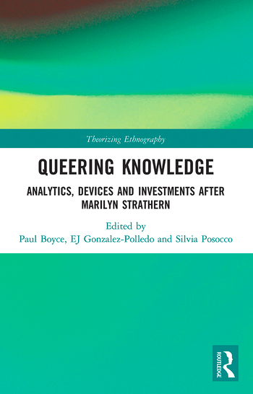
Some Relevant Texts

Slide 11

Convener:
Paul Boyce
My work explores anthropology and ethnography in theory and practice
I am interested in practical uses of anthropological knowledge in ways that disrupt debates about applied versus conceptual knowledge
Much of my ethnographic work has taken place in India – with a focus on sexual-life-worlds and queer theory
I have also worked for many years as a researcher in international health and development

