Slide 1
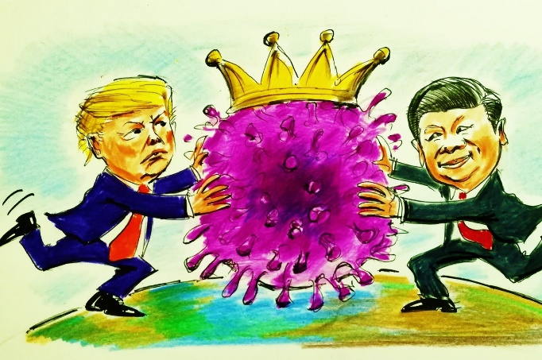
The Anthropology of Geopolitics
Autumn Term 2020/21
Geopolitics is all around us – from discussions over communications technology to the use of ‘vaccine diplomacy’ by powerful states to extend their influence across the world.
Today and in the past, anthropologists have been uneasily implicated in geopolitical processes – including the role they played in establishing UNICEF, the support they received from national governments during the Cold War period, and their projects in projects of US imperial expansion in the Middle East during the 2000s.
This module will critically explore anthropology’s engagement with geopolitics as well as the insights that ethnography affords into geopolitical projects, ranging from the imperial to the humanitarian.
Above all, it will challenge the conventional idea that state actors – notably diplomats - are the kingpins of geopolitics. We will explore instead the importance of informal and everyday modes of doing geopolitics and being diplomatic and the effects that life at the midst of competing geopolitical struggles has on people’s lives, relations, and identities.
The module will be taught by Professor Magnus Marsden.

Slide 2
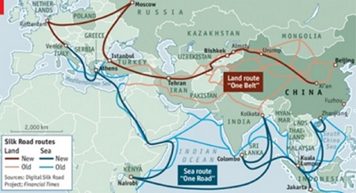
TOPICS
WEEK 1: What is the anthropology of Geopolitics and Diplomacy?
WEEK 2: Anthropology’s Awkward Relationship Geopolitics – From the ‘Handmaiden of Colonialism’ to ‘Perpetual Peace’ and the ‘Human Terrain System’
WEEK 3: Imperialism, Colonialism and Decolonisation as Geopolitics: Anthropological Insights
WEEK 4: The Cold War and the Global Cold War: Kinship and Beyond
WEEK 5: Humanitarianism and International Intervention: Neo-imperialism?
WEEK 6: Borders and Boundaries: Fortress Europe and Beyond
WEEK 7: Propaganda and the Pursuit of Popular Geopolitics
WEEK 8: The Geopolitics of Infrastructure – China’s Belt and Road Initiative
WEEK 9: Informal Diplomacy: Diasporas, Migrants and Long Distance Networks
WEEK 10: Tutorial Meetings
WEEK 11: Tutorial Meetings

Slide 3
Aims and Objectives
The module introduces students to literature and debates in the fields of the anthropology of geopolitics and the anthropology of diplomacy.
It explores historical expressions of geopolitical projects and processes, focusing on the spatial, cultural, political and social characteristics of these, the experiences of societies living in contexts shaped by geopolitical processes across the world, and the forms of informal diplomacy that are also an important aspect of the contemporary world (dis)order.
A comparative analysis of geopolitical projects and processes across space and time – including imperialism, the Cold War, humanitarianism and the transnational infrastructure projects - based on specific case studies is deployed to engage with theories ascribing universal characteristics to the field of geopolitics.

Slide 4
Learning Outcomes
By the end of the module, a successful student should be able to demonstrate:
• knowledge/understanding of anthropological approaches to the understanding of geopolitics
• ability to analyse/evaluate/assess critically main theoretical debates in the fields of the anthropology of geo-politics and diplomacy, and to have an awareness of the history of these debates and how specific theoretical trends have developed over time.
• capacity to relate theory to specific ethnographic contexts in the analysis of geopolitical processes, conflicts and projects.
• Ability to evaluate/compare strengths and weaknesses of anthropological theories developed and deployed to understand urban spaces and urban lives.

Slide 5
Teaching
A weekly 3 hour workshop including a lecture and extended class discussion
Student presentations form an important part of the teaching
Two weeks (weeks 10 & 11) of dedicated advice and guidance of the dissertation. Group discussion on dissertation (week 6)

Slide 6
Assessment
Assessment will be by way of a 4000 word dissertation. Dissertation topics will be chosen by students in discussion with the module convenor.
The module convenor will encourage the writing of original, creative and critical dissertations that have the potential to beomce a contribution to the field of study in their own right!
This is a new module and Sussex is one of the first universities in the world in which this field of the discipline has been taught. While deeply ethnographic, the module draws on scholarship in anthropology, geography and international relations. As a result, the topics and the dissertations are likely to be path-breaking in many respects!

