Slide 1
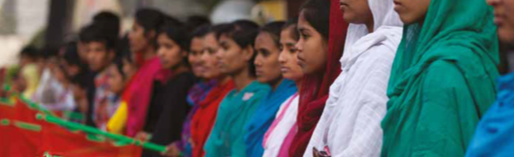
Anthropology of Work, Labour and Precarity
Dr Rebecca Prentice
Department of Anthropology
30 credit, final-year module
Autumn 2022

Slide 2
Module overview
Most of us spend a huge amount of our lives engaged in ‘work,’ but what counts as work (and how it is valued) varies culturally and historically.
This module will help students develop a fine-tuned appreciation of anthropologies of work, and how human labour mediates our relationships with the environment, with each other, and with utopian possibilities for the future.
We take an ethnographic, feminist, anti-racist perspective to break down timeworn categories that have been used previously to theorise work (formal/informal, public/private, paid/unpaid) to rethink the relationship between ‘making a living’ and ‘making a life.’

Slide 3
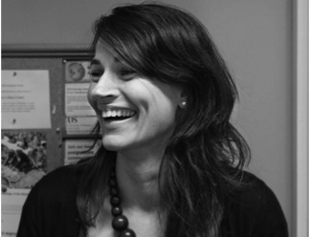
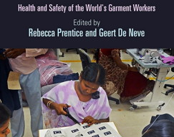
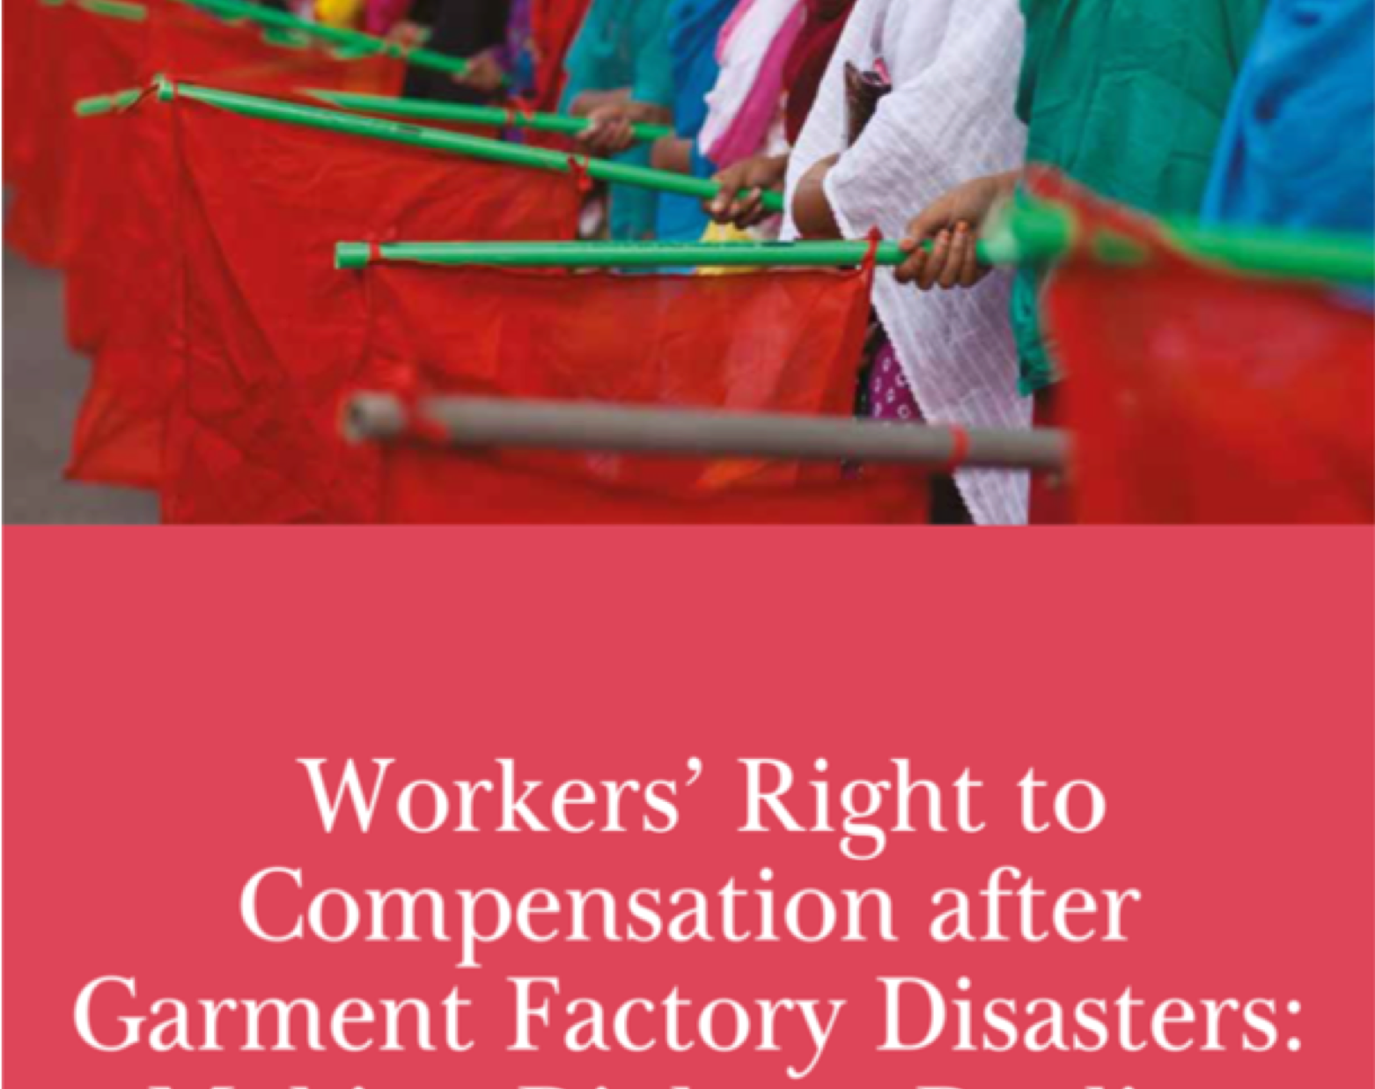
Module convenor
I am an economic anthropologist who focuses on the anthropology of work and labour.
My research is mostly on the politics of labour and health in the global garment industry, in the Caribbean and Bangladesh.
I have also done research on trade unions, Deliveroo riders, and the UK gig economy.
Dr Rebecca Prentice
Arts C133
r.j.prentice@sussex.ac.uk
Blog: Culture & Capitalism

Slide 4
Topics include:
Laying the foundations: work, capitalism, and wageless life
Race, class, gender and the ’making’ of production
Sex work, emotional labour, and gendered subjectivities at work
Precarity and the precariat: new subjectivities for the 21st century?
Embodied approaches: skill, precarious bodies, occupational health
Migrant labour, debt bondage, and modern slavery
Narratives of ‘Working’: from life histories to shop floor banter
Environment and work on a troubled planet
Labour politics in an age of automation: resistance and utopias

Slide 5
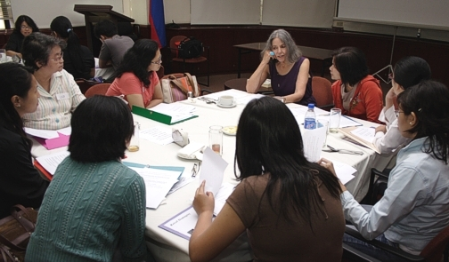
Format & assessment
This is an interactive module, with a 1-hour lecture and 2-hour seminar each week. In the latter part of the term we will switch to one-to-one tutorials to support the writing of your essays.
Students play a big role in the module design and activities, with weekly peer facilitation.
You will have an opportunity to experiment with qualitative interviewing as we seek to understand what narratives of ‘work’ can tell us more widely about society.
Assessment:
  1,000-word book review (see next slide)
  3,000-word essay

Slide 6



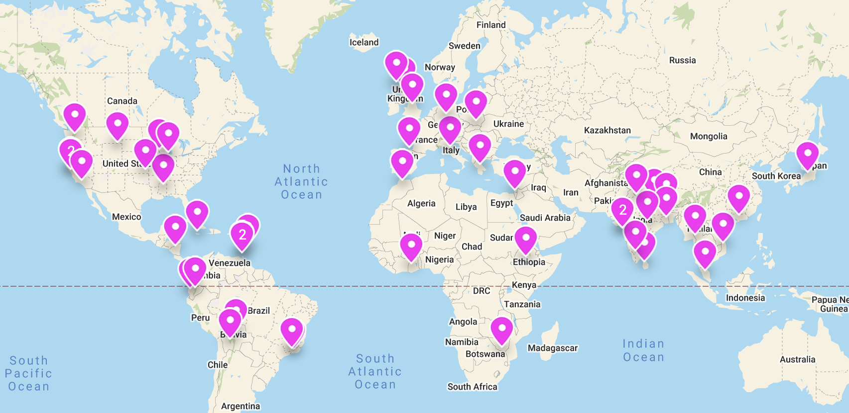

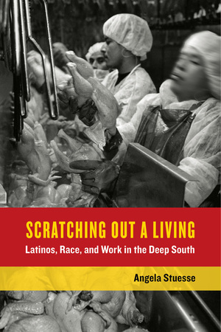


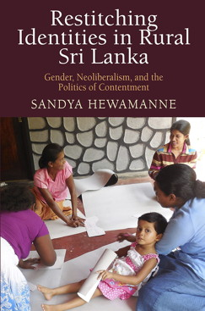

Ethnographies of work
Students will select, read and review a book-length ethnography of work. Various options can be explored on this map here:
https://uofsussex.padlet.org/rebeccaprentice/w2ia5lg75ihruo6t

Slide 7

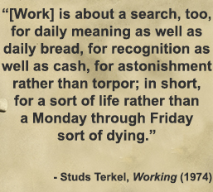
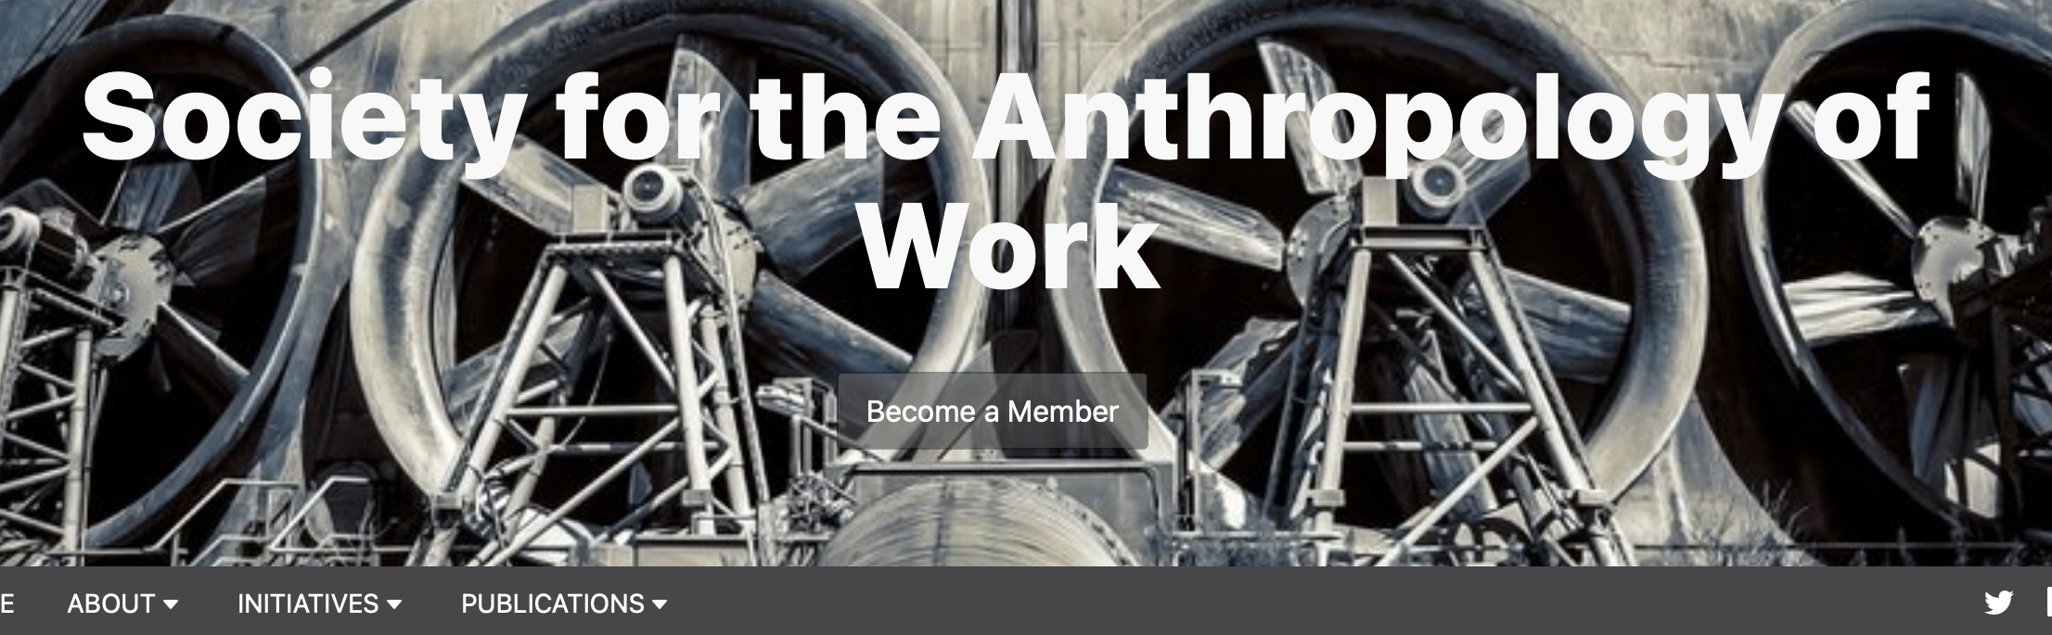




More on the topic
Inspired by Studs Terkel’s films and 1974 book, Working, we’ll work with narratives of ordinary people talking about their jobs
Newer examples include the Slate podcast Working
More on the anthropology of work and labour:
  Society for the Anthropology of Work
  EASA Anthropology of Labour Network

