Slide 1
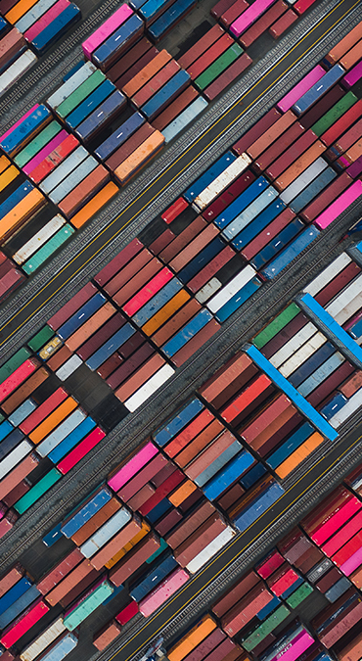

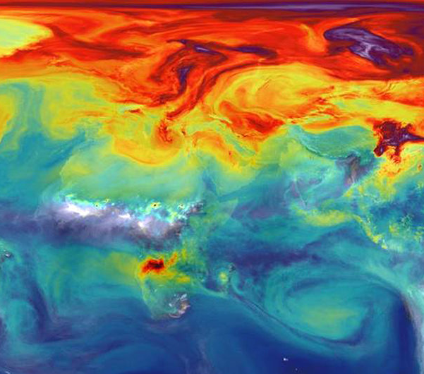
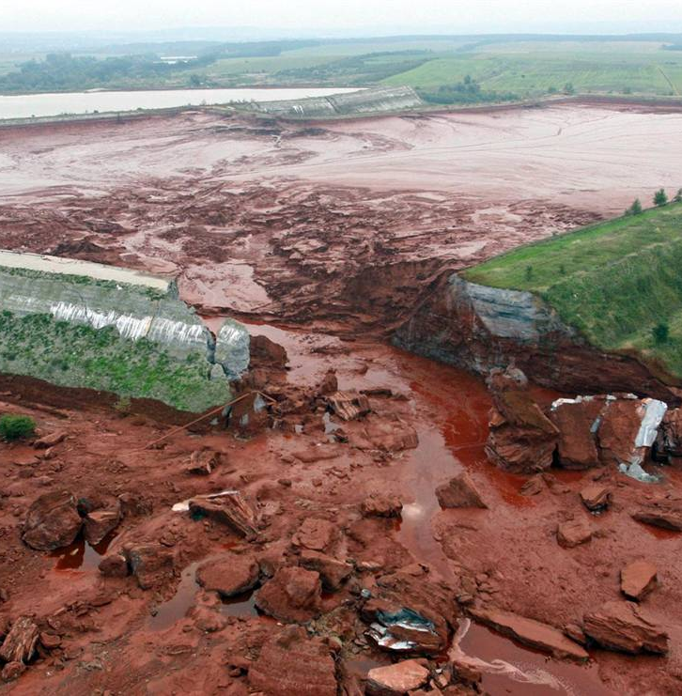
Political Economy of the Environment
(2023/24)
(L7094A)
Dr Earl Gammon
Dept of International Relations

Slide 2
Description
This module introduces students to a political-economy perspective on key issues of the global environment. It attempts to move beyond the limitations of conventional political and economic analyses in coming to terms with the threats of environmental degradation and climate change. The module taps into a broader type of ethical, natural and social theorisation that defined an earlier tradition of political economy.
This is not a module on environmental or resource economics, though these will be examined during the term. Rather, this module tries to understand social production as much more than a series of market relations. It tries to develop a broader socio-cultural understanding of production that `de-naturalises' the way we view and exploit the natural world.

Slide 3


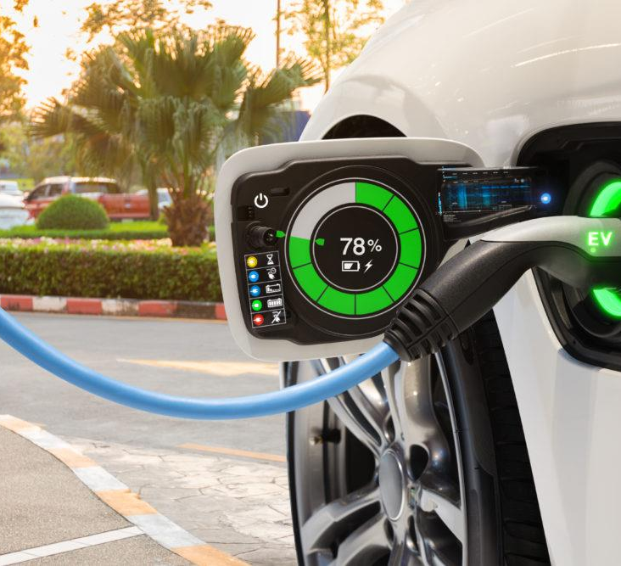
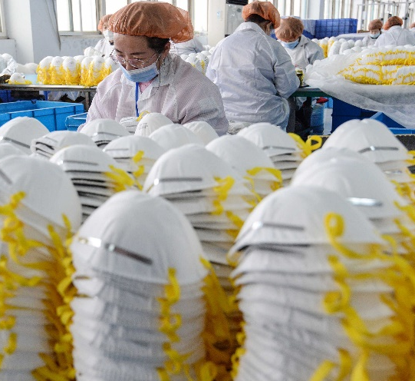
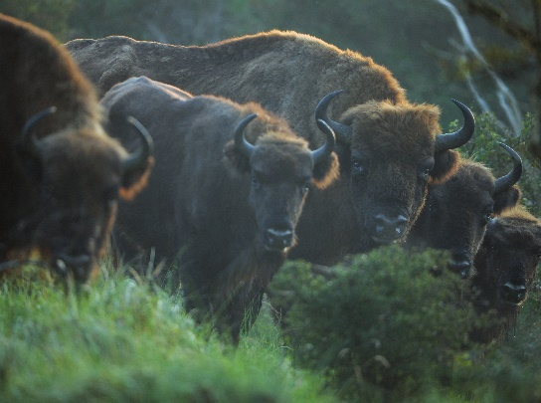
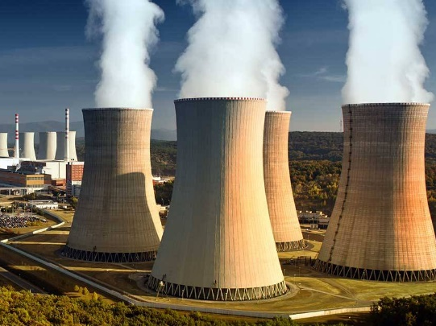
Topics for 2023
What is Political Economy of the Environment?
Environmental and Ecological Economics
PE of Climate Change
Energy and Energy Transitions
Automobility and Sustainable Transportation
Global Health and the Environment
Global Value Chains and the Environment
Land Use and Land-Use Change
Geoengineering and Environmental Futures

Slide 4
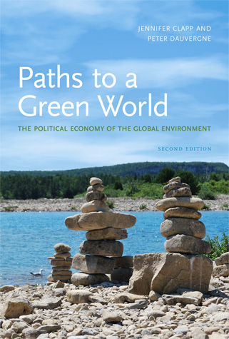
Teaching Mode and Assessment
Teaching:
  Three hour blended interactive lecture and seminar
Assessment:
  1500-word essay (30%) on set question
  3500-word term paper (70%) on topic of your choosing
Preliminary Reading:
  Clapp and Dauverge (2011) Paths to a Green World

Slide 5
About Earl
I’ve been teaching political economy of the environment for many years here at Sussex, and previously at the University of East Anglia
My research is in the area of critical global political economy. In my work, I employ depth psychology in illuminating the unconscious dynamics of political, economic and social behaviour.

Slide 6
Get in touch!
I’m happy to discuss the module with interested students. Feel free to get in touch, and we can arrange a brief online meeting.
e.gammon@sussex.ac.uk

Slide 7
Further Reading
Babe, R. (2006) Culture of Ecology: Reconciling Economics and Environment, Toronto, University of Toronto Press.
Böhm, S., et al. (2006) 'Introduction: Impossibilities of Automobility', The Sociological Review, 54, 3-16.
Buck, H. J. (2012) 'Geoengineering: Re-making Climate for Profit or Humanitarian Intervention?', Development and Change, 43, 253-70.
Gammon, E. (2010) 'Nature as adversary: the rise of modern economic conceptions of nature', Economy and Society, 39, 218-46.
Martínez Alier, J. (2013) Ecological economics from the ground up, ed. Healy, H., London, London : Earthscan.
Paterson, M. and P-Laberge, X. (2018) 'Political economies of climate change', WIREs Climate Change, 9, e506.
Mitchell, T. (2009) 'Carbon democracy', Economy and Society, 38, 399-432.
Ponte, S. (2020) 'The hidden costs of environmental upgrading in global value chains', Review of International Political Economy, 1-26.
Vineis, P. (2017) Health Without Borders: Epidemics in the Era of Globalization, Springer International Publishing . pp. 1-44.
Warren, J. W. (2018) Meat Makes People Powerful: A Global History of the Modern Era, Iowa City, University of Iowa Press.

