Slide 1
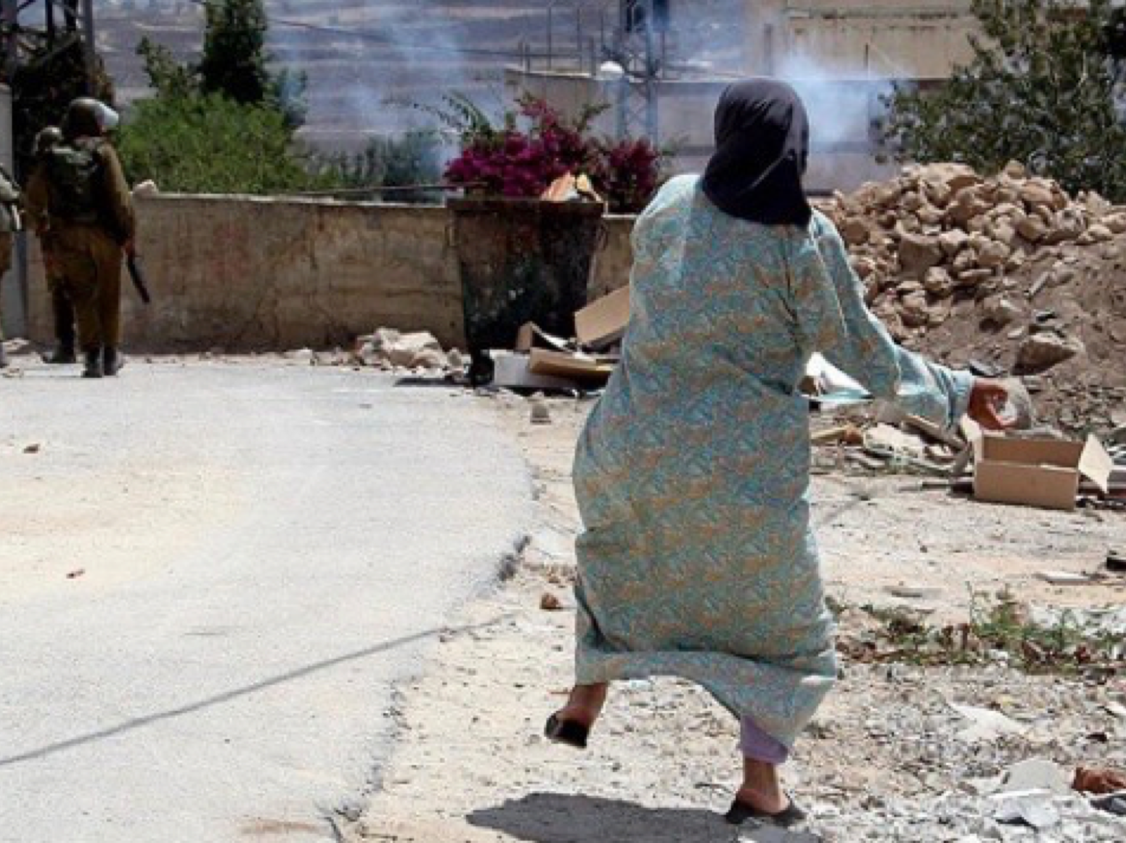
Sex, Race & Death in Global Politics
Convenor: Dr. Melanie Richter-Montpetit
M.Richter-Montpetit@sussex.ac.uk
Spring term 2022

Slide 2
Module description
This module explores the multiple connections between gender and violence in contemporary international politics in historical and theoretical perspective. This module centres interdisciplinary literature and other learning materials from feminist perspectives that foreground the “intersectionality” of different power relations, including postcolonial, decolonial, Critical Indigenous, transnational, Black studies, critical disability and queer approaches. The first few sessions will focus on core concepts for studying ‘sex’ (different analytics of ‘gender’, ‘heteronormativity’/‘homonormativity') and ‘death’ (including ‘body’/‘flesh’, ‘continuum of violence’, ‘militarization’ and ‘martial politics’, ‘biopolitics’ and ‘necropolitics’).
Among the themes we will explore are: the erotics of conquest and slavery; military masculinities and military femininities; drones and ‘posthuman warfare’; international law and the targeting of civilians; sexual/ized violence in conflict; torture and surveillance; women and queers as agents of violence; Orientalism and the War on Terror; occupation and resistance; human rights and international law; ‘humanitarian’ warfare and liberal interventionism.

Slide 3
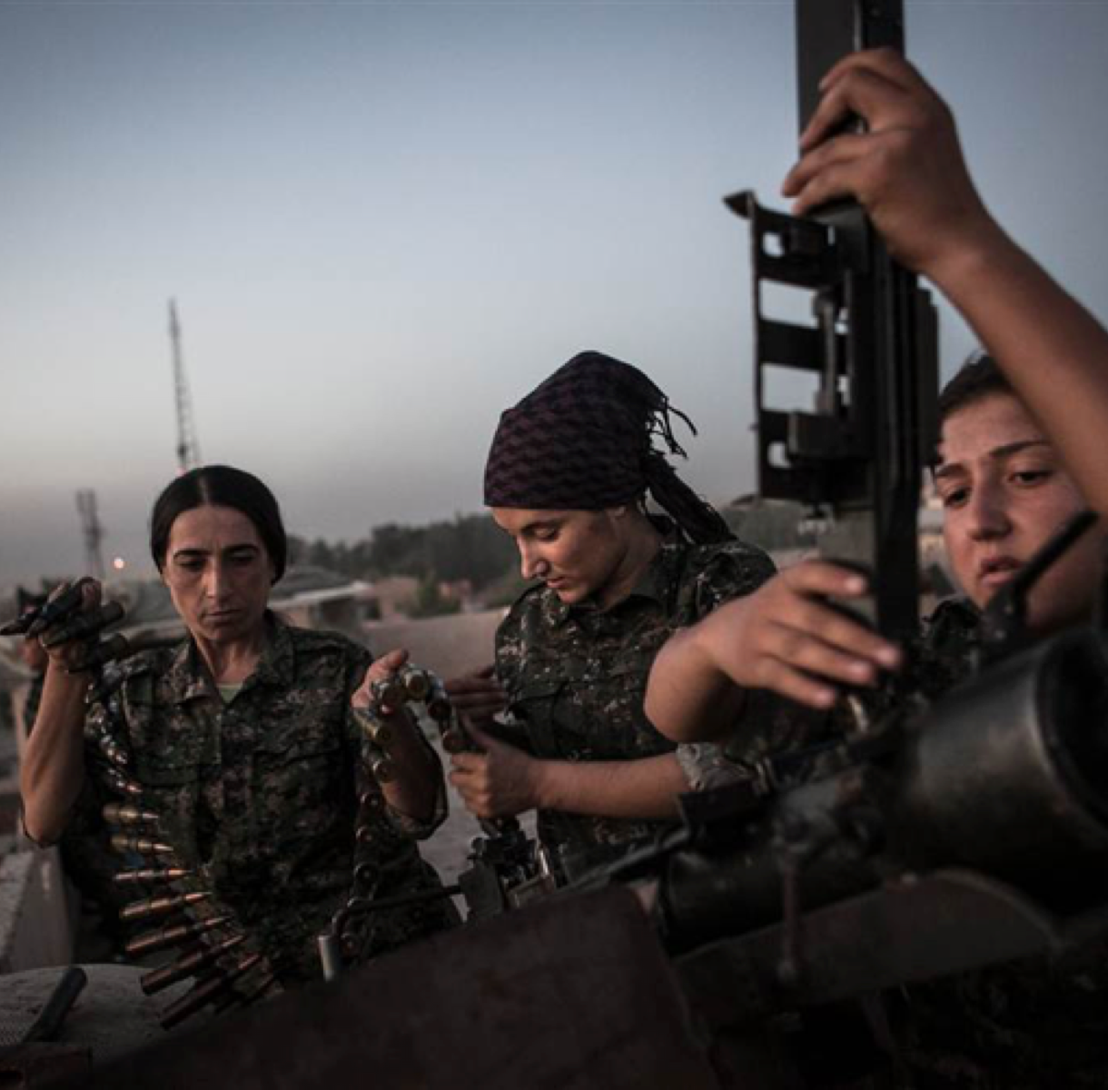
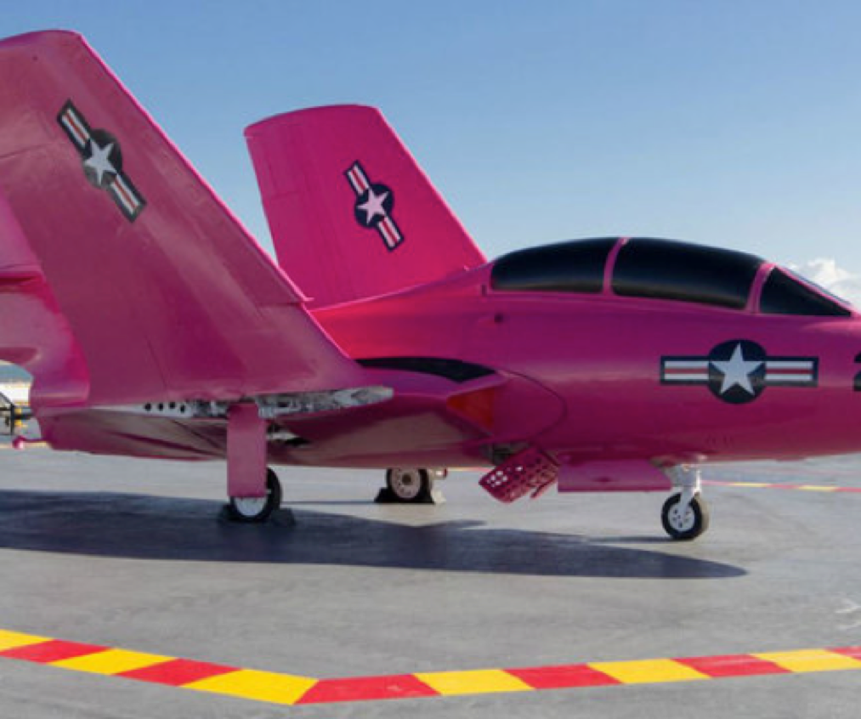
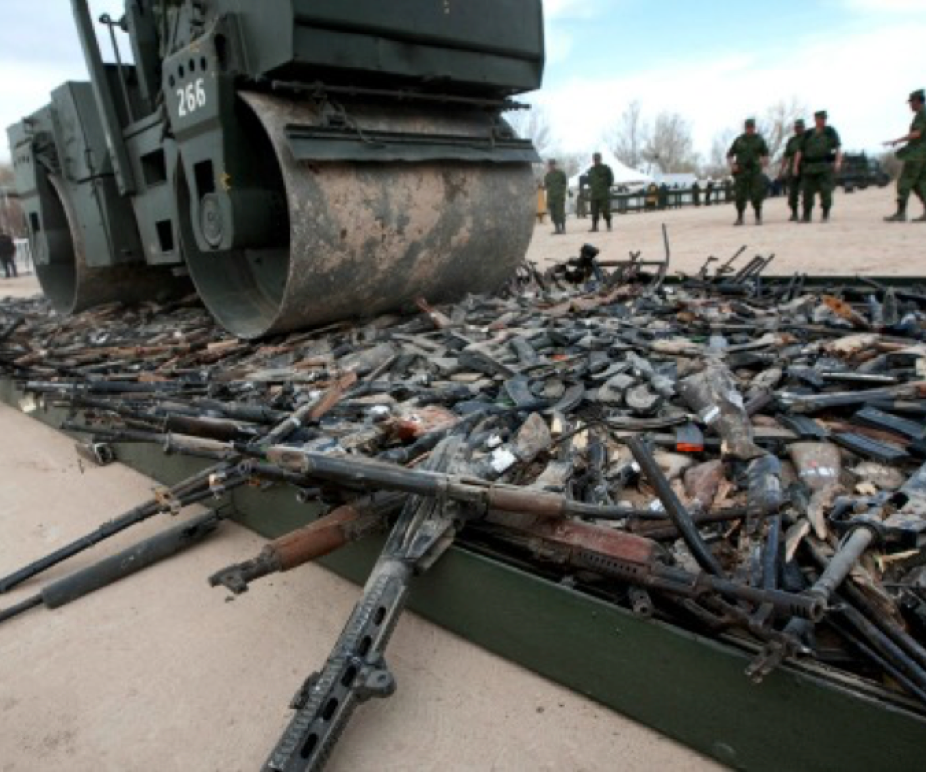

Slide 4
syllabus Roadmap
PART 1: Basic tools of the trade: Key concepts and the ethics and geo/politics of knowledge production
Week 1: Analytics of ‘Sex’/‘Gender’ and the politics of feminist knowledge production
Week 2: Re/thinking the study of Sex and Death in Global Politics: Power, Violence and Subjectivity
Week 3: Re/thinking the study of Sex and Death in Global Politics: Analytics of ‘Militarization’ vs.
‘Martial politics’? and ‘Biopolitics’ vs. ‘Necropolitics’?
Week 4: ‘The Pain of Others’: Ethical Dilemmas and Practical Challenges in researching and representing
Sex and Death in Global Politics
PART 2: Sex and Death in Global Politics
Week 5: Military masculinities, Soldiering and War
Week 6: READING WEEK – NO CLASS: Work on your Reflection papers
Week 7: Military femininities, Soldiering and War
Week 8: ‘Humanitarian War’ and the Politics of International Interventionism
Week 9: (International) Law and (Human) Rights to the rescue? Racial-sexual logics and economies of
suffering and protection
Week 10: Bodies of technology: biometrics, drones and posthuman warfare
Week 11: Essay workshop

Slide 5
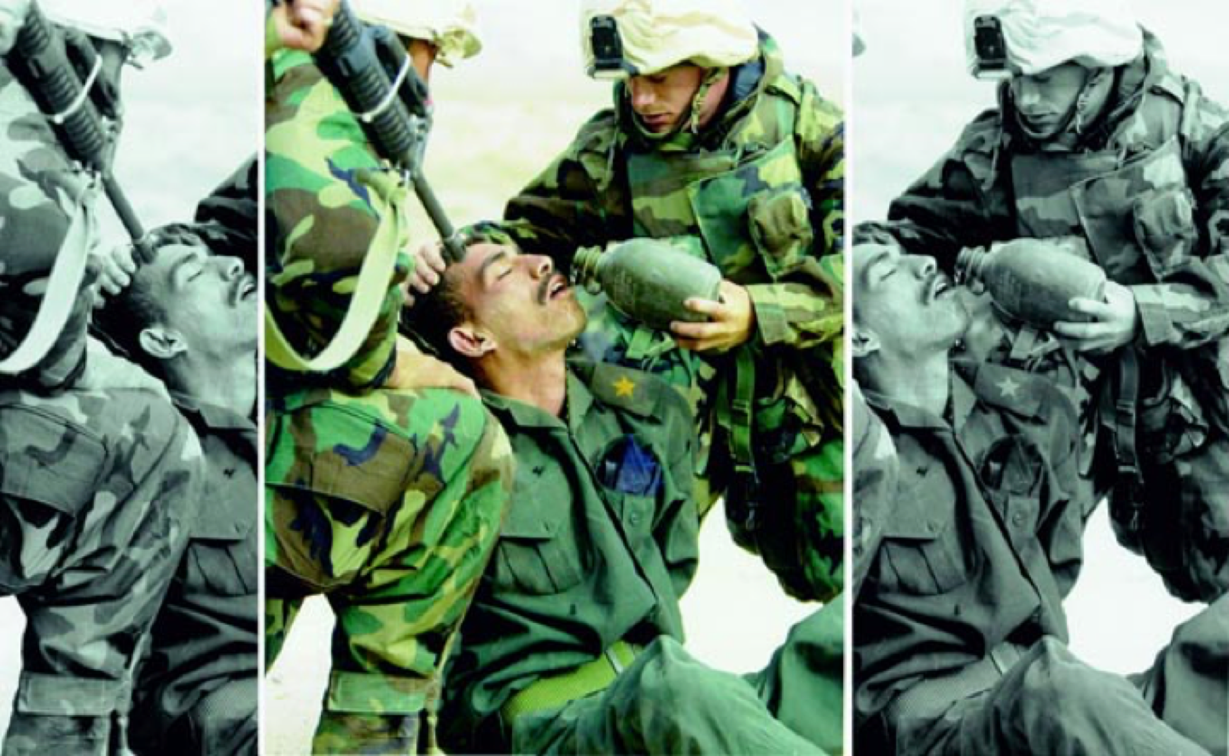

Slide 6
Fostering an Inclusive Learning Environment. Access and Accommodation
Basic Premise of my Teaching Philosophy:
We all have different learning and communication styles.
The forms of power and violence we study in this Module shape and in many ways pose real obstacles to (un)learning in the classroom.
The diversity of lived experiences and perspectives we all bring to the class are a resource, strength and benefit.
If there are ways in which the overall structure of the Module and general classroom interactions could be adapted to facilitate full participation, please do not hesitate to raise your ideas with the Module convenor: comments and suggestions about the format of readings, lectures, and class discussions are welcome. If, at any point in the term, you find yourself not able to fully access the space, content, and experience of this course, you are welcome (and not required) to contact me by email or during office hours to discuss your specific needs.
Name and pronouns: If you have a name and/or set of pronouns that differ from those that appear in your official Sussex records, don’t hesitate to let me know. You can do so in class, in my office hours, or by email.
Children in class: Some of us will have babies and children around during class time that might need your attention or make some disruptive noise. We understand!
Hot Moments in the Classroom: The topics that we’re covering in this class are often difficult, not just intellectually but emotionally. While I expect there to be rigorous discussion and even disagreement in the course of our class discussions, I ask that you engage in discussion with care and empathy for the other members in the classroom. Aim to disagree without becoming disagreeable. In this class we will not shy away from the uncomfortable. Critically examining and assessing our most basic assumptions and values is not just one of the tasks of scholarly inquiry but is an activity vital to living an authentic life. I urge you to have the courage to the uncomfortable in this class. Let’s all work towards a classroom environment that supports taking these intellectual and emotional risks. (Source: Whitman College).

Slide 7
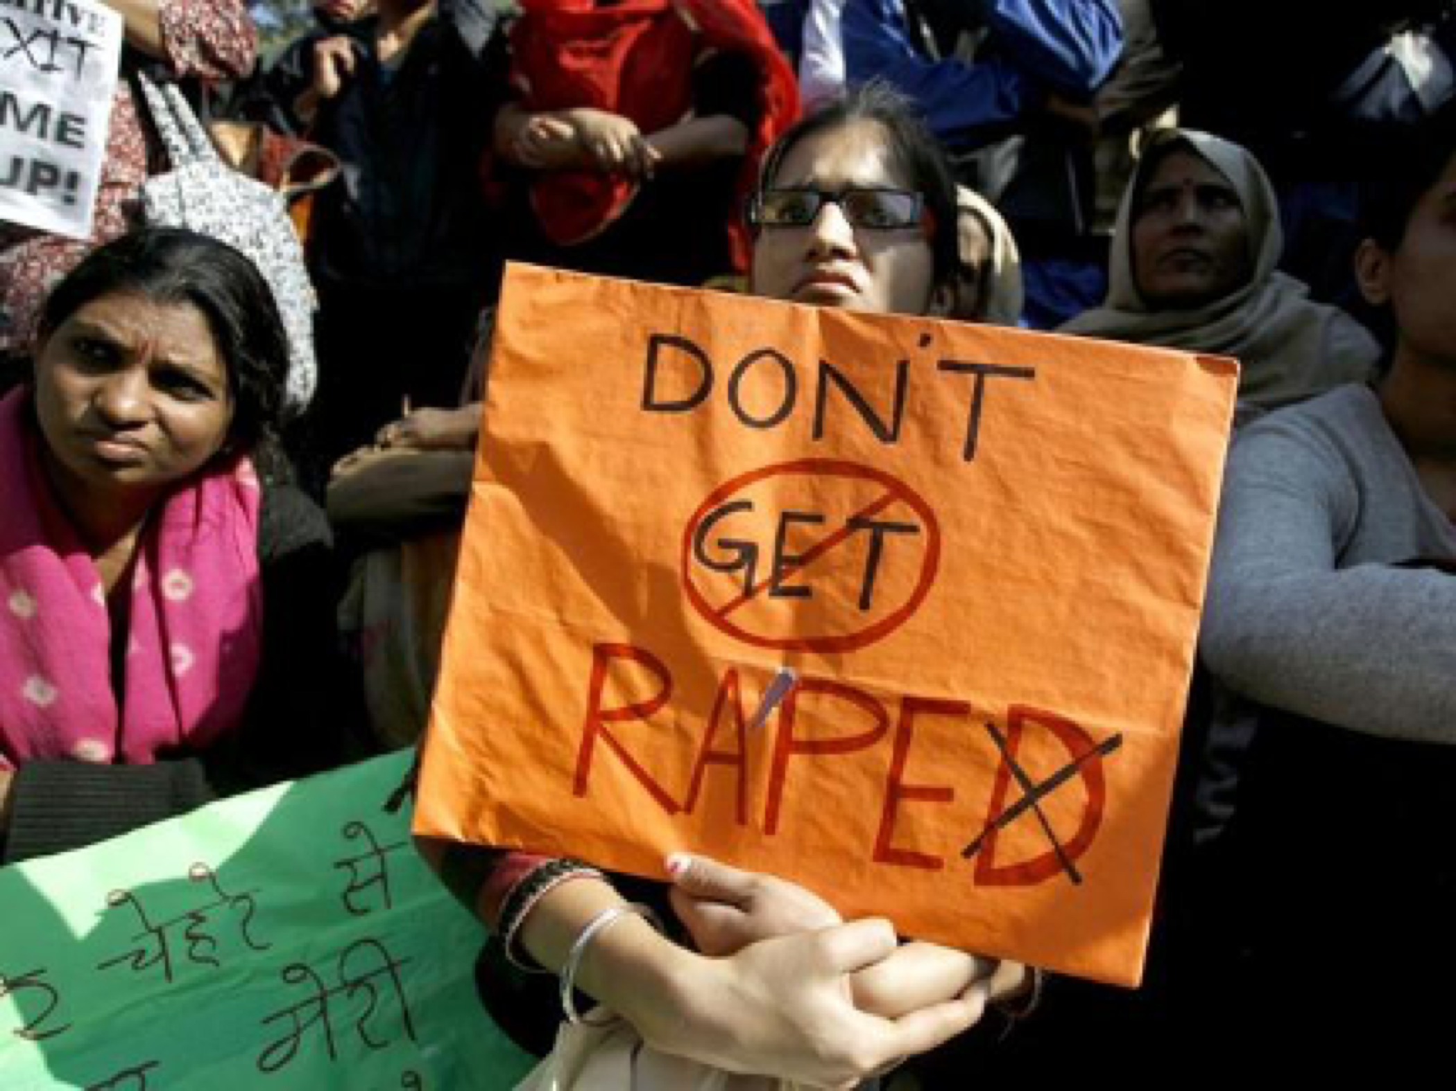

Slide 8
about the convenor
I’m Dr. Richter-Montpetit, and that’s pronounced like: RICK-ter MOW-pe-TEE. I use she/her pronouns. I am Lecturer in International Security and the Director of the Centre for Advanced International Theory (CAIT).
My research interests are in the areas of War and Security Studies, and in International Political Theory with focus on feminist, queer, and anticolonial thought. Much of my work is concerned with the ongoing hold of racial-sexual and colonial formations of power on contemporary war and liberal security regimes. I explore how racial-sexual norms, practices and identities shape the production of force in ‘the international’, and in turn, how war and associated racial-sexual security practices are productive of new gendered racial-sexual normativities, subjectivities and (larger) political and economic orders.
You can follow me (@MRichterMontpet) and CAIT (@SussexCAIT) on twitter.
For a fuller description of my research and publications, see academia.edu as well as a recent Interview – Melanie Richter-Montpetit

Slide 9
