Slide 1
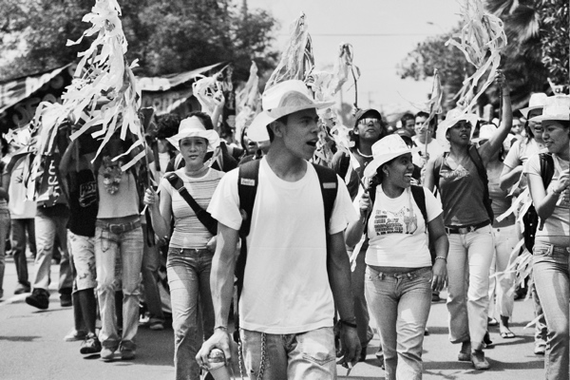

GLOBAL RESISTANCE
Subjects and practices
image ©Lara Coleman

Slide 2
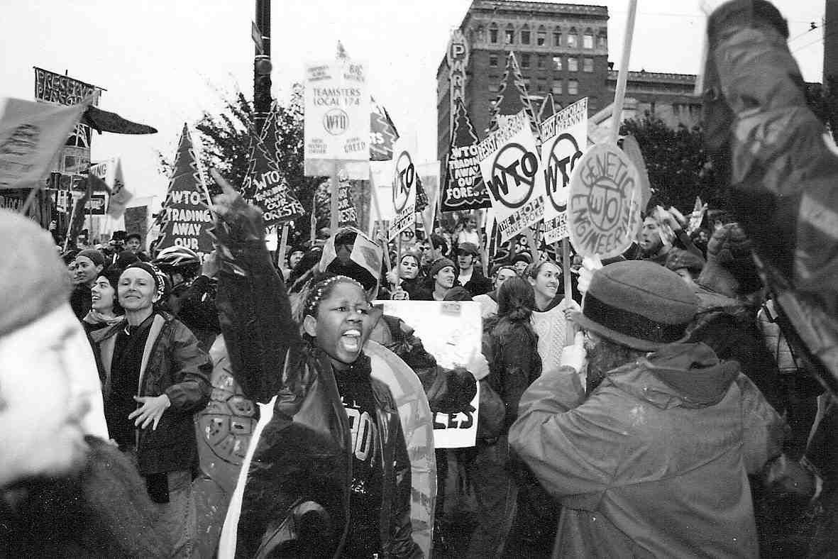
Since the 1999 “battle of Seattle”, when protestors from across the world descended on the World Trade Organisation ministerial conference, scholars and activists alike have spoken of a “global” movement against neoliberalism, capitalism and imperialism…..

Slide 3
“Another world is possible!” has been a rallying cry of globally-networked struggles against socio-economic dispossession and armed repression.

Slide 4
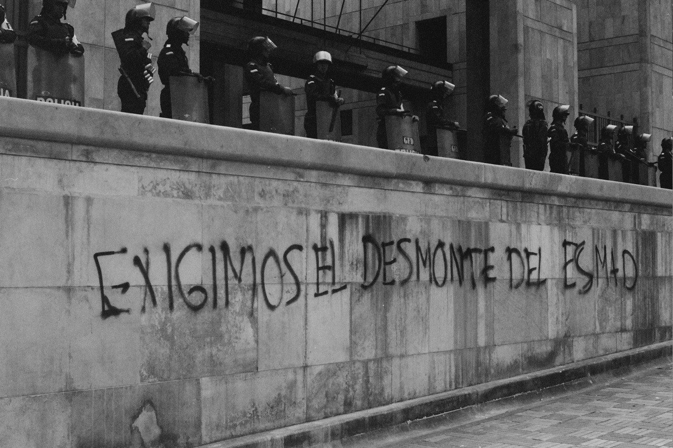
image ©Lara Coleman
But how and to what extent do these mobilisations represent the possibility of “another world”?

Slide 5
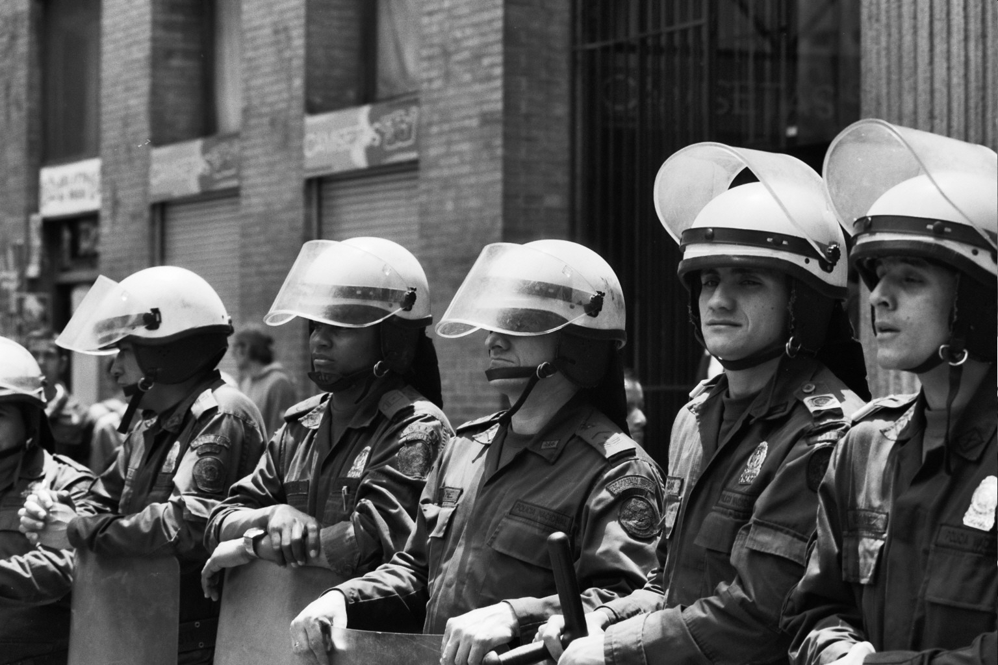
image ©Lara Coleman
These struggles have been not only been aggressively repressed, but also co-opted within processes of liberal, capitalist order-building once contested.

Slide 6
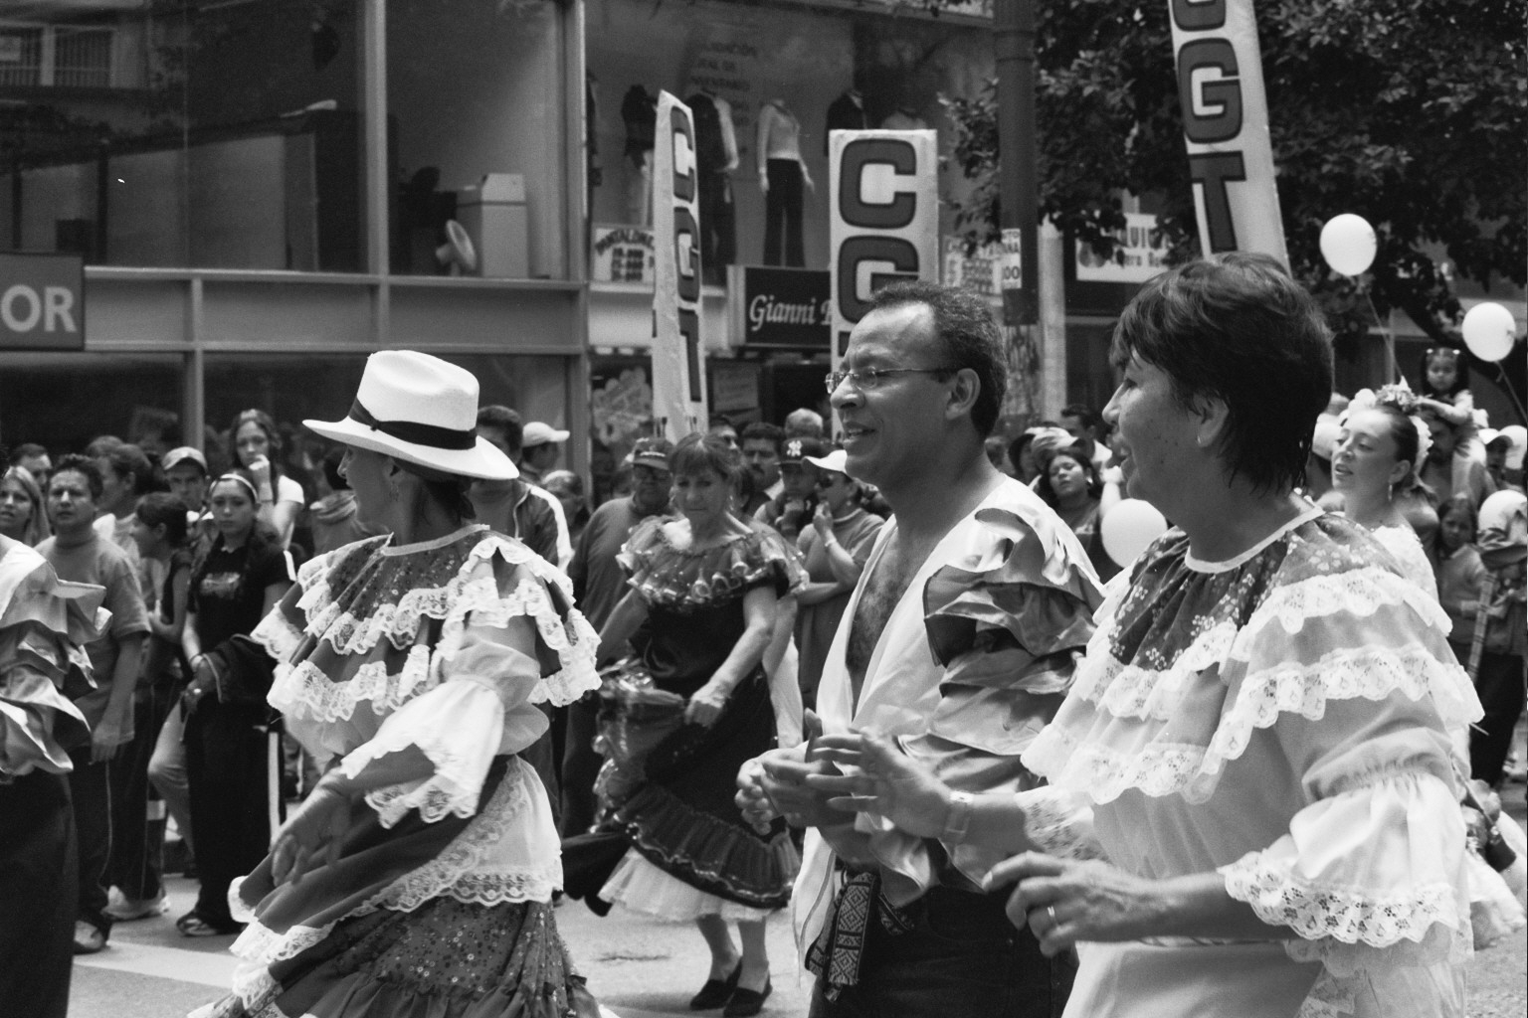
image ©Lara Coleman
How do we understand the complex entanglements between power and resistance, between political dissent and forms of social and political control?

Slide 7
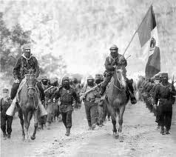
This module will explore some of the main concepts and theories used to make sense of resistance – including Marxist, post-structuralist, decolonial, feminist and anarchist approaches.

Slide 8

Rather than assuming that resistance is straightforwardly emancipatory, the module will interrogate the politics of resistance, and the ways in which anti-systemic struggles may become entangled with relations of power.

Slide 9
It will also examine means of repressing or disciplining dissent, eliminating political struggles or containing contestation within manageable limits.

Slide 10
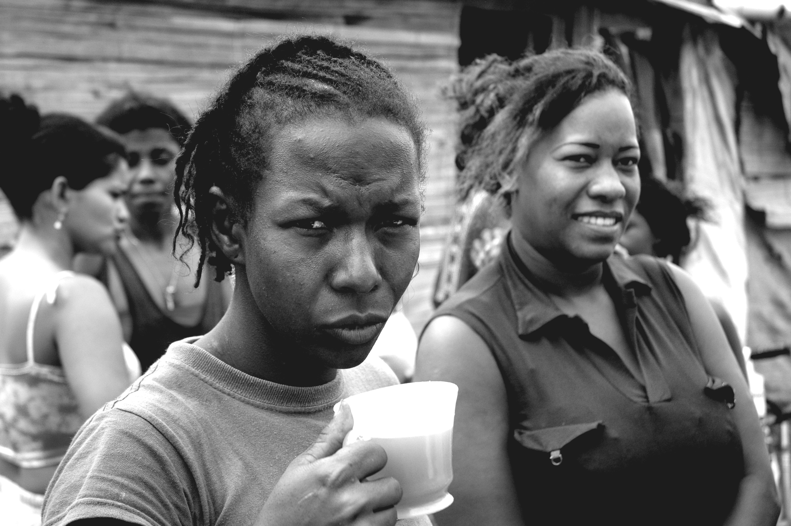
image ©Lara Coleman
It will explore thematic debates such as the ethics of resistance, the concept of solidarity and the racialised and gendered politics of resistance…

Slide 11
image ©Lara Coleman
….the politics of human rights, using (or refusing) law in resistance, and associated questions of civil disobedience, violence and rebellion

Slide 12
image ©Lara Coleman
We will explore these issues through specific instances of struggle….

Slide 13
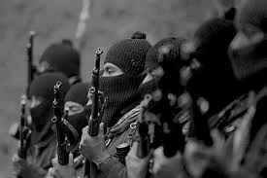
… from the global summit protests of the early 21st century and the emergence of the influential Zapatista movement in Mexico

Slide 14
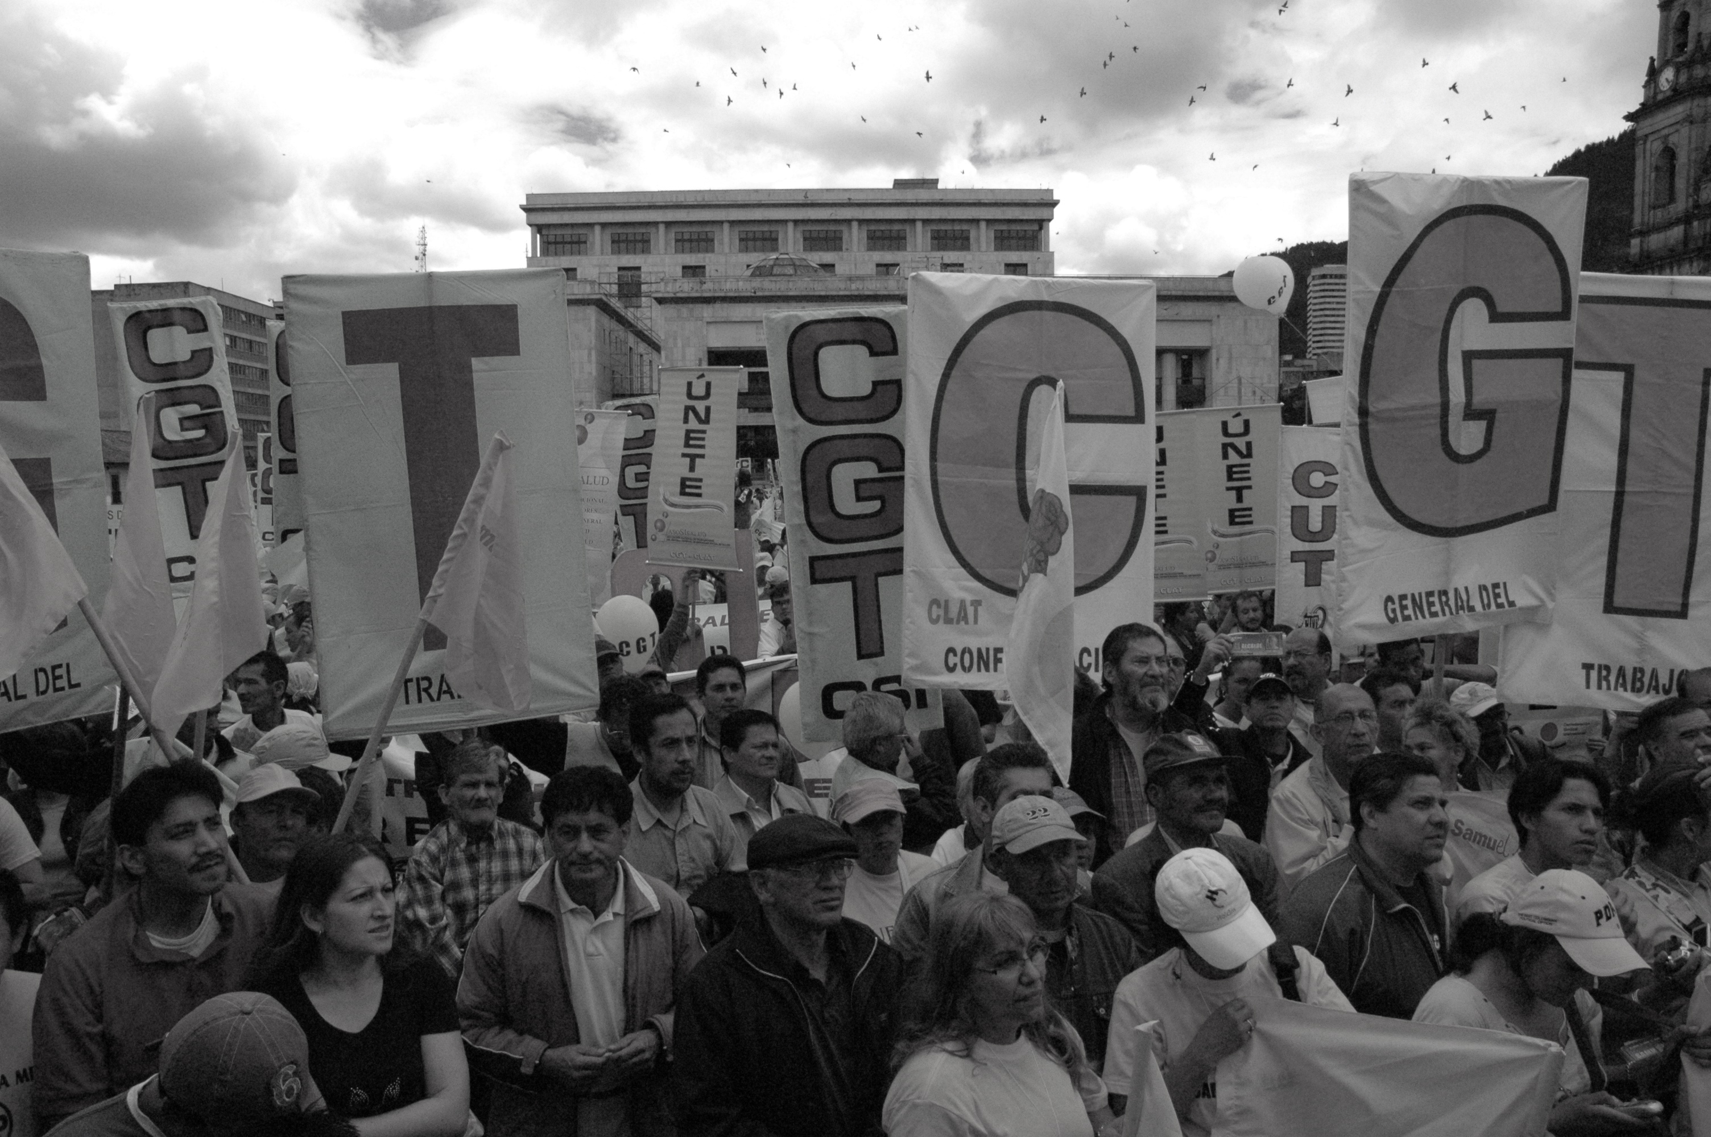
… to international trade unionism

Slide 15
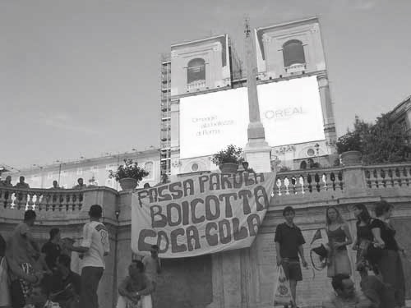
… campaigns against multinational corporations

Slide 16
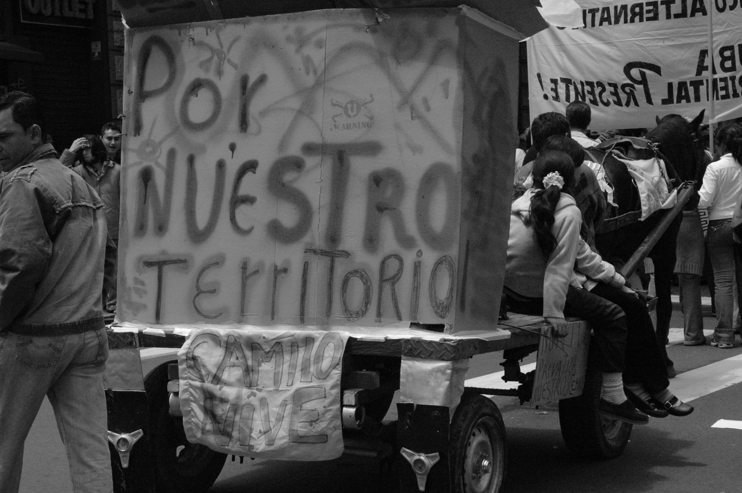
image ©Lara Coleman
…peasant and indigenous struggles over land and nature

Slide 17
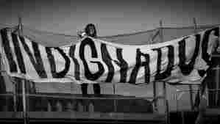
…recent anti-austerity protests in Europe…

Slide 18
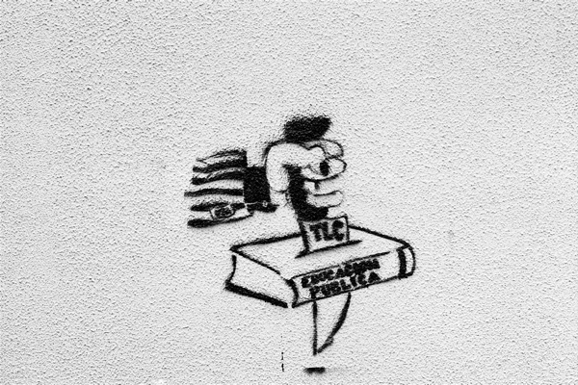
image ©Lara Coleman
…and student mobilisations in defence of higher education

Slide 19
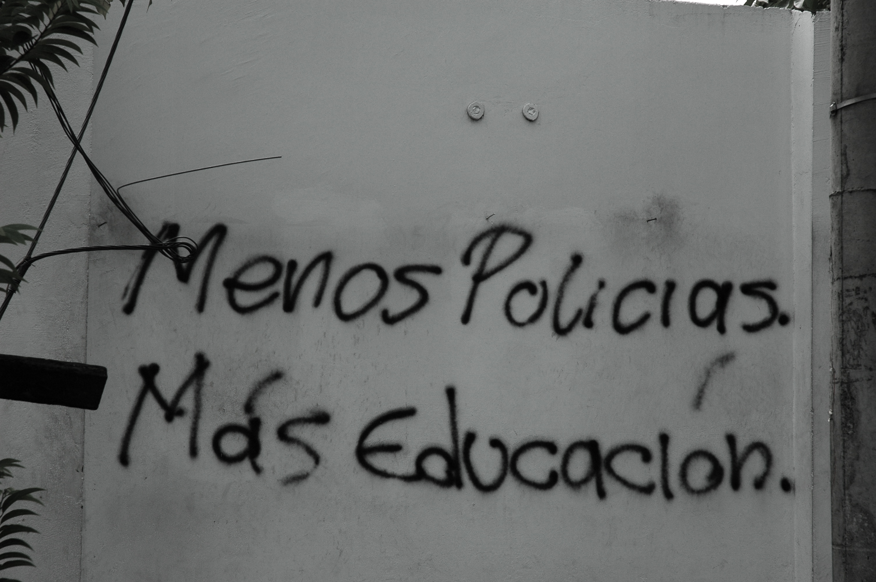
image ©Lara Coleman
Assessed learning outcomes:

Slide 20
image ©Lara Coleman
By the end of the module, you should be able to:
Systematically understand key conceptual debates around the theory and practice of resistance in world politics

Slide 21
image ©Lara Coleman
2) Situate understandings of “global resistance” in broader debates around power, world order and processes of political subjectivisation

Slide 22
image ©Lara Coleman
3) Appreciate the variegated and ambiguous politics of resistance through an understanding of specific empirical examples

Slide 23
image ©Lara Coleman
4) Demonstrate a coherent and detailed knowledge of the theoretical and political challenges associated with understanding resistance

Slide 24
image ©Lara Coleman
5) Apply research skills to the analysis of case studies of political dissent

Slide 25
The module will run in the Spring term. It will be taught through a weekly 3-hour seminar

Slide 26
Module Assessment
It will be assessed by a 3,500 word essay (70% of mark), a 1,000 word mid-module concept note (20% of mark) and a group presentation (10% of mark)

Slide 27
image ©Lara Coleman
The module convenor, Dr Lara Montesinos Coleman is co-editor of the book Situating Global Resistance and part of the steering committee of the international Resistance Studies Network.

Slide 28
image ©Lara Coleman
She has published widely on resistance, rights, ethics and violence. Her work draws on 15 years of engagement with peasant and worker struggles in Latin America, and an academic background in philosophy and IR.

