Slide 1

East Asia Rising:
Beyond the American Century
Prof. Kevin Gray k.gray@sussex.ac.uk

Slide 2
East Asia Rising: Beyond the American Century
By taking this module, you will develop an deep understanding of the world-historical rise of East Asia in the international system, with particular reference to the development of the region under post-war US hegemony as well as the extent to which there may now be a hegemonic transition under way in the region.
You will be able to relate empirical practices to the relevant theoretical approaches in the fields of IR/IPE and development, and will be able to critically explain how such theories themselves have emerged out of the power struggles that have shaped the East Asia.
You will gain an understanding of the region that goes beyond elite-centred accounts of international relations and development to one that includes the role of social forces in the formation of the regional political economy.

Slide 3
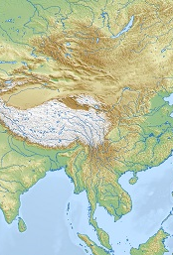
Teaching and Assessment Methods
Seminars are taught by a combination of lectures and seminars.
The module is assessed by a 3,500 word essay (70%), a book review (20%), and a group presentation (10%).

Slide 4
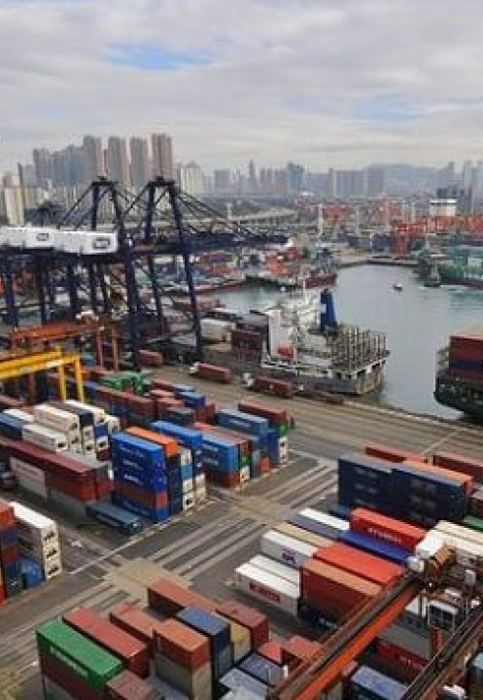
Seminar List
Week 1 The Origins of Post-War East Asian Capitalism
Week 2 National Developmentalism in Northeast Asia
Week 3 Dependent Development in Southeast Asia
Week 4 China’s Re-engagement with the Global Economy
Week 5 Labour and Capital in East Asia
Week 6 The East Asian Financial Crisis and Neoliberalism
Week 7 North Korea: Towards Market Socialism?
Week 8 East Asian Regionalism: Keeping the US out?
Week 9 The Rise of China: Hegemonic Transition?

Slide 5

Indicative Readings
Richard Stubbs (2005) Rethinking Asia’s Economic Miracle: The Political Economy of War, Prosperity and Crisis (Basingstoke: Palgrave Macmillan).
Kevin Gray (2015). Labour and Development in East Asia: Social Forces and Passive Revolution. London: Routledge.
Mark T. Berger (2004) The Battle for Asia: From decolonization to globalization (London: RoutledgeCurzon).
Paul Burkett and Martin Hart-Landsberg (2000) Development, Crisis, and Class Struggle: Learning from Japan and East Asia, (New York: St Martins Press).
Jeffrey Henderson, East Asian Transformation: on the political economy of dynamism, governance, and crisis (London: Routledge, 2010).
Katsiaficas, G. (2012). Asia’s Unknown Uprisings. Oakland, CA: PM Press. Volumes 1 & 2.
Glassman, J. (2018) Drums of War, Drums of Development: The Formation of a Pacific Ruling Class and Industrial Transformation in East and Southeast Asia, 1945-1980. Leiden: Brill.

Slide 6
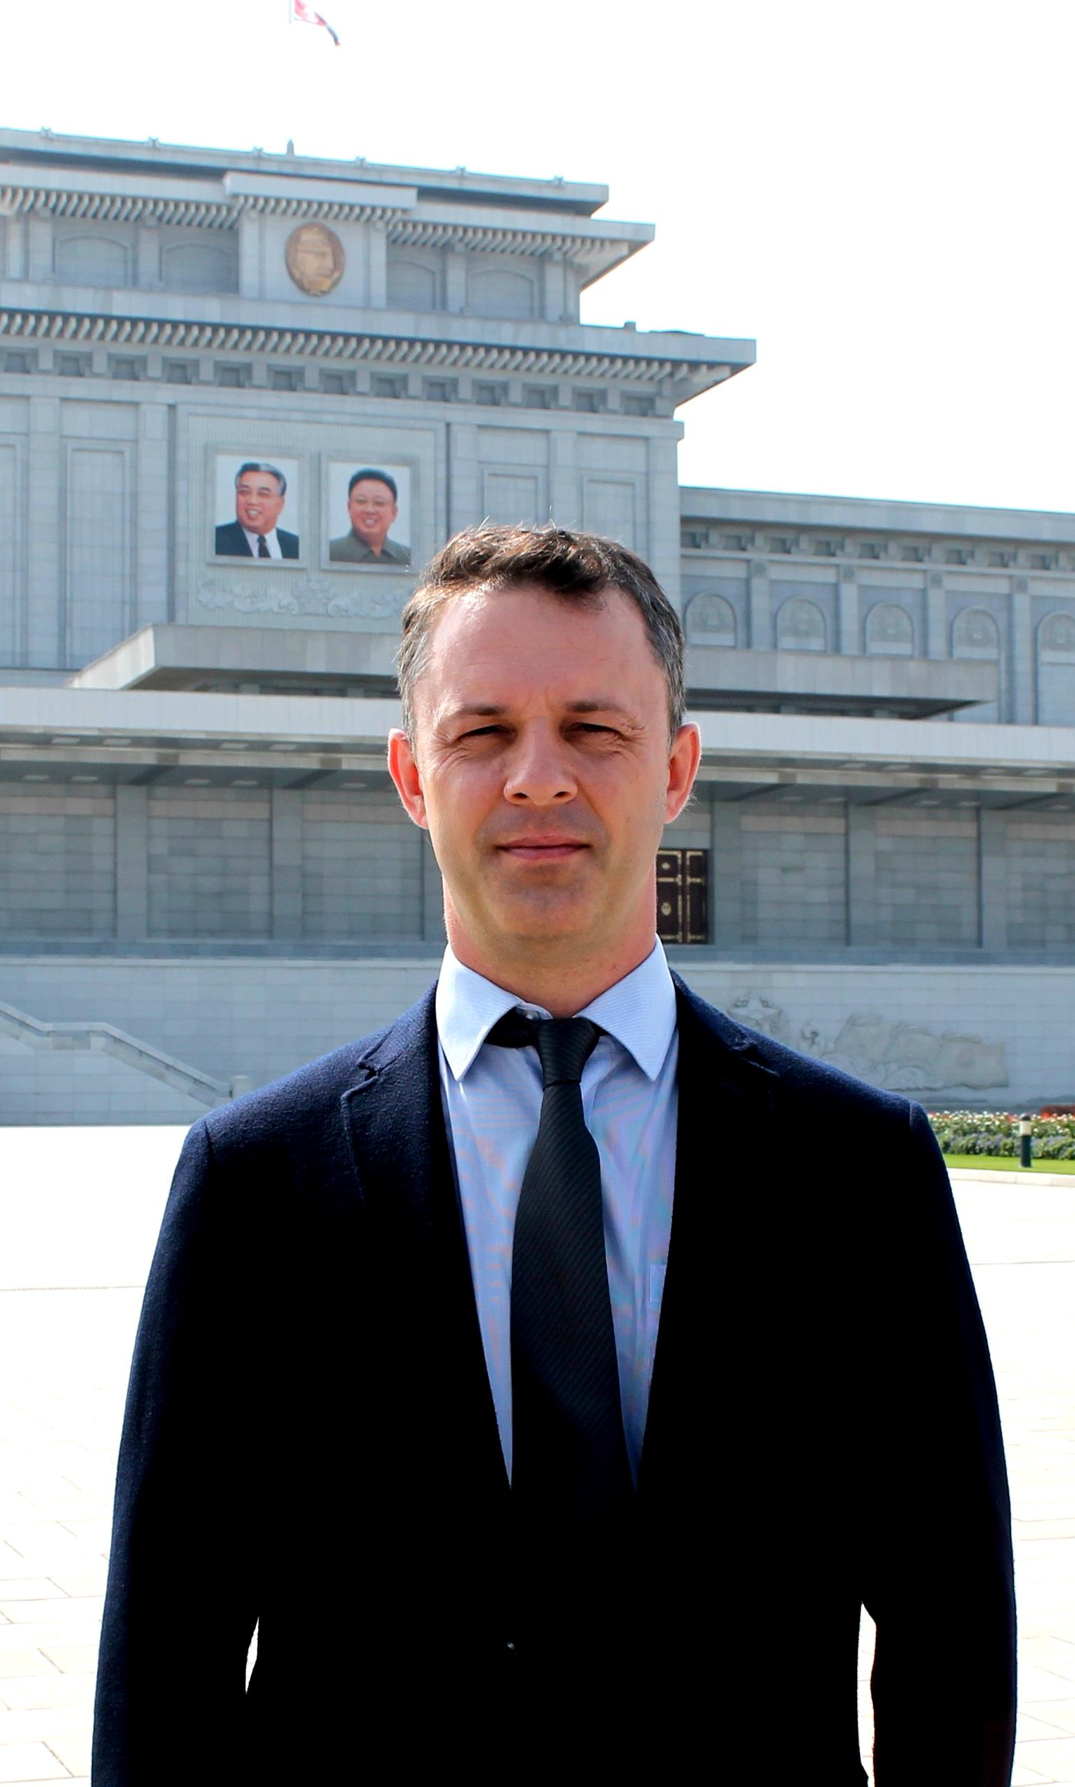
About me:
I have been writing and researching East Asian international relations, political economy, and development for two decades, and have published on Japan, both Koreas, Taiwan and mainland China. I also studied, worked and lived in the region for five years (mostly in South Korea and Taiwan).
My most recent book is a history of the development of the North Korean political economy, titled North Korea and the Geopolitics of Development (Cambridge University Press, 2021).

