Slide 1

ANTHROPOLOGY THESIS (l6078)
Course convenor:
Dr Diana Ibañez-Tirado di40@sussex.ac.uk

Slide 2
Final year structure
SINGLE HONOURS
Autumn term: two advanced topics in Anthropology
Spring term: two advanced topics in Anthropology OR one topic and year-long thesis
JOINT HONOURS
Autumn term: one advanced topic in Anthropology
Spring term: one advanced topic in Anthropology OR year-long thesis (*thesis not available for joints in Geography or History)

Slide 3

What is an anthropology thesis?
The Anthropology Thesis is an exciting opportunity to do individual and original supervised research on a topic that you have chosen yourself relating to Anthropology.
8,000 words
30 credits
Written under the supervision of a faculty mentor
Based on primary research →
  Ethnographic fieldwork (including online methods)
  Discourse analysis
  Analysis of existing data (Mass Observation Archive;
  Social Media posts; News; Films)

Slide 4

Applying to do a year-long Thesis
Students must apply during their second year to undertake the year-long thesis in Anthropology by submitting a research proposal.
  1 - 2 pages long
  Due in Week 9 of the Spring Term
  Deadline: Friday 24 of March 2023, 4pm.
  Email to anthoffice@sussex.ac.uk cc di40@sussex.ac.uk
The research proposal will be evaluated in week 10. You must achieve more than 60% on your proposal to be matched with a supervisor.
We will also look assess your marks for the first year, although there is not a strict rule about average required.

Slide 5
Research Proposal (address the following points)
Name of Student and Email.
Title of the thesis and topic area.
Why is this topic relevant to you (how/why you chose it), and to anthropology?
CONTEXT of the topic/research, and aims. Explain what topic you want to study, and what you aim at achieving when studying such topic (think of the introduction of an essay).
Remember: Do not take the context of your research for granted. Eg. "the research will be conducted in Brighton“. This is not enough. You need to explain where in Brighton more specifically, when, and among who.
E.g. "I will investigate what women in Brighton think about stand-up comedy shows”.
Explain further: who are these women? What ages, professions or type of activities they do, or communities they are part of? Why do you want to focus on women and their view of stand-up comedy shows? What stand-up comedies will you focus on and why? Where in Birghton will you be doing your fieldwork?

Slide 6
Research Proposal (address the following points)
RESEARCH QUESTIONS AND KEY CONCEPTS. Remember that questions are related to your title and topic, and that you need to address key categories. For instance:
Title: “Gender Performativity among women who watch stand-up comedies in Brighton”. Main research question: How do stand-up comedy shows affect the way in which women understand and perform gender identities in Brighton?
Key Concepts (that you need to explain based on with existing anthropological literature: Gender Performativity; Comedy/Humour; Identity
INITIAL LITERATURE REVIEW and key authors.
When you tackle the key concepts of your title/topic, you have already started to build the literature review. You need to continue searching for sources and answering: how does your research builds upon existing anthropological literature? Or in other words, what articles/books/authors have written about this topic (e.g. comedy shows, anthropology of humour, jokes, irony; anthropology of gender and performativity; key authors, e.g. Butler, etc.).
The literature review is not a list of sources, but a critical engagement with these sources.
In your proposal, engage with at least 5 ethnographies or academic sources.

Slide 7
Research Proposal (address the following points)
Proposed METHODOLOGY.
Mention what methods you will use to gather data IN DETAIL. E.G. Interviews; participant observation; analysis of Instagram and Youtube videos: “I plan to conduct at least 10 open-ended interviews with women who go to Komedia on Fridays, and will accompany them to the shows. In addition, I will analyse the Instagram accounts and YouTube videos of comedians to learn more about how their life inform their jokes…etc”. In other words, think of different methods including surveys, participant observation, photo elicitation, analysis of media, etc., and explain – where, when, how, with who, how long and why you will apply such methods.
ETHICAL considerations and risk assessment. Read first: https://www.theasa.org/downloads/ASA%20ethics%20guidelines%202011.pdf
Think how your research can affect, or be a risk for you or your research participants. Will they feel uncomfortable with your questions or presence? If so, how will you mitigate this?
Remember: the research proposal needs to be 1-2 pages maximum (excluding bibliography). Your plans for the research proposal may slightly change in the future, but it is important for us to assess how prepared you are for undertaking a Year Long research project.

Slide 8

Anthropology thesis timetable
Year 3
Autumn: Reading, planning, analysing fieldwork and/or preparing for more fieldwork; 3 research workshops with convenor plus 3 supervisory meetings.
Oral presentations: weighed10% of the final mark
Spring: Writing up; 3 individual meetings with supervisor, 3 workshops with convenor.
Submit thesis in Assessment Block 2
Weighed 90% of the final mark

Slide 9

Study abroad
If you are currently studying abroad (or will study abroad in your third year), you need to send your research proposal in week 9 of Sprint Term (2023) - Friday 24 of March 2023, 4pm.
If you already submitted an application and are currently abroad (and doing fieldwork) you do not need to submit again.
After being allocated a supervisor in week 10-11, and obtaining ethical clearance from the university, you can conduct fieldwork whilst being abroad (e.g. summer and/or the whole year abroad).

Slide 10

Not sure what to write a thesis about?
Discuss with your Academic Adviser.
Contact a member of the department whose work you find relevant.
Ask your modules’ tutors.
http://www.sussex.ac.uk/anthropology/people/peoplelists/group/academic-faculty

Slide 11
PAST THESIS IN ANTHROPOLOGY
* Pilgrimage and the economic infrastructure on Camino de Santiago (Fieldwork in Spain)
* Gendered borderwork: an analysis of the TV show “Love Island” (Discourse analysis and Interviews in the UK)
* Tracing Levantine-Argentine Migration: The Social World of Yerba Mate and Trans-Atlantic Conviviality (Argentina; Syria; Lebanon)
* A Sensory Storytelling of San Giovanni’s Night in Northern Italy (fieldwork in Italy)
* Parks, People and the Media: Virtual Wildlife Conservation in Zambia (Online interviews with participants in Zambia).
* Anthropological insight into the memory of Liverpool FC supporters following The Hillsborough disaster in 1989 (analysis of media: Brighton and Liverpool).

Slide 12
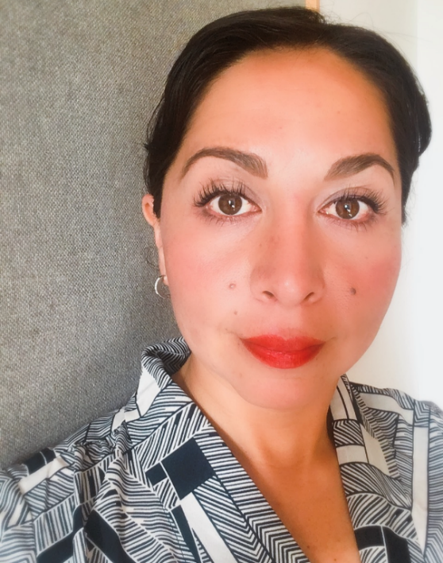
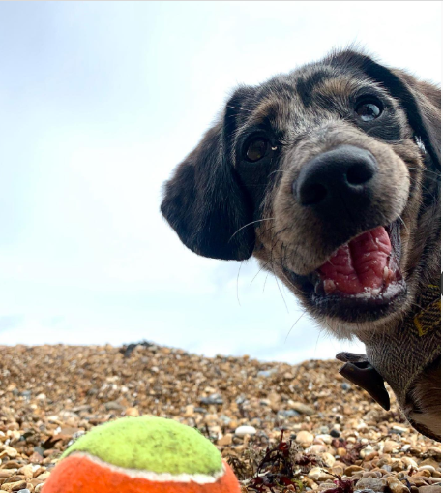

More information and next steps…
Come and see the course convenor, Dr Diana Ibañez-Tirado.
Book an appointment: di40@sussex.ac.uk (or ask directly, if you see her outside walking her little assistant-dog, Toto)
You can also consider:
Contact your academic adviser to discuss a topic of your interest.

