Slide 1
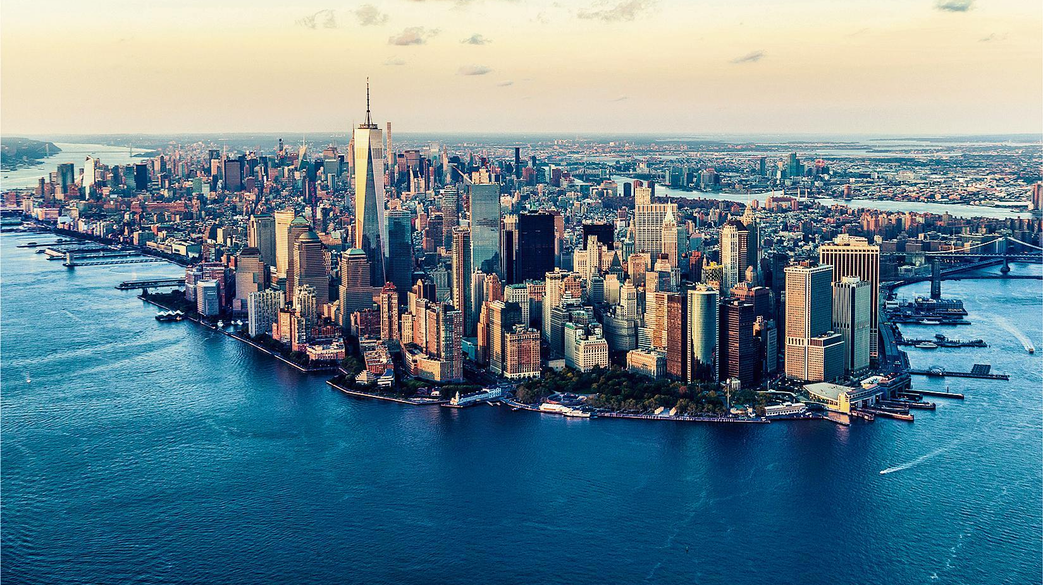
Finance and Power In the Global Age

Slide 2
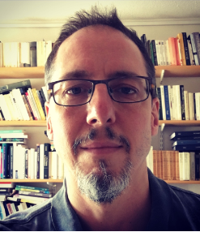
Hi everyone!
I am teaching the course Finance and Power in the Global Age. This is a course I taught for five years. I have been keen to introduce students to financial dynamics in IR because of my conviction that finance is too important to be left to economists or financial specialists.
My goal is to help you develop a political and social perspective on the politics of finance. You do not need any background in economics. I have set up this class to make these questions accessible for everyone with the hope to empower you deal with these issues that can seem at first intimidating.
If you have any questions about the course, feel free to contact me by email: s.knafo@sussex.ac.uk

Slide 3

A few words about myself.
I am a reader in International Political Economy. I am initially from Montreal (I miss the snow…) and did my Ph.D at York University in Toronto on questions of global finance and governance. I've been at the university of Sussex now for 18 years and feel very fortunate to be in such a great place in particular because of the students here.
My work now focuses on financialisation. This term refers simply to the fact that finance has come to encompass all aspects of social life. So I am interested in what has changed since the 1980s leading to this explosion of financial activities. As I hope to show, no one can afford to ignore finance because of the direct ways in which it affects our daily lives and everything around us.

Slide 4
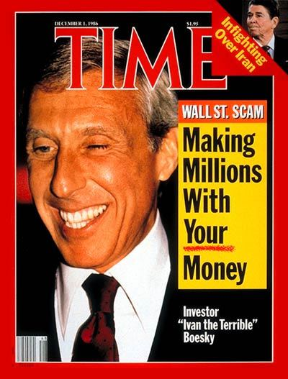
What is In this Course
The course is organised in two parts. First we examine the main dynamics of finance and the power structures they buttress. Key themes are what is distinctive about US finance? What does it tell us about current financial dynamics? Why so many financial crises? How is finance organised in different countries?
The second part of the course focuses on how to change finance. We look at mainstream initiatives, for example the world banks attempt to rethink development through finance with the maximising finance for development initiative. We will also examine changes in technology with the rise of Bitcoin and more radical propositions for democratising finance (e.g. using central banks as engines for welfare spending).

Slide 5
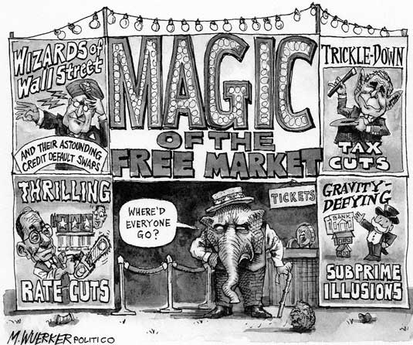
Themes for the Course
1- The Mad World of Financial Markets
- Overview of Financial Markets
- Why are Financial Crises so common?
2- How US Finance Changed Everything
- The explosion of finance under neoliberalism
3- Germany: Can Finance support Manufacturers and/or Workers
- Shareholder value and the power of financiers over corporations
4- Japan: Liberalisation of finance
- Mobilising Finance for a State led development

Slide 6

5- China: Cashing in on Trade
- Will China Challenge the hegemony of the Dollar?
6- Financial Globalisation and Structural Power
7- The World Bank: ‘Maximising Finance For Development’
8- A New Financial Architecture?
What are governments doing to control finance?
9. Bitcoin And Fintech: The Politics of Financial Technology
10 - Radical Alternatives to Global Finance

Slide 7

Assessment
3,500 word essay (70%)
1,000 word essay outline (20%)
Group presentation (10%)

