Slide 1
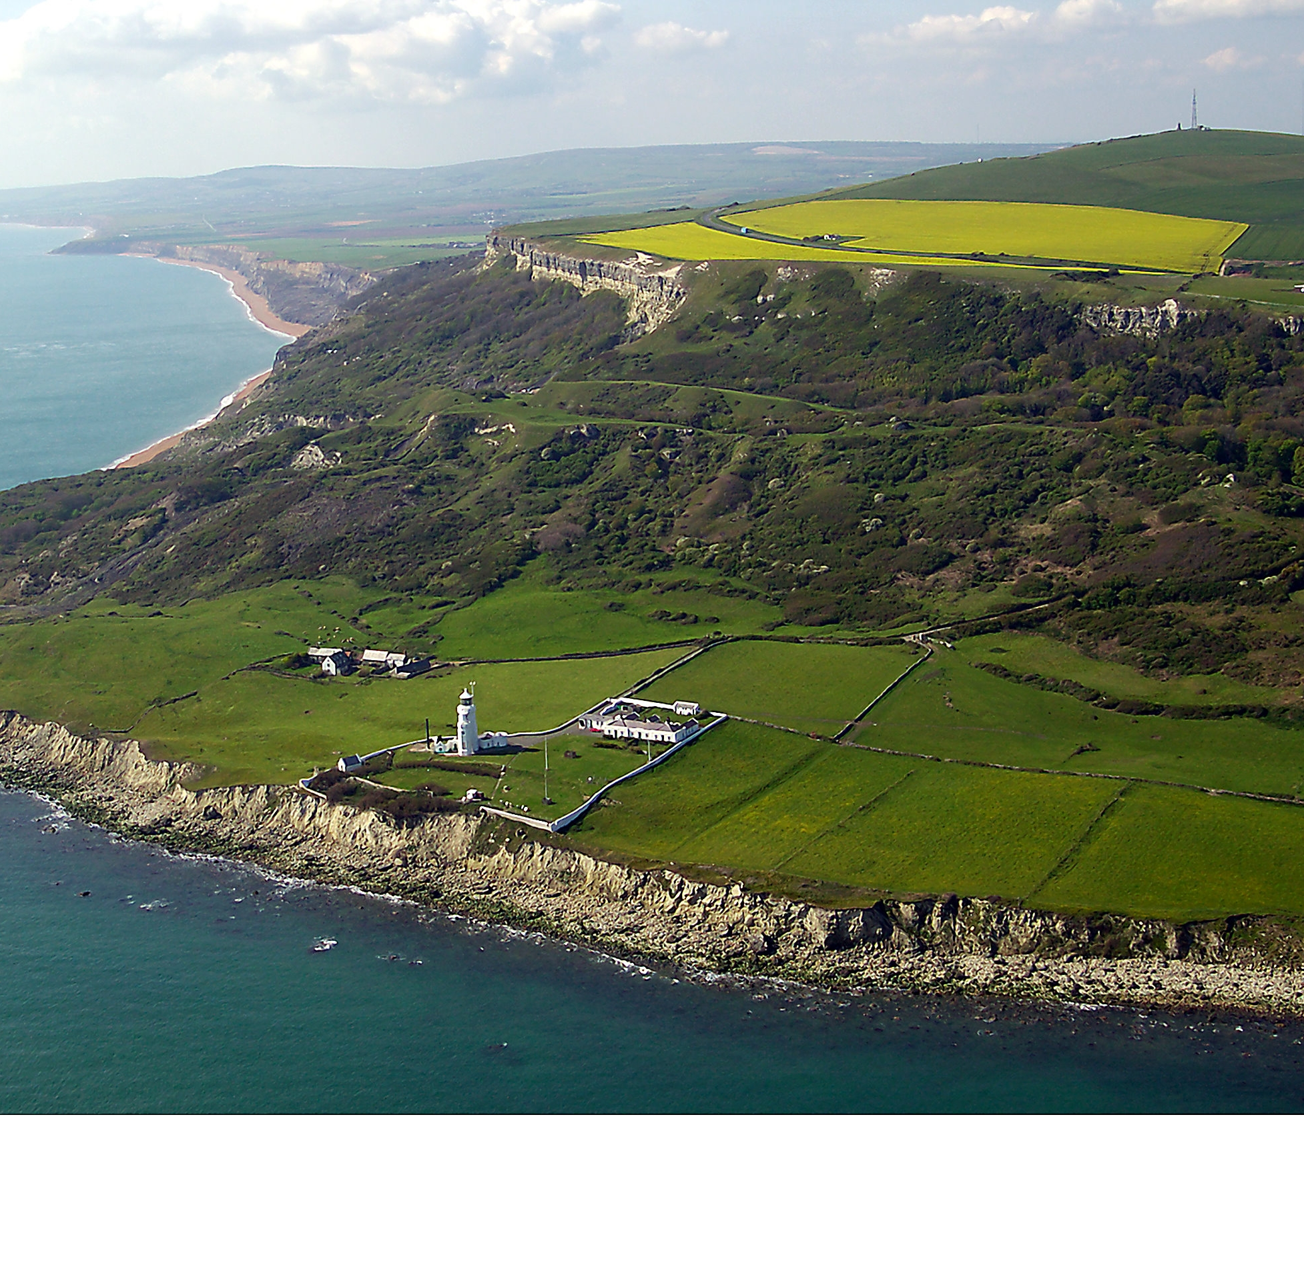
Geohazards: Climate, Disaster and Sustainable Development (004GA)
30 Credit Final Year Option
Convenor: John Barlow
john.barlow@sussex.ac.uk

Slide 2
What will you study?
Earth surface processes and natural hazards pose significant challenges to society and infrastructure. The expansion of global population and urbanization, coupled with the potential impacts of climate change on natural processes, are anticipated to result in more frequent natural disasters and an increase in their associated risks. An understanding of geohazards can be used to evaluate the opportunities for sustainable development and engineering through cost effective mitigation of natural hazards and risk. The module integrates academic and commercial training with real case work. The structure and content is based on real-world problems and will be taught by leading practitioners and academic experts in the discipline.

Slide 3
By the end of the module students should be able to:
1. An ability to create geomorphic maps using field and remotely sensed datasets.
2. An ability to produce 3D ground models using soil and rock description.
3. An understanding of the numerical frameworks used to model earth systems.
4. An ability to quantitatively assess risk
5. An understanding of methods used to mitigate risk.

Slide 4
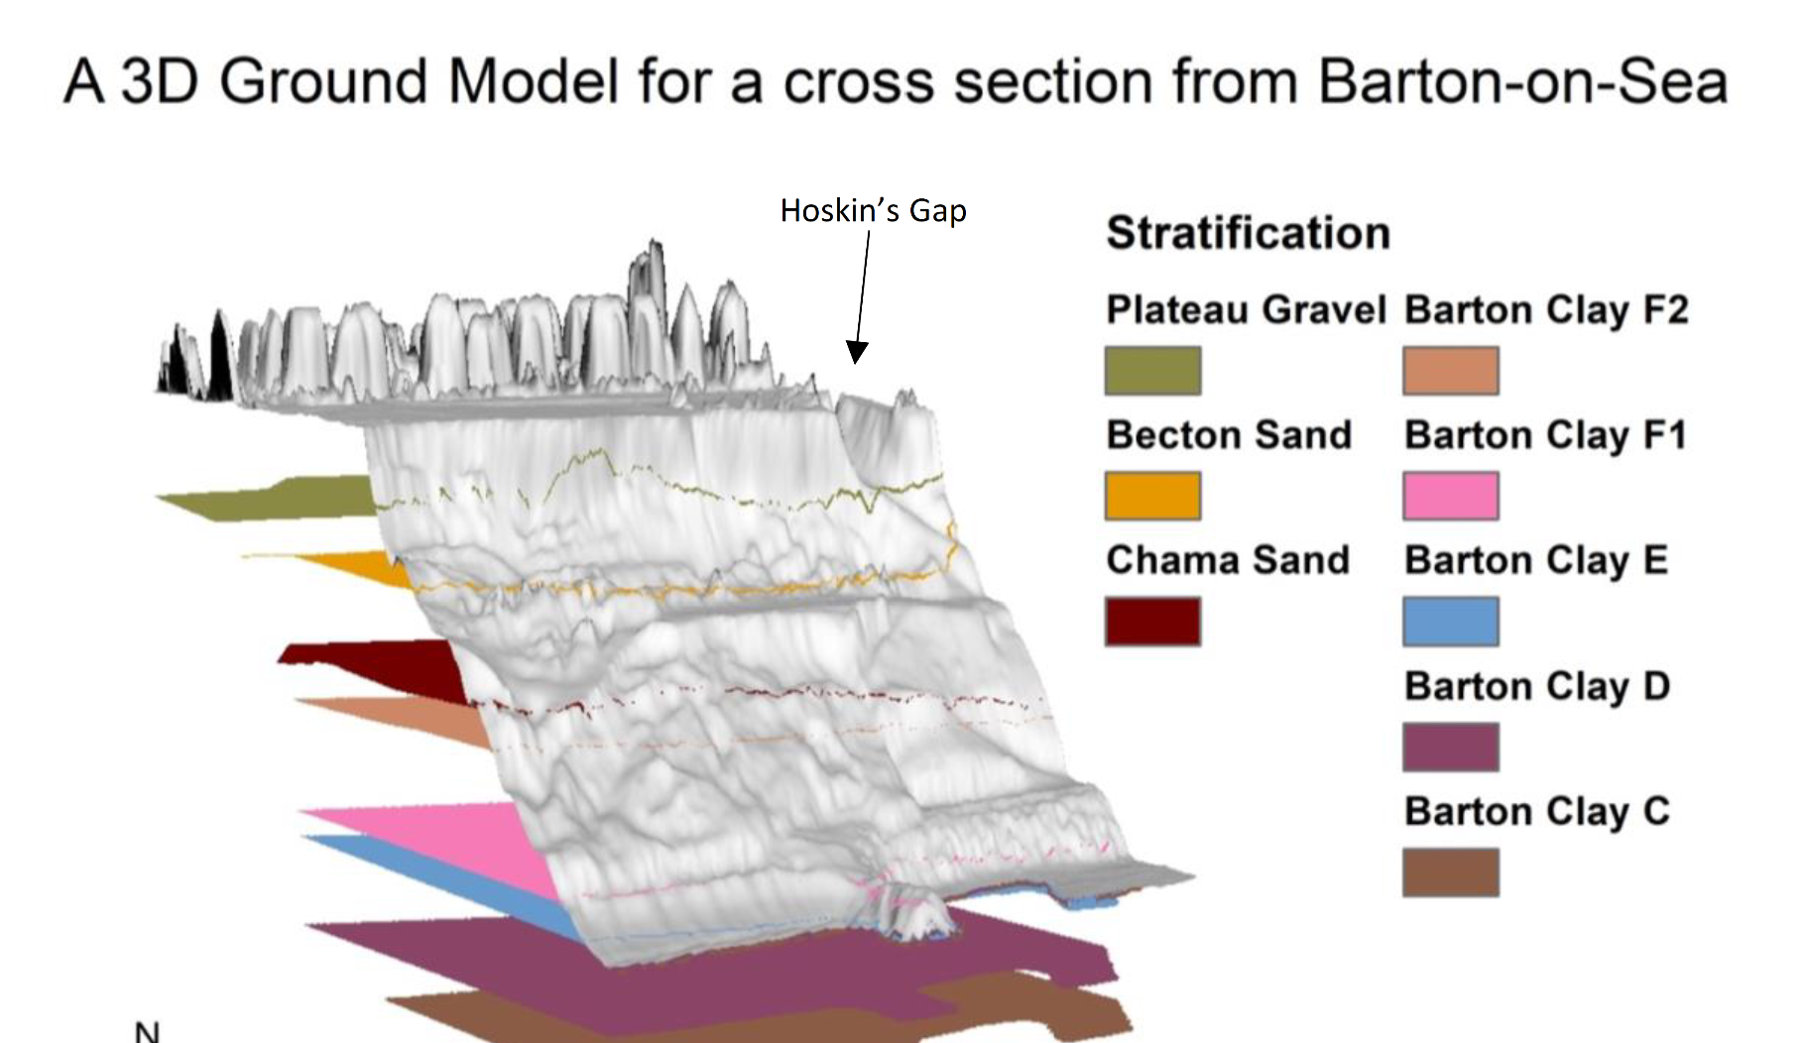
Module Assessment:
4 x 1200 word reports:
  Geomorphic Mapping
  Ground Modelling
  Landslide Hazard Assessment
  Quantitative Risk Assessment

Slide 5
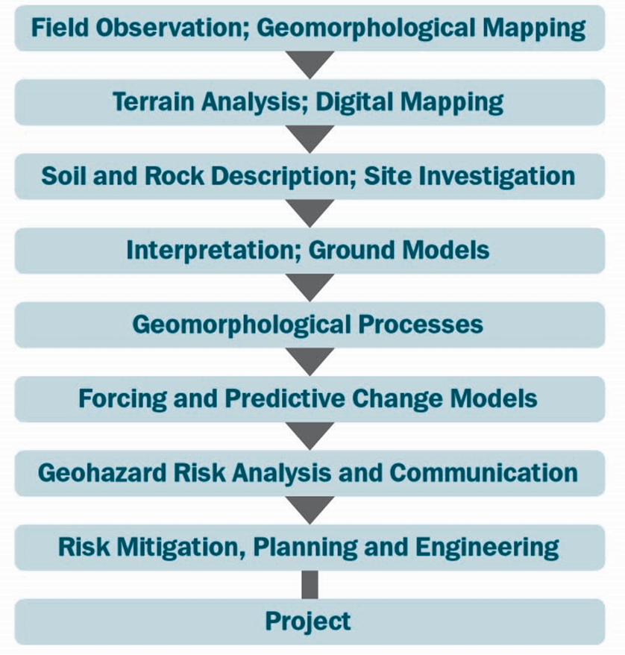
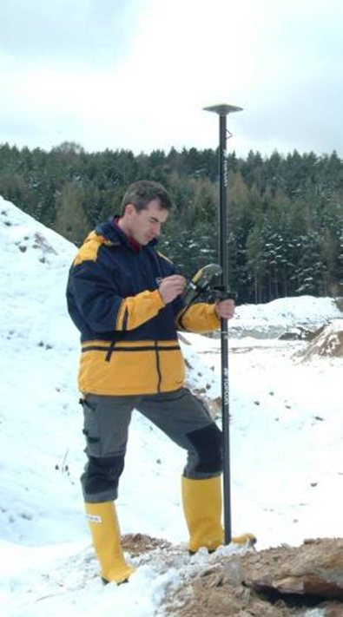
How to conduct a Geoscience Project
The module is intended to familiarize students with the workflow involved in geohazards consultancy

