Slide 1

Geographies of Money, Finance, and Debt
A third year module convened by Dr Andrew Hook

Slide 2

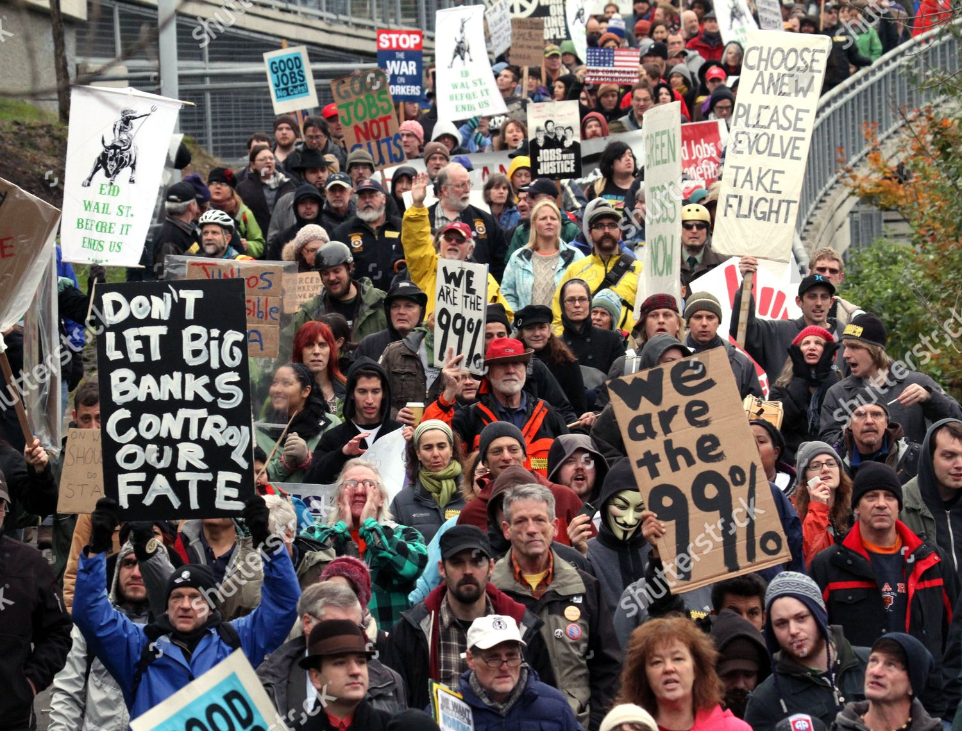
Module overview
This module will provide students with a critical introduction to the role of money, finance, and debt in contemporary global crises of inequality, democracy, and environmental sustainability.
It will position money, finance, and debt as an inherently political subject that has long been neglected by non-economists.
Despite assumptions that finance is now a ‘de-territorialized’ global phenomenon, the module will show how the impacts of finance and debt are nonetheless still spatially constituted and experienced by real people in real places.
Topics will include:
- an introduction to where money comes from and the politics of money creation;
- an examination of the drivers and impacts of rising private household debt;
- a focus on the role of global financial institutions in fossil fuel investment and climate change;
- an examination of the proliferation of cryptocurrencies and money reform movements.

Slide 3

Module aims
Identify and define the main features of money, finance, and debt in the contemporary world.
Articulate the main links and relationships between money, finance, and debt and contemporary crises of inequality, democracy, and environmental sustainability.
Demonstrate a critical awareness of the range of debates around the merits and legitimacy of the current financial and money system.
Apply key concepts about money, finance, and debt to empirical examples in both Global North and South.

Slide 4
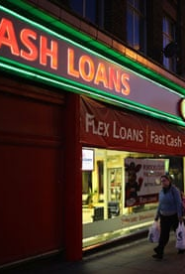
Teaching method and assessment
The module is taught in a weekly 1-hour lecture and a weekly 2-hour seminar. Note that the module will be taught in a way that is accessible to all students and it requires no background in economics.
It will be assessed in the form of:
- One policy briefing (2000 words), usually deliverable in Week 7, and worth 25%.
- One term essay (3000 words), deliverable at the end of the semester, and worth 75%.
If you have any questions about the module, feel free to email the convenor, Andrew Hook, on a.hook@sussex.ac.uk, or visit him in his advice and feedback hours (term time: Tuesdays 13:00-15:00, Arts C255).

Slide 5


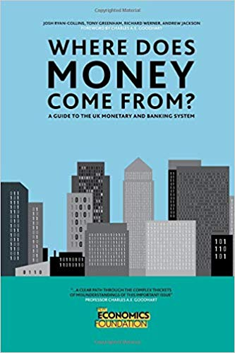



Suggested introductory texts

