Slide 1
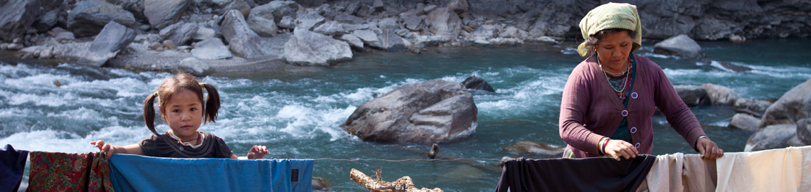
Disasters Environment and Development
Final year (cross-listed International Development option
with Geography)
Prof Dom Kniveton

Slide 2
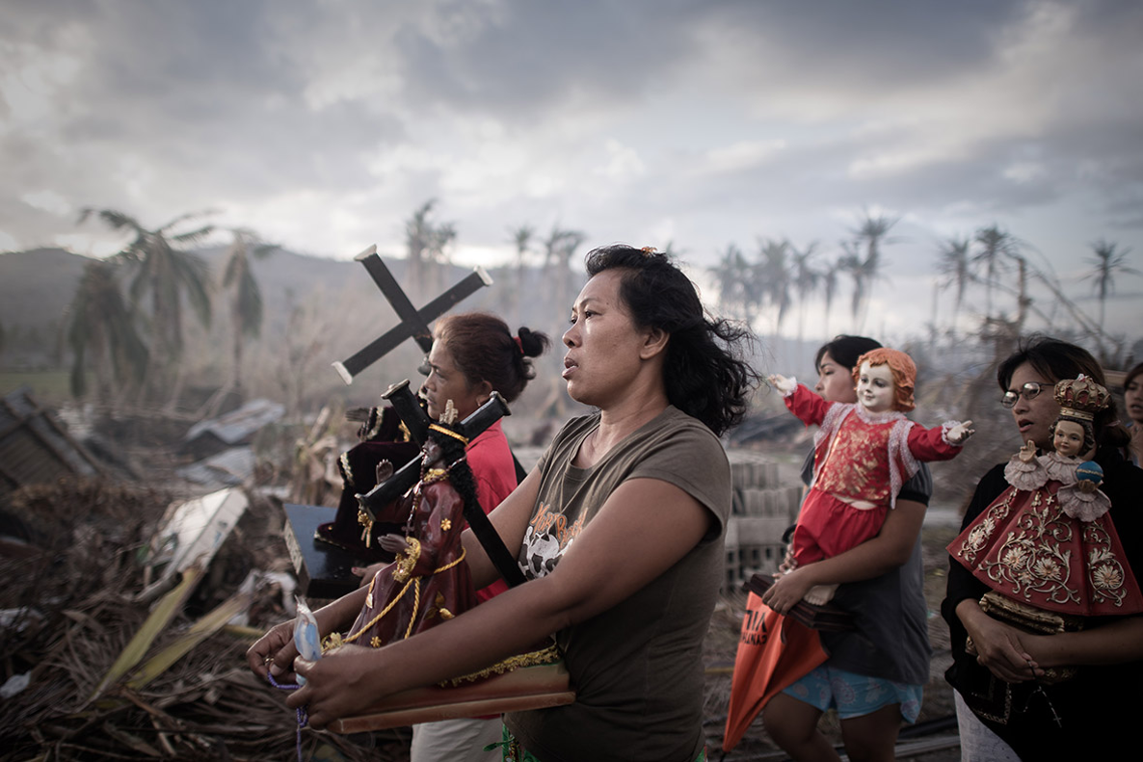
What’s the module about?
Environmental change and disaster risk present fundamental threats to the eradication of poverty. They threaten to roll back decades of development gains.
The overall aim of this module is provide an exploration of the connections between disasters, the environment and development.

Slide 3
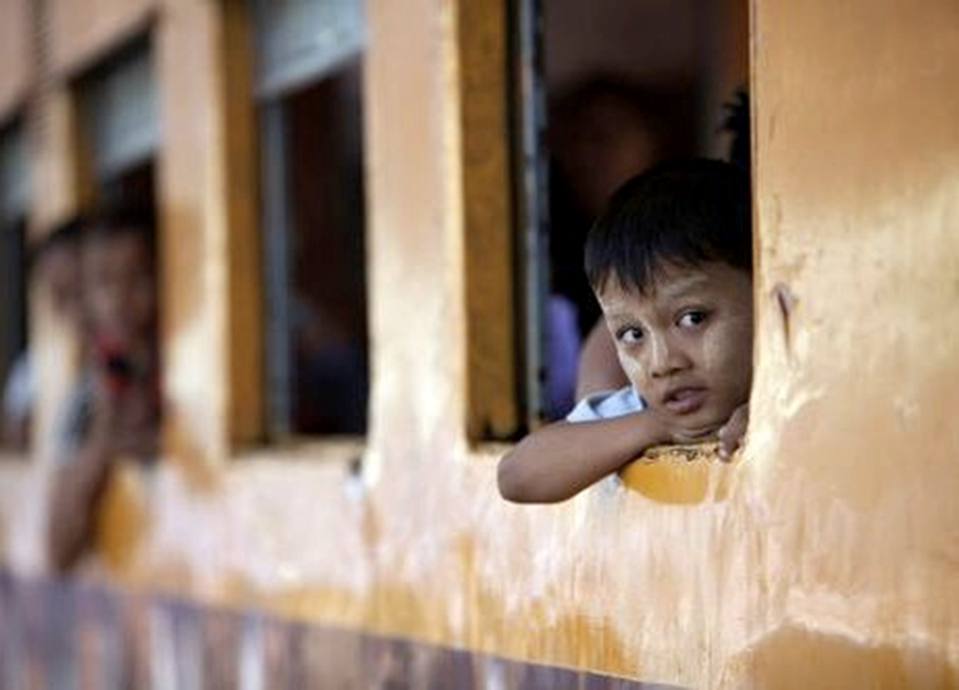
What is the structure of the module?
The module is split into three parts:
a conceptual part that explores similarities and differences in concepts, frameworks and terminology used in disaster risk, climate change and development;
a problem part that looks at the issues of ‘Droughts, floods and food security’, ‘Complex disasters’, ‘Environmental migration’, ‘Trapped populations’ and ‘Resource wars’;
a ‘solution’ part that looks at some of the possible avenues that may help address these problems.

Slide 4
Do this module if you’ve ever wondered:
How natural are disasters? Have disasters become more frequent and catastrophic in recent years?
What is the relationship between the state of the environment and human well-being?
Why do people sometimes decide not to evacuate even though they receive an early warning message? What does religion or cultural beliefs have to do with disaster response planning? Are there any dangers in defining someone as vulnerable or resilient?
What is so special about climate change? Is climate change really an equality issue?
What is the difference between climate change adaptation and sustainable development?
What is vulnerability?
How do you make decisions when you have no idea what the outcome might be?
What solutions are there to reduce disaster risk, to adapt to climate change and sustainably develop?

Slide 5
The module will be assessed through three pieces of work:
• Policy brief (Wk 6) - a comparative study of disaster risk reduction strategies in two developing countries - 1500 words and count for 33% of the module mark
Policy brief (Wk 11) -a comparative study of climate change adaptation approaches in two developing countries - 1500 words and count for 33% of the module mark
Policy brief (A1) - 1500 words on the use of serious games as participatory tools to facilitate the development of disaster risk, climate risk and development solutions OR the development and demonstration a serious game that supports disaster risk, climate risk and development solutions - This count for 34% of their module mark

Slide 6
Additional information:
No pre-requisites for module
Suitable for students from either a social or more science based background – BA or BSc International Development and Geography – including joint majors.
One*2 hour lecture a week, One*2 hour seminar a week, 1* 4 hour games workshop
Convenor: Dom Kniveton
My research interests include disaster risk, climate change and development (surprise surprise) with a particular focus on decision making under uncertainty and modelling social change. My research is both global and local with a focus on Africa and south Asia.
I aim to start each lecture with a breathing exercise and a bit of music
Contact: Chichester 1 Room 155
Phone: ext 7757
Email: d.r.kniveton@sussex.ac.uk

Slide 7
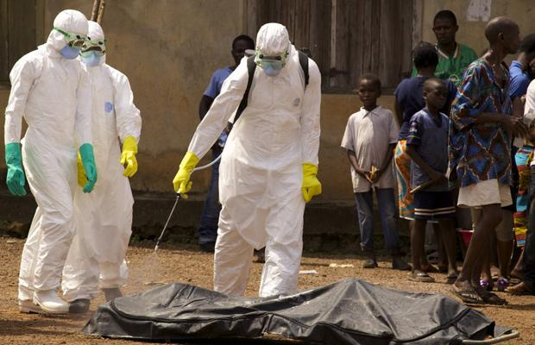
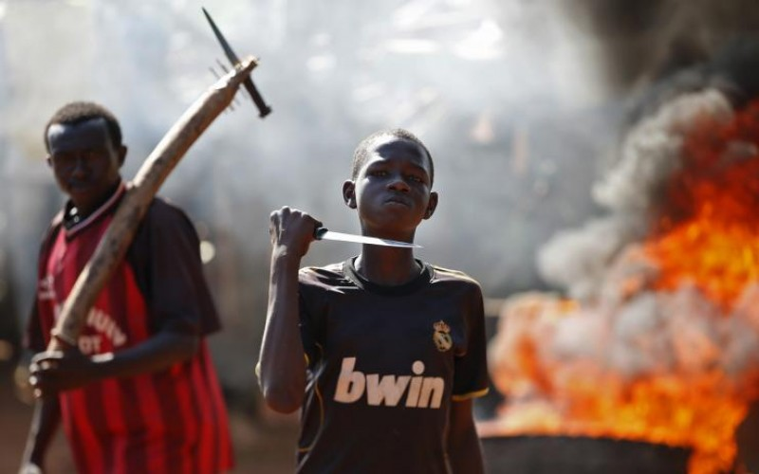
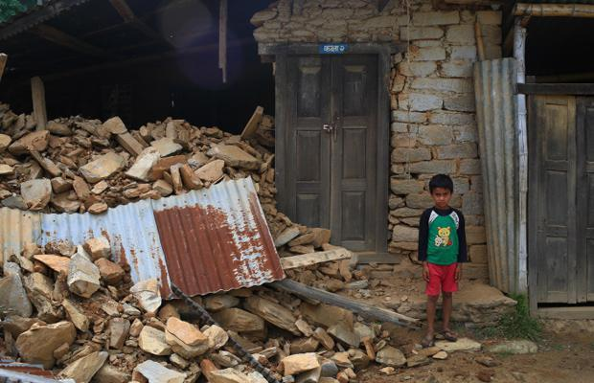
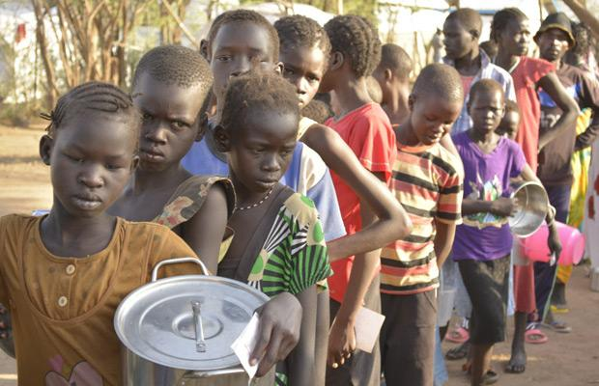
http://www.worldvision.org/news-stories-videos/top-humanitarian-crises-2015

