Slide 1

Global Work Experience
Course convenor: Ben Hunter

Slide 2
Overview
This module is designed to allow students to gain practical work experience in an area of relevance to your degree course. It will take the form of a period of work experience of a minimum of 5 weeks in the autumn term of Year 3
There will be a supervised assessment which will be a career planning portfolio and a Reflexive Essay completed during term one of the third year
The module provides an opportunity to experience the practical aspects of work, contribute to your personal development and to develop skills needed for graduate employability beyond university
Students on this module will be expected to be proactive in finding their own work experience provider

Slide 3
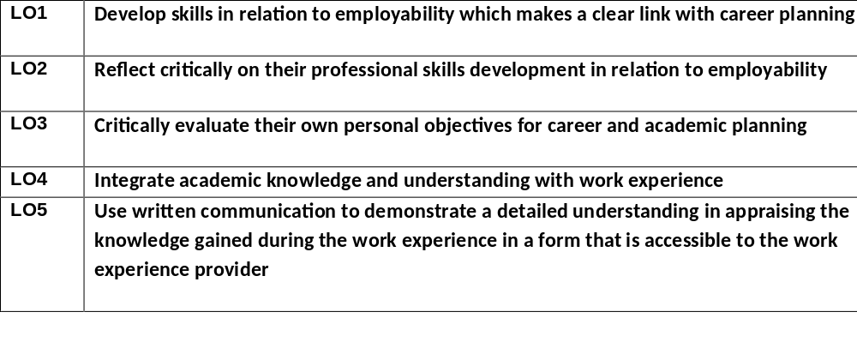

Learning outcomes:

Slide 4
Teaching Methods and Assessment:
Weekly skills workshops (3 hours) in weeks 1-4
Placement/Work Experience in weeks 5-10
Closing and Assessment Workshop: week 11
Career Portfolio | 1500 words | Week 11 | Canvas | 30
Reflective Essay | 3500 words | AB1 | Canvas | 70

Slide 5
How does it work?
To register for this module, or to ask questions, please send an email to the ID course coordinator, Ben Facer, at <intdevoffice@sussex.ac.uk>
Students should select their third year modules as normal; if they secure a placement they will then be transferred onto the Global Work Experience module
It is important that students choose their modules first before registering their interest for the Global work experience
The options talk on Wedn 8th March will provide further opportunity for Q&A.

