Slide 1
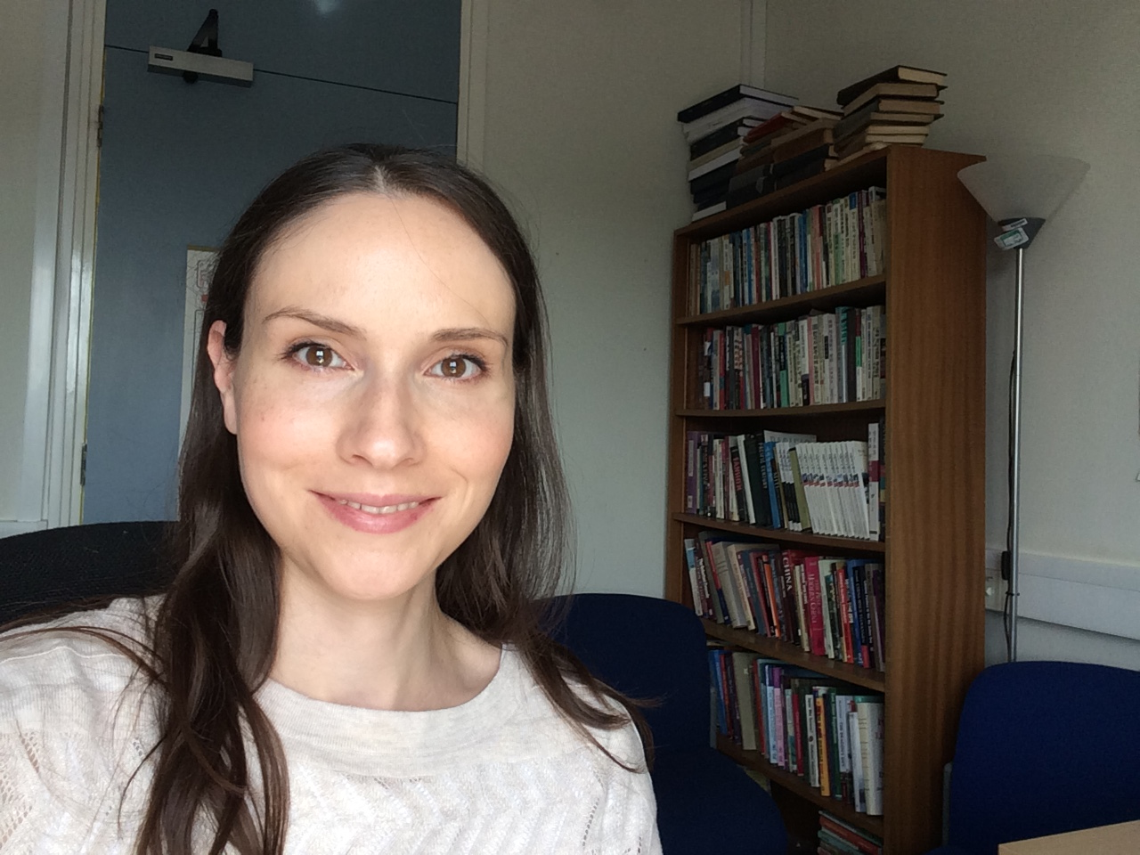
CRITICAL PERSPECTIVES ON CONFLICT AND VIOLENCE
3rd year option
2023/24 ACADEMIC year
Dr Louise Wise
Lecturer in International Security
L.wise@Sussex.ac.uk

Slide 2
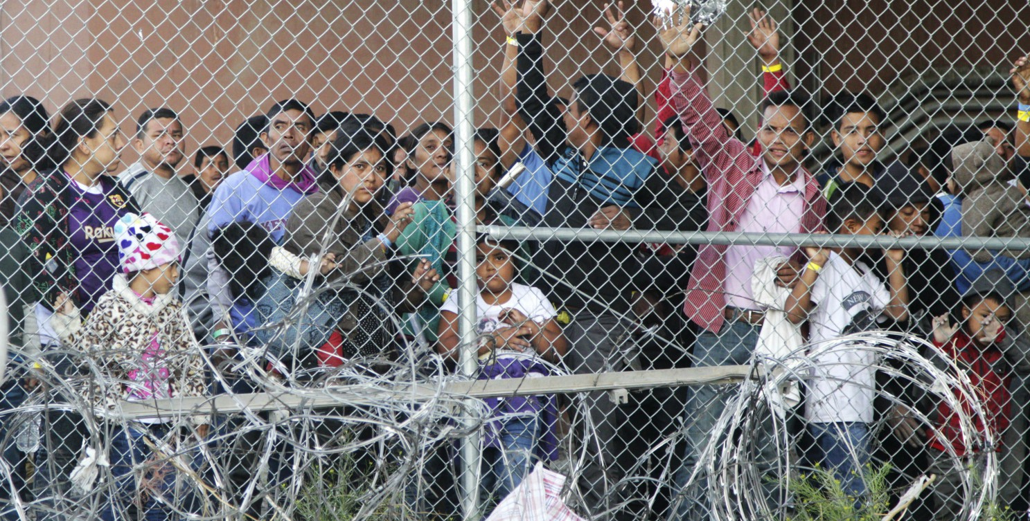
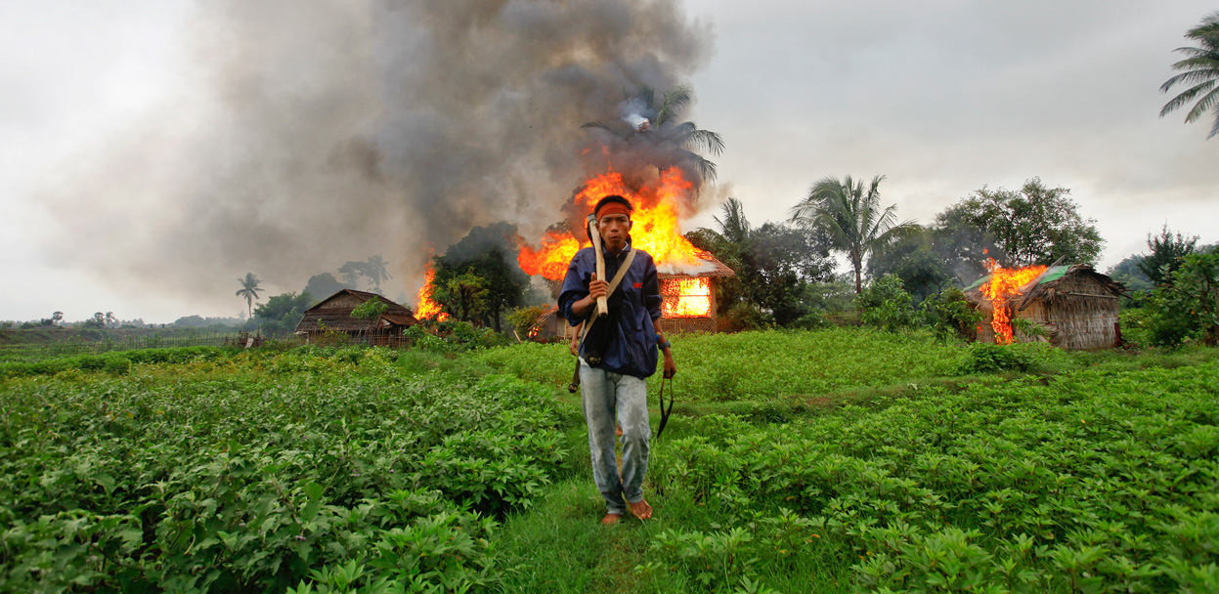
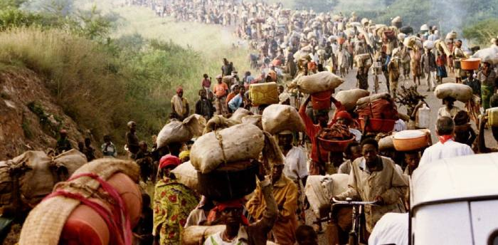
overview
What is violence? How should it be represented? Why is there conflict - and what is ‘our’ responsibility in the face of it? How can we begin to make sense of the many different forms of violence and conflict that shape our world?
In this module, we will grapple with these challenging questions and more. To do so, we will explore a range of critical theoretical and conceptual perspectives and engage with a diverse range of empirical cases from around the world.
Throughout, we will emphasise how the experience of violence is shaped by race, class, and gender, as we problematise clear-cut distinctions between 'war' and 'peace’. We will think about the structural character of violence, and the role of the state in perpetrating and perpetuating forms of violence.
We will draw on a range of disciplinary areas, including critical security studies, anthropology, political economy, feminist and postcolonial perspectives, philosophy, state crime scholarship, international relations, and critical genocide studies.

Slide 3
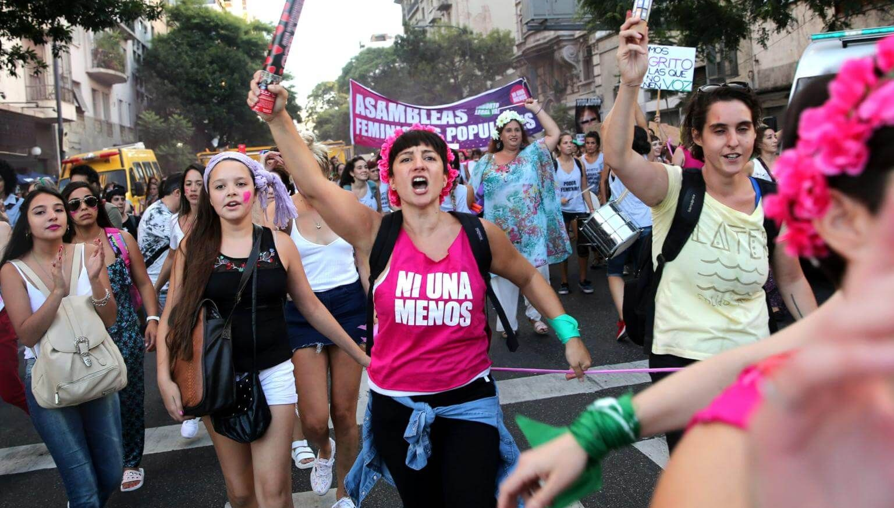
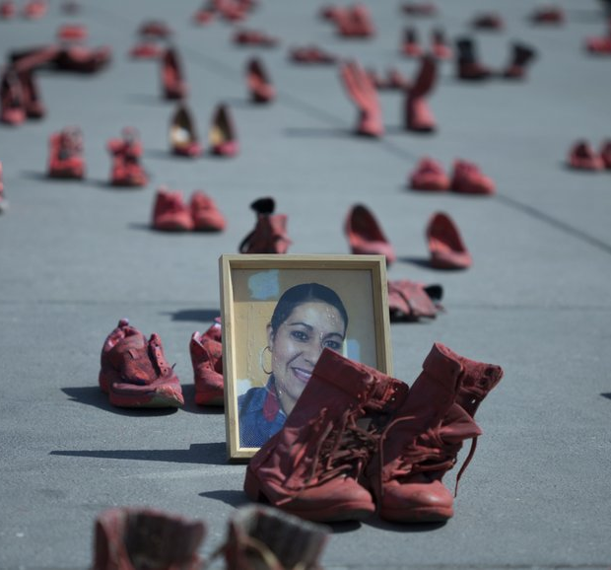
Themes and topics covered
Conceptualisations of ‘violence’
Representations of violence, and ethics of representing others’ suffering
The nexus between feminicide and neoliberalism in Latin America
Social death and the meaning of ‘genocide’
Ecocide and its connection with genocide
Concentrations camps and border violence
Structural and everyday violence
Feminist perspectives on violence
Necropolitics
Humanitarian intervention and its critics
Indigenous perspectives on post-conflict justice and healing
* Please note some of these may change year to year, as I update the module on a regular basis ☺

Slide 4
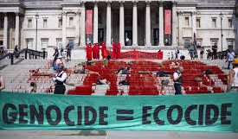
Learning outcomes
Critically reflect on the gendered, racialised, and colonial politics of representation and knowledge production about conflict and violence, and the ethical implications of this for us as students, teachers, and researchers in the Global North.
Gain a deeper understanding of, compare, and critically evaluate different theoretical and conceptual approaches to the study of conflict and violence, and apply these theories and conceptual frameworks to national and global politics.
Analyse and engage in class discussions about case studies and examples in a way that centres the everyday experience of ‘ordinary people’ as an important source of knowledge about conflict and violence, and about the search for justice, peace, and healing after conflict.
Develop the skills to think about complex long-term interactions between international, local, structural, political economic, and cultural-ideological determinants of violence and conflict.

Slide 5
MODULE FORMAT AND ASSESSMENT
ASSESSMENT
  5,000-word final essay (100%)
  Students are encouraged to develop their own essay question in consultation with me.
WEEKLY 3-HOUR SEMINARS
  There will be a mix of small group and individual work, class discussions and lectures.
  Our format will be flexible from week to week.

