Slide 1
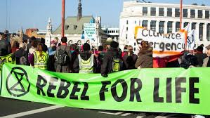

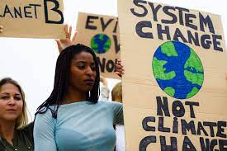

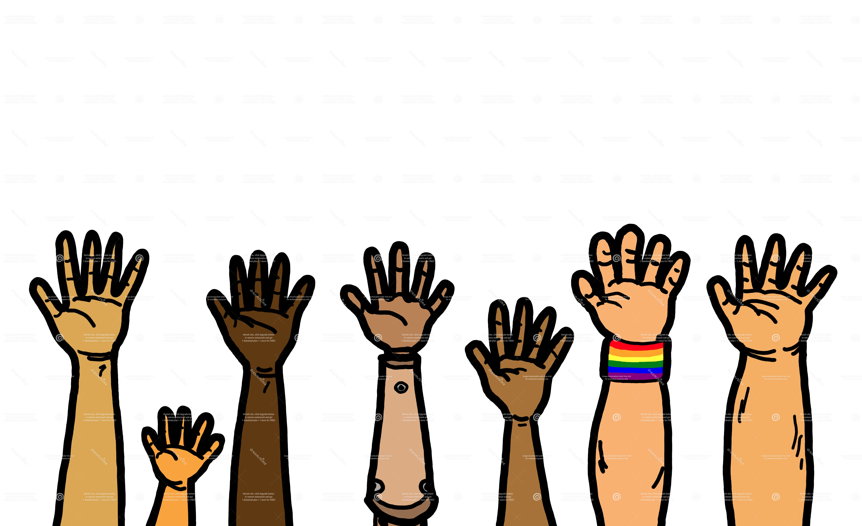
Advanced Sustainable Development
Sustainability in Policy and Practice
Professor David Ockwell

Slide 2
Why take this module?
This is the stuff no one taught me at undergrad level & I wish they had.
Sustainability isn’t an objective, scientific goal or “truth”; it’s messy, it’s political, it’s value driven & it goes to the very heat of democracy itself – this module explains how & why this is so & what this means for sustainability in policy and practice
I’ll introduce you to the advanced level of critical thinking you need to understand sustainability in the real world of politics and policy
I’ll teach you skills you need to work in sustainability as a career
I’ll bring my work as an advisor to the UN, World Bank and other international policy organisations into the classroom to bring this module to life

Slide 3
Module overview
Watch this video https://www.youtube.com/watch?v=cZ53Dre0xxE
This module builds on the work of the STEPS (Social, Technical & Environmental Pathways to Sustainability) Centre, a £10million research centre at Sussex where David Ockwell was deputy director of research
It is the first time the work of the STEPS Centre has been made accessible to undergrad students & builds on the Centre’s famous international summer school & accompanying online course (which Ockwell wrote & was geared towards PhD students)
The module gives you all you need to know to understand & apply the STEPS Pathways Approach & apply it in the real world
It also provides you with real world analytical skills + practical skills such as writing policy briefs to prepare for a career in sustainability

Slide 4
Teaching method:
Each week you’ll engage in a 1 hr lecture and 2 hr workshop.
Workshops will be highly interactive & peer led, helping you to understand on a deeper level the myriad perspectives of different types of stakeholders that characterise real world policy debates.
Assessment:
Policy brief, 2k words
Reflective essay, 3k words
Formative feedback:
Students also get feedback from participation in a student led conference & peer review of reading diaries

Slide 5
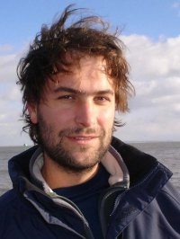
About me
I am Professor of Sustainability and International Development in the Dept of Geography and Global Studies School Impact Lead (meaning I am the person responsible for helping staff across the School to maximise the impact of their research and teaching on real world policy and practice). My research focuses on sustainability with a strong focus on the Global South. In particular, I work on low carbon energy and international development, and on public engagement in low carbon behaviour change.
I am also an advisor to the UN on global climate policy. My work has been adopted as policy by organisations such as the UN, World Bank and African Union, as well as multiple countries across the Global South. I also do focussed work in the local community in Brighton and Hove via a not-for-profit, martial arts based community organisation that I am a director of and have networks across a range of local sustainability relevant organisations, including those working with surplus food, refugees and asylum seekers and many other diverse marginalised groups.

Slide 6
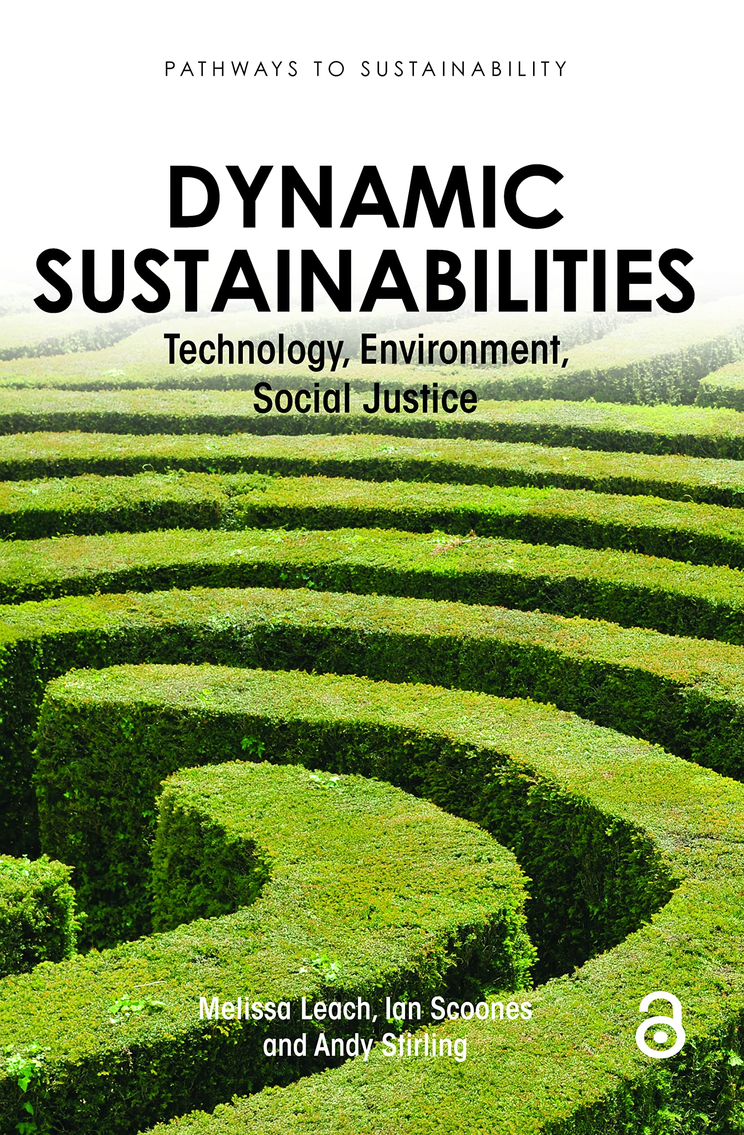
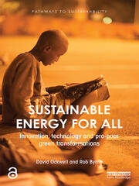
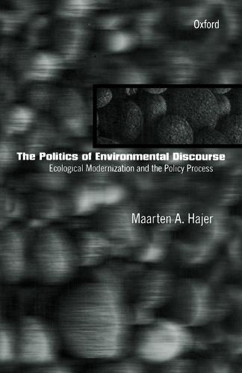
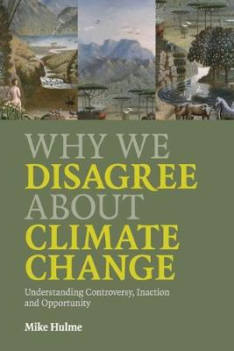
Suggested introductory reading

