Slide 1


HORIZONTAL DEVELOPMENT:
GRASSROOTS AND SOUTH-SOUTH COLLABORATIONS
International Development
Year 3 Option
Spring Term 2023/24

Slide 2


What’s the module about?
It’s about ‘horizontal’ forms of development and humanitarian aid, including flows of resources, expertise and labour that make up ‘South-South humanitarianism’
Informal development practices by grassroots groups, local and international solidarity activities, peer-to-peer assistance, mutual aid

Slide 3


Key Questions:
Does horizontal aid and development challenge the power differentials that often shape North-to-South practices?
How does that change our understanding of what counts as aid and humanitarianism?
Where can non-professionals place
themselves in order to make a difference?
Is mutuality the future of aid?

Slide 4
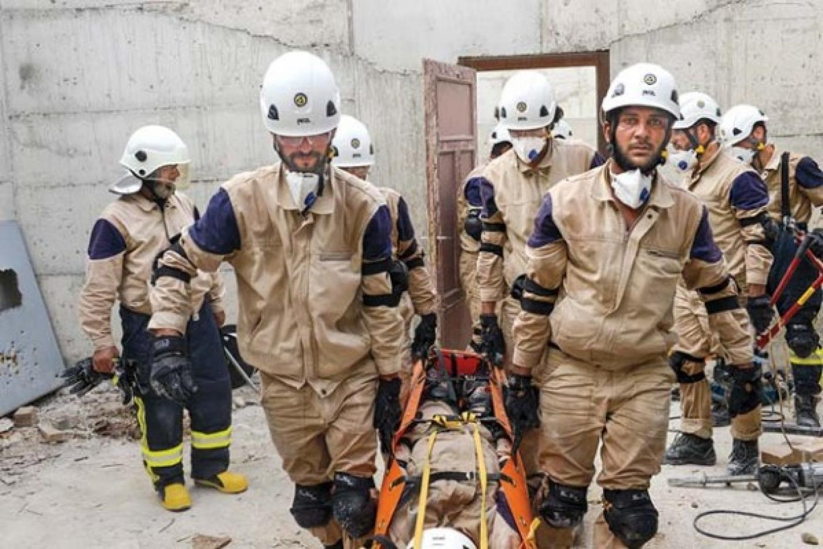

Module outline
Week 1 From global hegemonies to new horizontality?
Week 2 Professionals, Amateurs and Volunteers
Week 3 South-South Cooperation and Humanitarianism
Week 4 Faith-based Approaches
Week 5 Local Social Enterprises
Week 6 Reading Week
Week 7 Diaspora-led Development
Week 8 Citizen Aid and Grassroots Humanitarianism
Week 9 Digital Humanitarianism
Week 10 Aid, Solidarity and Activism
Week 11 Individual Tutorials

Slide 5
Module Format
The course consists of weekly 3-hour workshops, which include a lecture segment/topic overview and seminar
The seminars include student-led workshops; producing a short podcast; group reading discussions, exercises, and visual material

Slide 6
Assessment
one Blog piece (1,000 words) (25%), due in week 7 of the Spring term
one Case Study (4,000 words) (worth 75%) due in week 12 of the Spring term.
Topic of choice, to be agreed with Module Convener.

Slide 7
Learning outcomes
By the end of the module, you should have:
systematic knowledge of key theoretical perspectives on non-institutionalised development
Critically analyse the political, economic and social factors that shape these emerging forms of decentralised development and private aid
Independently identify evidence of drivers of such private aid activities through specific case studies
apply knowledge of key theoretical perspectives to analyse, evaluate and assess the implications of these emerging forms of development horizontality.

Slide 8


Module convenor: Meike Fechter
My research areas include
ethnographies of aid and development, everyday humanitarians, and
international aid workers
please email me at
a.fechter@sussex.ac.uk to find out more,
or have a chat

