Slide 1


Climate change: the IPCC 5th assessment and beyond…
Prof. Martin Todd
Dept. Geography
University of Sussex
m.todd@sussex.ac.uk
www.sussex.ac.uk/climatechange

Slide 2
Aim and overview
Aim
  To provide updated summary of state-of-the-art in climate change science from IPCC AR5
  To give a flavour of some of the related research at Sussex

Slide 3
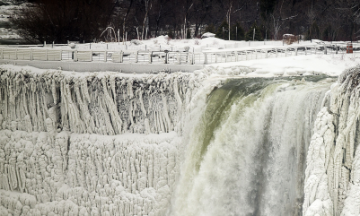
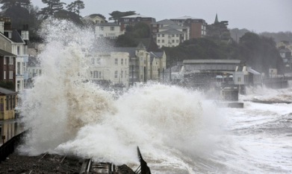

Climate change
Climate change is perhaps the biggest issue of our time
  Fascinating science challenge integrating all environmental sciences
  Major challenge for our socio-economic-political systems
  Potentially enormous implications for all aspects of society
www.sussex.ac.uk/climatechange
Notes:
Despite Copenhagen CC is here to stay. The issue is what mix of mitigation and adaptation we will need to undertake

Slide 4

Sussex climate change network
www.sussex.ac.uk/climatechange

Slide 5
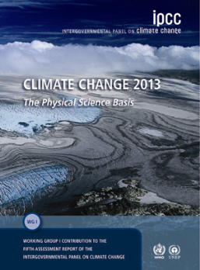
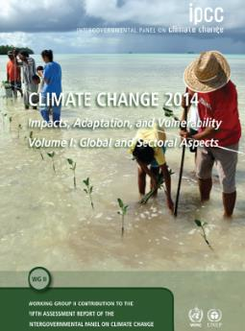
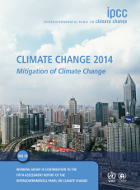
Scope of the IPCC
Climate Science Adaptation Mitigation
All reports available at www.ipcc.ch
www.sussex.ac.uk/climatechange

Slide 6
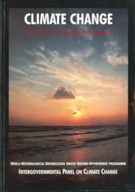
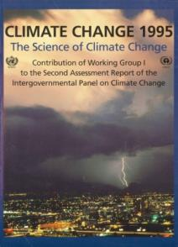
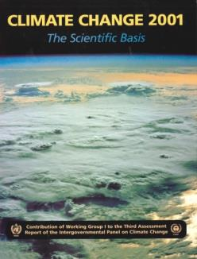
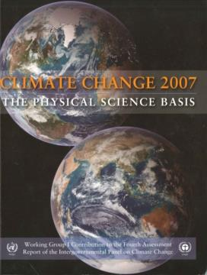
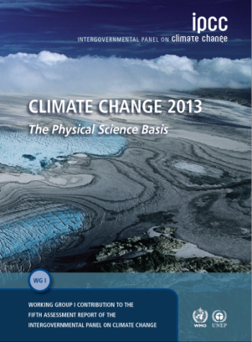
IPCC Assessment Reports since 1990: WGI Contribution
1990
What is new in IPCC AR5?
Affirmation, refinement and reinforcement of previous conclusions
1995
2001
2007
2013
Notes:
All IPCC Assessment Reports are available at www.ipcc.ch

Slide 7
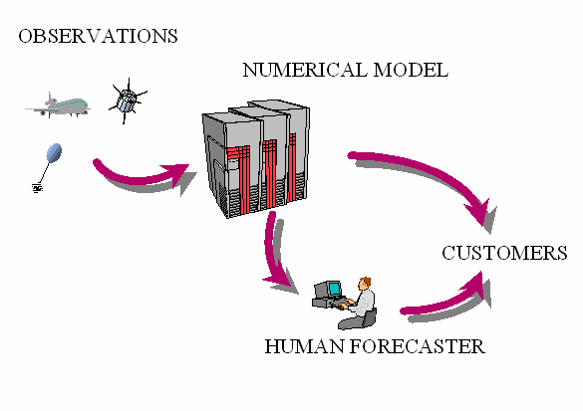
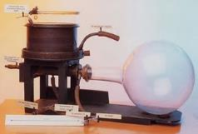

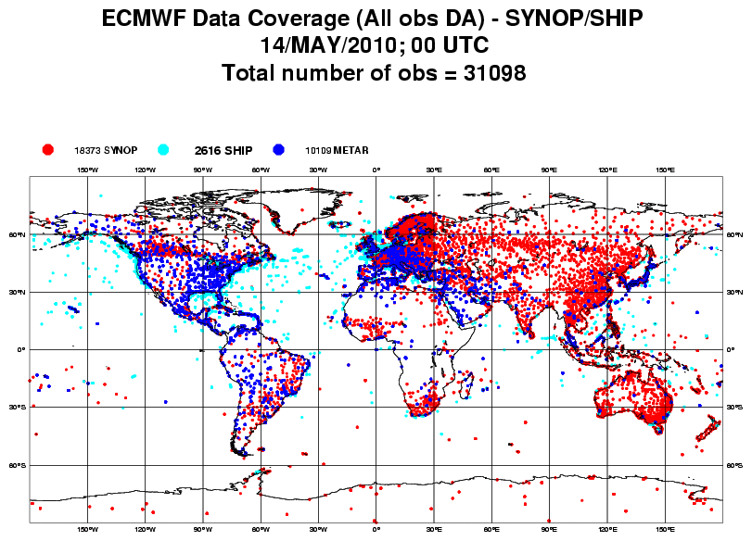
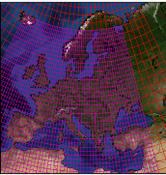
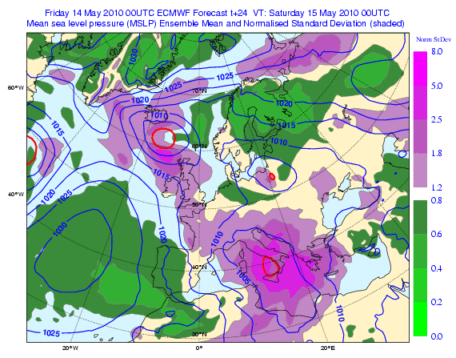
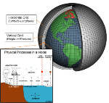
Tools of climate science
LAB EXPERIMENTS
NUMERICAL ANALYSES OF DATA
Observations are crucial cornerstone of climate science
NUMERICAL MODEL
PREDICTIONS
Days-seasons-years-decades

Slide 8
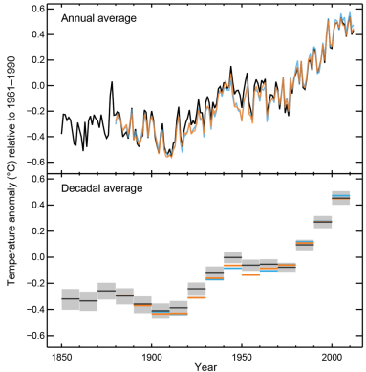
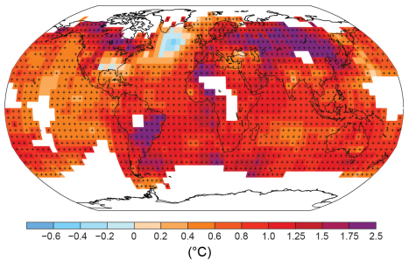
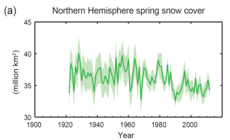
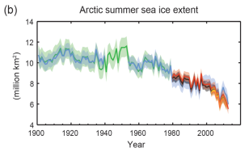
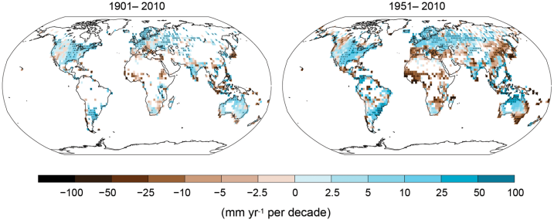
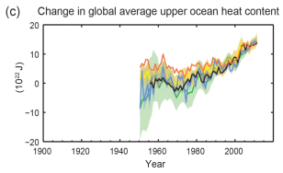
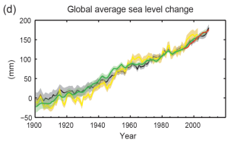
1. Observations of our changing climate…
All Figures © IPCC 2013
Notes:
Figure SPM.1, Panel a
Complete caption of Figure SPM.1:
Figure SPM.1 | (a) Observed global mean combined land and ocean surface temperature anomalies, from 1850 to 2012 from three data sets. Top panel: annual mean values. Bottom panel: decadal mean values including the estimate of uncertainty for one dataset (black). Anomalies are relative to the mean of 1961−1990. (b) Map of the observed surface temperature change from 1901 to 2012 derived from temperature trends determined by linear regression from one dataset (orange line in panel a). Trends have been calculated where data availability permits a robust estimate (i.e., only for grid boxes with greater than 70% complete records and more than 20% data availability in the first and last 10% of the time period). Other areas are white. Grid boxes where the trend is significant at the 10% level are indicated by a + sign. For a listing of the datasets and further technical details see the Technical Summary Supplementary Material. {Figures 2.19–2.21; Figure TS.2}

Slide 9
Summary of observed changes
Atmosphere and oceans have warned
  1983–2012 was likely the warmest 30-year period of the last 1400 years (medium confidence).
  Ocean warming accounting for more than 90% of the energy accumulated between 1971 and 2010 (high confidence). It is virtually certain that the upper ocean (0–700 m) warmed from 1971 to 2010

Slide 10
Summary of observed changes
Sea levels have risen
  Over the period 1901 to 2010, global mean sea level rose by 0.19 [0.17 to 0.21] m.
Amounts of snow and ice have declined
  Over last 20yrs Greenland & Antarctic ice sheets have been losing mass, glaciers have continued to shrink worldwide, and Arctic sea ice and Northern Hemisphere snow cover have continued to decrease (high confidence).

Slide 11
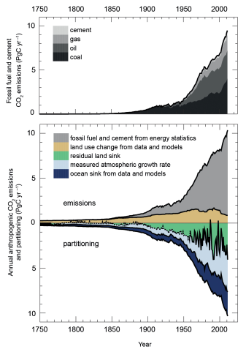
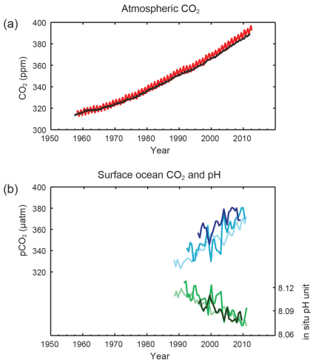
Observed changes in the composition of the atmosphere…
All Figures © IPCC 2013

Slide 12
Summary of observed changes
The concentrations of greenhouse gases have increased
  CO2, CH4, and NO2 greater than any time in at least the last 800,000 years.
  CO2 increased by 40% since pre-industrial times, from fossil fuel emissions and secondarily from net land use change emissions.
  The ocean has absorbed about 30% of the emitted anthropogenic carbon dioxide, causing ocean acidification.

Slide 13
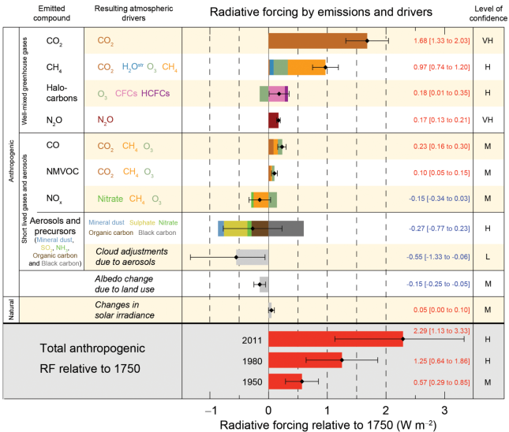
Observed changes in the energy budget of the planet…

Slide 14
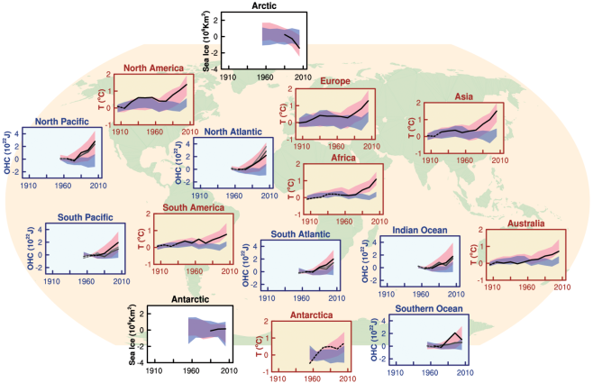
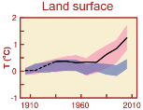
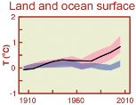
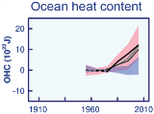
2. Attribution: What is causing climate change?
We use all the observed information to drive and validate climate model simulations of the 20th Century

Slide 15
Summary of attribution
Human influence has been detected in warming of the atmosphere and the ocean, in changes in the global water cycle, in reductions in snow and ice, in global mean sea level rise, and in changes in some climate extremes.
This evidence for human influence has grown since AR4. It is extremely likely that human influence has been the dominant cause of the observed warming since the mid-20th century.
Confidence in this statement is increasing with improvements in models and data.

Slide 16
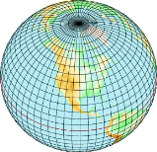

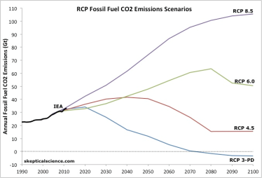
3. Making projections of the future
Many climate models
Driven with projections of future GHG and aerosols

Slide 17
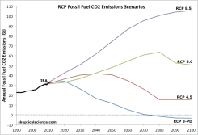
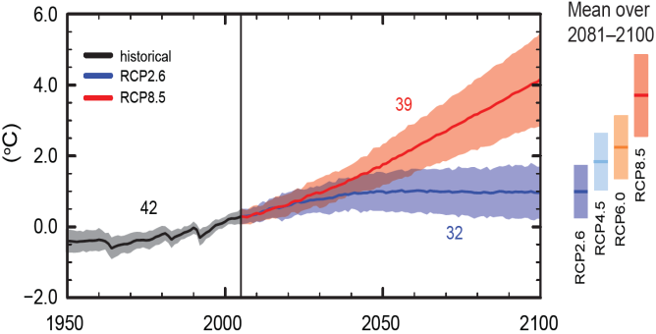
Projections of the future: Global mean temperature
Global surface temperature change for the end of the 21st century is likely to exceed 1.5°C relative to 1850 to 1900 for all RCP scenarios except RCP2.6. It is likely to exceed 2°C for RCP6.0 and RCP8.5, and more likely than not to exceed 2°C for RCP4.5.

Slide 18
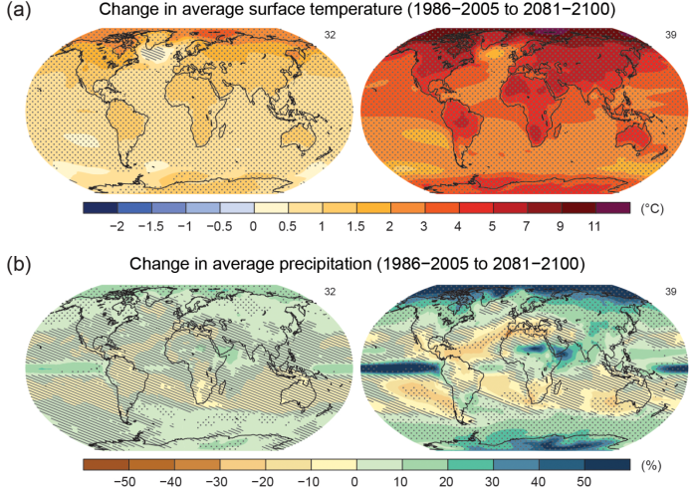
Projections of the future: Temperature and precipitation
Notes:
Figure SPM.8 | Maps of CMIP5 multi-model mean results for the scenarios RCP2.6 and RCP8.5 in 2081–2100 of (a) annual mean surface temperature change, (b) average percent change in annual mean precipitation, (c) Northern Hemisphere September sea ice extent, and (d) change in ocean surface pH. Changes in panels (a), (b) and (d) are shown relative to 1986–2005. The number of CMIP5 models used to calculate the multi-model mean is indicated in the upper right corner of each panel. For panels (a) and (b), hatching indicates regions where the multi-model mean is small compared to natural internvariability al variability (i.e., less than one standard deviation of natural internal variability in 20-year means). Stippling indicates regions where the multi-model mean is large compared to natural internal (i.e., greater than two standard deviations of natural internal variability in 20-year means) and where at least 90% of models agree on the sign of change (see Box 12.1). In panel (c), the lines are the modelled means for 1986−2005; the filled areas are for the end of the century. The CMIP5 multi-model mean is given in white colour, the projected mean sea ice extent of a subset of models (number of models given in brackets) that most closely reproduce the climatological mean state and 1979 to 2012 trend of the Arctic sea ice extent is given in light blue colour. For further technical details see the Technical Summary Supplementary Material. {Figures 6.28, 12.11, 12.22, and 12.29; Figures TS.15, TS.16, TS.17, and TS.20}

Slide 19
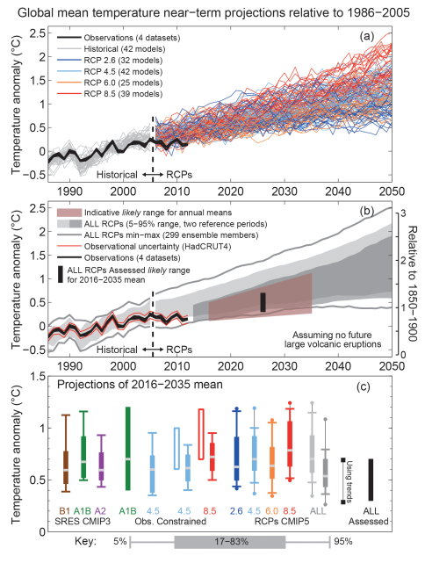
What to expect in the near future: Hiatus?

Slide 20

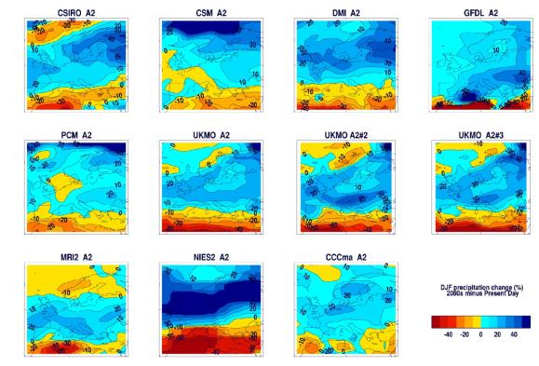
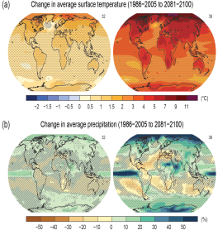
But climate model projections remain uncertain
Uncertainty problem for adaptation decision making

Slide 21
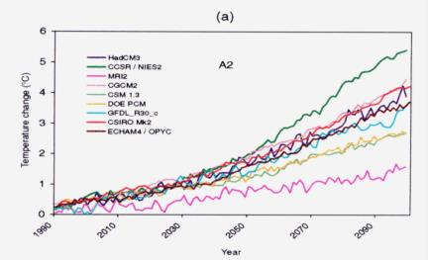
Why are climate model projections uncertain
Uncertain future emissions
Uncertainty in model processes (feedbacks)

Slide 22
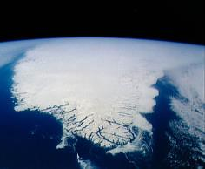
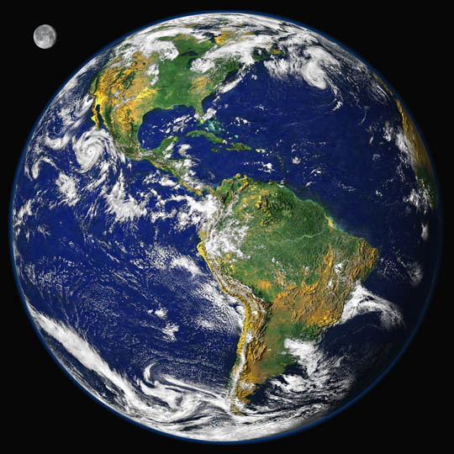
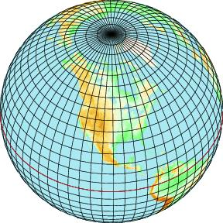
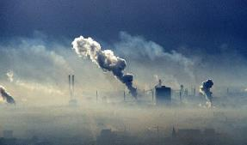
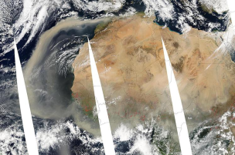

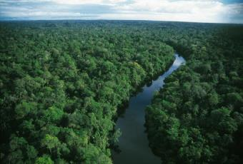
Notes:
Achievement #2. Earth system is highly complex. One of the great achievements is GCMs. Very challenging e.g. slow components interactions and and feedbacks. Exemplified by dust image. Also rainforest. Great strides forward. Success story. Detection/attribution
Climate sci underpins entire issue. This is important because policies must be consistent with this.

Slide 23
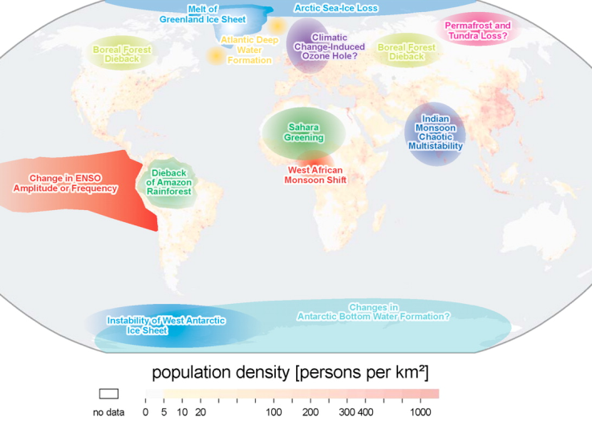
…Can models represent crucial processes that might lead to ‘tipping points’?
www.sussex.ac.uk/climatechange
Notes:
Under such warming climate may start to behave in unpredictable ways: tipping points. Great challenge to represent these in models

Slide 24
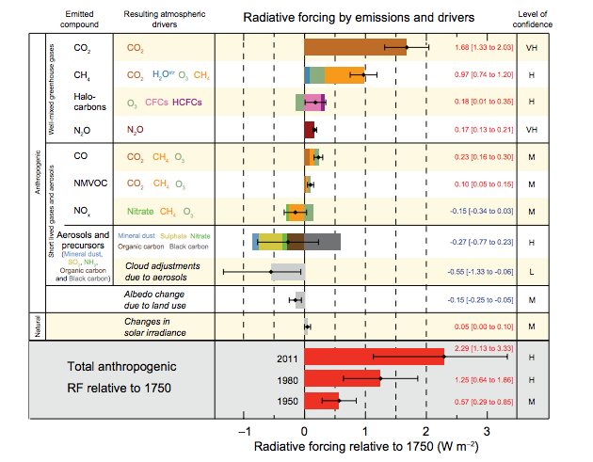
Aerosols are one of biggest uncertainties in climate change
From IPCC 2013

Slide 25
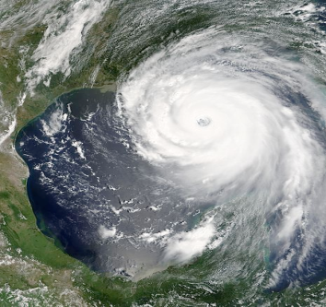
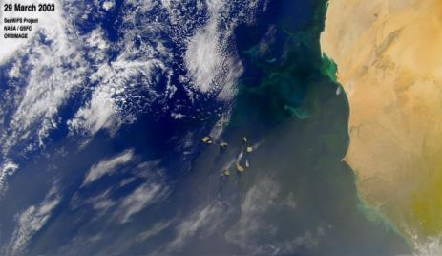
Why is dust important? Effect on climate
Infrared radiation
Solar radiation
On balance dust aerosols cool the planet
Cloud and rainfall
Fertiliser of land and ocean: Dust deposition inputs nutrients (Iron, Potassium, Phosphorus etc)

Slide 26
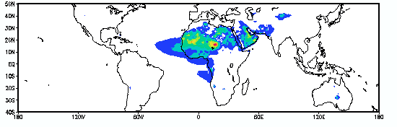

The Bodele Depression is the most important dust source in the world
Why?
What are the regional and global implications?
Notes:
How much dust is the the atmosphere? We don’t know exactly due to weak surface obs. What we do know comes from satellite: TOMS has longest record (25 years of data). Shows Key source region is Bodele depression in Chad?
Why Bodele? Unique set of circumstances

Slide 27




What is the Bodele Depression?
A topographic depression in Northern Chad (about 150m above sea level)
The deepest part of ancient palaeo-lake ‘Mega Chad’
Lake now dry and diatom deposits remain (area of ~10,600km²)
World’s greatest dust source (more than 100 dust storms per year)

Slide 28



BoDEx: Various instruments to measure dust and weather

Slide 29




Slide 30

How much dust is emitted from the Bodélé?
Observations from Bodélé suggest about 60-120 million tonnes emission per year
About 5-20% of global total
About 50% of all dust deposited over South America comes from the Bodélé (22 million tonnes pa)
Koren et al. 2006, Env. Res. Lett.
Todd et al 2007, J Geophysical Research

Slide 31



All the Elephants in Africa?
60 – 120 million tonnes of dust exported from the Bodélé every year
500,000 x 5 tons = 2,500,000 (2.5 million tons) x 48 = 120 million tons
That’s all the elephants in Africa, blown out of the Bodélé, every week!

Slide 32

What is the importance of this dust to global ecosystems?
Dust can fertilize oceanic and terrestrial ecosystems over Africa, the Atlantic and South America
Need to know how much nutrient is in the Bodélé dust

Slide 33



What is the Bodélé dust made of?
Dust from Bodélé
Bodélé dust nutrient content:
Fe 33,000ppm,
P: 780ppm
(Bristow et al., 2010)

Slide 34


Amazon Rainforest Fertiliser
Bodele contributes to Amazon
6.5MT of Fe/year
0.12MT of P
(Bristow et al., 2010)
Bristow, Hudson-Edwards and Chappell 2010 GRL

Slide 35



Expertise in Sussex Geography
Climate science
Climate and energy policy
Impacts and adaptation
www.sussex.ac.uk/climatechange
Notes:
You will be taught be leading researchers. People who advise governemnts in UK and abroad, lead contirbuters to IPCC.

Slide 36

IPCC 5th assessment projections vs 4th assessment

