Slide 1


What do Geography Students do?
Evelyn Dodds and Helen Gorman

Slide 2
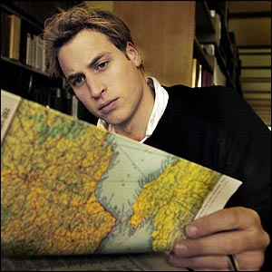
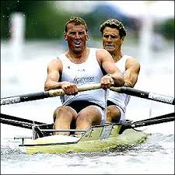
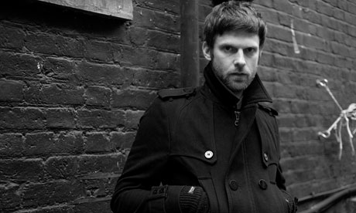

What do Geographers do?
Notes:
Famous geographers include Prince William, Michael Jordan, Nick Hodgson (drummer for the Kaiser Chiefs), Rowers James Cracknell and Matthew. Pinsent
Geography isn’t an obviously vocational subject like law or medicine, which means it can be a little scary for geography students to decide what to do when they graduate. There are a broad range of careers open to a geography graduate. You could do anything from working in the war room of a royal navy vessel, to working with the environment agency, running housing schemes, or working almost anywhere is the public sector.
With further qualifications or training, you could also teach geography, do urban design or town planning, or become a chartered surveyor.
The ability to view problems from a number of angles.
The ability to write a professional standard document, as well as effective verbal communication.
The ability to work to deadlines gained from projects and fieldwork.
The independence gained from working abroad and producing a report in foreign conditions.
The ability to work in a group gained from fieldwork or project.
An analytical approach to people and their environment, which means that geographers should also have developed an objective aptitude for management.
From a careers adviser perspective, I find that geographers often have the broadest range of careers ideas. Some geography careers may depend on your interest in physical or human geography. Some graduates will consider jobs that are very degree-related jobs, some will choose jobs that incorporate elements of your degree, or jobs that are not related at all…
Graduate destinations for geography- nationally
Employed (59.6%)
Further study (20.2%)
Working and studying (5.8%)
Unemployed (8.1%)
Other (6.3%)

Slide 3
Career exploration for Geography students
Important factors in career choice often include:
Values, interests and motivations
Degree subject
Graduate destinations
Job availability
Notes:
eco- campaigner or oil worker? Values do play a big part in career decision making for sussex students.
Some people will want to use their subject knowledge/ degree knowledge directly in their role- others may not.
Values, interests, personality, skills- think about what you are looking for in work
Where to graduates go? Useful for generating ideas
Location, recession etc

Slide 4
Issues for students
Importance of building skills & experience
Competitive nature of graduate careers
It’s never too early to start your career exploration
Getting ahead of the game!
Notes:
We try to engage with students in their first year at Sussex. We talk to them initially at the induction stage but continue to have input through lecture talks to encourage them to engage with the career exploration.
Competitive- graduate careers are very competitive but you can increase your chances by gaining work experience and understanding what the employers are looking for- (broadly- good academics, interpersonal skills, written & oral communication skills, personal responsibility & integrity)
Vitally important to achieve good grades!
Forewarned is forearmed! This is totally true in the context of most career choices- it really is never too early to start researching your path & building your experience

Slide 5
Jobs directly related to a Geography degree include –
Cartographer
Environmental Consultant
Geography Information Systems Officer
Planning and Development Surveyor
Secondary School Teacher
Town Planner
International aid / development worker
Transport planner
And many many more…..
See www.prospects.ac.uk to find out more.
Notes:
Some of these roles will have a direct entry point through a graduate training scheme/ post graduate qualification route (town planner, surveyor) while other career pathways are less defined and more about getting experience and an entry level position within an organisation.
geological assistant
development analyst
country or rural planner
environmental consultant
cartographer
recycling manager
weather analyst
GIS analyst
park ranger
travel agent
soil conservationist
landscape architect
water/land manager
tourism

Slide 6
Recent examples - Sussex graduates
Rural Officer for the Sussex Rural Community Council,
Project Manager for Watling Chase Community Forest,
Conservation Officer for the Environment Agency,
Training Manager for London Transport,
Personnel Manager for London Underground,
Energy Researcher for a management consultancy,
Editor for Thomson Science Publishers,
Marketing Manager for an ecotourism organisation

Slide 7

Typical Employers?
Notes:
Typical employers
Examples of employers include local government, the armed forces, private companies, environmental consultancies, environmental protection agencies, utilities, charities, information systems organisations, education, commerce, industry, transport, tourism and the Civil Service. Geography graduates have excellent transferable skills, which also attract employers from the business, law and finance sectors.
Organisations are interested in the analytical and research skills developed by geographers during their degrees. For example, The Ministry of Defence (MOD) employs geography graduates as research analysts, and the Police Service offers civilian careers in intelligence analysis and research. Companies also recruit geography graduates as trainee account executives, with responsibility for developing knowledge of their clients' accounts and understanding their research needs.

Slide 8

Options with a degree in any subject include:
Law
Accountancy
Media
Marketing
Business
Civil service
Graduate training schemes
IT
And many more
Notes:
Some career areas are open to all graduates, regardless of subject. Many of these have a graduate entry scheme & others have a PG training route such as GDL for law, ACCA exams for accountancy, teaching etc.
If you would like to explore graduate schemes- we have a section on our website

Slide 9
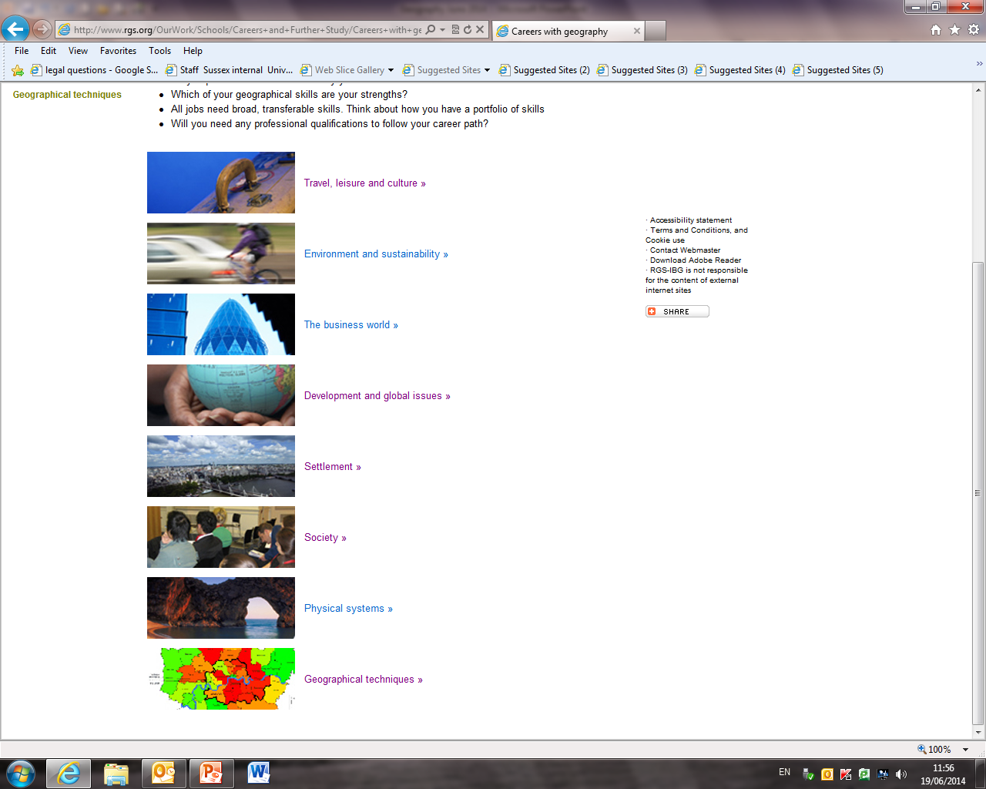
RGS Careers pages www.rgs.org

Slide 10
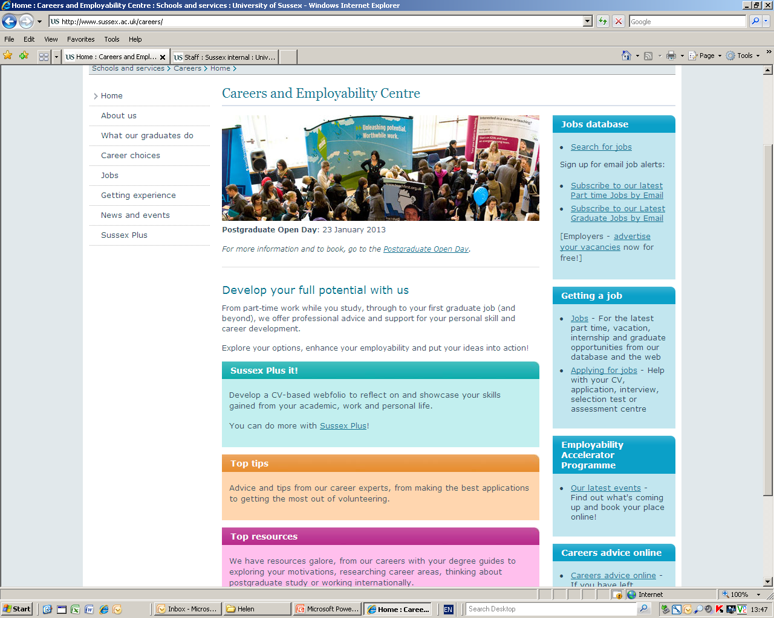
Use our website for research! www.sussex.ac.uk/careers
Notes:
Research your career options- look at what is available, what you might be interested in & what you need to enter those professions.
Start to build relevant experience if you can.
Show website- jobs, work experience, sector guides, CVs etc

Slide 11
Careers and Employability services for students
Careers and employability accelerator programme
One-to-one consultations with a careers adviser
Employer events
Central website / specialist materials
Follow us on twitter @SussxUniCareers
Facebook
www.sussex.ac.uk/careers
Notes:
Specifically geography – mention work within the department

