Slide 1
What do geographers do?
Travel, leisure and culture
Environment and sustainability
The business world
Development and global issues
Settlement
Society
Physical systems
Geographical techniques

Slide 2
http://www.sussex.ac.uk/geography/ugstudy/careers

Slide 3
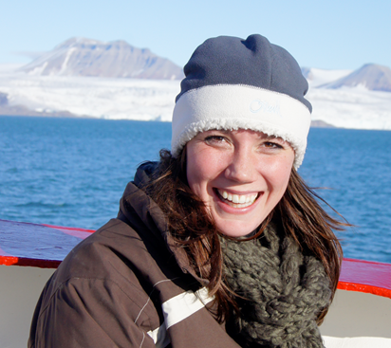
BSc Geography with Ecology (2007)
Undergrad Dissertation in Sea Life Centre, Brighton
Summer vacations - volunteering for the RSPB , British Ecological Society & Institute of Biology
2007 RSPB
2009 Policy Advisor for International and Domestic Outreach, Office of Carbon Capture and Storage, Department of Energy and Climate Change (DECC)
Now Senior Policy Advisor, Global Carbon Markets, International Climate Change, DECC
Briony Daw

Slide 4
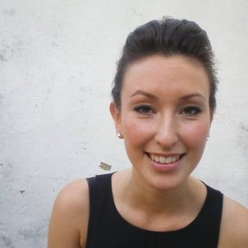
Hannah Blake
BA 2011
2011 – Paralegal Internship with A4ID
2012 – BBC Worldwide : Paralegal assistant to head of business and legal affairs
2013 - Programme Manager BBC Worldwide
“I run Labs, BBC Worldwide's award winning start-up accelerator. We take six of the best digital media start-ups and help them to secure commercial partnerships with BBC Worldwide.
My main responsibility is to work alongside the start-ups and BBCW business units to recognise and secure commercial partnerships. ”

Slide 5
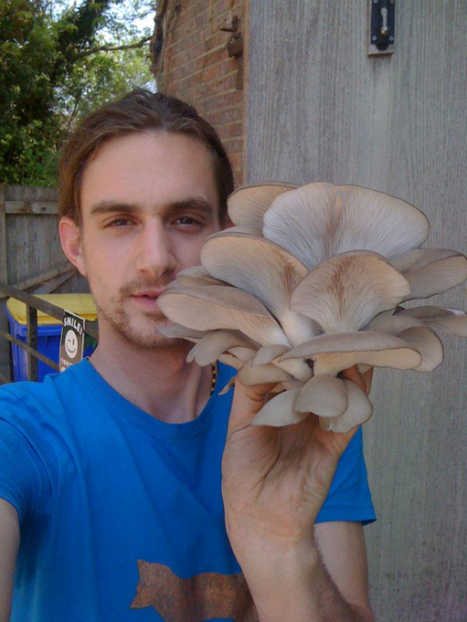
Robbie Georgiou
BA (Hons) Geography and Development Studies 2011
Start-Up Sussex – support funding for entrepreneurial students
http://www.sussex.ac.uk/careers/careerchoices/startupsussex
Founder and Operations Director at Espresso Mushroom Company - www.espressomushroom.co.uk

Slide 6
