Slide 1
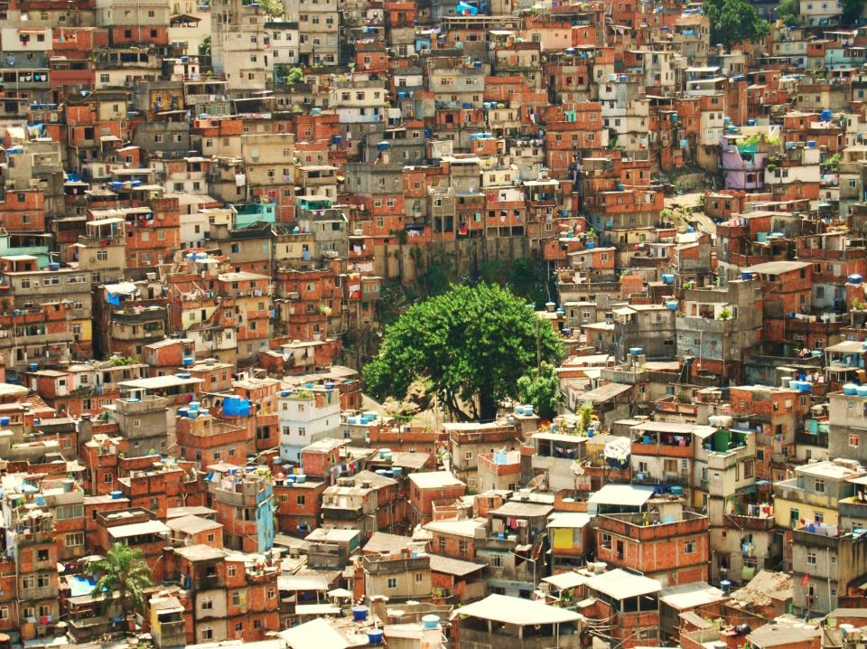
The Biggest Migration in the World
Mobility, Urbanisation and Informal Housing
Michael Collyer

Slide 2
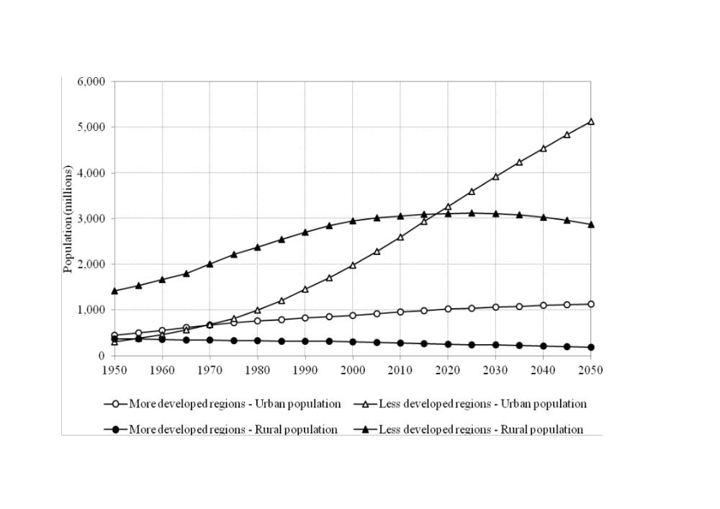
Global population growth will be concentrated in poor cities
Notes:
World urban population expected to increase by 72% by 2050 from 3.6b to 6.3b. More developed regions increase 1b to 1.1b less developed regions 2.7b to 5.1b

Slide 3
Megacities account for smaller but fastest growing proportion of total urban population
Notes:
1970 there were 2 megacities (New York and Tokyo) in 2011 23, project to be 39 by 2025. Lagos and Dhaka expected to grow at almost 3%/year 2011-2025
Distribution varies by region – Europe and Africa larger concentrations in smaller cities; Asia and America concentrations in larger cities.

Slide 4
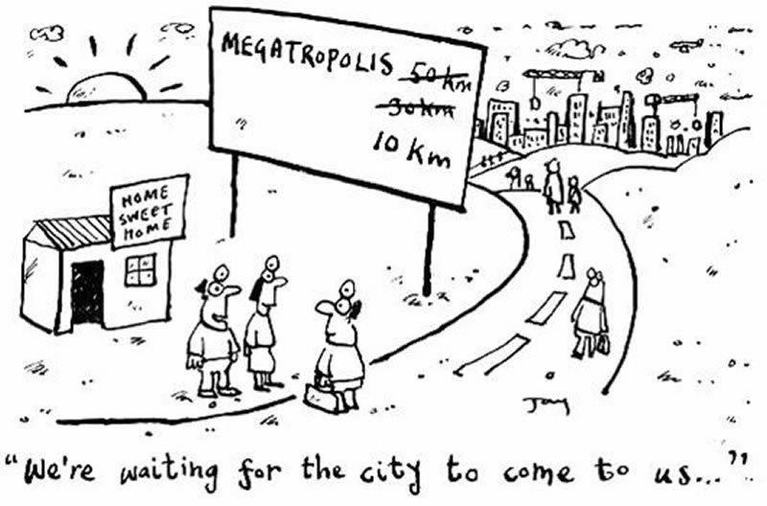
2011-2050 urban growth will vastly outpace population change as driver of urbanisation

Slide 5
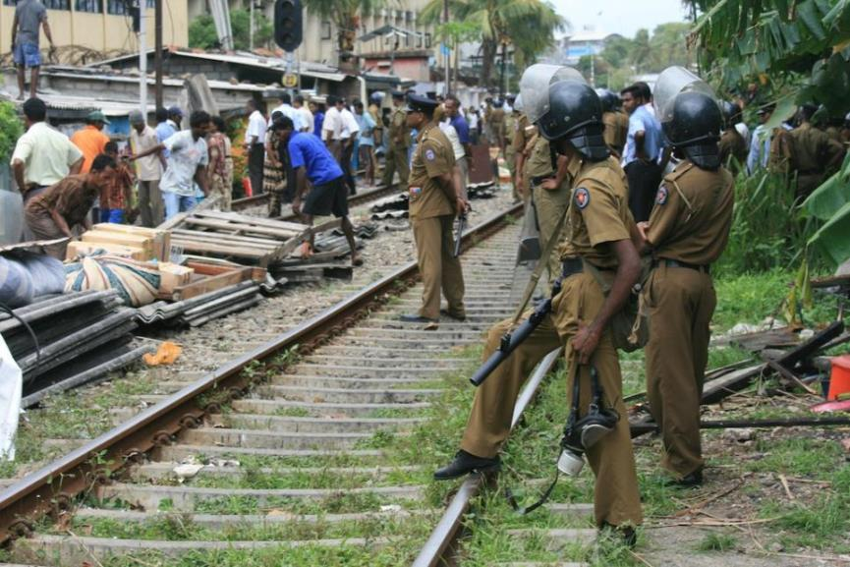
83% of governments reported concerns about patterns of population distribution. 72% developing countries have policies to reduce migration to large cities
Notes:
From World Population Policies 2009. Governments in Africa and Asia most likely to report desire to change spatial distribution of populations. 75% in Africa and 57% in Asia desired major change. Only 34% of developing countries have policies to reduce rural to urban migration.

Slide 6
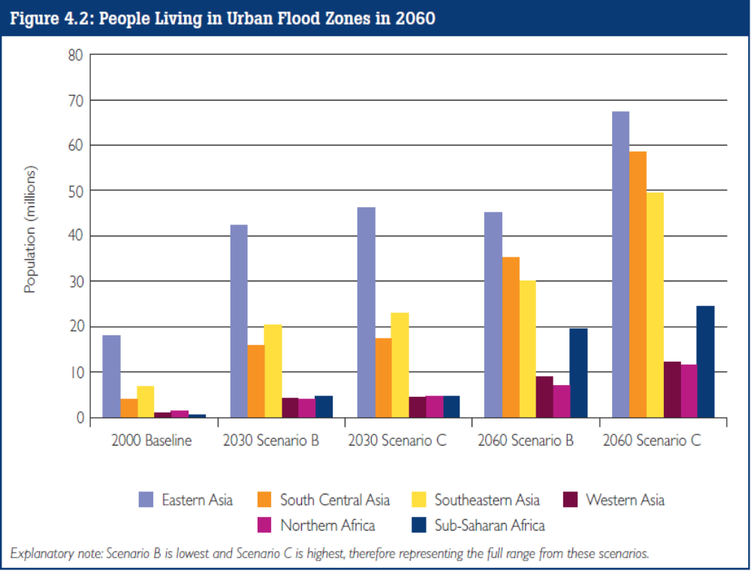
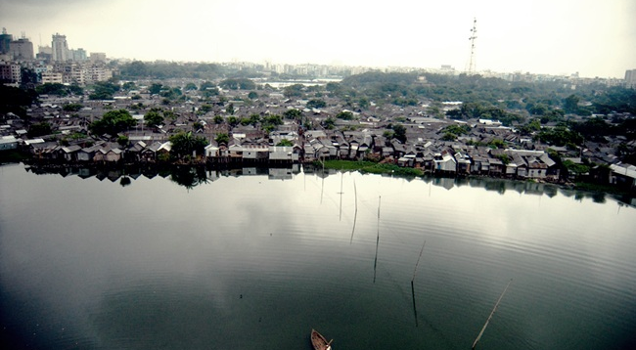
New awareness of impact of natural hazards on cities
People living in urban coastal flood zones in 2060
Notes:
World Urbanisation Prospects 2011 first to take account of natural hazards. Of 633 cities studied 233 (663m people) at risk of flood, 132 at risk of drought (277m people), cyclones affect 68 cities (229m residents) and earthquakes 40 – landslides and volcanoes marginal.
Data from Natural Disaster Hotspots: a global risk analysis (Dilley et al 2005) Columbia Uni and World Bank. Data on 6 hazards 1980-2000.

Slide 7
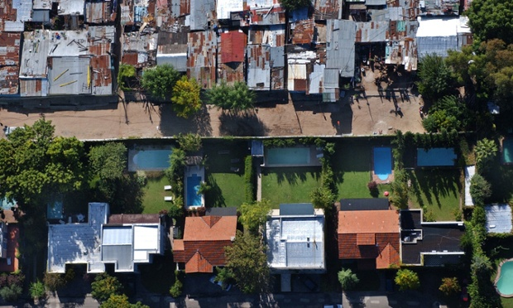
Vulnerability of new urban residents varies widely
Notes:
Photo is Villa La Cava largest shanty town in Buenos Aires. UNHabitat says 889m slum dwellers in 2010. 95% in developing countries.

Slide 8
What contribution can academic research make?

Slide 9
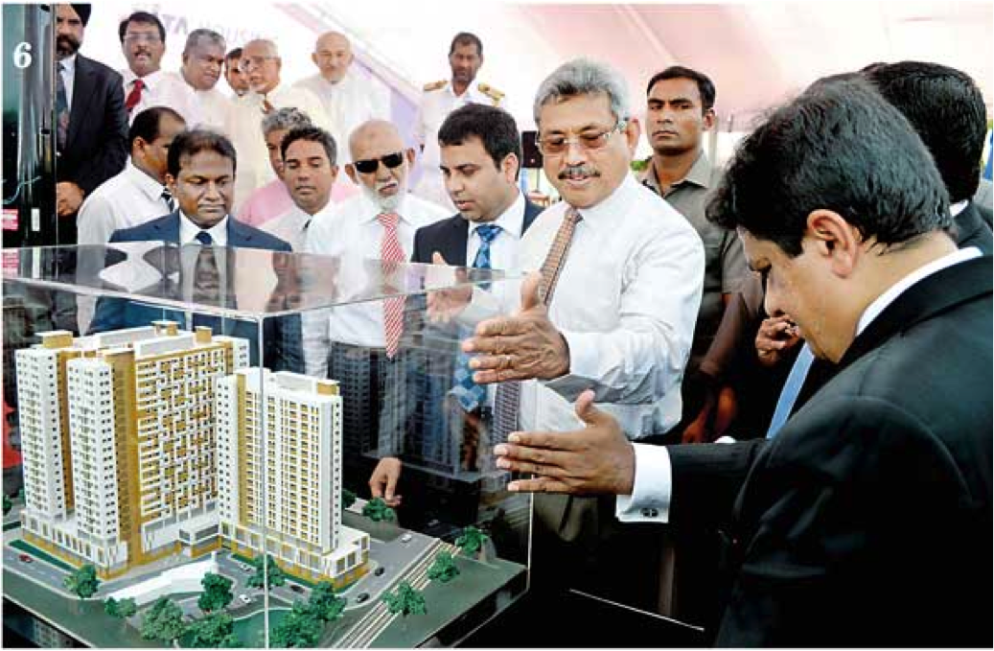
Colombo beautification: financialisation of development
Notes:
65k-135k famillies to be moved 2011-2020
Research in 5 locations – majority very unhappy.

Slide 10
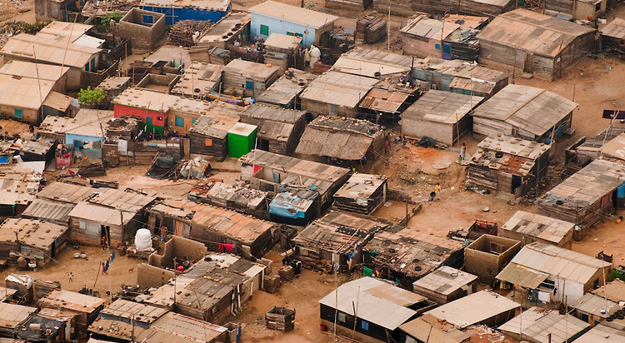
Migrating out of Poverty RPC: New research in informal settlements in Accra: 87% migrants positive about migration
Notes:
April 2014 working paper by Mariama Awumbila, George Owusu and Joseph Kofi Teye. Research in Nima and Old Fadama

Slide 11
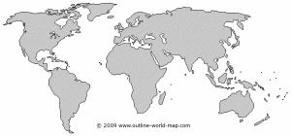
RGS Field Research Programme: ‘Migrants on the Margins’

Slide 12
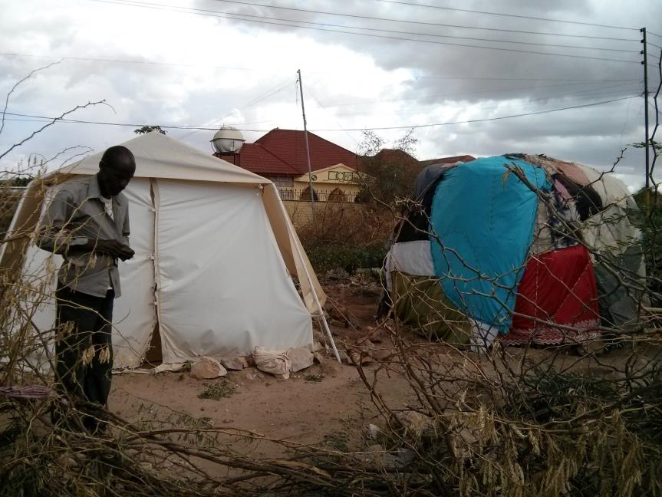
Focus on ‘marginalised urban areas’

Slide 13
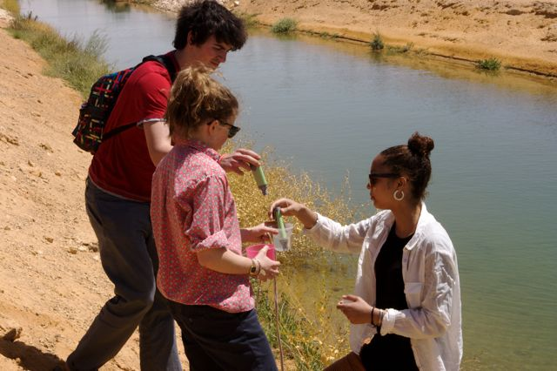
Plans for student involvement in research

Slide 14
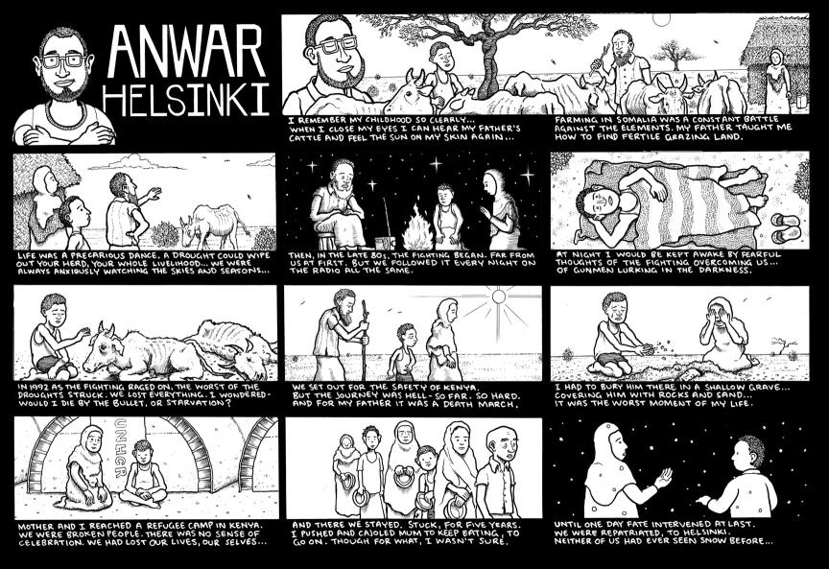
Plans for continuous outreach

Slide 15

Thankyou.
http://migratingoutofpoverty.dfid.gov.uk
http://www.rgs.org/OurWork/Field+Research+Programmes/Field+Research+Programme.htm
M.Collyer@sussex.ac.uk
@CollyerMC

