Slide 1
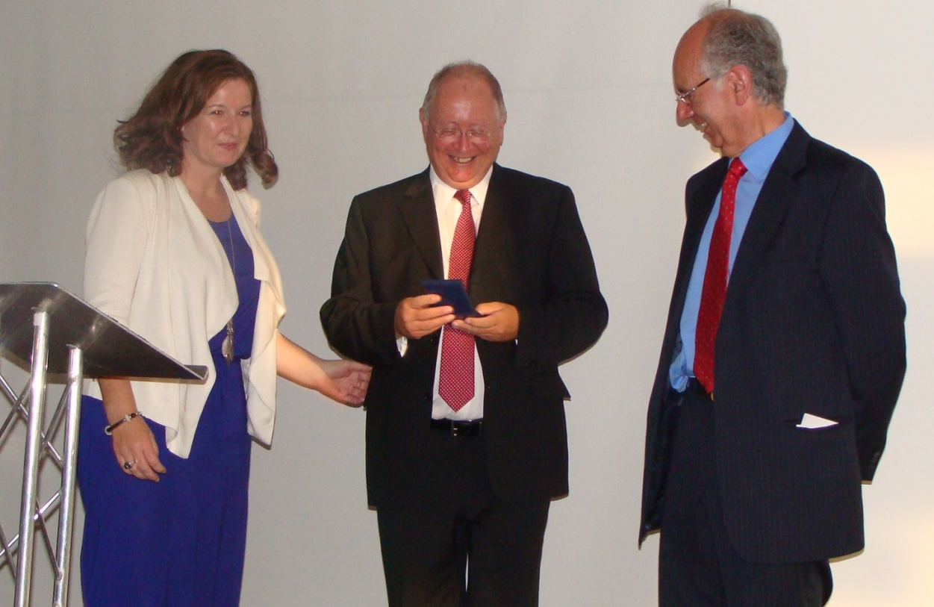
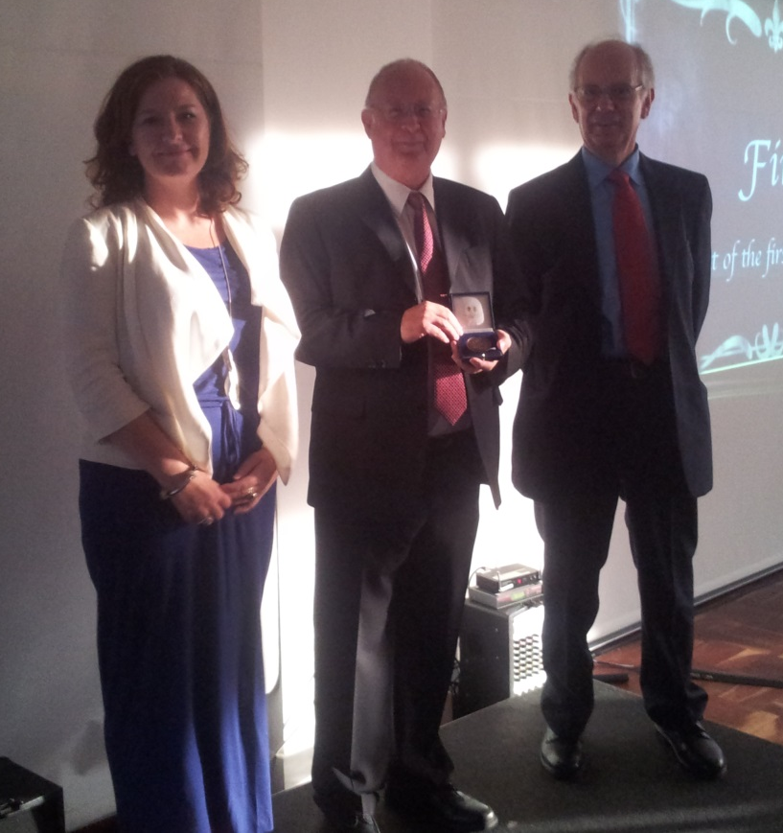
Michael Atkinson receiving the Weiss Medal from ARR Chair, Rhona Anderson and Bernard Weiss.

Slide 2
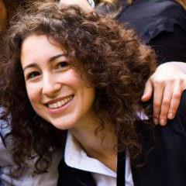
The following Scientists in Training (SITS) were chosen to present short talks:
Cynthia Eccles, Grainne Manning, Simon Horn, Saray Jevons
Anne-Sophie Schreurs, Lara Barazzuol, Dafni-Eleftheria Pefani and Iosifina Foskolou
All SIT talks were excellent and the SIT presentation prize was awarded to:
Iosifina Foskolou

Slide 3
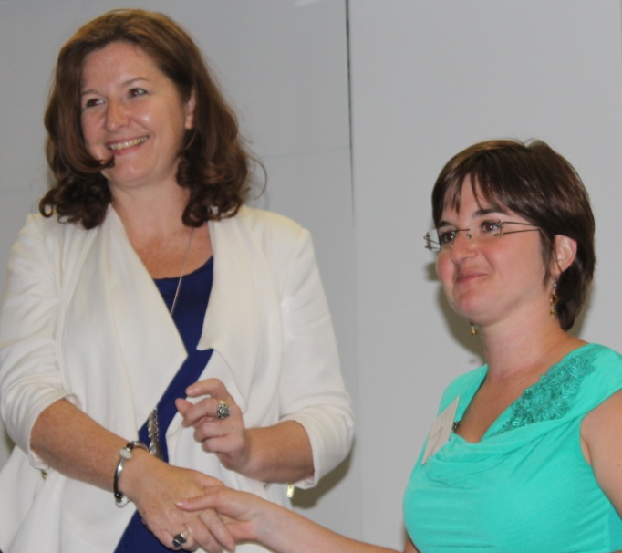
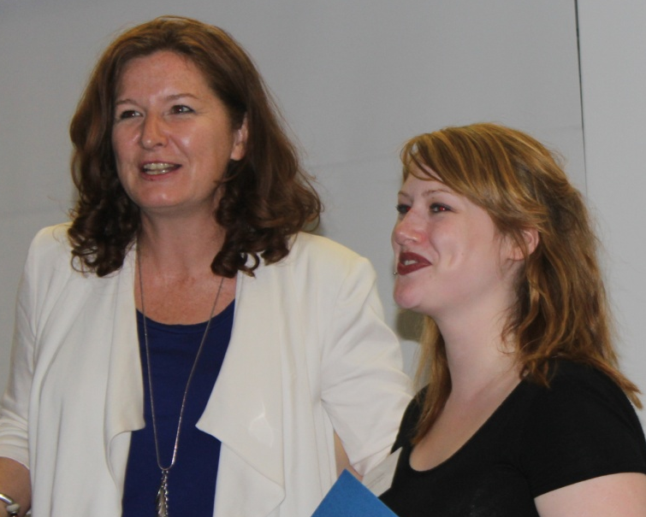
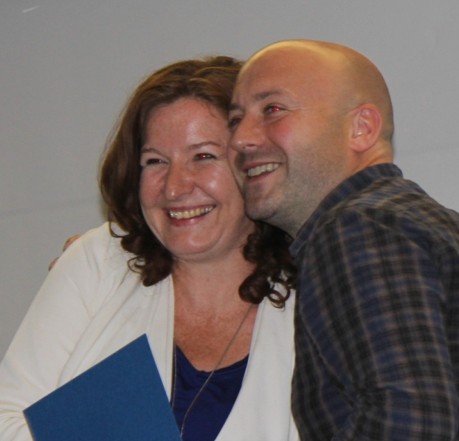
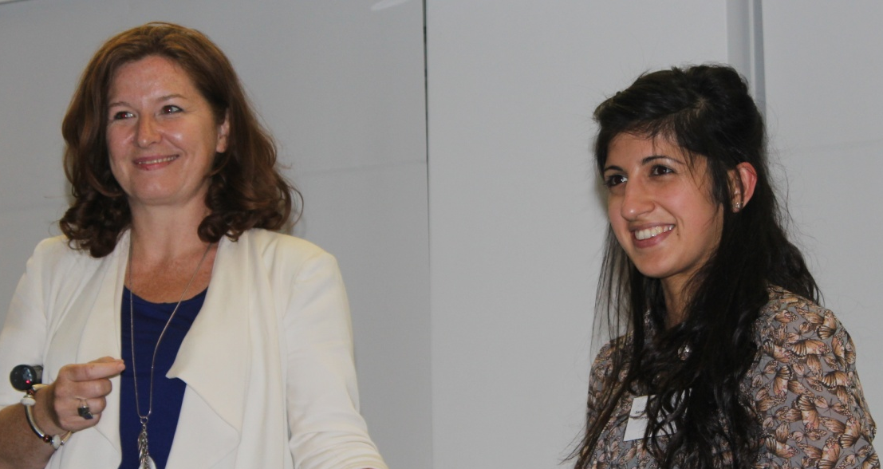
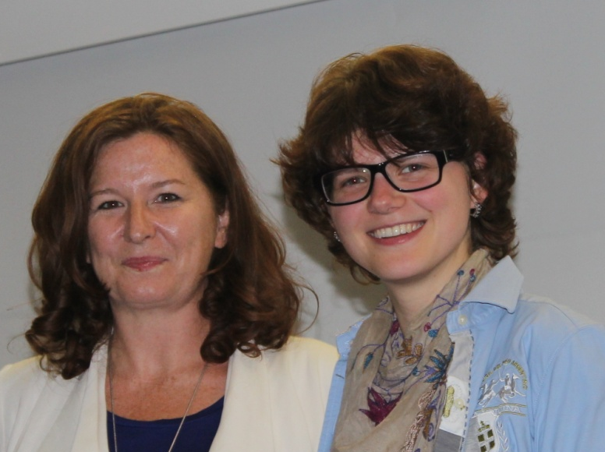
ARR Poster prizes (sponsored by EACR) were awarded to:
Laury Perriaud
Alex Walker
Martin Kerr
Sarah Sabir
Ronja Diemer-Biehs
Francois Boussin was also awarded a poster prize (photograph not available)

Slide 4

Poster Prize being awarded to Laury Perriaud

Slide 5

Poster Prize being awarded to Alex Walker

Slide 6

Poster Prize being awarded to Sarah Sabir.

Slide 7
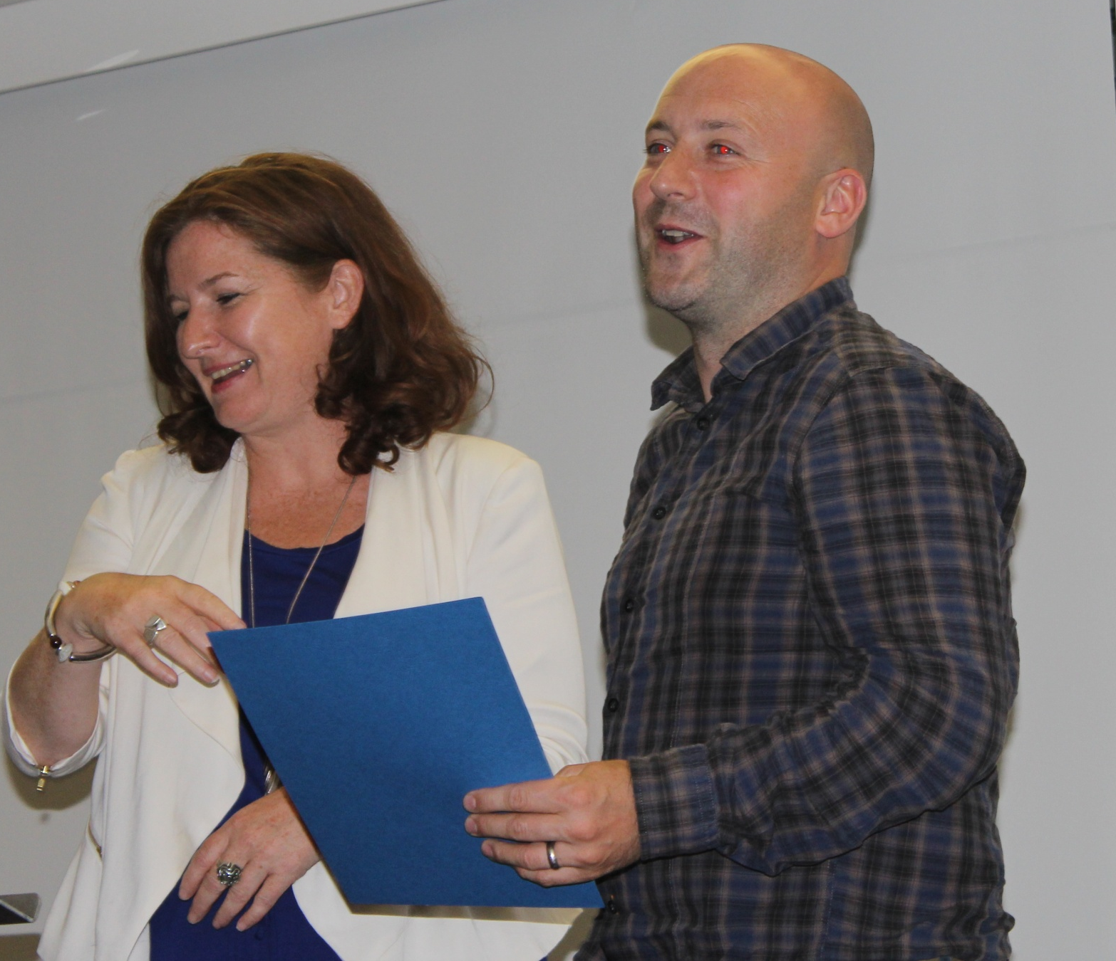
Poster Prize being awarded to Martin Kerr

Slide 8

Poster Prize being awarded to Ronja Diemer-Biehs

Slide 9
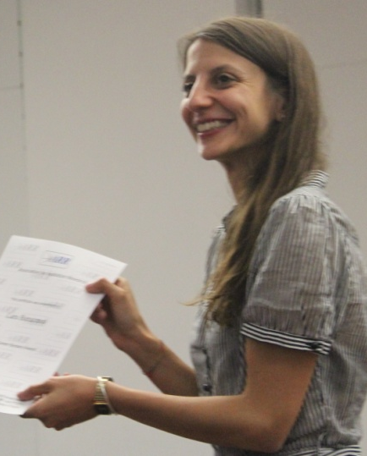
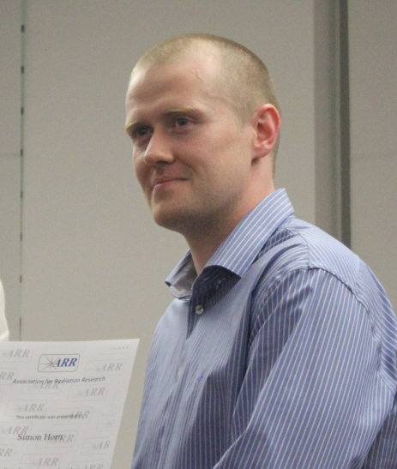
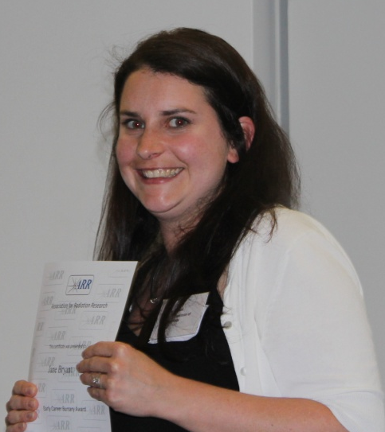
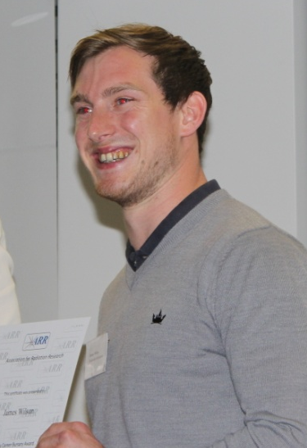
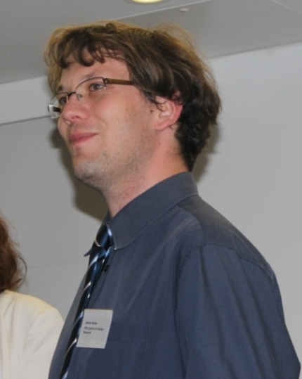
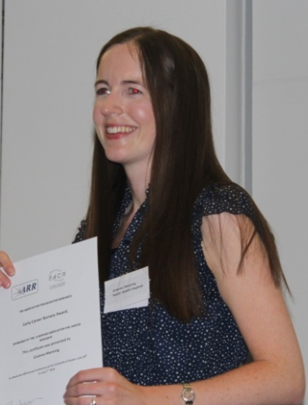
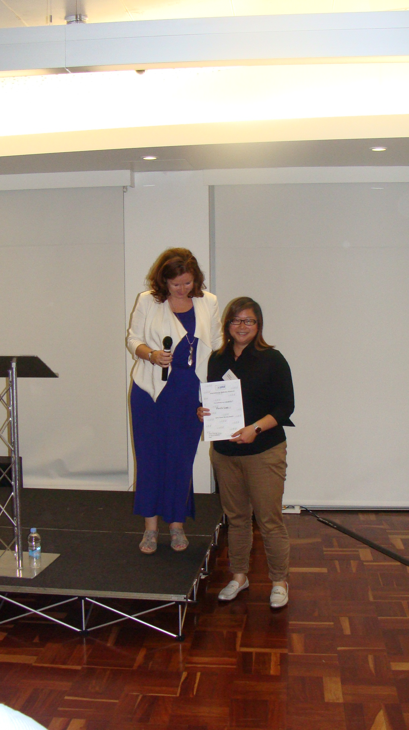
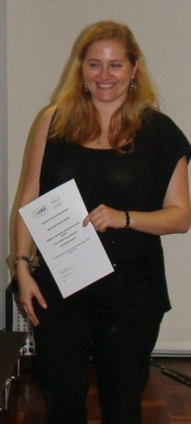
ARR Early Career Investigator Awards were awarded to:
Lara Barazzuol
Simon Horn
Jane Bryant
James Wilson
Balzas Madas
Grainne Manning
Phoebe Lam
Anne-Sophie Schreurs
Awards to Grainne Manning, Balzas Madas and Anne-Sophie Schreurs were sponsored by EACR. Cynthia Eccles was also an award winner but a photo is not available.

Slide 10

Lara Barazzuol receiving an ARR Early Career Investigator Award

Slide 11

Simon Horn receiving an ARR Early Career Investigator Award

Slide 12

Balzas Madas receiving an ARR Early Career Investigator Award
-

Slide 13

Grainne Manning receiving an ARR Early CareerInvestigator Award

Slide 14
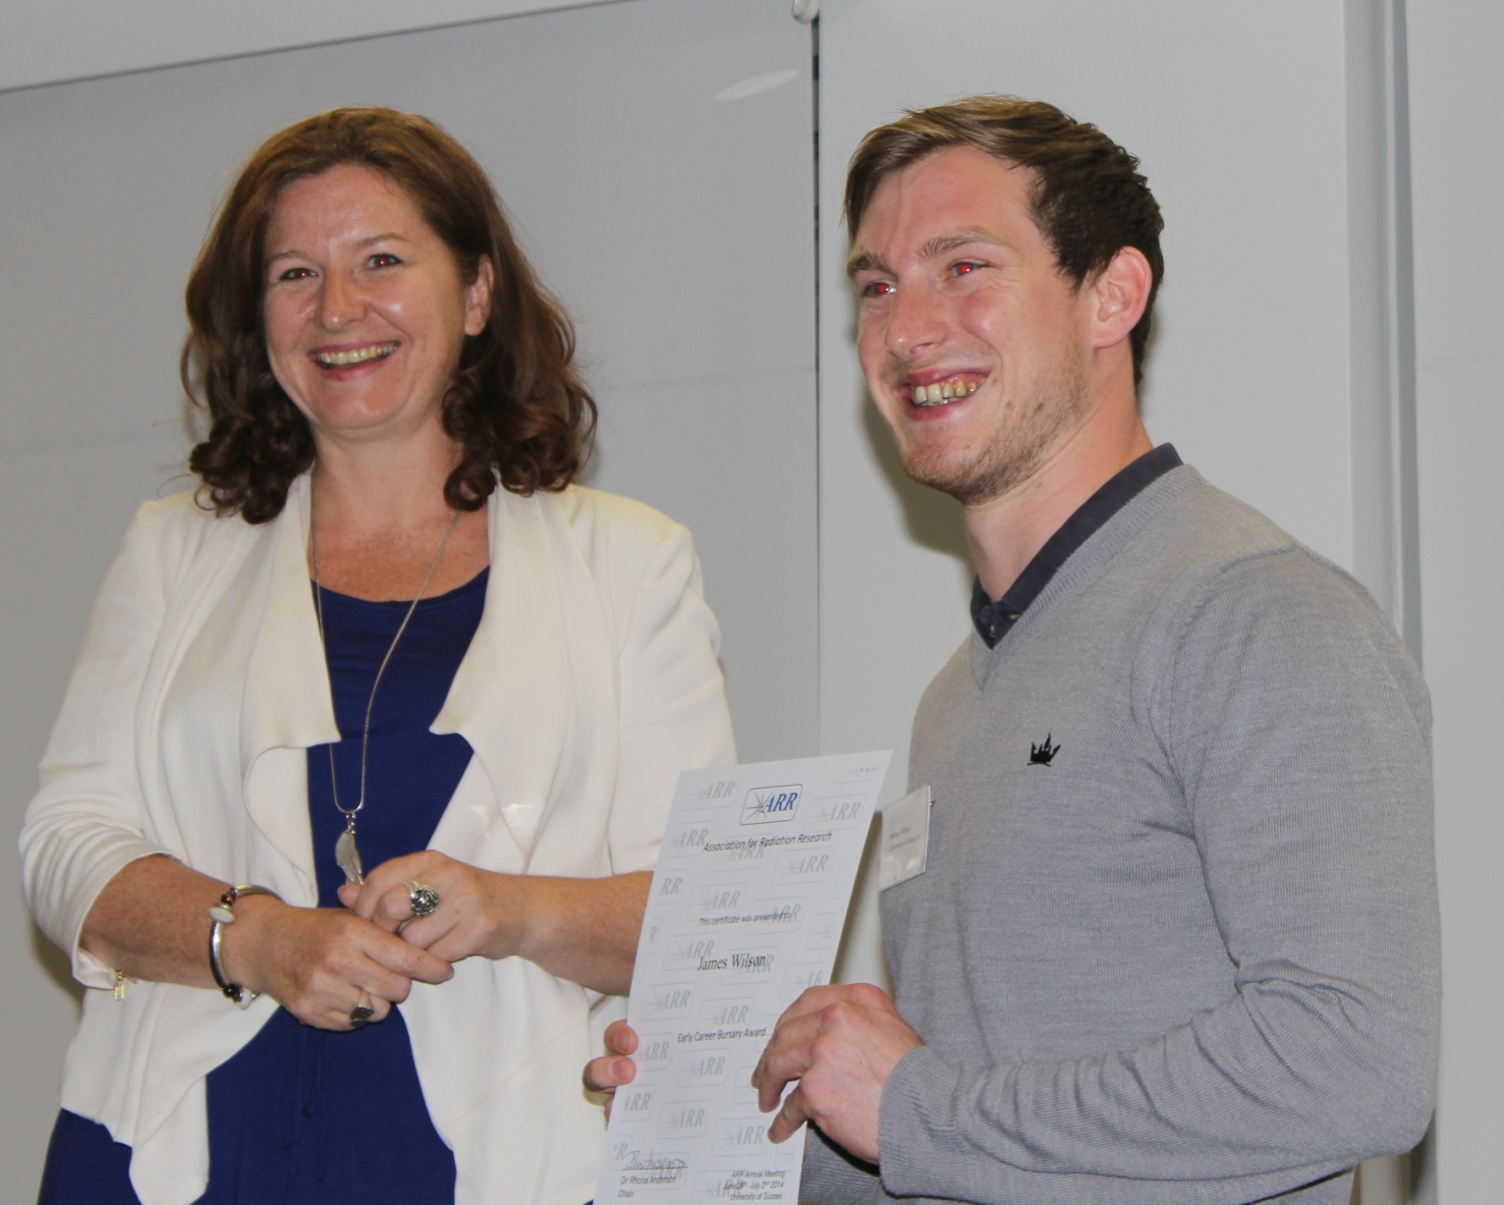
James Wilson receiving an ARR Early Career Investigator Award

Slide 15

Jane Bryant receiving an Early Career Investigator Award

Slide 16
Phoebe Lam receiving an ARR Early Career Investigator Award

Slide 17
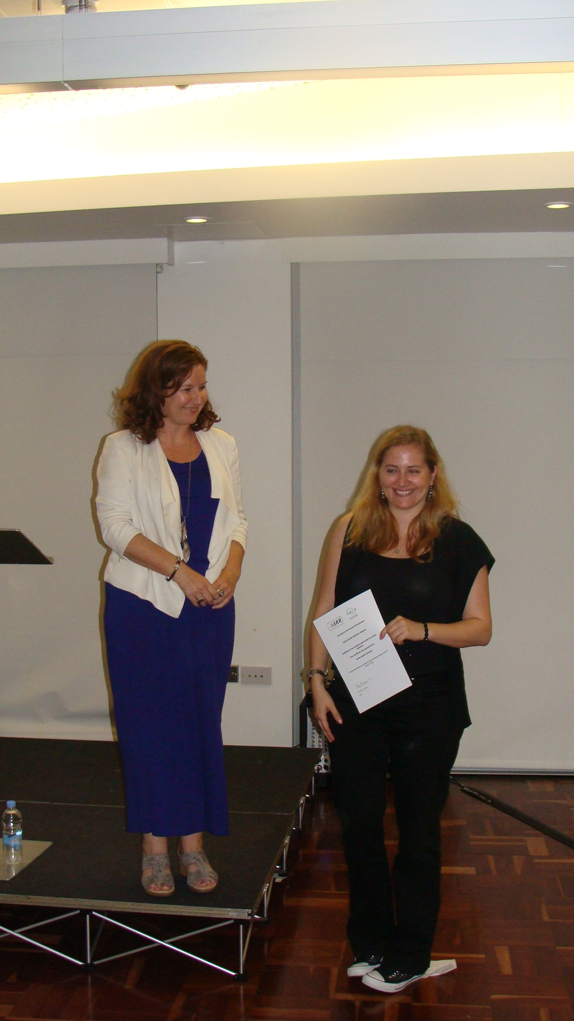
Anne-Sophie Schreurs receiving an ARR Early Career Investigator Award

Slide 18
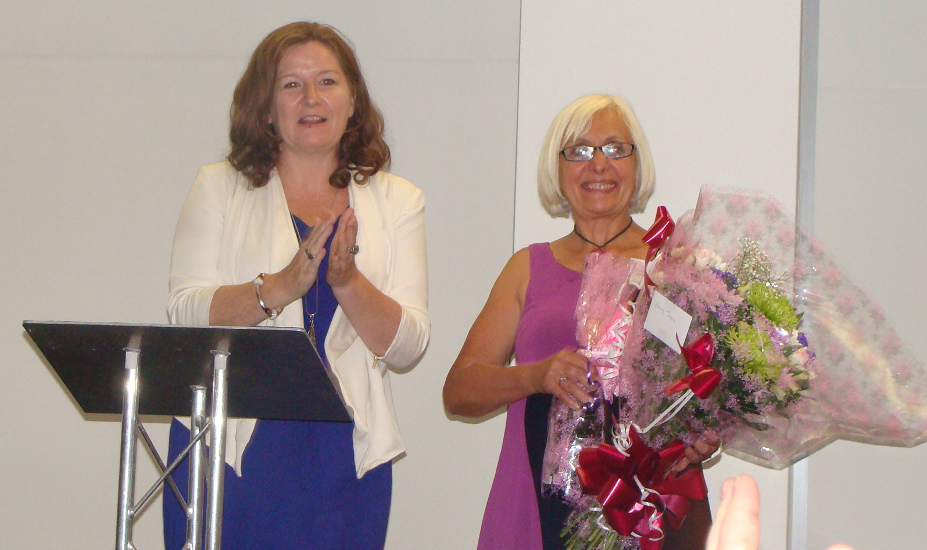
Penny Jeggo receiving flowers and champagne from ARR chair, Rhona Anderson

Slide 19
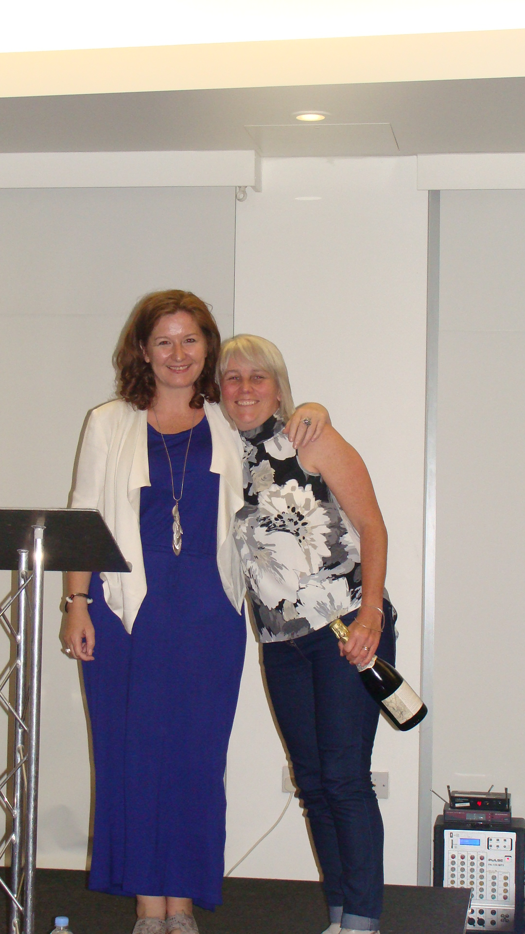
The past and current ARR chairs:
Kaye Williams and Rhona Anderson

Slide 20
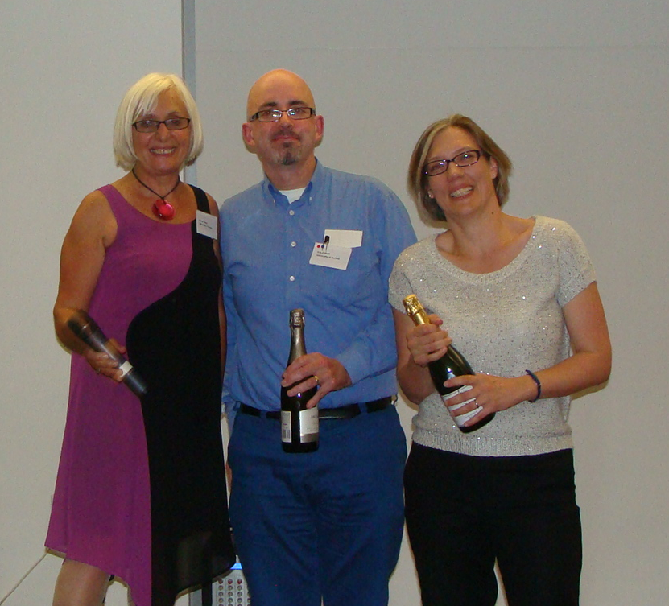
Three of the organisers of ARR2014 (Penny Jeggo, Eric O’Neill and Ester Hammond) (Rhona Anderson is missing!)

Slide 21
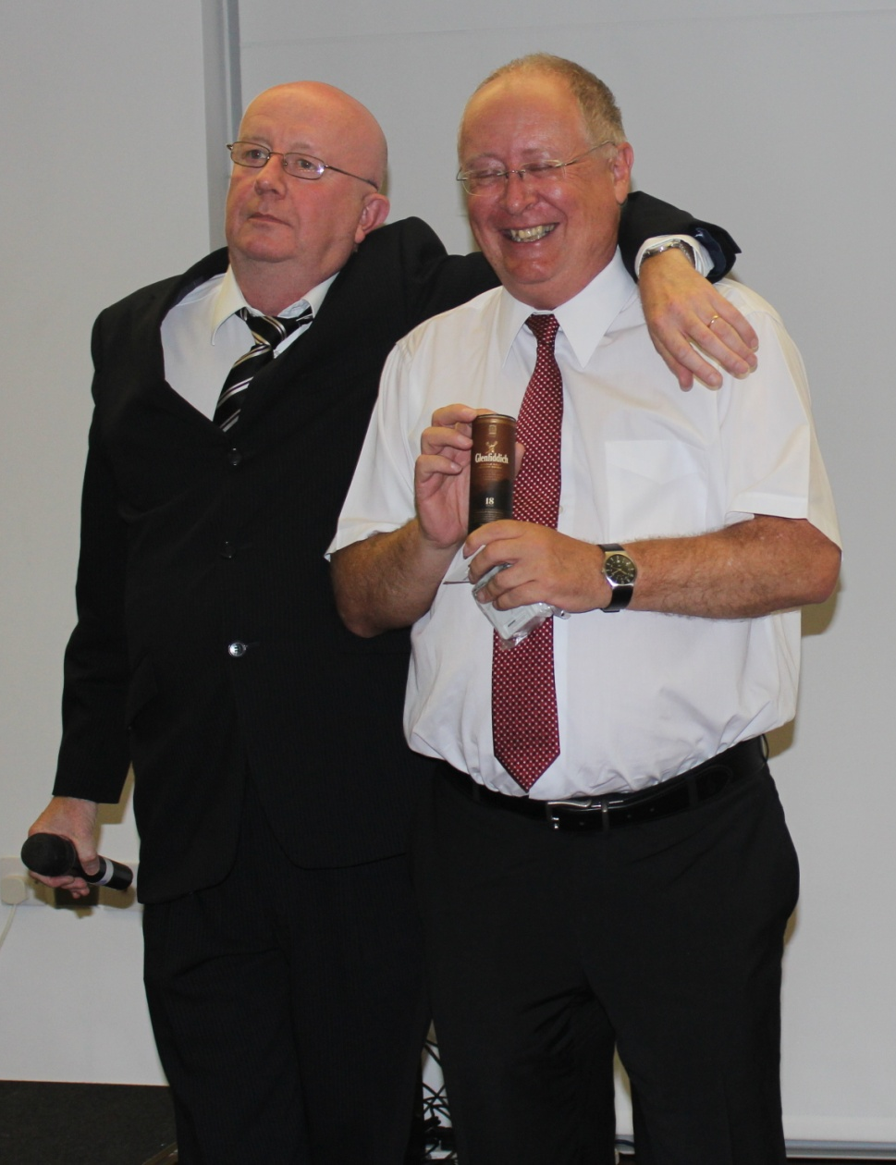
Mike Atkinson receiving a late-submitted abstract award from Don Jones!

Slide 22
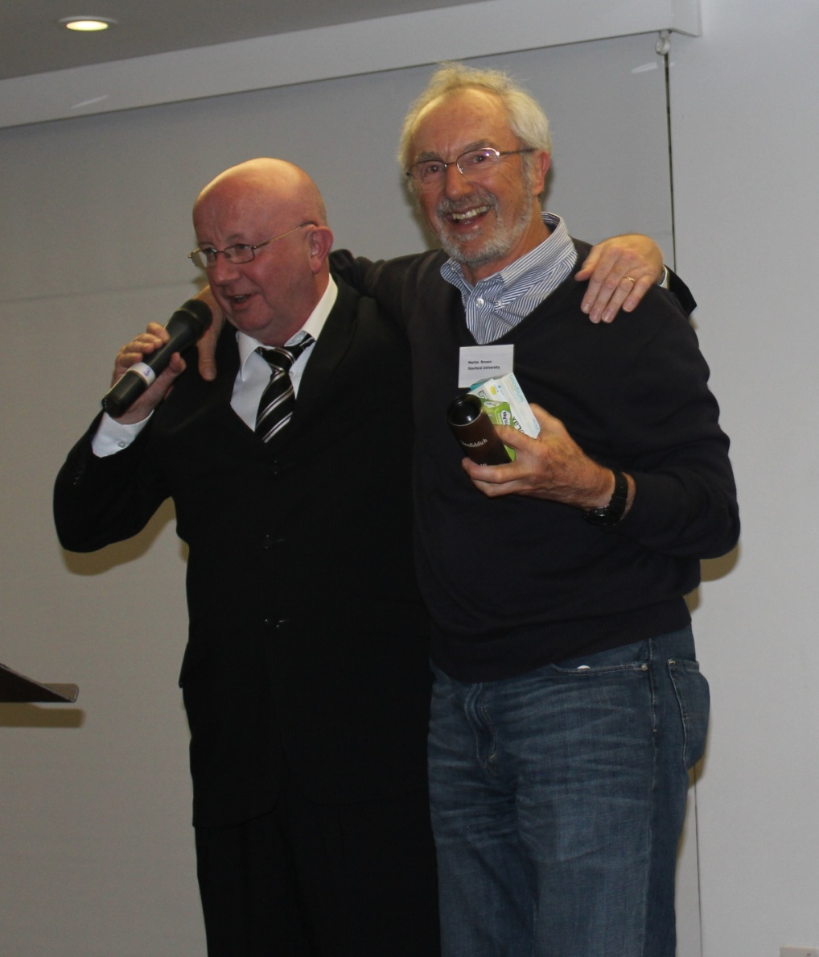
Martin Brown receiving the furthest person travelled Award – he came from California – just two miles further than Anne-Sophie Schreurs – the runner up!

