Slide 1

ESRC Funding Opportunities
RTSG
Overseas Fieldwork
Overseas Institutional Placements
Further development opportunities

Slide 2
RTSG Funding for:
UK fieldwork
Conferences
Language training
Survey costs
And more…………….

Slide 3
How to apply
Pooled fund based on £750 per year per researcher
Discuss with supervisor – complete form
Attach estimate / quotation to your application
Submit to DTC for approval
Once approved – submit expense claim with receipts for reimbursement

Slide 4
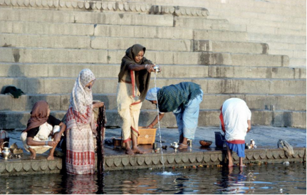
Overseas Fieldwork allowance

Slide 5
Funding for:
Difficult language training
Return flights
Visas
Vaccinations
Interpreter / translation costs

Slide 6
How to apply
Applications should be made at least 3 months before your intended trip
Check the status of the country on FCO website: https://www.gov.uk/foreign-travel-advice
Contact your School Research and Enterprise Coordinator (REC) for information on your School processes
Complete application and attach quotes and statement of support from supervisor
Funding requests require the approval of the DTC Director

Slide 7

Overseas Institutional Placements

Slide 8
Funding for STUDENTS TO:
Undertake additional specialist research training not available in the UK
Develop language skills
Establish research links to benefit their academic career
Disseminate early research findings
Attend and participate in seminars relevant to their research
Visits between 4 – 13 weeks

Slide 9
How to apply
Limited funds – competitive process
Support needed from supervisor and host institution
Application forms available from our website: http://www.sussex.ac.uk/internal/doctoralschool/esrcdtc/funding/oiv
Deadline: 4 November 2016

Slide 10
Further development opportunities
Placements / internships
ESRC Media Training
UoS Teacher training

