Slide 1
Enhancing Feedback in Law
Professor Donald McGillivray & Dr Verona Ní Drisceoil, Sussex Law School
Feedback as a dialogue: co-creating learning

Slide 2

Introduction and Overview

Slide 3
Our Year: 5 stages
Call for Action/Drivers for Changing our Practice
Feedback Workshop with Yvonne Skipper, Wendy Garnham, Tab Betts: November 2017; and cross-departmental discussions
Review of our Guidance on Minimum Standards for Feedback
Student Focus Groups and findings: April 2017
Next steps: looking ahead, short term and long term goals

Slide 4
1. Call for Action/Drivers
Drivers to/for change
NSS
Externals
Departmental discussions
Greater use of e-submitted coursework
Curriculum Review

Slide 5
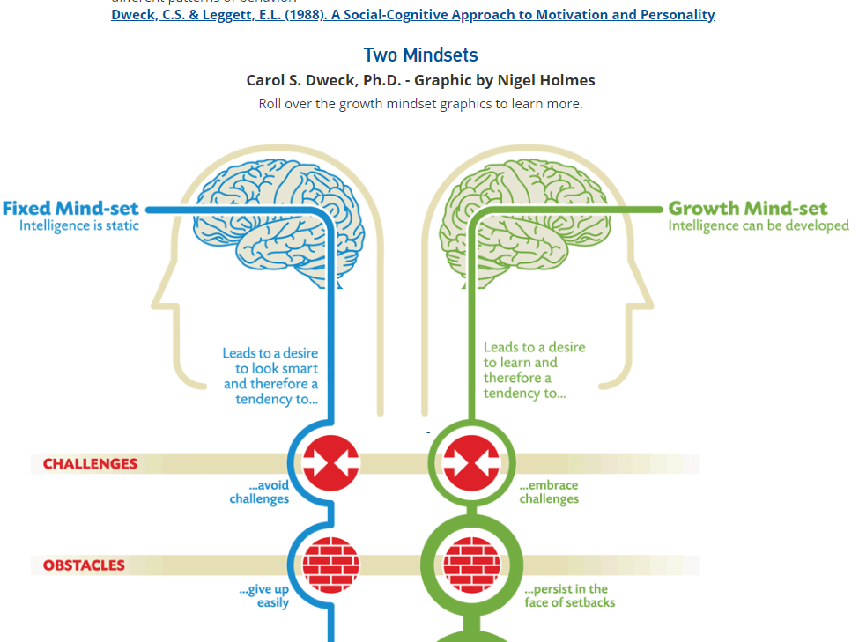
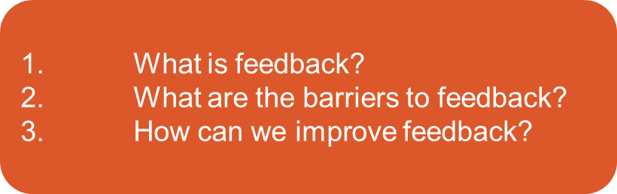
2. Feedback Workshop
Workshop led by Dr Yvonne Skipper on the ‘The Psychology of Feedback’

Slide 6
(Carol Dweck, 1999).
We should give feedback on process not on the person.
The power of ‘yet’
You’re not quite there yet with referencing.
Feedback on process
Growth mind-set

Slide 7

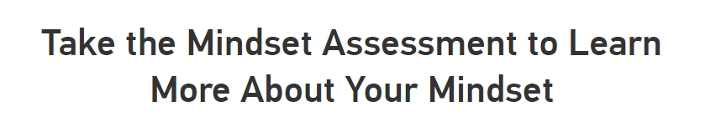
What about the teacher?
The mindset of the teacher matters!!!
…was founded by Dr. Carol Dweck and colleagues
http://blog.mindsetworks.com/what-s-my-mindset?view=quiz

Slide 8
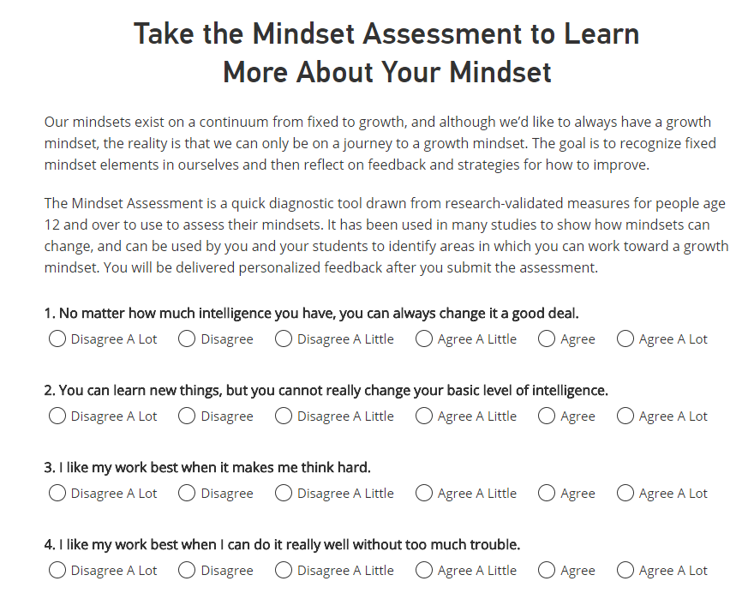

Slide 9
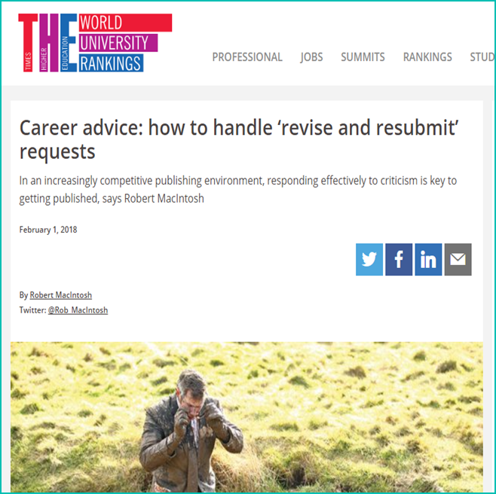
Everyone struggles with feedback!

Slide 10
3. New minimum standards and guidance
Tone: Please consider the tone used in feedback, whether verbal or written.
Encouraging a growth mindset: Feedback should encourage a growth mindset; that is, a mindset more open to development and improvement. This can be achieved by providing feedback on ‘process’ rather than on the ‘person’. (e.g. ‘you’re not quite there yet with referencing’.
Personalised feedback: As far as is possible, feedback should be personal and should avoid generic language and statements.
Level: Take note of the level of study of the student (Level 4, 5 etc.). The following is a link to the level descriptors used by the QAA: http://www.qaa.ac.uk/en/Publications/Documents/qualifications-frameworks.pdf
Links: Where appropriate, provide links to useful resources such as Skills Hub http://www.sussex.ac.uk/skillshub/
See further C Dweck, Self-theories: Their role in motivation, personality and development (Psychology Press, 1999); C Dweck, Mindset: The new psychology of success (Random House, 2006).
+ include Feedback sessions in our Skills & Employability Info Sessions
Feedback action plans
LPS Feedback Day

Slide 11
BUT is feedforward effective?
Feedforward is a strategy that aims to ‘increase the value of feedback to the students by focusing comments not only on the past and present…but also on the future – what the student might aim to do, or do differently in the next assignment or assessment if they are to continue to do well or to do better’ (Hounsell, 2008, p. 5).
D Hounsell, The trouble with feedback: New challenges, emerging strategies (2008) Interchange, 2, pp.1-10 (as cited by Phil Race, April 2018)
But….
R Nash, N Winstone, S Gregory and E Papps ‘A memory advantage for past-oriented over future-oriented performance feedback’ (2018)
Journal of Experimental Psychology: Learning, Memory, and Cognition (Mar 5, 2018)

Slide 12
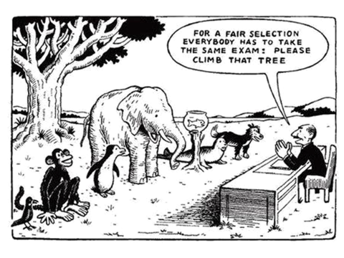
Part of the problem is HOW we assess!
Graphic - Phil Race
Notes:
PHIL RACE: many of the problems we have making feedback work originate from the kinds of assessment we find ourselves using (not least, essays)

Slide 13
4. Student Focus Group comments
‘The SLS assessment guidelines needs to be more specific, specific to types of assessment’
‘More variety in modes of assessment: Moot required in Canada therefore it would be good for Canadian GE students if there was a form of assessment by moot, presentation etc.’
‘Formative should be relevant to summative - The reason students don’t do it is because of timing (there is a lack of time to complete), it often clashes with extra-curricular activities and it is not directly related to the summative piece of work – it should be related to the summative. Another group said the formative is a ‘waste’ of time, subject is irrelevant and feedback is minimal at best.’
‘The rubric on grademark is not helpful’

Slide 14
Student Focus Group comments cont.
‘Audio feedback is good. It is the best’
‘More sample answers would be helpful’
‘End of year exams: Students would like more feedback and if there was a system created to communicate this feedback to students during the summer term.’
What about international students? - ‘International students overlooked in every aspect at this university ‘
‘Feedback is too late.’

Slide 15
5. Next Steps
Making feedback fit for purpose!!
Phil Race: Recognising that many of the problems we have making feedback work originate from the kinds of assessment we find ourselves using (not least, essays).
In law, in particular, almost all of our assessments are text based.
What can we do in the short term/medium term/long term?
Marking allocation changes – recognising time spent giving feedback not just grading; a ‘Marking and Feedback Allocation’
More engagement with students

Slide 16
Observations
Feedback as dialogue. If it is a dialogue why do we have anonymous marking? (Phil Race)
  We need to know our students for feedback to be effective
More faculty using audio feedback
Many examples of efforts to improve feedback and make it more ‘effective’.
But how do we…
Incentivise improving feedback?
What does ‘ensuring feedback is effective’ look like?
Do students see the issue as about wanting MORE feedback? Feedback as something delivered v Feedback as a process
‘It is simply madness
to keep doing the same things over and over again,
and expect different results.’
Albert Einstein

