Slide 1
From “Paddling” to swimming- a new approach to flipped learning in seminars
Wendy Garnham, Alexandru cristiean, Narella minns, Narmeen mohammed, Prapti gurung

Slide 2
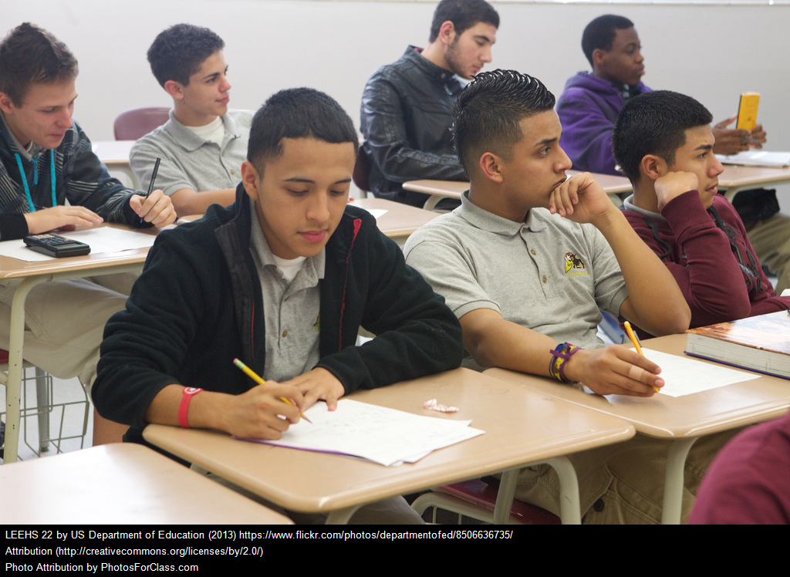
“Seminars of old”
Won’t make eye contact as doesn’t want to be asked a question
Lacks confidence in contributing so looks at phone instead
Bored. Has read paper, contributes well but isn’t feeling challenged
Feels anxious due to missing a couple of seminars
Didn’t read the paper so cannot answer any questions
Finishing off his notes on the paper because he didn’t get it finished before the seminar
Consequence: Seminar turns into mini-lecture or is dominated by 1 or 2 more confident students
Notes:
Seminars would tend to be dominated by 1 or 2 more confident students, others would take a back seat and not contribute. Many would arrive having not read the paper. Once the seminar was complete, the paper would be put to one side and forgotten about until the exams.

Slide 3
The Padlet Project
In conjunction with Anne Hole and Tab Betts in TEL
Consolidation or extension opportunity
Small group structure
Aim: To produce a “Padlet” post relating to the topic of the week
Students take ownership of the Padlet wall
The Padlet wall remains “live” until after the exams
Skills developed alongside knowledge
Students construct their own resource bank
Notes:
A move away from the one size fits all approach. Difference now: Everyone is involved. Small groups of no more than 3 people so that no-one gets to sit back and watch the others work. If students understand the paper, they can look to extend their knowledge of the area further. If they are struggling with the paper, they can work on a post together to help them consolidate their understanding. In doing so, they create a bank of resources to help both themselves and others understand the topic area better. It also develops research skills, transferable IT skills and engages students in learning in a way that meets their own needs.

Slide 4
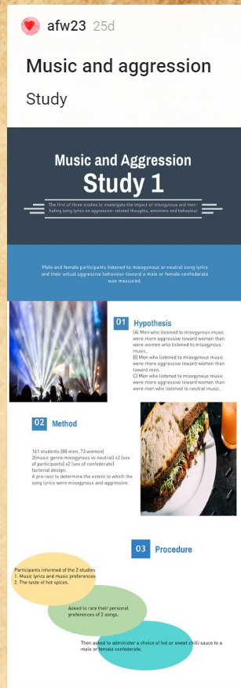
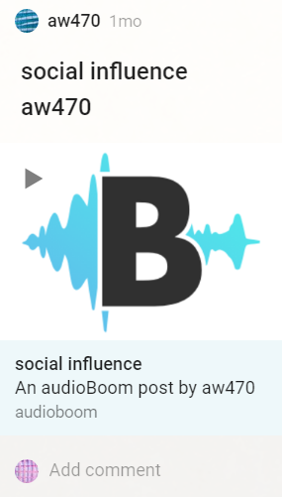
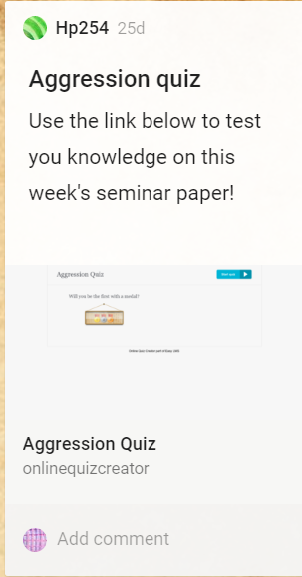
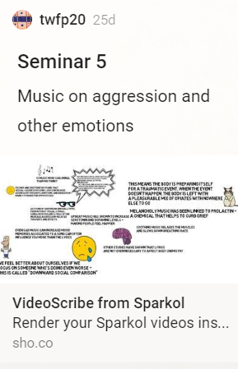
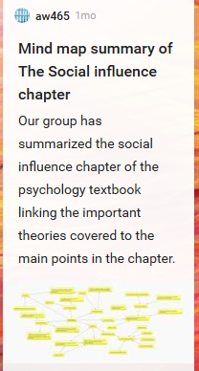
Notes:
Highlight range of posts – not just one type but shows willingness to explore range of apps and learning tools.
Example of revision postings

Slide 5
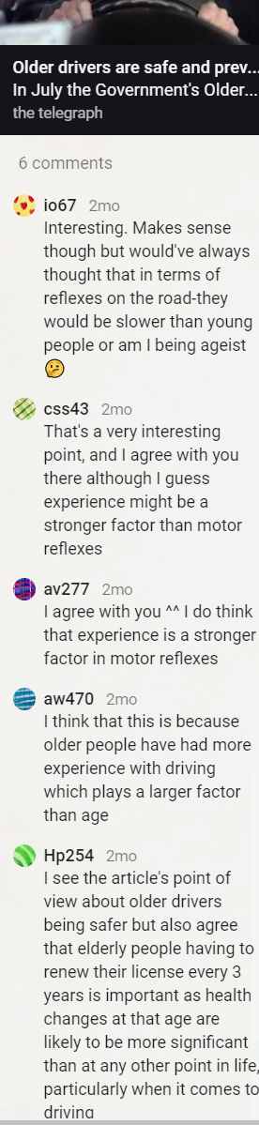
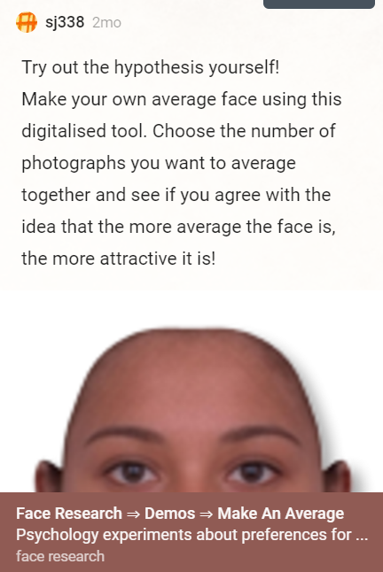
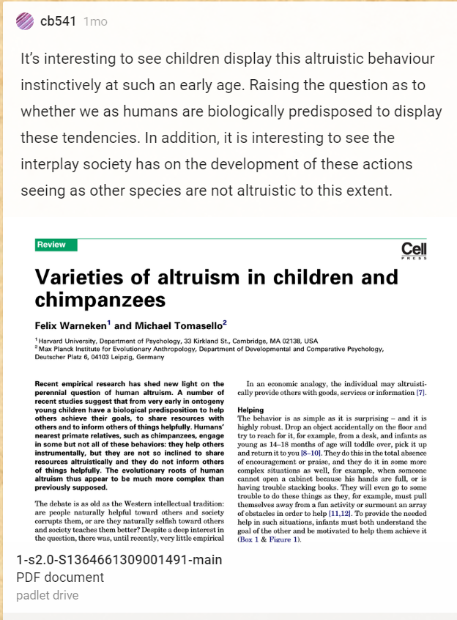
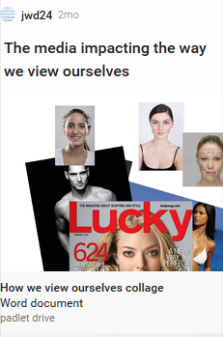
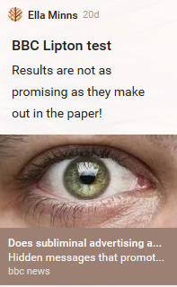
Notes:
Example of extension postings

Slide 6
A more inclusive environment?
It is tailored to the way you easily learn
Helps people that are shy to contribute
I loved that I could really express my ideas freely
Good for all learners
I read the papers more actively and critically to come up with ideas for Padlet
I like working with different people each week
You can use it out of the seminar
It gives us a chance to explore further than just the seminar reading
It is a good way to learn what other people in your group think about the readings
I like the freedom to develop my learning and research in any direction I want
It keeps me on top of my seminar reading

Slide 7
Phase 2 of the Padlet Project
Mid-term review – focus groups/online survey
Move from 48 hour challenge to 1 week challenge to enable more ambitious postings
A Padlet wall for each topic
Built in slot for discussion of focus paper before Padlet posting
  10 mins- review of previous week’s postings
  10 mins – discussion of paper
  30 mins – Padlet posting
  Bigger challenges!
Notes:
Previously, would always be last to leave, now it’s the students who are often the last to leave!
Inclusion on social level as well as intellectual level

Slide 8
The Student Perspective

Slide 9
My experience: Narella Minns
Inclusion and engagement via technology and time
Notes:
Mature student experience. Allows me to think about personal experience and add my own research. Ability to ask questions ‘off the top of my head’ and see others ideas, enabling a conversation without time constraints to formulate a response and without fear of ‘sounding stupid’ or out of touch with other who may have more experience in the field.

Slide 10
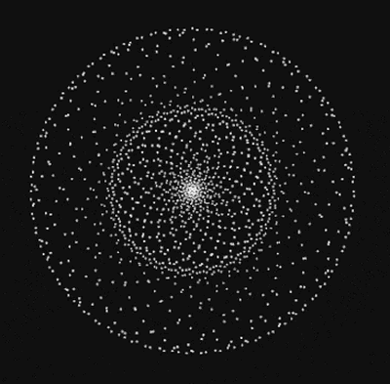

Social insertion
Confidence
Time
Other commitments
Lack of Motivation
My Experience as an E.U. student: Alexandru Cristiean

Slide 11
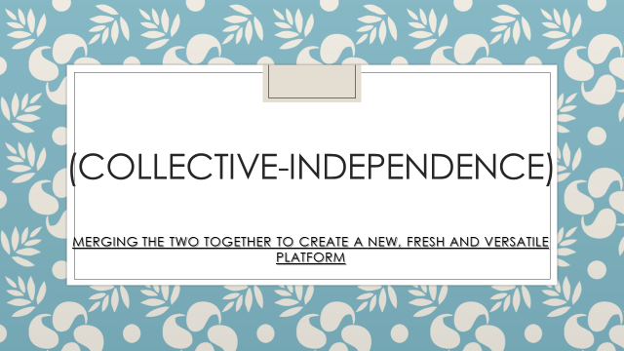
Narmeen Mohammed

Slide 12

The road ahead…
Building on the lessons of this term:
  Empowering students with skill development in Autumn Term
Broadening the scope of our project:
  The Psychology Foundation Year Blog
  Anchor FM
  The Flipped Learning Workshop at University of Sussex, 06.06.17

