Slide 1

PRACTICAL APPROACHES TO INSPIRING CONFUSED STUDENTS
© Alan Bullock
Freelance Careers Consultant
for University of Sussex conference
June 2015
alanbullockcareers.com

Slide 2
WEB-BASED AND
PSYCHOMETRIC SOLUTIONS
I contacted 50 careers colleagues last year to ask:
“What psychometric or web-based products do you feel are genuinely effective as a tool to inspire 'don't know' students - whether for students doing it alone, or as part of a programme or with your guidance?”
Result: my unofficial league table based on:
3 = Brilliant
2 = Very Helpful
1 = Helpful

Slide 3
MY VERY UNOFFICIAL 2014 LEAGUE TABLE!
(FOR WEB-BASED / PSYCHOMETRIC PRODUCTS)
PREMIERSHIP:
32 i-could (esp. the Buzz Test)
26 Morrisby Profile
22 Fast Tomato
19 NCS website
(esp. Skills Health Check/Job Profiles)
17 UKCourseFinder
Those underlined are free resources
SECOND DIVISION:
11 U-Explore
10 Kudos
9 Higher Ideas
9 Pathfinder Live
9 prospects.ac.uk
(esp. Options with my subject)
9 Adult Directions
8 Which? University
5 BestCourse4me
5 Thomas International
4 Adult Directions
4 Centigrade
4 E-Clips Online
4 notgoingtouni.com
4 Unifrog

Slide 4
WEB-BASED AND PSYCHOMETRIC SOLUTIONS:
QUOTES FROM MY ADVISER SURVEY - 1
“I only think these tools have value with a creative practitioner….used without support, they have limited benefit.”
“I find Kudos and Fast Tomato very helpful, if used at the right time AND with support to unpick the answers.”
“People are inspirational, not machines. Websites are tools and can never replace an adviser who is prepared to spend time and think creatively with clients.”
“I’m a great believer in psychometrics, but ONLY if the results are explained by a qualified practitioner, so the client understands why the results are as they are.”

Slide 5
WEB-BASED AND PSYCHOMETRIC SOLUTIONS:
QUOTES FROM MY ADVISER SURVEY - 2
“Students often need to sit with you to understand the questions.”
“The conclusions are something I could pretty easily obtain from a 1-to-1 consultation, but the impartiality of the Morrisby process gives parents a level of confidence in the results.”
“Morrisby/Fast Tomato with guidance = 2, without = 0.”
“An interview with a qualified adviser gets a 3.”
“You can’t beat good old-fashioned CEIAG!”
But they would say that, wouldn’t they!

Slide 6




HELP IN CHOOSING COURSES/UNIS
I suggest :
search.ucas.com – the Course Search tool on
bestcourse4me.com
unistats.direct.gov.uk
university.which.co.uk
sacu-student.com – especially the Spartan Test
Or try ukcoursefinder.com, universitycompare.org or whatuni.com
AND… go to university open days! (opendays.com)

Slide 7
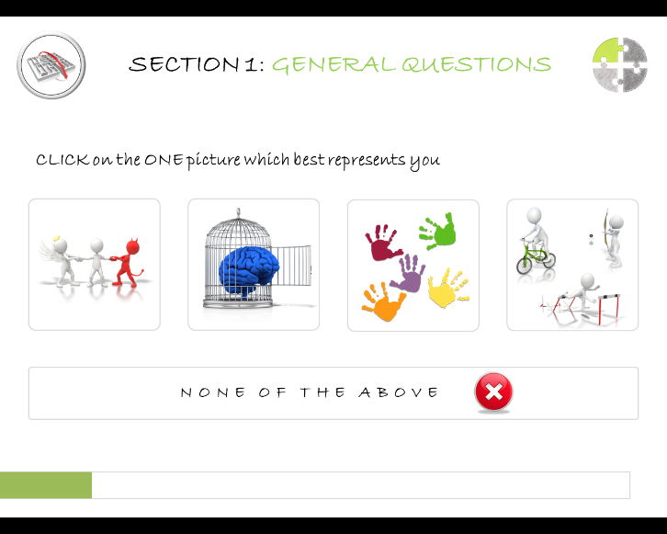


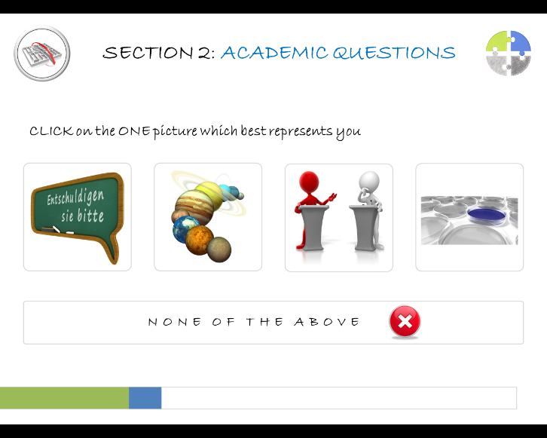
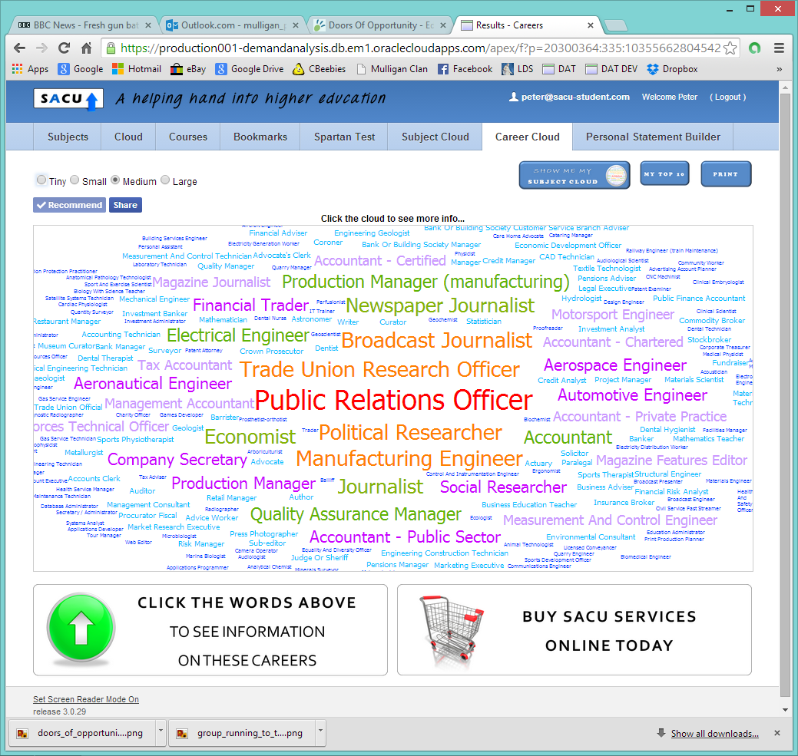
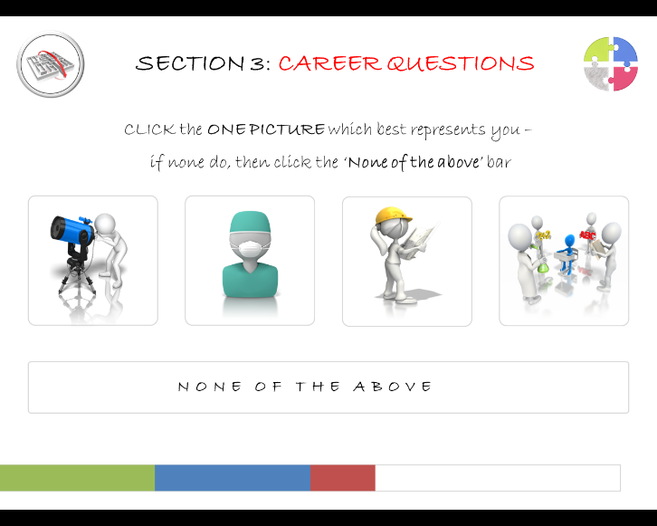
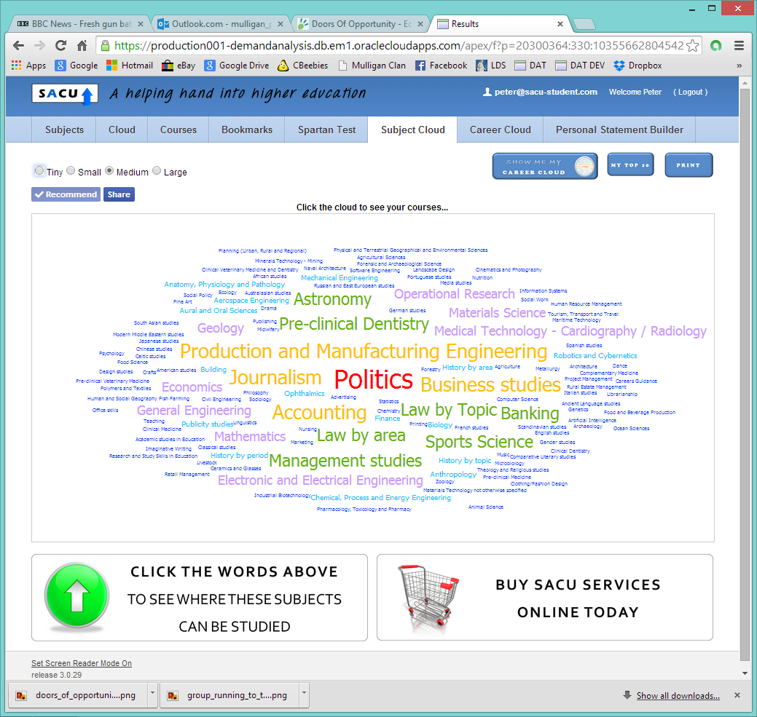
Free SACU Spartan Test
AMEND YOUR TOP TEN
AMEND YOUR TOP TEN

Slide 8
PEER & PARENT PRESSURE
Joyce: “My parents want me to be a doctor, so I have conditioned myself into thinking I want to be one.”
Rebekah: “So many of my friends want to be doctors or lawyers …. or are being pushed into wanting to be doctors or lawyers.”

Slide 9
MY OWN APPROACHES 1
It’s GOOD to be confused – the Diamond model
Blank sheet of paper…?
Kiera’s route maps – “like tickets to the future”
You Can’t All Be Doctors
My Degree Course Menu
…or a Menu?

Slide 10
MY OWN APPROACHES 2
The fantasy to maturity timeline
Knowing what’s out there (via social media)
The Glider Approach
Knowing what happens to your students…
…like Aqsa in Amsterdam…
THE POWER OF
DESTINATIONS INFORMATION

Slide 11
‘WHERE ARE THEY NOW?’ 1
NAME | DEGREE | JOB
Dan | Archaeology (Reading) | Investment Analyst, London
Emma | Maths (Warwick) | Head of UK Trade & Investment, Chicago USA
Stephanie | Sound Engineering (LIPA) | Assistant Tour Manager, Foo Fighters
Paul | Logistics (Aston) | Director of Supply, Airbus, Miami US
Amy | Tourism (Greenwich) | Assistant Producer, Ant & Dec’s Saturday Night Takeaway
Gemma | Aviation & Pilot Studies (Leeds) | Guitarist, “Savages” world tour
Chris | Business Studies & Sports Science (Roehampton) | Director of Football, Kick4Life, Lesotho
Becky | Criminology & Social Policy (Manchester) | Entrepreneur, Fairylicious Cupcakes
Valentina | Sociology & Criminology (Portsmouth) | Psychodynamic Counsellor
Alex | Medicine (UCL) | BBC Political Correspondent

Slide 12
‘WHERE ARE THEY NOW?’ 2
NAME | DEGREE | JOB
Aiofe | Spanish & Catalan (Swansea) | Marketing Manager, ESADE, Barcelona
Amy | German (Exeter) | Editor, Diesterweg (publishers), Frankfurt
Mike | Electronic Engineering (York) | Research Scientist in The Antarctic
Carla | Multimedia Journalism (Bournemouth) | Senior Producer, “Lorraine” (ITV show)
Katy | Drama (Hull) | Improvisational Actress & Comedian
Lorin | Law (Westminster) | Immigration/Detainee Specialist, London
Tolu | International Business Management with Communication (Birmingham) | Customer Intelligence Analyst, Sky IQ
Nicole | Maths & Sports Science (Loughborough) | Strength/Conditioning Coach (elite athletes)
Naomi | Agricultural Business Management (Reading) | Senior Rural Property Surveyor, Surrey
Esen | Accounting & Finance (Surrey) | Software Applications Engineer, CGI

Slide 13
‘WHERE ARE THEY NOW?’ 3
NAME | DEGREE | JOB
Tom | Psychology (Bristol) | Forensic Psychologist, Prison Service
Anna | Fine Art (Aberystwyth) | Freelance Mural Designer
Laura | English Literature (UCL) | Freelance Fashion Writer
Mary | International Relations (Sussex) | English Teacher in Pamplona, Spain
Liam | Computer Animation (Bournemouth) | Computer Graphics Post-Production, London
Christine | Geological Hazards (Portsmouth) | Project Engineer, Bellway Homes
Cat | International Business (Aston) | BP’s Business Negotiator in Algeria
Jess | Economics & Management (Oxford) | Investment Banking Analyst, BMO Capital Markets
Andrew | Business Economics (Exeter) | Project Risk Manager, Mott MacDonald, Glasgow
Andy | Geography (Royal Holloway) | Senior Transport Planner, Hampshire

Slide 14
NON-UNI ‘WHERE ARE THEY NOWS?’
NAME | FIRST DESTINATION | LATEST JOB
Matt | CBBC Presenter | BBC Radio 1 DJ / Freelance TV Presenter
Adrian | Sales Assistant, Debenhams | Senior Buyer, Lindt chocolates, Zurich
Alice | Merchant Navy Cadet | 3rd Officer, Holland America Cruise Line
Carly | Merchant Navy Cadet | Lecturer, South Tyneside College (after a few years with Regent Seven Seas Cruises)
Donna | Customer Assistant, Halifax Bank | Leader of Portsmouth City Council
Philip | Engineering Apprentice | Officer, Carnival UK Cruises, The Aurora
Ben | Pilot Training, CAE Oxford | First Officer, British Airways, Gatwick
Becka | Singer/Songwriter/Pizza Waitress | Recording Artist London/New York/Rome
Rob | Sailing Instructor | Police Officer, Hampshire Constabulary
Peter | Assistant Retail Manager, One Legged Jockey | Police Officer, Hampshire Constabulary
Sam | Set up his own computer shop | Astronomy Photographer of the Year

Slide 15
CHALLENGING PERCEPTIONS ABOUT
‘THE BEST UNIVERSITIES’
BIS report on ‘the Graduate Premium’ in 2013:
“The Russell Group earnings boost is statistically insignificant”
CBI ‘Education & Skills Survey’ 2014:
Only 12% of employers said that ‘the university you went to’ is an important factor
In the following tables, which show ‘rankings’ from a variety of viewpoints, universities in red are not in the Russell Group

Slide 16
UK UNIS IN QS WORLD TOP 100
2= CAMBRIDGE | 64 BIRMINGHAM
2= IMPERIAL | 69 SHEFFIELD
5= OXFORD | 71 LSE
5= UCL | 77 NOTTINGHAM
16 KINGS | 88 ST ANDREWS
17 EDINBURGH | 92 DURHAM
29 BRISTOL | 94 SOUTHAMPTON
30 MANCHESTER | 97 LEEDS
55 GLASGOW | 98 QUEEN MARY
61 WARWICK
 | (QS Top Universities 2015)

Slide 17
UNIS TARGETED BY BIGGEST NUMBER OF GRADUATE EMPLOYERS
(BUT ONLY 8% OF GRADUATES GET THESE JOBS)
MANCHESTER | EDINBURGH
NOTTINGHAM | LOUGHBOROUGH
WARWICK | 16. SHEFFIELD
CAMBRIDGE | 17. SOUTHAMPTON
OXFORD | 18. EXETER
DURHAM | 19. NEWCASTLE
BRISTOL | 20. KING’S
UCL | 21. YORK
IMPERIAL | 22. CARDIFF
LEEDS | 23. STRATHCLYDE
BATH | 24. GLASGOW
LSE | 25. LEICESTER
13. BIRMINGHAM | (www.highfliers.co.uk 2015)

Slide 18
UNIS WITH HIGHEST
STUDENT SATISFACTION
BATH | BANGOR
LOUGHBOROUGH | LANCASTER
SHEFFIELD | 16. ST ANDREWS
CAMBRIDGE | 17. WARWICK
OXFORD | 18. BIRMINGHAM
SURREY | 19. SOUTHAMPTON
EAST ANGLIA | 20. DURHAM
EXETER | 21. KEELE
LEEDS | 22. READING
NEWCASTLE | 23. YORK
FALMOUTH | 24. QUEEN’S BELFAST
DUNDEE | 25. ROYAL VETERINARY COLLEGE
13. NOTTINGHAM | (TIMES HIGHER EDUCATION 2015)

Slide 19
TOP 25 IN THE TIMES/SUNDAY TIMES LEAGUE TABLE
CAMBRIDGE | EAST ANGLIA
OXFORD | BIRMINGHAM
ST ANDREWS | 16. YORK
IMPERIAL | LEEDS
LSE | SOUTHAMPTON
DURHAM | BRISTOL
EXETER | LEICESTER
WARWICK | SHEFFIELD
UCL | 22= EDINBURGH
BATH | 22= NEWCASTLE
SURREY | 22= NOTTINGHAM
LANCASTER | SUSSEX
13. LOUGHBOROUGH | (Good University Guide 2015)

Slide 20
TOP 25 IN THE COMPLETE UNIVERSITY GUIDE LEAGUE TABLE
CAMBRIDGE | SOUTHAMPTON
OXFORD | BRISTOL
LSE | 16. EAST ANGLIA
IMPERIAL | 17. YORK
DURHAM | 18. BIRMINGHAM
ST ANDREWS | 19. LEEDS
WARWICK | 20. EDINBURGH
SURREY | 21. SUSSEX
LANCASTER | 22. KENT
UCL | 23. KING’S
EXETER | 24. LEICESTER
BATH | 25. NOTTINGHAM
13. LOUGHBOROUGH | (The Complete University Guide 2016)

Slide 21
TOP 25 IN THE GUARDIAN
LEAGUE TABLE
CAMBRIDGE | SOUTHAMPTON
OXFORD | COVENTRY
ST ANDREWS | 16. KENT
SURREY | 17. BIRMINGHAM
BATH | 18. HERIOT-WATT
DURHAM | 19. SUSSEX
WARWICK | 20= EAST ANGLIA
IMPERIAL | 20= EDINBURGH
EXETER | 22. YORK
LANCASTER | 23. LEEDS
LOUGHBOROUGH | 24. GLASGOW
UCL | 25. READING
13. LSE | (The Guardian 2016 rankings)

Slide 22
UNIS WITH BEST NIGHTLIFE…
LSE | 9. LEEDS
MANCHESTER | 10. LIVERPOOL
NEWCASTLE | 11. SUSSEX
LIVERPOOL JOHN MOORES | 12. UCL
GLASGOW CALEDONIAN | 13. LEEDS BECKETT
STRATHCLYDE | 14. NOTTINGHAM TRENT
NORTHUMBRIA | 15. GLASGOW
BRISTOL | (“Which? University” 2015)

