Slide 1

OPTIONS AT 18 IN A CHANGING WORLD
Reflections on pathways now open at 18 to students with A Level, BTEC Level 3, IB or equivalent qualifications
©Alan Bullock, Freelance Careers Consultant
For University of Sussex conference, June 2016
alanbullockcareers.com
All information in this presentation is subject to continuous change

Slide 2

SECTION 1
FULL-TIME HIGHER EDUCATION IN UK
THE BIG ADVANTAGE OF THIS SECTION IS:
37,000+ course options
370+ different unis/colleges
And almost all can be found and
applied for in one place …………

Slide 3
A MESSAGE FROM THE
UCAS CHIEF EXECUTIVE:
“Please tell students to stop being so boring!”
“Choices are still very traditional, with 75% of students applying for 25% of courses
… so be more imaginative and choose a degree that’s going to motivate you!”
(Mary Curnock Cook, Chief Executive Officer, UCAS, January 2016)

Slide 4

WHERE ARE THEY NOW?
Career pathways of some former students
Gemma studied BSc Aviation Technology &
Pilot Studies at University of Leeds
Tonight she is …

Slide 5

PLAYING IN SYDNEY, AUSTRALIA
Savages live tour 2016: USA, Mexico, Canada, Australia, Spain, Switzerland, France, Portugal, Netherlands, Denmark, Belgium, Italy, Norway, Ireland, England
(including Reading & Glastonbury)

Slide 6
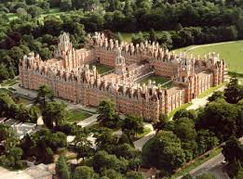

Helena got a First in History
and a Masters in Holocaust Studies at
Royal Holloway, University of London…

Slide 7

… and is now
Communities Manager
for innocent smoothies
She manages their SOCIAL MEDIA STRATEGY
“I spend my days tweeting for @innocent”
It’s a key role in modern business, needing a cutting edge ability to analyse social media strategy and generate new ideas that engage potential customers and grow the brand
But when Helena started at uni, social media didn’t even exist in UK, so her future career hadn’t even been invented
…which brings me to:

Slide 8
60 CAREERS FOR THE FUTURE - 1
Bioregenerative Integrator
Robotician
Application Programme Interfacer
Drone Traffic Controller
Digital Detox Therapist
Cultural Intelligence Agent
High Intensity Therapist
Cloud Capacity Manager
Virtual Architect
Book Digitiser
Quantified-Self Personal Trainer
Big Data Software Architect
Myotherapist
Haptic Programmer
Mobile Biomass Therapist
Rewilder
Nostalgist
Garbage Designer
Simplicity Expert
Healthcare Navigator
Gamification Designer
Epidemiologist
Vertical Farmer
Urban Shepherd
Productivity Counsellor
Transhumanist Design Engineer
Telesurgeon
Media Remixer
Powered Exoskeletal Engineer
Telecop

Slide 9
60 CAREERS FOR THE FUTURE - 2
Personal Microbiome Steward
Trait Selection Adviser
Mind-Uploading Re-integrator
Extinction Revivalist
Synthetic Protein Designer
Pharma-Artisan
Connectome Architect
Gene Programmer
Celebrity Tweet Adviser
Vicarious Videographer
Culinary Diplomat
Arena Booster
Native Advertising Manager
Brain Augmenter
Weather Controller
Ethics Lawyer
Medical Roboticist
Custom Implant Organ Designer
Sensuality Simulator
Future Forecaster
Virtual Teacher
Avatar Relationship Manager
Talent Aggregator
Personal Brand Manager
Global Sourcing Manager
Plant Psychologist
Terabyter
Brain Quant
Digital Archaeologist
Post-Normal Job Counsellor

Slide 10
MORE WHERE ARE THEY NOWS
Paul: Logistics at Aston
Head of Supply for Airbus, Miami USA
Alex: Politics at Portsmouth
Political Reporter, BBC News
Liam: Computer Animation at Bournemouth
Senior R & D Programmer at Dneg, London (VFX for Harry Potter, Hunger Games)
Marianne: Law at Cambridge
Technical Author in Cambridge for a world-leading SME, writing about complex software functionality to help companies comply with legislation
Stephanie: Sound Engineering at Liverpool Institute of Performing Arts
Freelance Production Manager; toured with One Direction, Ed Sheeran, Gorillaz, Blur, Foo Fighters, Robbie Williams, Coldplay, Spice Girls Reunion tour, X Factor tour
Chris: Business Studies & Sports Studies at Roehampton
Director of Football, Kick4Life, Lesotho (world’s first club dedicated to social change)
Emma: Maths at Warwick
Operations Manager at the British Consulate in Chicago USA
Katy: Drama at Hull
Improvised Comedy Performer & Teacher, London/Brighton/New York/Lidl TV ad!

Slide 11
So if you don’t know what to do for a career, choose a course that motivates you, because:
“IT’S NOT JUST WHAT YOU STUDY AT UNI,
IT’S THE SKILLS YOU CAN BRING” (Microsoft)
Time management
Teamwork
Communication (verbal & written)
Problem solving
Planning/organisation
Leadership
Initiative & self-motivation
Negotiation
Commercial awareness
Flexibility
Innovation & creativity
Self-confidence
Resilience
Intellectual curiosity
Numeracy & IT skills
Self-awareness
Professionalism
Stress tolerance
Cultural intelligence
KEY EMPLOYABILITY SKILLS & ATTRIBUTES (ADAPTED FROM RESEARCH BY WARWICK & KENT UNIVERSITY … AND GOOGLE)

Slide 12
SKILLS SHORTAGES – random examples
Electronic/Electrical/Systems Engineering:
“It’s a fast-growing area (eg wearable tech/driverless cars), every student has a job lined up before their final year, we don’t necessarily need A Level Physics and we need more girls.” (Will, course leader at Loughborough)
Fremantle Media (X Factor, BGT, The Apprentice, Take Me Out, Neighbours):
“We need more graduates with that rare combination of business, mathematical and creative talents.” (Nicky, Global HR Director)
Double Negative (Harry Potter, Interstellar, Hunger Games, Sherlock):
“In VFX we’re looking for a new type of artist, who understands art and physics. It’s difficult to find staff with the right skills.” (Paul, 2 x Oscar winner)
More woman needed in IT!
“We need good communicators with a logical, inquiring mind who can see the wider picture and who love solving problems and helping people.” (Lisa, Zurich Insurance & Girls Into IT Initiative)
Conservatoires – endangered species are:
Viola, oboe, tuba and double bass players (and tenors too!) (John, Director of Music at Royal Welsh College of Music & Drama)

Slide 13
THINK OUTSIDE THE BOX!
Remember Mary Curnock Cook’s advice to “be more imaginative” …
Don’t be a doctor, be a Doctor! (Biochemistry professor at King’s) …
You Can’t All Be Doctors…
My handout containing 66 other ideas from Audiology to Sleep Science, including…
Therapeutic Radiography … and Podiatry
Sport orthopodics, podopaediatrics, forensic podiatry, space podiatry, diabetes “There will always be a need to treat feet!”
Choosing less competitive courses at popular unis … such as LSE:
“There is intense competition for many of our courses”
But not for Social Policy!

Slide 14
CONSIDER Joint, Combined or Multidisciplinary Degree
Combine 2 subjects
    Examples: History and Spanish or Physics and Music Performance
  Take a major/minor course
    Example: Maths with Management
  Combine 3 subjects
    Example: Triple Honours at Sheffield (19 subject choices)
  Or a multidisciplinary course
    Examples: Natural Sciences or Liberal Arts or Arts & Sciences

Slide 15
AND CONSIDER THE ‘SANDWICH’ OPTION
Degrees with a professional year/sandwich placement
Unis like Aston, Bath, Brunel, Loughborough, Surrey & Harper Adams offer it across a wide range of subjects
Sussex offers it through Sussex Choice
Placement year is usually paid (e.g. Sussex average = £16K - £25K)
Tuition fee for placement reduced to £1,800 (UK/EU)
Some unis are reporting that, as well as giving a big boost to employability, sandwich students’ degree results are 30% better

Slide 16
ADVICE ON GRADUATE EMPLOYABILITY from leading UK commentator Dr Paul Redmond at Manchester Uni
“From our work with graduate recruiters it’s clear that the key to 21st century employability lies in positioning yourself at the intersections between academic subject disciplines. That’s where innovation exists, that’s what gives organisations from Apple to Unilever a competitive advantage.”
If you want to compete for graduate jobs, then:
Immerse yourself in all aspects of university life
Year 1 is the new Year 3
32% of jobs with top 100 graduate employers now go to students who’ve already had work experience with the company
But it isn’t just about the 100 top graduate employers … 64% of graduates who go straight into employment get jobs with SMEs & start-ups

Slide 17
CHOOSING UNIVERSITIES
What’s a “good” university?
There’s often an assumption that Russell Group universities are the best
But it depends what you’re judging it by …
… most importantly, it depends on what’s right for YOU
For example, in these tables, non-Russell Group unis are in red:

Slide 18
2016: UK UNIS IN WORLD TOP 150
MY OWN LEAGUE TABLE, GIVING EACH UNI’S BEST POSITION IN QS OR TIMES 2016 TABLES | UNIS IN RED = NOT IN THE RUSSELL GROUP
2 OXFORD | 76 BIRMINGHAM
3 CAMBRIDGE | 80 SHEFFIELD
7 UCL | 81 SOUTHAMPTON
8 IMPERIAL | 87 LEEDS
19 KINGS | 93 EXETER
21 EDINBURGH | 98 QUEEN MARY
23 LSE | 103 YORK
33 MANCHESTER | 121 LANCASTER
48 WARWICK | 122 CARDIFF
61 DURHAM | 129 ROYAL HOLLOWAY
62 GLASGOW | 137 ABERDEEN
68 ST ANDREWS | 140 SUSSEX
70 NOTTINGHAM | Source: latest QS & THE tables

Slide 19
2016: UNIS TARGETED BY LARGEST NUMBER OF GRADUATE EMPLOYERS
NON-RUSSELL GROUP UNIS IN RED
MANCHESTER | LSE
NOTTINGHAM | LOUGHBOROUGH
WARWICK | 16. SHEFFIELD
BRISTOL | 17. SOUTHAMPTON
CAMBRIDGE | 18. EXETER
OXFORD | 19. NEWCASTLE
UCL | 20. KING’S
DURHAM | 21. YORK
BATH | 22. CARDIFF
LEEDS | 23. LIVERPOOL
BIRMINGHAM | 24. LANCASTER
IMPERIAL | 25. GLASGOW
13. EDINBURGH | (www.highfliers.co.uk 2016)

Slide 20
2016: TOP 25 IN THE TIMES /
SUNDAY TIMES LEAGUE TABLE
NON-RUSSELL GROUP UNIS IN RED
CAMBRIDGE | LEEDS
OXFORD | YORK
IMPERIAL | SOUTHAMPTON
ST ANDREWS | 17. BIRMINGHAM
DURHAM | 18. EAST ANGLIA
WARWICK | SUSSEX
EXETER | BRISTOL
SURREY | 21. SHEFFIELD
LSE | 22. EDINBURGH
UCL | 23= KENT
LANCASTER | 23= NEWCASTLE
BATH | 25. NOTTINGHAM
13. LOUGHBOROUGH | (Good University Guide 2016)

Slide 21
2016: TOP 25 IN THE COMPLETE UNIVERSITY GUIDE LEAGUE TABLE
CAMBRIDGE | EAST ANGLIA
OXFORD | BIRMINGHAM
LSE | 16. LEEDS
IMPERIAL | 17. SOUTHAMPTON
ST ANDREWS | 18. SUSSEX
DURHAM | 19. EDINBURGH
LOUGHBOROUGH | 20. YORK
WARWICK | 21. KING’S
LANCASTER | 22. NOTTINGHAM
UCL | 23. KENT
SURREY | 24. BRISTOL
BATH | 25. MANCHESTER/NEWCASTLE
13. EXETER | (The Complete University Guide 2016)

Slide 22
2016: TOP 25 IN
THE GUARDIAN LEAGUE TABLE
CAMBRIDGE | UCL
OXFORD | COVENTRY
ST ANDREWS | 16. LEEDS
SURREY | 17. SOUTHAMPTON
LOUGHBOROUGH | 18. CITY
DURHAM | 19. YORK
IMPERIAL | 20. SUSSEX
LANCASTER | 21. FALMOUTH
WARWICK | 22. EDINBURGH
BATH | 23. KENT
EXETER | 24. EAST ANGLIA
LSE | 25. NOTTINGHAM
13. BIRMINGHAM | (The Guardian 2016 rankings)

Slide 23
2016: UNIS WITH
HIGHEST STUDENT SATISFACTION
NON-RUSSELL GROUP UNIS IN RED
LOUGHBOROUGH | 14= ST ANDREWS
HARPER ADAMS | 14= BANGOR
SHEFFIELD | 14= EXETER
OXFORD | 17. NOTTINGHAM TRENT
BATH | 18= NORTHUMBRIA
LEEDS | 18= NOTTINGHAM
7= EAST ANGLIA | 20. READING
7= NEWCASTLE | DUNDEE
CAMBRIDGE | BIRMINGHAM
10. KEELE | 23= EDGE HILL
FALMOUTH | 23= YORK
12= QUEEN’S BELFAST | CHICHESTER
12= CARDIFF | (TIMES HIGHER EDUCATION 2016)

Slide 24
2016: TIMES HIGHER EDUCATION MOCK TABLE
BASED ON TEACHING EXCELLENCE, EMPLOYMENT, RETENTION, STUDENT SATISFACTION
NON-RUSSELL GROUP UNIS IN RED
LOUGHBOROUGH | 14. LINCOLN
ASTON | 15. SUSSEX
3. DE MONTFORT | 16. DURHAM
4. SWANSEA | 17. HUDDERSFIELD
KENT | 18. BIRMINGHAM
6. COVENTRY | 19. PORTSMOUTH
7. KEELE | 20= CHICHESTER
8. SURREY | 20= OXFORD BROOKES
9. BATH | EXETER
10. LANCASTER | 23. EAST ANGLIA
WINCHESTER | 24. NEWCASTLE
12. CAMBRIDGE | 25. LEEDS
13. ESSEX | (TIMES HIGHER EDUCATION 2016)

Slide 25
TOP UK UNIS FOR PRODUCING MILLIONAIRES
POSITION IN WORLD TOP 500
6 OXFORD | 168 NEWCASTLE
9 CAMBRIDGE | 173 DURHAM
27 LSE | 215 BIRMINGHAM
68 IMPERIAL | 217 NOTTINGHAM
102 BRISTOL | 238 LIVERPOOL
114 UCL | 267 GLASGOW
115 EDINBURGH | 296 LANCASTER
148 LEEDS | 299 SHEFFIELD
150 SOUTHAMPTON | 460 BRADFORD
152 MANCHESTER | (Source: Times HE/Wealthinsight/Spear’s, 11/2013)

Slide 26
UNIS WITH BEST NIGHTLIFE
(this slide is not for parents)
NON-RUSSELL GROUP UNIS IN RED
LSE | 9. LEEDS
MANCHESTER | 10. LIVERPOOL
NEWCASTLE | 11. SUSSEX
LIVERPOOL JOHN MOORES | 12. UCL
GLASGOW CALEDONIAN | 13. LEEDS BECKETT
STRATHCLYDE | 14. NOTTINGHAM TRENT
NORTHUMBRIA | 15. GLASGOW
BRISTOL | (“Which? University” 2015)

Slide 27
SECTION 2
“VARIATIONS ON A THEME” OF HIGHER EDUCATION
Higher Education, with a twist…

Slide 28
NEW/Private/INDEPENDENT UNIs IN UCAS
Cost differentials now less prohibitive; partial scholarships or tuition fee loans available in most cases; all in UCAS except CTC Wings & Condé Nast:
University of Law (Birmingham/Bristol/Chester/Guildford/London/Manchester/York)
New College for the Humanities (NCH) (London) can also apply outside UCAS
UCFB (Wembley Stadium/The Etihad) Degrees for the football & sports Industries
Academy of Contemporary Music (Guildford) / Tech Music School (London) / BIMM (Brighton/Bristol/Dublin) / Inst of Contemporary Music (London) popular music degrees
Backstage Academy Degrees in Stage Management/Live Events/Visual Prod (Wakefield)
SAE Institute 2-yr degrees for creative industries (London/Oxford/Liverpool/Glasgow)
BPP University 2 or 3-year Law/Business degrees (Birmingham/Bristol/Cambridge/Leeds/Liverpool/London/Manchester/Swindon)
Pearson College FTSE 100 company; job-ready degrees in Business/Law/Media (London)
Richmond American International University dual US/UK degree (London)
Norland College BA Early Childhood Studies (Bath)
University of Buckingham 2-yr degrees (+ a new degree in Medicine with £36K fees)
Edge Hotel School 2-year degree at country house hotel on Essex University campus
CTC Wings BSc Professional Aviation Pilot Practice (Southampton/Bournemouth/Gatwick/Coventry)
Condé Nast College of Fashion & Design 2-yr BA Fashion Communication (London)

Slide 29
FOUNDATION DEGREE OR HND
2-year vocational courses (eg these are all available in the Bath/Bristol area, where I was speaking recently)
FDg: Addiction Counselling, Aerospace Engineering Manufacturing, Agriculture, Agricultural Management, Animal Behaviour & Welfare, Animal Management, Animal Science & Management, Applied Computing, Administration & Business Technology, Art & Design, Business, Business with Management, Care Management in the Community, Communication & Computer Networks, Computing & IT, Contemporary Circus & Visual Performance, Contemporary Art & Professional Studies, Counselling, Creative Arts Therapy Studies, Dance Theatre & Performance, Digital Media Production, Early Childhood Studies, Early Years, Early Years Care & Education, Education Studies for T/As, Equine Performance, Equine Science & Management, Equine Veterinary Nursing Science, Fashion & Textile Design Skills, Film & Media Arts Production, Fine Art, Games & Animation Production, Graphic Design, Graphic Design with Interactive Multimedia, Health & Social Care Practice, Healthcare Science, Inclusive Practice, Integrated Wildlife Conservation, Interactive Multimedia with Graphic Design, Mechatronics, Media Practice, Music Production, Music Production & Artist Development, Musical Theatre, Performing Arts, Photography in Practice, Popular Music, Professional & Commercial Dance, Professional Photography, Public & Environmental Health, Public Services with Outdoor Education, River & Coastal Engineering, Sports Business Management, Sports Coaching, Sports Performance, Sports Studies, Tourism Management, Uniformed & Public Services, Veterinary Nursing Science
HNC/HND: Aeronautical Engineering, Biology for Industrial Applications, Business, Civil Engineering, Computing, Electronic Engineering, Health & Social Care, Horticulture, Mechanical Engineering, Music Performance/Production, Photography, Sport

Slide 30
OTHER Level 3/4 courseS
Examples (not in UCAS):
CAE Aviation Academy (Oxford)
£80,000 for 16 month course (but Ben became a First Officer with BA at 21)
Tante Marie Culinary Academy (Woking); Cordon Bleu School (London)
£20,000+ for up to 1 year
Executive PA Diploma
£10,500 for 1 year course eg at Oxford Media & Business School
Fashion Retail Academy, London
£9,000 for 1 year (Retail, Merchandising, Buying & Range Planning, Garment Technology, Visual Display & Branding; placements with 110 retailers)
NCTJ Pre-Entry Journalism
1-year professional journalism training at random colleges
eg £1,800 @Highbury College, Portsmouth (a leading NCTJ centre)
Pre-Degree Art Foundation
1-year course giving the option to progress to art/design degrees
Usually free if under 19

Slide 31
SECTION 3
HIGHER EDUCATION
ABROAD
There’s a global revolution going on…
“It’s no good thinking national now, you have to be global”
(Dorothy Foster, SKEMA Business School, Antibes, FR)
“Internationalization of education worldwide isn’t going to stop”
(Rob Maat, Fontys International Business School, Venlo, NL)

Slide 32
OVERSEAS UNIVERSITIES:
APPROX TUITION FEES FOR UK/EU APPLICANTS
(THIS IS PER YEAR IN STERLING AND MAINLY FOR PUBLIC UNIVERSITIES; but BREXIT would change everything)
£0: Austria, Denmark, Finland, Germany, Greece, Hungary, Iceland, Luxembourg, Malta, Norway, Slovenia, Sweden £160-£535: France £400-£2700: Switzerland £450-£1850: Portugal, Spain £500-£3500: Belgium £750-£2900: Italy £800+: Czech Republic £1600: The Netherlands £2100: Ireland £2150-£3750: China £2450-£3075: Malaysia £2500-£5650: South Korea | £3350: USA (average, 2-yr college) £4050-£5150: Japan £4350+: S Africa £6000+: Hong Kong £6500+: Singapore £9000: England, NI, Scotland, Wales (BUT MAY NOT NEED TO BE REPAID) £9000-£14500: N Zealand £9000 - £20000: Canada £12000- £22000: Australia £15300: USA (average, public uni) £16500: Barbados/Trinidad £21000: USA (average, private uni) £31500: USA (approx. Ivy League) All these are very rough figures but they give some idea of the variation around the world; last updated 2015.

Slide 33
MY 2016 WORLD UNI LEAGUE TABLE
Scores = number of unis in the Times Higher Education World University Rankings top 100;
Where scores are equal, country with highest listed uni ranks higher.
1. USA (39)
2. England (13)
3. Germany (9)
4. Netherlands (8)
5. Australia (6)
6. Canada (4)
7. Scotland (3)
8. Sweden (3)
9. Switzerland (2)
10. Singapore (2)
11. China (2)
12. Japan (1)
13. Hong Kong (1)
14. Belgium (1)
15. France (1)
16. Finland (1)
17. Denmark (1)
18. South Korea (1)

Slide 34
DEGREE AT UNI IN EUROPE
POSSIBLE ADVANTAGES COMPARED WITH UNI IN UK:
900+ courses now taught in English (biggest number are in The Netherlands)
Easy search facility at eunicas.co.uk
Later application window in most countries (so can apply though UCAS first)
Lower tuition fees*** in most countries
10 unis in The Netherlands offer ‘Liberal Arts & Sciences’ degree
“Because of the liberal arts system, I've finally been able to figure out what I want to do in life, and what I’m passionate about.” (my ex-student Aqsa, now at University College Amsterdam – she started by majoring in Biology but has now changed to Politics)
POSSIBLE DISADVANTAGES COMPARED WITH UNI IN UK:
You’re not entitled to UK tuition fee loans/student loans
***Implications of EU Referendum: BREXIT would change this radically
Netherlands – easier to get in, but harder to stay in …
… “if you don’t keep up in Year 1, you’ll be expelled!”

Slide 35
MEDICINE/VET/DENTISTRY IN EUROPE
You’ll probably need to learn the local language in time for clinical placement in Year 3
Annual tuition fees range from around £5,600pa to £16,800pa
Medicine
Italy: Milan, Bari, Naples, Rome
Spain: Valencia
Eastern Europe: Zagreb (Croatia); Riga (Latvia); Pleven, Plovdiv, Sofia, Varna (Bulgaria); Kosice, Bratislava (Slovakia); Pécs, Debrecen (Hungary); Kaunas (Lithuania); Poznan (Poland); Masaryk, Palacky (Olomouc), Prague (Czech Republic)
Joint programme: Murcia & Pleven (Years 1 & 2 in Spain, Years 3-6 in Bulgaria)
Dentistry
Kosice, Varna, Sofia, Pleven, Plovdiv, Kaunas, Kosice, Palacky, Prague, Debrecen, Riga, Valencia, San Pablo, Madrid
Veterinary Medicine
Warsaw, Brno, Valencia (taught in Spanish from Year 2)
For info: Eunicas, Medical Doorway, International Medicine Studies, Astarfuture

Slide 36
UNI ELSEWHERE IN THE WORLD
A few random observations: North America
USA: 4,000 unis to choose from, so look beyond the brand names – “it’s like choosing shoes - you need to find the right fit” (Donn Grinager, Augustana College)
Needs-blind/full-need policy @ MIT/Harvard/Yale/Princeton/Amherst
Sutton Trust summer school (MIT: only 1% of UK applicants from state sector)
Florida State Uni has Gateway programme (1st year in London)
Canadian unis recruiting very keenly in UK
More emphasis on undergraduate breadth followed by postgraduate depth
Rise of the Multinational degree courses in Global Business, like:
SP Jain (Global BBA: Y1 Singapore/Mumbai; Y2 Dubai; Y3/4 Sydney; total cost £88K-£95K)
Bocconi (World Bachelor in Business: Los Angeles/Hong Kong/Milan)
Hult (London/San Francisco + summer programs in Dubai/Shanghai/Miami)
Columbia + Sciences Po (Dual BA Program in New York & Paris)
ESCP Europe (BSc Management: Y1 London; Y2 Madrid/Paris/Turin; Y3 Berlin)
College of Exploratory Education (LSE Business degree whilst travelling the world)

Slide 37
OVERSEAS UNIS: WEBSITES
Excellent info and support now
available, especially through:
thestudentworld.com*
eunicas.co.uk
astarfuture.co.uk
careerseurope.co.uk
studyinholland.co.uk
(Netherlands)
fulbright.co.uk (USA)
uniintheusa.com (USA)
studyoptions.com (Oz & NZ)
educationau-incanada.ca (Canada)
World uni rankings listed at:
timeshighereducation.co.uk
topuniversities.com (for 2016 QS World University rankings by subject)
*The Student World runs twice-yearly Study Abroad Fairs in London in March & October

Slide 38
UK UNI WITH YEAR ABROAD
Examples of unis with semester/year abroad (most other unis have them too):
Aston: work/study/teaching placements (or a combination) worldwide
East Anglia: study abroad in USA, Canada, Hong Kong, Australia, NZ + Erasmus in 21 European countries
Exeter: 400 students per year at 40 different European unis on Erasmus or European Study programmes
Lancaster: 60 partner unis in Europe, USA, Canada, Mexico, Australia, NZ, Hong Kong, Thailand, China (no tuition fees for full year Erasmus programme in Europe) + 28 non-language courses with Study Abroad
Portsmouth: potential Erasmus options in 30 European countries + some opportunities worldwide
Southampton: Erasmus partnerships with 24 European countries + some specific courses have worldwide links
Sussex: year abroad at 140 unis in 34 countries worldwide
Swansea: partnerships with 100 unis worldwide, open to ALL students + summer programmes in India, China, Zambia, Australia, USA
Also most Modern Languages or American Studies degrees have a year abroad
Maximum tuition fee = £1350 for UK/EU students; NB Brexit could change all this

Slide 39
SECTION 4
EMPLOYER/UNI PARTNERSHIPS APPRENTICESHIPS
EMPLOYMENT AT 18
“The student recruitment market is changing to such a degree that the AGR's name is no longer fit for purpose. Many employers are now looking at an integrated talent strategy for early careers - not just graduates.”
(Stephen Isherwood, CEO, Association of Graduate Recruiters,
last Monday!)

Slide 40
EMPLOYER-LED SPONSORED DEGREE SCHEMES
Various models; most pay a salary or bursary and/or uni fees too; NOT in UCAS;
Examples with grades (using the ‘old’ UCAS points system) + approx annual pay:
Airbus @ Bristol UWE (Engineering); 300pts/£13K
Barratt @ Sheffield Hallam (Trainee Asst Site Manager; Foundation Degree in Construction)
CGI @ Winchester (Business Management; based at Reading/Leatherhead); 300pts/£14K
EDF Energy @ Bridgwater College (Somerset) (Nuclear Foundation Degree); £15K
Environment Agency @ Bristol UWE (FDg River & Coastal Eng) 180pts/£15K max + fees paid
Experian @ Nottingham Trent (Management & Leadership); 300pts
EY Scholarship @ Bath, Lancaster, Warwick (4-year Acc/Fin); A*AA-AAB/£5K + paid vac work
KPMG @ Birmingham/Durham (5-yr Audit prog); 22 locations; ABB/£16-£21K + all fees
Mayer Brown @ Uni of Law (6-yr Articled App’ship; LLB+LPC+PSC); London; AAB/£18K (SLC Fee Loan)
Merchant Navy Cadets @ Southampton/Fleetwood/S.Tyneside; £120pw sea/£175pw college
Morrisons @ Bradford (Management & Business); 260pts/£15K
National Grid @ Aston (p/t) (Substations Elec Engineer: Barking/Bolney/Elstree/Scunthorpe/Melksham/Sellindge); 160pts/£23.5K + car
Nestlé @ Sheffield Hallam (Gatwick/York; HR/Sales/Marketing/Buying); £17K + all fees
PwC @ Reading/Newcastle/Nottingham (4-yr FlyingStart programme); AAB/£20K offsets fees
Tesco @ Fashion Retail Academy (F&F Fashion Apprenticeships); 240pts/£18K

Slide 41
DEGREE APPRENTICESHIPS
Introduced in 2015; all with p/t degree study
Starting salaries from £6K to £19.5K + all uni costs paid for + benefits
Apply direct to employer, not UCAS
Entry requirements in region of BBB to CCC, depending on the scheme
Most will need one or more STEM or numerate subjects at A Level
Training can be up to 6 years, but with incremental pay rises that could reach £35,500 by the age of 24
Programmes currently available include:
Accounting & Finance
Aerospace Engineering
Aerospace Software Development
Automotive Engineering
Banking Relationship Manager
Chartered Management
Chartered Surveying
Construction
Defence Systems Engineering
Digital & Technology Solutions
Electronic Systems Engineering
Laboratory Science
Nuclear
Power Systems
Public Relations

Slide 42
DEGREE APPRENTICESHIP EXAMPLES - 1
CAPGEMINI – eg London, Birmingham, Bristol, Rotherham, Sale, Woking
Software Engineering & Consulting Degree Apprenticeship
4.5 year programme with multinational firm of technology consultants
Blended learning includes distance-learning, work-based study & on-campus study days at Aston University leading to BSc Digital & Technology Solutions
Needs 240 UCAS points including a STEM subject, or relevant BTEC, or Advanced Apprenticeship in IT; starting salary £16,000
Some roles need 300 points including B in A Level Maths
NESTLÉ ACADEMY – York & Halifax
Confectionery Degree Apprenticeship; working as p/t team member developing new confectionery + learning about food science, nutrition, factory processing, business improvement & manufacturing management techniques
Study p/t for BSc in Food Manufacture at University of Lincoln, incl exclusive modules in chocolate moulding, toffee/caramel manufacture, sugar processing
Needs 3 A Levels including a Science; starting salary £16,000
Apply Feb/March/early April

Slide 43
DEGREE APPRENTICESHIP EXAMPLES - 2
JAGUAR LAND ROVER – West Midlands
Accounting & Fiance Degree Apprenticeship; 6-year programme
Day-release to BPP University, Birmingham to qualify as CIMA Chartered Accountant, plus top-up degree for BSc in Professional Accounting
Starting salary £18,550 increasing every 6 months if you meet expectations
Likely salary of £35,500 after 6 years, although no firm job guarantee
Tuition fees + other support/mentoring paid for + holiday allowance + benefits
280 UCAS points from 3 A-Levels, incl B in numerical/business-related subject
ARCADIS – London, Birmingham, Bristol, Manchester
Chartered Quantity Surveying Degree Apprenticeship; global design engineers
Leads to RICS accredited degree & Assessment of Professional Competence (APC), leading to full Chartered Surveyor status
Fixed term 4 to 5 year contract; no firm job guarantee at the end
In partnership with University College of Estate Management (UCEM)
Blended learning includes online and distance learning, supported by a VLE with online tutor support; 1 day pw off-the-job.
Starting salary £15,600; needs 230 UCAS points

Slide 44
DEGREE APPRENTICESHIP EXAMPLES - 3
MEINERT SCHIVERS - London
Chartered Management Degree Apprenticeship; global management consultancy; business technology solutions for public & healthcare sectors
Work as Trainee Management Consultant + p/t study at BPP University, London
Needs 260 UCAS points minimum; starting salary - £12,750
FUJITSU - Basingstoke
Technology Degree Apprenticeship; working on Defence & National Security a/c
P/t study at University of Winchester; 4-yr BSc Digital & Technology Solutions degree; study modules + dissertation matched to business area you work in
Needs 280 UCAS points; starting salary - £17,500
CLEARLY SCRUMPTIOUS - Keighley
Operations Management Degree Apprenticeship
Healthy snacking products company run by 2 guys, Rick & James!; via BPP
Needs 280pts; starting salary £6,500

Slide 45
DEGREE APPRENTICESHIP EXAMPLES - 4
JP MORGAN - Bournemouth
Technology Degree Apprenticeship in Financial Services;
Based at their technology hub; degree delivered by blend of virtual lectures leading to BSc Digital and Technology Solutions and internal training led by industry experts (but scheme may be jeopardised by a Brexit vote)
Needs 3 A Levels at BBB
CISCO – Reading, Feltham
Technology Degree Apprenticeship in the Internet of Everything
3-year programme starts with induction bootcamp & leads to BSc Digital and Technology Solutions through QA Ltd, working across mobile, cloud, security, IT and big data spaces including software & consulting services
Individualised training programme; on graduation Cisco aims to offer a graduate job, subject to role availability
Needs 160 points; staring salary £15,500

Slide 46
HIGHER APPRENTICESHIPS 1
Accredited & salaried work-based programmes with p/t university level study – examples with approx starting salaries & grades :
Accenture: IT, Software, Web & Telecoms; London/Newcastle; FdSC IT/ BSc Software Eng; 200pts/£14K
Aon: Actuarial/Consulting/Insurance; 14 locations; 260-280pts/£16K-£18K
Atkins: Surveying/Civil Mech Elec Engineering/Project Man; various locations; 230pts/£15K-£17K
BAE Systems: Proj Man/IT/Engineering/Finance; Portsmouth/Camberley/Yeovil/Pontypool/Hull/Preston/Barrow
Barclays: Audit/Finance/HR/Management; 200pts/£16K
BBC/Pearson: Leadership & Management; London; study at Pearson College; £17K
BDO: Audit/Tax/Advisory; 10 locations; 280pts/£16K
Boots: 2-year Future Leaders programme; Nottingham; 240pts/£15K
BT: HR/Finance/IT/Engineering/Customer Service; various locations; up to 300pts/£14K-£18K
CGI: Software Dev/Cyber Security/Project Man/Business Intelligence; (eg Police Nat D’base); CC/£14K
Civil Service Fast Track: IT/Finance/Project/Business/Commercial; 36 locations; £19K-£22K
Deloitte: Audit/Tax/Consulting/Business Advisory; 5-yr BrightStart scheme; 260pts
Eversheds: Law; London/Bmgham/Cmbdge/Cdiff/Edin/Ipsw/Leeds/Manch/Newc/Notts; 300pts/£15-£17K
Ford: Finance; based at Warley/Dunton (Essex); study at BPP (London); 300pts
GCHQ/MI5/MI6: Intelligence HA’s; Cheltenham/London; CCC incl 2 STEM subjects

Slide 47
HIGHER APPRENTICESHIPS 2
GlaxoSmithKline: Design/Laboratory/Engineering/Supply Chain; 12 locations; 240pts min
IBM: Business/IT; Winchester/Farnborough/Manchester/Portsmouth/London/Warwick; 160pts/£15K
Hewlett Packard: Project Management; Newcastle; £12K
John Lewis/Waitrose: Retail Management; nationwide; CC/£16.5K
Lafarge Tarmac: Operations Management; Airdree/Bristol/Durham/Radlett/Shrewsbury
M&G Investments: Finance & Investment Operations; London/Essex; 240pts/£19K
PwC: Assurance/Consulting/Deals/Tax; numerous locations; 240-280pts/16K min + benefits
Rolls-Royce: Engineering/Supply Chain/Project Man; Derby + others; 240-300pts/£11,700/
Smith & Williamson: Accountancy; London/Guildford/Southampton/Salisbury/Birmingham/Manchester 280pts
RSM: Accounts/Outsourcing/Tax/Forensic Accounting; numerous locations; 280pts/£10K
Transport for London: Finance/Project Management/HR/IT/Surveying/Engineering; £16K+
TUI: Tour Operations; based at Luton head office; 280pts/£15K
Virgin Media: IT/Telecomms; nationwide; 2 A-levels/up to £18K
Visa Europe: IT/Finance; London/Basingstoke/Reading; £15K

Slide 48
18+ SCHOOL-LEAVER PROGRAMMES (NON-UNI)
Examples (with UCAS points needed & approx starting salary if known):
Bank of England: School Leaver Development prog, London; Statistics/Operations/Technology 180pts
BBC: App’ships: Production (London/Birmingham/Salford) Digital Journalist (Brighton/Reading/Dunstable/Sheffield/Coventry/Liverpool) Broadcast Op (Newcastle/Leeds/Salford/Hull/Birmingham/Nottingham/Norwich/Cambridge/Oxford/Plymouth/Bristol/Southampton/TunbdgeWells/Jersey)
Channel 4: App’ship; Bus Admin, Creative & Digital, Social Media & Digital Mktng; London £18.5K
Close Brothers: Investment Banking; Wimbledon/Doncaster/Hove/Manchester/Sidcup/Burton-on-Trent; 280pts/£16K
EY: 5-year School Leaver programme, Assurance/Tax/Corp Finance; 300pts/£18K-£22K
Grant Thornton: Accelerate prog; Audit/Tax/Business Advisory; 22 locations; “No minimum entry criteria – we look for interesting candidates who’ve done some great things outside their studies” £6K
Kennedys: Legal Apprenticeship; 2-yrs; London/Chelmsford/Cambridge/Taunton/Birmingham/Manchester/Sheffield; AAB/ £15K (regions) - 18K (London)
KPMG: 360°prog; Audit/Tax/Advisory; Birmingham/Bristol/Glasgow/Leeds/London/Manchester/Reading; BCC/£18K
Marks & Spencer: Trainee Management Scheme, nationwide; 240pts/£18K
National Audit Office: 5 year Accountancy prog; London/Newcastle; 300pts/ £23K/£17.5K
Rolls-Royce: Accounting Technician; Derby; 300pts/£15K
Santander: Flying Start programme; 4 yrs; Glasgow/Edinburgh/Cardiff/Belfast/Leicester/Bootle/Radford; CC
Tesco: Trainee Management programme nationwide; 2 years; 240pts/£18.5K
Transport for London: Road Space Design & Management; 240pts
UHY Hacker Young: 2-year Audit programme, London; AAB/£17K
Willis Towers Watson: Insurance/HR/IT; Ipswich; 240pts/£16K

Slide 49
DEGREE APPRENTICESHIPS SNAPSHOT
207 VACANCIES WERE ADVERTISED ON 1/6/2016 ON GOV.UK/APPLY-APPRENTICESHIP (With ENTRY GRADES IF STATED & STARTING SALARY)
107 IT (DTS) (Capgemini; London, Sale, Birmingham, Bristol, Woking, Rotherham) 240/300pts/£16K
30 Internet/Big Data (Cisco; Feltham + UK-wide) 160pts/£17K
30 Civil Engineering (Balfour Beatty; Slough + UK-wide) £12K
15 Quantity Surveying (Balfour Beatty; London, Manchester, Birmingham, Exeter, Swaffham, Northampton, Reading, Wolverhampton, Peterborough, Leeds) £12K
15 Construction Management (Balfour Beatty; Swaffham + UK-wide) £12K
5 IT (BT; 3 Ipswich, 1 Sheffield, 1 London) BCC/£14K
2 IT (DTS) (Santander; 1 Leicester, 1 Milton Keynes) BCC/£14K
1 Quantity Surveying (Atkins; Warrington) £19.5
1 Software Engineering (Payara Services; Malvern) £14.5
1 Operations Management (Clearly Scrumptious; Keighley) 280pts/£6.5K

Slide 50
HIGHER APPRENTICESHIPS SNAPSHOT 1
431 VACANCIES WERE ADVERTISED ON 1/6/2016 ON GOV.UK/APPLY-APPRENTICESHIP;
THE BIGGEST PROVIDERS WERE (With ENTRY GRADES IF STATED & STARTING SALARY):
84 BT (British Telecom) 160-300 £14K
IT, Finance, Management Accounting, HR
London/Ipswich/Bristol/Walsall/Brentwood/Cambridge
65 Balfour Beatty £12K
Civil Engineering, Highways, Commercial, Business, Data Analysts London/Derby/Hereford/Swaffham/South Mimms
35 RSM (formerly Baker Tilly) 280 £10K
Accountancy, Tax, Audit
London/Guildford/Reading/Bury St Edmunds/Crawley /Leeds/ Milton Keynes/Preston/Stoke/Swindon/Tunbridge Wells/ Bromley/Eastleigh/Hull
28 Vodafone 240 £20K
Mobile Netwks, Tech Ops, Engineering, Fibre Service Planners
Newbury/Bracknell/London/Swindon/Birmingham/Newcastle
20 University of Southampton NHS Trust £9.5K
Healthcare Assistants; Southampton
19 BDO 280 £15K
Accountancy/Tax/Audit/Risk Assurance
London/Bristol/Reading/Gatwick/Guildford/Leeds/Leicester
17 Thales 240-300 £14.5 - £18K
Project Management, Software Development, Accountancy
Gatwick/Templecombe/London (all EU-funded)
13 Stockport Metropolitan Borough Council £10K
Business Administration, Project Management; Stockport
8 Mazars 280 £13.5K
Accountancy/Audit/Tax
Milton Keynes/Sutton/Leicester/London/Poole
8 PwC 280 £6.5K
Accountancy/Tax/Audit/Assurance
Uxbridge/Derby/Hull/Norwich/Manchester/Sheffield/St Albans
8 Conveyancing Direct £10K
Conveyancing Technicians; Hastings
5 Lloyds Banking Group £25.5K
Senior Finance Administrator; Bristol
5 Lockheed Martin £14K
Engineering, Project Management, Software Engineering
Havant/Fareham
5 Hope Construction Materials £13K
Mineral Product Technologists
Coventry/Egham/Leicester/Lutterworth/Reading
5 Halfords £7K
Vehicle Technicians
Milton Keynes/Warrington/Woking/Worcester/Worksop

Slide 51
HIGHER APPRENTICESHIPS SNAPSHOT 2
THE REMAINING PROVIDERS WERE:
4 AON 260 £17K
Actuarial Bristol/Epsom/Farnborough/St Albans
4 John Lewis Partnership 240 £16.5K
Retail Management London
4 Aggregate Industries 160 £15K
Minerals/Asphalt/Ready Mix Concrete Operations Burton-on-Trent/Carnforth/High Wycombe/Newton Abbot
4 Wessex Water £14K
Construction/Building Services Management Bath
3 Microsoft Partners £9K - £10.5K
IT Network Engineers Leamington Spa/London/Nottingham
3 Digital Skills Solutions
Marketing & Blogging/Recruitment/Social Media & Digital Mktng London
2 Haysmacintyre 300 £17.5K
Accountancy London
2 Aviva 300 £17K
Web Developers London/Norwich
2 Arcadis £14.5K
Project Management Birmingham/London
2 Menzies 300 £14K
Accountancy Egham/Leatherhead
2 Atos IT Services (Olympic Partner) £14K
Project Management London
2 CGI £14K
IT Applications Support Birmingham/Bristol
2 Westcon UK £13K
Project Management Bracknell
2 Portakabin £12K
Project Management Highbridge/Lingfield
2 North West Ambulance Service £12K
IT Support Technicians Liverpool/Preston
2 Halesowen College £6.5K
Hairdressing/Beauty Salon Management Halesowen
64 OTHERS 160-280 (mostly 240)
Starting salaries = £6K - £34K;
Average = £13K; highest were £34K (DfT/HS2), £24K (Nomura)
8 Project Management; 7 IT Network Engineers/Technicians;
6 Accountancy/Financial Analyst; 4 IT Systems Administrators;
4 Web Design/Development; 4 Tax Advisers; 4 Business Admin;
4 Social Media & Digital Marketing; 3 Quality Technicians;
3 Engineering; 2 Public Relations; 2 Human Resources; 2 Actuaries;
2 Nursery Nursing; 1Advertising; 1 Automotive Design; 1 Banking;
1 Construction Management; 1 Food Technology; 1 Hospitality;
1 Logistics; 1 Marketing & Blogging; 1 Paralegal
16 Greater London; 7 West Midlands; 5 Greater Manchester;
4 Berkshire; 4 Yorkshire; 3 Cheshire; 3 Durham/Tyneside;
3 Hampshire; 3 Liverpool; 2 Devon/Cornwall; 2 Essex;
2 Leicestershire; 2 Surrey; 1 Bedfordshire; 1 Bristol; 1 Derbyshire;
1 Shropshire; 1 Staffordshire; 1 Sussex; 1 Wiltshire; 1 Worcestershire

Slide 52
LOCAL APPRENTICESHIPS SNAPSHOT 1
HIGHER APPRENTICESHIP VACANCIES LISTED ON GOV.UK/APPLY-APPRENTICESHIP
THIS WEEK, WITHIN 30 MILES OF BRIGHTON
8 Conveyancing Technicians, Conveyancing Direct, Hastings
5 Project Planners, Thales, Gatwick (EU–funded)
3 Human Resources Assistants, West Sussex County Council, Chichester
1 Project Assistant, Lloyds Banking Group, Hove
1 Audit Trainee, BDO, Gatwick
1 Software Developer, Bond International Software, Worthing
1 Project Management Trainee, Portakabin, Lingfield
1 Business Advisory Trainee, RSM Baker Tilly, Crawley
1 Audit Trainee, RSM Baker Tilly, Tunbridge Wells
1 Tax Trainee, RSM Baker Tilly, Tunbridge Wells
At present there are no Degree Apprenticeships on the website in the Sussex region
£9,750
£14,500
£17,000
£21,000
£15,000
£12,000
£12,000
£10,000
£10,000
£10,000

Slide 53
LOCAL APPRENTICESHIPS SNAPSHOT 2
ADVANCED APPRENTICESHIP VACANCIES LISTED ON GOV.UK/APPLY-APPRENTICESHIP
THIS WEEK, WITHIN 30 MILES OF BRIGHTON
15 Digital Marketing/Social Media
13 Digital Business Support
11 Contact Centre Agents (BT)
9 Business Administration
9 IT Technical Support
9 General Engineering/Production
8 Web & Digital Design
7 Vehicle Technician
6 Vehicle Parts Adviser
6 Sales Support
5 Electricians/H&V/Gas/Building Services
4 Photography
4 Child Care
4 Software Developer
3 Town Planning Technician
2 Banking/Insurance
2 Personal Trainer
2 Printing
2 Medical Administration
1 Marketing Assistant
1 Media Officer
1 Construction Site Technician
1 Professional Chef
1 Vehicle Service Adviser
1 Dental Nursing
1 Pharmaceutical Technician
1 Hairdressing
1 Accounts Technician
1 Assistant Restaurant Manager
1 Dance
+ nationally advertised vacancies with:
RAF, BAM Nuttall, Travis Perkins

Slide 54
WEBSITES FOR SCHEMES & APPRENTICESHIPS AT 18
(red ones especially recommended)
CHECK OUT THESE SITES… | …AND FOLLOW THEM… | …ON SOCIAL MEDIA TOO
gov.uk/apply-apprenticeship | milkround.com/earlycareers | schoolleaverjobs.co.uk
apprenticeshipguide.co.uk | ratemyapprenticeship.com | studentladder.co.uk
notgoingtouni.com | lawcareers.net (law) | icaewjobs.com (finance)
getmyfirstjob.co.uk | thescholarshiphub.org.uk | investment2020.org.uk
allaboutschoolleavers.co.uk | myjobs.cimaglobal.com (finance) | thebigchoice.com
apprenticeships.qa.com (IT) | unisnotforme.com | bpp.com/ready

Slide 55
SOME PROS & CONS OF EMPLOYER-LED PROGRAMMES
POSSIBLE ADVANTAGES
POSSIBLE DISADVANTAGES
No student debt
More disposable income
Potential for quite high earnings
Foot on career ladder early
Unprecedented range of opportunities across wide spectrum of industries & career sectors
Many of the top graduate employers now recruit at 18 too
Most unis don’t want you to go to uni just because it’s the default option
You’ll need to be “work-ready” at 18
You miss out on the true uni experience
Not in UCAS, so you can’t source all the opportunities in one place and it’s hard to access info if vacancies aren’t current
Each one has separate selection process
Location: no Halls of Residence (usually)
Committing to a specific job role at 18
Uni gives you time to grow, develop, build networks, prepare for a changing world

Slide 56
… BUT WHAT’S NOT TO LIKE? (ACCORDING TO CGI)
Will I miss out on the social side of going to university?
Not at all. Our sponsored degree students form a very strong friendship group and do a lot together socially and you can afford it as you’re earning a salary. Unlike University the students will use their weekends to socialise. And they take advantage of the CGI Sports and Social club where they get lots of discounts and money off comedy, theatre, music and more events.
I'd need to relocate to take part in the programme, can I?
Yes. CGI will cover up to £1,000 of relocation costs if you live outside of a reasonable travel distance. Most of our students choose to relocate to their base office and commute to university.
Many of our current undergraduates have relocated and we make sure to support each new intake and answer any location queries they have. Read up on thoughts from those who have relocated on Facebook.
Am I guaranteed a job at the end of the programme?
You’ll already be a permanent employee, and will continue to be employed by CGI as long as you complete the programme successfully and meet our expectations. (But this is not always the case with other employers.)

Slide 57
SECTION 5
GAP YEAR(S), HIDDEN JOBMARKET
& SELF-EMPLOYMENT
Some students take more than a year out (my record = 7)
It is possible to just get a job at 18
Also, self-employment is an option at 18 too

Slide 58
GAP YEAR / SELF-EMPLOYment / HIDDEN JOBMARKET IDEAS
Paid gap year opportunities in UK:
Year in Industry; Deloitte Scholars; IBM Futures; EDF Energy;
Henderson Global Investors; Accenture; Schroders;
Arup Pre-University Trainee; EM Academy; Pinsent Masons (law)
Voluntary work in UK:
csv.org.uk do-it.org
Volunteering, paid work, study or expeditions overseas:
yearoutgroup.org campamerica.co.uk bunac.org
Self employment advice & financial support: Shell Livewire; The Prince’s Trust; Government StartUp Scheme
Hidden jobmarket – what some of my ex-students did at 18:
International Kite Surfer; CBBC Presenter; Singer Songwriter; Smoking Adviser;
Superyacht Crew; Bike Specialist; Airport Ramp Operator; Soccer Co-ordinator; Ann Summers Party Organiser

Slide 59





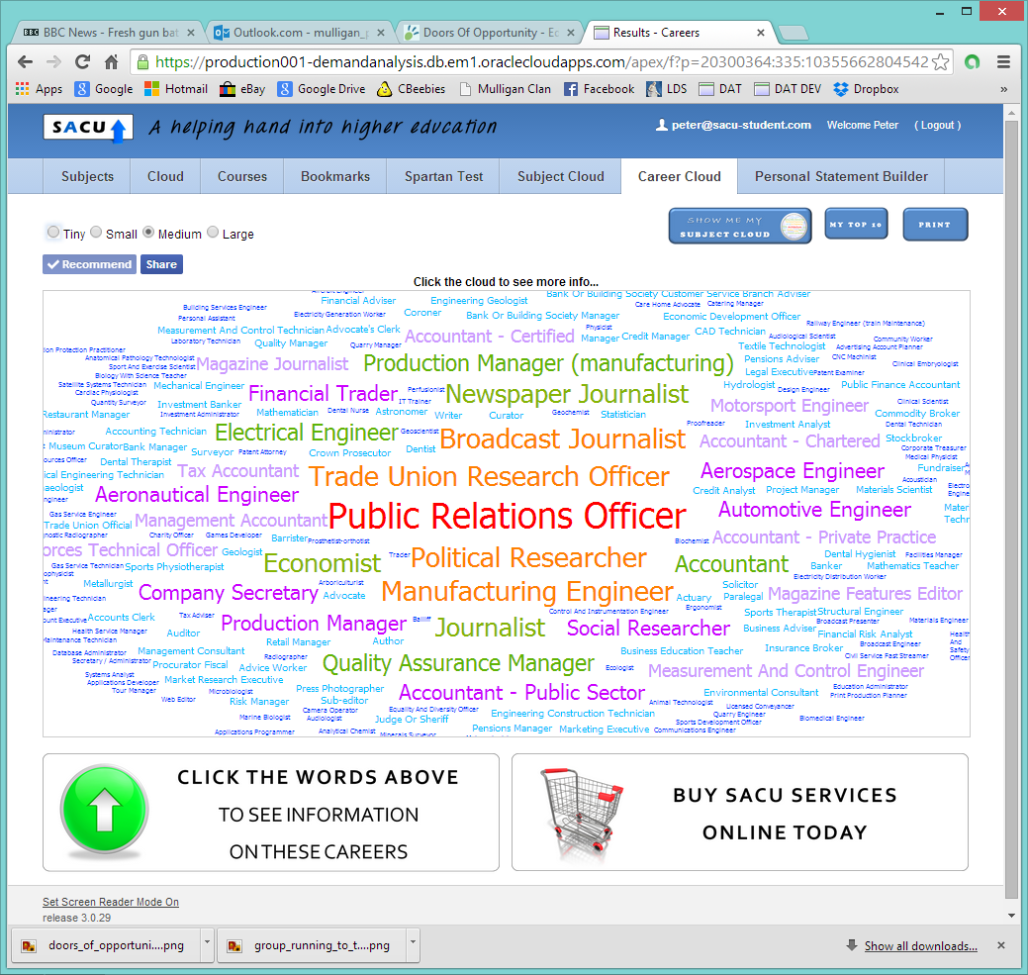

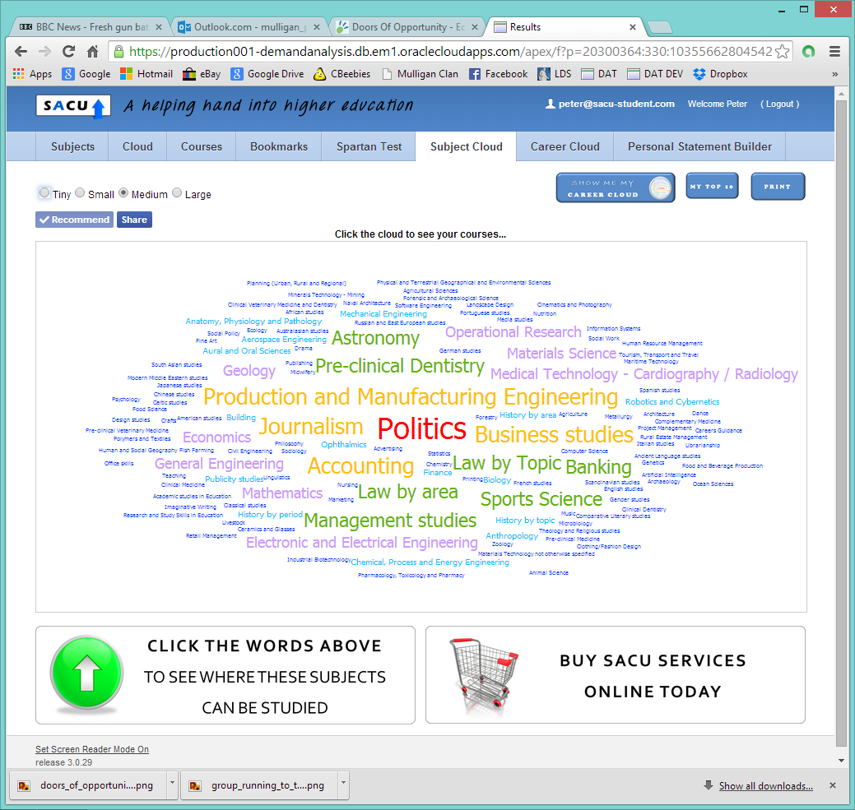
CONFUSED? Try the free SACU Spartan Test
AMEND YOUR TOP TEN
AMEND YOUR TOP TEN

