Slide 1
Performance of units
These slides complement the article
How journal rankings can suppress interdisciplinary research.
A comparison between innovation studies and business & management
Available at:
www.interdisciplinaryscience.net
http://www.sussex.ac.uk/Users/ir28/IDR/Rafols2011-Rankings&IDR.pdf
Ismael Rafols¹, Loet Leydesdorff², Alice O’Hare¹,
Paul Nightingale¹ and Andy Stirling¹
¹ SPRU —Science and Technology Policy Research, University of Sussex, i.rafols@sussex.ac.uk
² Amsterdam School of Communication Research (ASCoR), University of Amsterdam, loet@leydesdorff.net

Slide 2
Performance measures of units
 | Innovation Studies Units |  |  | Business and Management Schools
 | ISSTI | SPRU | MIoIR | Imperial | WBS | LBS
ABS ranking-based Mean (Std Error)
Mean ABS rank | 2.82 (0.13) | 2.65 (0.10) | 2.54 (0.10) | 3.36 (0.07) | 3.01 (0.05) | 3.92 (0.05)
% Papers ranked | 43% | 51% | 74% | 69% | 79% | 93%
Citation-based Mean (Std Error)
Cites/paper | 2.69 (0.45) | 5.11 (0.59) | 3.50 (0.63) | 5.30 (0.73) | 2.91 (0.23) | 5.04 (0.39)
Cites/paper (Journal normalized) | 1.99 (0.31) | 2.74 (0.36) | 2.35 (0.34) | 2.69 (0.33) | 2.16 (0.16) | 2.28 (0.17)
Cites/paper (Field normalized) | 1.67 (0.28) | 2.79 (0.35) | 2.10 (0.43) | 3.34 (0.47) | 2.11 (0.16) | 3.60 (0.28)
Cites/paper (Citing-side normalized) | 0.18 (n.a.) | 0.12 (n.a.) | 0.09 (n.a.) | 0.13 (n.a.) | 0.07 (n.a.) | 0.11 (n.a.)
Impact Factor-based Mean (Std Error)
Journal IF | 2.29 (0.38) | 3.14 (0.51) | 1.96 (0.34) | 2.76 (0.27) | 1.65 (0.09) | 2.50 (0.09)
Journal IF (Field normalized) | 1.17 (0.12) | 1.26 (0.11) | 0.98 (0.06) | 1.46 (0.07) | 1.11 (0.03) | 1.74 (0.06)
Citing journal IF | 3.12 (0.28) | 2.45 (0.15) | 1.98 (0.11) | 2.79 (0.14) | 1.79 (0.06) | 2.18 (0.05)

Slide 3
Performances according to ABS ranks and citation/publication

Slide 4
Further performances measures

Slide 5
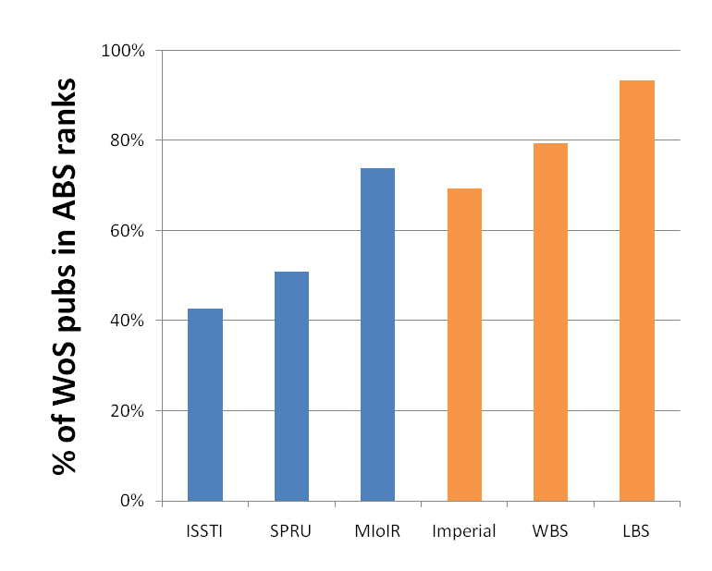
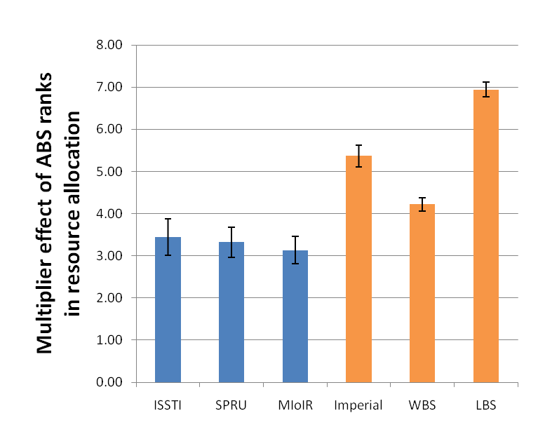
The effect of rankings on the outcomes of assessment exercises

