Slide 1
Disciplinary diversity of the Association of Business Schools’ rankings
These slides complement the article
How journal rankings can suppress interdisciplinary research:
A comparison between innovation studies and business & management
Available at:
www.interdisciplinaryscience.net
http://www.sussex.ac.uk/Users/ir28/IDR/Rafols2011-Rankings&IDR.pdf
Ismael Rafols¹, Loet Leydesdorff², Alice O’Hare¹,
Paul Nightingale¹ and Andy Stirling¹
¹ SPRU —Science and Technology Policy Research, University of Sussex, i.rafols@sussex.ac.uk
² Amsterdam School of Communication Research (ASCoR), University of Amsterdam, loet@leydesdorff.net

Slide 2
Diversity of journals ranked by the Association of Business Schools
 | Rank 1 Modest standard | Rank 2 Acceptable standard | Rank 3 Highly regarded | Rank 4 Top in Field | Rank 4* World Elite
# of Journals | 205 | 295 | 231 | 73 | 21
% of Journals in JCR | 14% | 56% | 86% | 100% | 100%
SC of Journals
Variety | 27 | 33 | 25 | 21 | 10
Balance | 0.90 | 0.85 | 0.81 | 0.86 | 0.87
Disparity | 0.866 | 0.819 | 0.792 | 0.789 | 0.767
Shannon Entropy | 2.979 | 3.454 | 3.280 | 2.940 | 2.002
Rao-Stirling Diversity | 0.779 | 0.733 | 0.703 | 0.685 | 0.571

Slide 3
Disciplinary diversity of ABS Journal Ranks

Slide 4
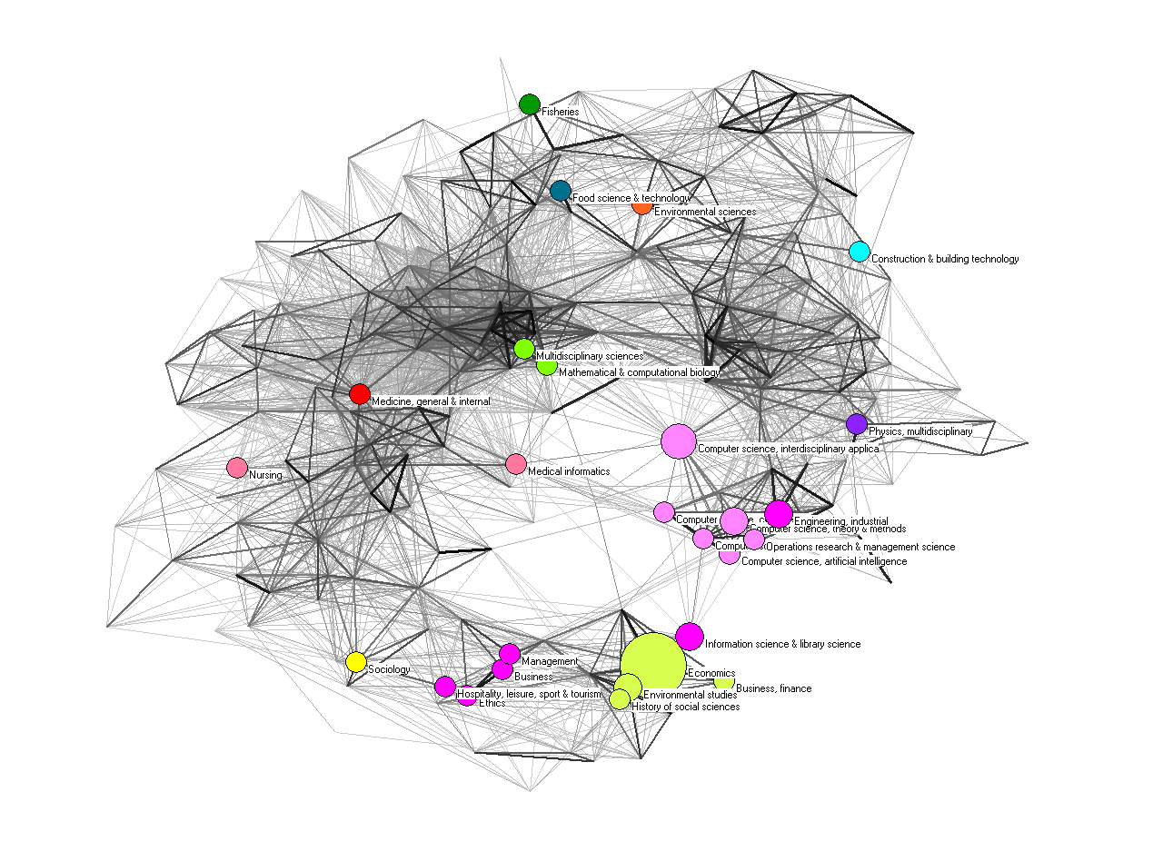
ABS Rank 1

Slide 5
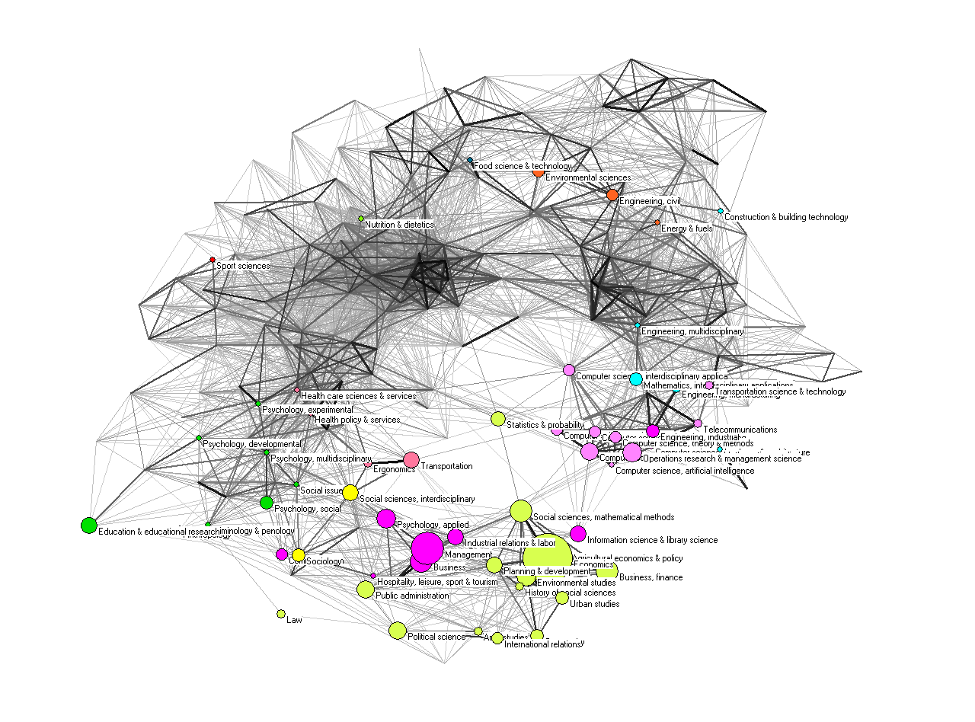
ABS Rank 2

Slide 6
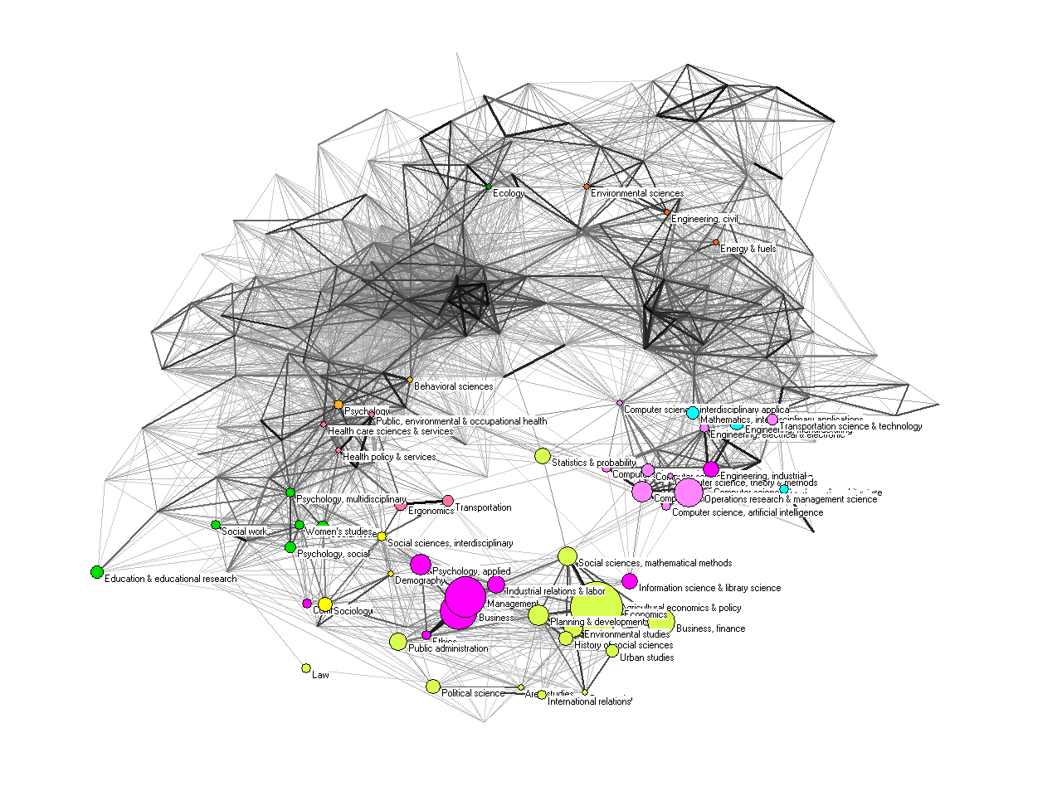
ABS Rank 3

Slide 7
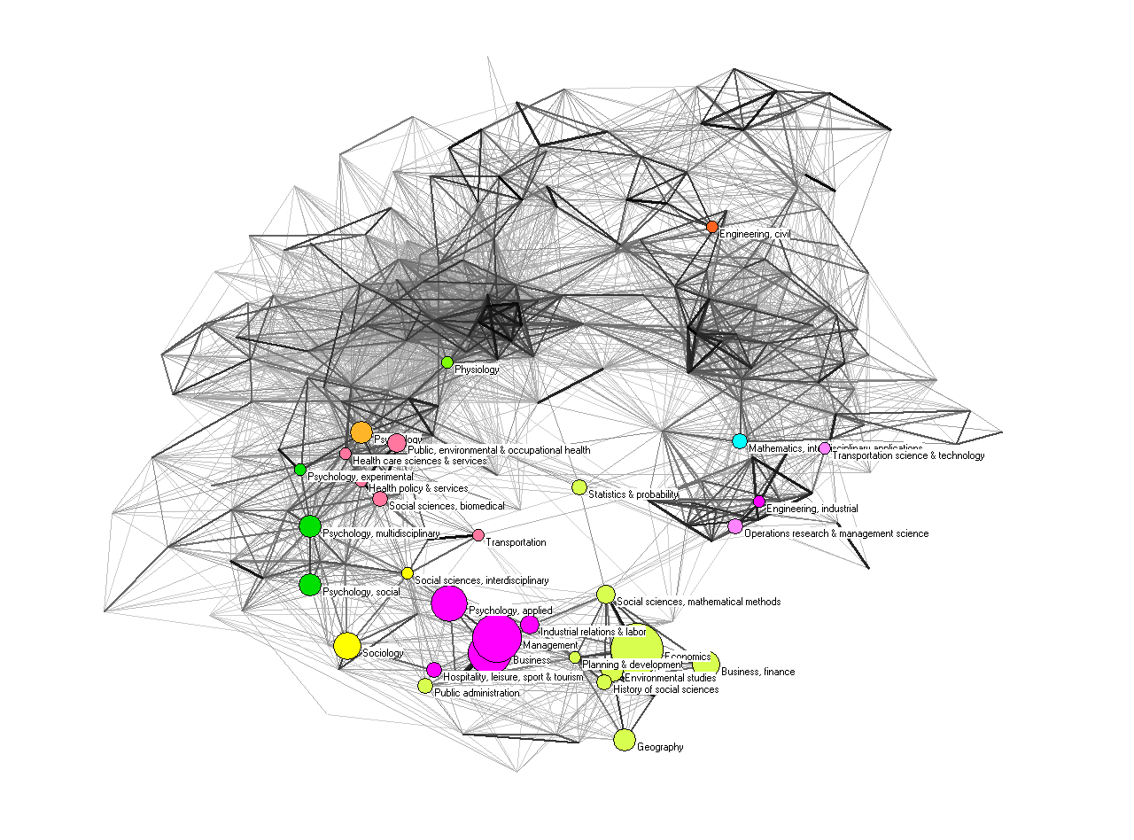
ABS Rank 4

Slide 8
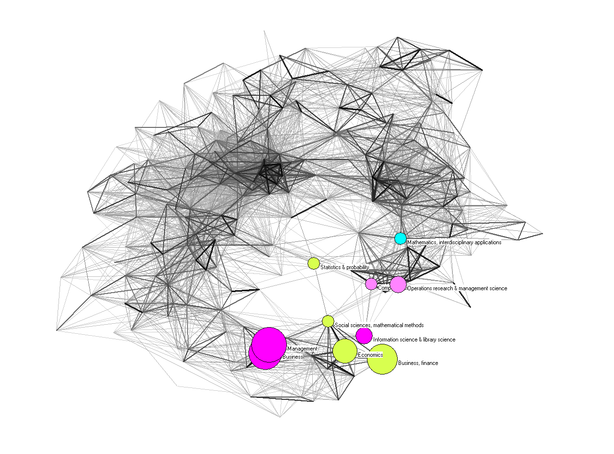
ABS Rank 4*

